Slide 1
KEYS IN DBMS

Slide 2
Keys play an important role in the relational database.
It is used to uniquely identify any record or row of data from the table. It is also used to establish and identify relationships between tables.

Slide 3
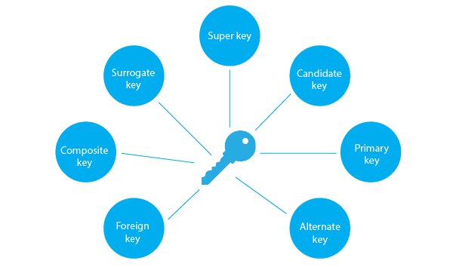

Slide 4
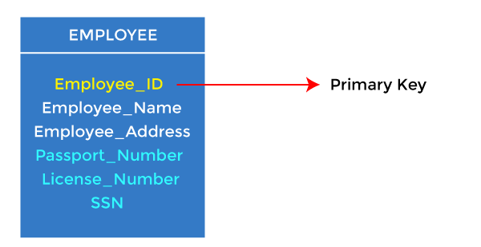
Primary key:
It is the first key used to identify one and only one instance of an entity uniquely. An entity can contain multiple keys, as we saw in the PERSON table. The key which is most suitable from those lists becomes a primary key.
In the EMPLOYEE table, ID can be the primary key since it is unique for each employee. In the EMPLOYEE table, we can even select License_Number and Passport Number as primary keys since they are also unique.

Slide 5
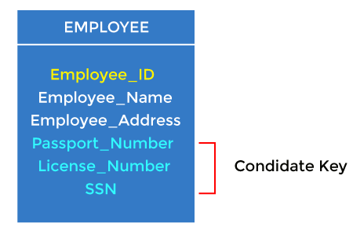
2. Candidate key
A candidate key is an attribute or set of attributes that can uniquely identify a tuple.
For example: In the EMPLOYEE table, id is best suited for the primary key. The rest of the attributes, like SSN, Passport_Number, License_Number, etc., are considered a candidate key.

Slide 6
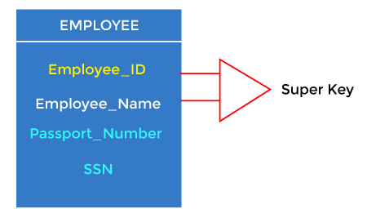
3. Super Key
Super key is an attribute set that can uniquely identify a tuple. A super key is a superset of a candidate key.

Slide 7
4. Foreign key
Foreign keys are the column of the table used to point to the primary key of another table.
Every employee works in a specific department in a company, and employee and department are two different entities. So we can't store the department's information in the employee table. That's why we link these two tables through the primary key of one table.
We add the primary key of the DEPARTMENT table, Department_Id, as a new attribute in the EMPLOYEE table.
In the EMPLOYEE table, Department_Id is the foreign key, and both the tables are related.

Slide 8
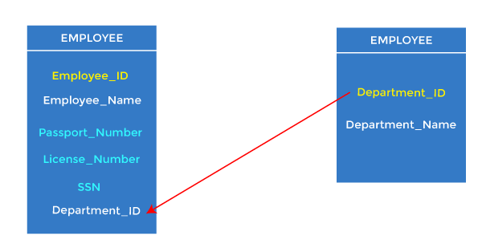
5. Alternate key
There may be one or more attributes or a combination of attributes that uniquely identify each tuple in a relation. These attributes or combinations of the attributes are called the candidate keys. One key is chosen as the primary key from these candidate keys, and the remaining candidate key, if it exists, is termed the alternate key.

Slide 9
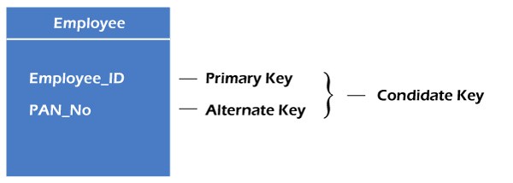

Slide 10
THANK YOU

