Slide 1
INHERITANCE

Slide 2
Inheritance: is a mechanism of driving a new class from an existing class. The existing (old) class is known as base class or super class or parent class. The new class is known as a derived class or sub class or child class. It allows us to use the properties and behaviour of one class (parent) in another class (child).

Slide 3
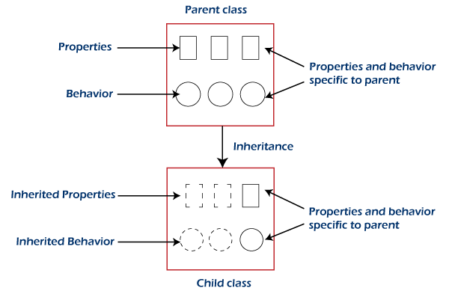

Slide 4
Types of Inheritance
Single Inheritance
Multi-level Inheritance
Hierarchical Inheritance
Hybrid Inheritance

Slide 5
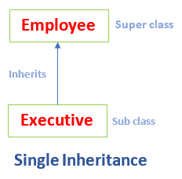
Single Inheritance
In single inheritance, a sub-class is derived from only one super class. It inherits the properties and behavior of a single-parent class. Sometimes it is also known as simple inheritance.
In the below figure, Employee is a parent class and Executive is a child class. The Executive class inherits all the properties of the Employee class.

Slide 6
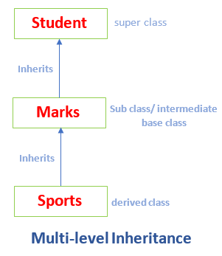
In multi-level inheritance, a class is derived from a class which is also derived from another class is called multi-level inheritance. In simple words, we can say that a class that has more than one parent class is called multi-level inheritance. Note that the classes must be at different levels. Hence, there exists a single base class and single derived class but multiple intermediate base classes.
Multi-level Inheritance

Slide 7
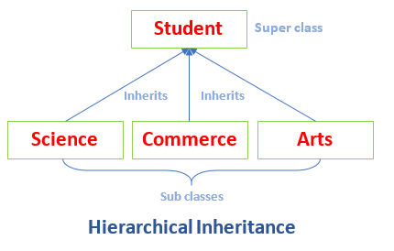
Hierarchical Inheritance
If a number of classes are derived from a single base class, it is called hierarchical inheritance.

Slide 8
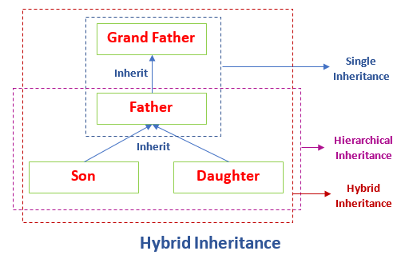
Hybrid Inheritance:

Slide 9
In the above figure, GrandFather is a super class. The Father class inherits the properties of the GrandFather class. Since Father and GrandFather represents single inheritance. Further, the Father class is inherited by the Son and Daughter class. Thus, the Father becomes the parent class for Son and Daughter. These classes represent the hierarchical inheritance. Combinedly, it denotes the hybrid inheritance.

Slide 10
THANK YOU

