Slide 1
OPERATING SYSTEM
GENERATIONS

Slide 2
DEFINITION
An operating system acts as an interface between the user of a computer and computer hardware.
An Operating System (OS) is a collection of software that manages computer hardware resources.
Examples of Operating Systems are Windows, Linux, Mac OS, etc.

Slide 3
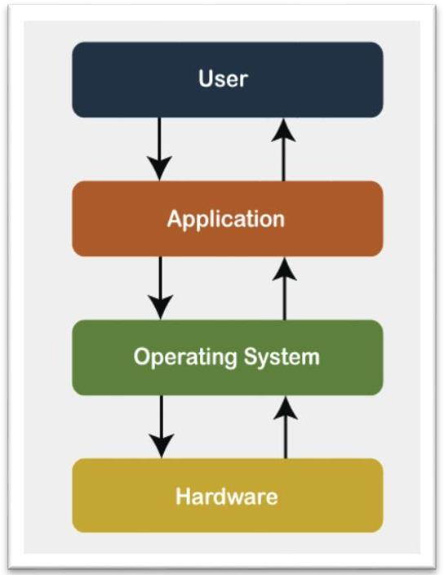
Operating System

Slide 4
GENERATIONS OF OPERATING SYSTEM
FIRST GENERATION (1945-1955)
1940 is the year when the first electronic computer was developed. This computer was created without any operating system.
SECOND GENERATION (1955-1965)
This operating system was developed for the IBM computer. The operating system using a punch card machines were very big and not everyone could use them, but only professional operators.

Slide 5
GENERATIONS OF OPERATING SYSTEM
THIRD GENERATION (1965-1980)
New operating system that could perform multiple tasks in a single computer program was success for this generation and this capability is called multiprogramming.
FOURTH GENERATION(1980 Present)
Development of personal computer represents the fourth generation. Microsoft Windows, Mac OS, and Linux. Linux operating system was created in early 1990s.

Slide 6
THANK YOU

