Slide 1
TYPES OF THREADS
OPERATING SYSTEM

Slide 2
DEFINITION
A thread is a sequential flow of tasks with in a process. Each thread has its own set of registers and stack space.
There can be multiple threads in a single process having the same or different functionality.

Slide 3
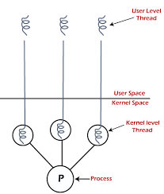
Types of Threads
In the operating system, there are two types of threads.
1. User-level thread
2. Kernel level thread

Slide 4
User-level thread
The operating system does not recognize the user-level thread. User threads can be easily implemented and it is implemented by the user.
The user threads can be easily implemented than the kernel thread.
It is faster and efficient.

Slide 5
Kernel level thread
The kernel thread recognizes the operating system.
The implementation of kernel threads is more difficult than the user thread.
Context switch time is longer in the kernel thread.

Slide 6
THANK YOU

