Slide 1
OPERATING SYSTEM
PAGE REPLACEMENT ALGORITHMS

Slide 2
DEFINITION
It is basically a memory error, and it occurs when the current programs attempt to access the memory page for mapping into virtual address space, but it is unable to load into the physical memory then this is referred to as Page fault.

Slide 3
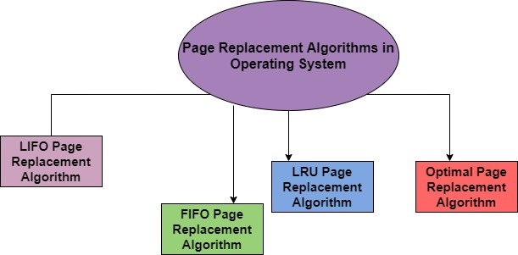

Slide 4
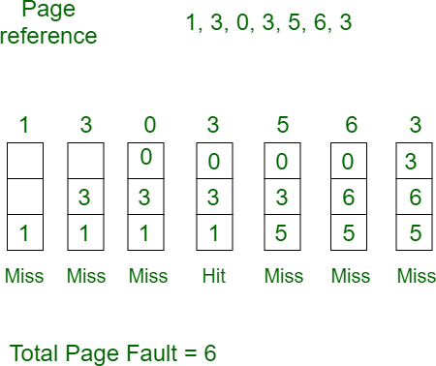
TYPES OF ALGORITHMS
FIFO Page Replacement Algorithm: It is a very simple way of Page replacement and is referred to as First in First Out. This algorithm mainly replaces the oldest page that has been present in the main memory for the longest time.
Example 1: Consider page reference string 1, 3, 0, 3, 5, 6, 3 with 3 page frames. Find the number of page faults.

Slide 5
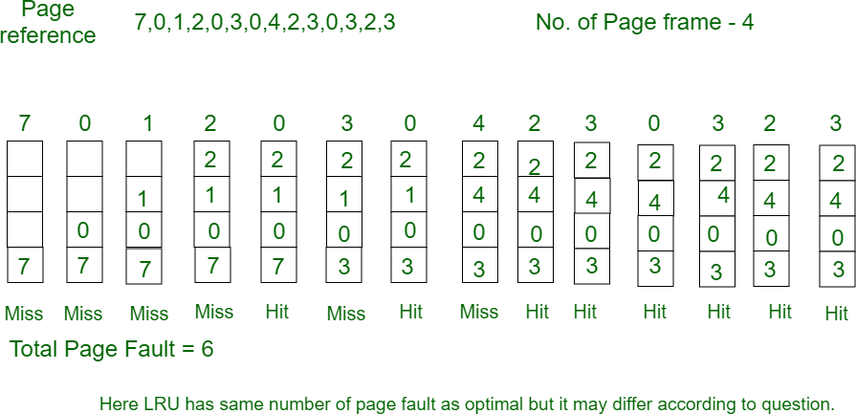
2. LRU Page Replacement Algorithm in OS: This algorithm stands for "Least recent used" and this algorithm helps the Operating system to search those pages that are used over a short duration of time frame.
Example-3: Consider the page reference string 7, 0, 1, 2, 0, 3, 0, 4, 2, 3, 0, 3, 2, 3 with 4 page frames. Find number of page faults.

Slide 6
3.Optimal Page Replacement Algorithm: This algorithm mainly replaces the page that will not be used for the longest time in the future. The practical implementation of this algorithm is not possible.
4.Random Page Replacement Algorithm: As indicated from the name this algorithm replaces the page randomly. This Algorithm can work like any other page replacement algorithm that is LIFO, FIFO, Optimal, and LRU.

Slide 7
THANK YOU

