Slide 1
OPERATING SYSTEM
ANDROID ARCHITECTURE

Slide 2
DEFINITION
Android architecture contains a different number of components to support any Android device’s needs.
Android software contains an open-source Linux Kernel having a collection of a number
Among all the components Linux Kernel provides the main functionality of operating system functions to smart phones and Dalvik Virtual Machine (DVM) provide a platform for running an Android application.

Slide 3
Components of Android Architecture
The main components of Android architecture are the following:-
Applications
Application Framework
Android Runtime
Native Libraries
Linux Kernel

Slide 4
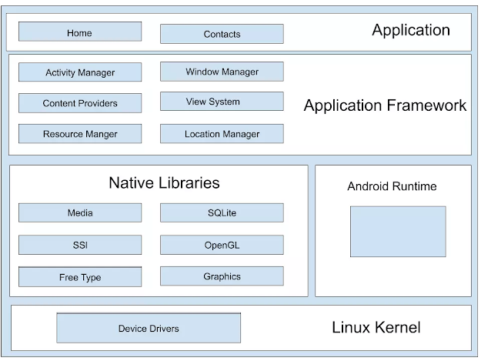

Slide 5
Applications: On top of the Android framework, there are applications. All applications such as home, contact, settings, games, gallery, browsers are using the android framework that uses android runtime and libraries. Android runtime and native libraries are using the Linux kernel
Application framework: On the top of Native libraries and android runtime, there is an Android framework. Android framework includes Android APIs such as UI (User Interface), telephony, resources, locations, Content Providers(data), and package managers. It provides a lot of classes and interfaces for android application development.
. Android runtime: In the android runtime, there are core libraries and DVM(Dalvik Virtual Machine) which is responsible for run android applications. DVM is like JVM but it is optimized for mobile devices. It consumes less memory and provides fast performance.

Slide 6
Linux Kernel: Linux Kernel is the core of the android operating system architecture that exists at the root of android architecture. It is responsible for device drivers, power management, memory management, device management, and resource management.
Native Libraries:
On the top of the Linux kernel, there are Native libraries such as WebKit, OpenGL, FreeType, SQLite, Media, C runtime library (libs), etc. The WebKit library is responsible for browser support, SQLite is for database, Free Type for font support, Media for playing and recording audio and video formats.

Slide 7
THANK YOU

