Slide 1

JAVASCRIPT
DATA TYPES

Slide 2
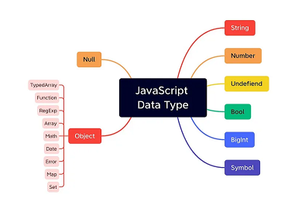
.

Slide 3
TYPES OF JAVASCRIPT:
JavaScript provides different data types to hold different types of values. There are two types of data types in JavaScript.
Primitive data type
Non-primitive (reference) data type

Slide 4

JavaScript primitive data types:
There are five types of primitive data types in JavaScript. They are as follows:
DATA TYPE | DESCRIPTION
String | represents sequence of characters e.g. "hello"
Number | represents numeric values e.g. 100
Boolean | represents boolean value either false or true
Undefined | represents undefined value
Null | represents null i.e. no value at all

Slide 5
JavaScript non-primitive data types
The non-primitive data types are as follows:
DATA TYPE | DESCRIPTION
 | represents instance through which we can access members
Array | represents group of similar values
RegExp | represents regular expression
Object

Slide 6

Thank you
.

