Slide 1
PHP WITH OOPS CONCEPT

Slide 2
Object-oriented programming is a programming model organized around Object rather than the actions and data rather than logic.
Class:
A class is an entity that determines how an object will behave and what the object will contain. In other words, it is a blueprint or a set of instruction to build a specific type of object.
In PHP, declare a class using the class keyword, followed by the name of the class and a set of curly braces ({}).

Slide 3
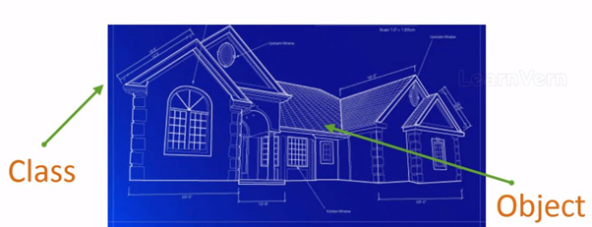
This is the blueprint of the construction work that is class, and the houses and apartments made by this blueprint are the objects.

Slide 4
Syntax to Create Class in PHP
<?php
class MyClass
{
// Class properties and methods go here
}
?>

Slide 5
Object:
A class defines an individual instance of the data structure. We define a class once and then make many objects that belong to it. Objects are also known as an instance.
An object is something that can perform a set of related activities.

Slide 6
Syntax:
<?php
class MyClass
{
// Class properties and methods go here
}
$obj = new MyClass;
var_dump($obj);
?>

Slide 7
THANK YOU

