Slide 1



DANTULURI NARAYANA RAJU COLLEGE (Autonomous)
Introduction to Economics
Prepared By:-
Sri . G. Milton
Lecturer
Department of Economics (U.G)

Slide 2
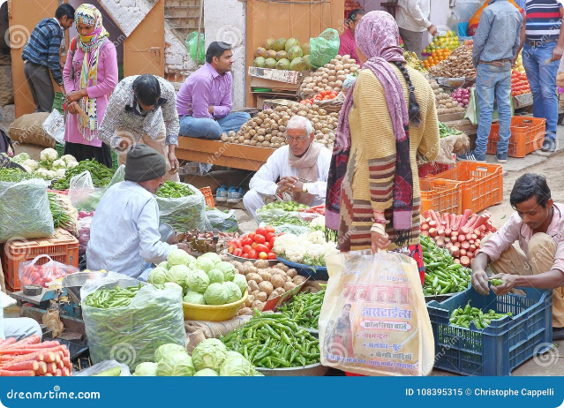
Introduction to Economics
Economics is the study of how individuals and societies make choices in the face of scarcity. It's a dynamic field that explores how people interact with each other and with resources to satisfy their needs and wants.
This course will introduce you to the fundamental concepts and principles of economics, providing you with a solid foundation for understanding the complex economic landscape we live in.

Slide 3
Economic Activities and Economic Systems
1
Production
2
Consumption
This refers to the process of creating goods and services. It involves transforming raw materials into finished products or providing services to meet human needs and wants.
This involves the use of goods and services to satisfy human wants and needs. It's the final stage in the economic cycle, where the products of production are utilized by consumers.
3
Distribution
4
Exchange
This involves the allocation of goods and services among individuals and groups in society. It's about ensuring a fair and efficient distribution of resources and products, taking into account factors like income, needs, and social equity.
This refers to the transfer of goods and services between individuals or entities. It involves the buying and selling of goods and services in a market, driven by prices and demand.

Slide 4

Fundamental Problems of Economics: Scarcity and Choice
The fundamental problem of economics is scarcity: our wants and needs are unlimited, but the resources available to satisfy them are limited. This means we must make choices about how to allocate our resources, and every choice involves a trade-off. For example, if you spend your money on a new phone, you're giving up the opportunity to buy a new pair of shoes or save for your future.

Slide 5

The Production Possibilities Curve
The production possibilities curve (PPC) is a graphical representation of the maximum combinations of two goods that an economy can produce with its given resources and technology. The PPC is typically bowed outward, reflecting the law of increasing opportunity costs. This means that as we produce more of one good, we must give up increasing amounts of the other good, because resources are not equally efficient in producing different goods.

Slide 6
Microeconomics and Macroeconomics
Microeconomics
Macroeconomics
Focuses on individual economic units, such as households, firms, and markets.
Focuses on the economy as a whole, including national income, inflation, and unemployment.
Examines how prices are determined, how resources are allocated, and how consumers make choices.
Analyzes how government policies affect the economy and how economic growth can be promoted.

Slide 7





Principles of Microeconomics: Equilibrium, Optimization, and Welfare
Equilibrium
Equilibrium refers to a state of balance in a market, where the forces of supply and demand are equal. At equilibrium, there is no tendency for the price or quantity of a good to change.
Optimization
Individuals and firms make decisions to maximize their well-being or profits, subject to constraints. This involves finding the best possible outcome given the available resources and choices.
Welfare
Economics is concerned with promoting the welfare of society, which can be measured by factors such as consumer surplus, producer surplus, and overall economic efficiency. Welfare economics explores how to allocate resources to maximize societal well-being.

Slide 8


Methodology in Economics: Positive and Normative
Positive Economics
Normative Economics
Positive economics deals with objective statements that can be tested and verified. It describes how the economy works, focusing on factual relationships and cause-and-effect relationships.
Normative economics involves subjective statements that reflect values and opinions. It makes judgments about what should be done, often based on ethical or philosophical considerations.

