Slide 1
8255 ARCHITECTURE
V.RATNA SEKHAR
DEPT.OF ELECTRONICS

Slide 2
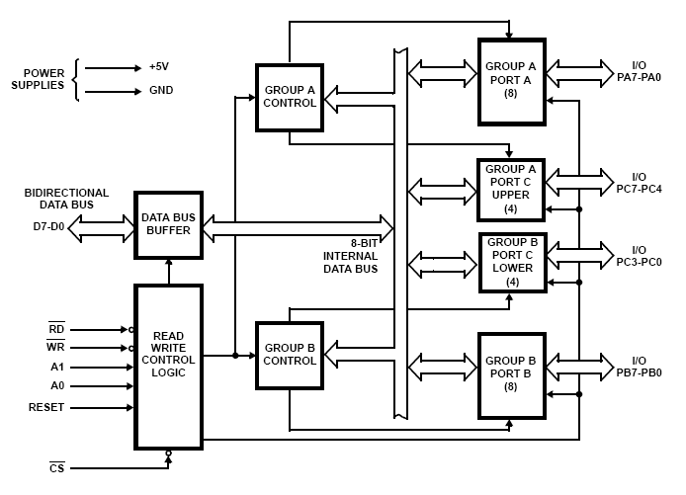
PROGRAMMABLE PERIPHERAL INTERFACE -8255

Slide 3
Data Bus buffer:
It is a 8-bit bidirectional Data bus.
Used to interface between 8255 data bus with system bus.
The internal data bus and Outer pins D₀-D₇ pins are connected in internally.
The direction of data buffer is decided by Read/Control Logic.

Slide 4
Read/Write Control Logic:
This is getting the input signals from control bus and Address bus
__ ___
Control signal are RD and WR.
__
Address signals are A0,A1,and CS.
8255 operation is enabled or disabled by CS.

Slide 5
Group A and Group B control:
Group A and B get the Control
Signal from CPU and send the command to the individual control blocks.
Group A send the control signal to port A and Port C (Upper) PC7-PC4.
Group B send the control signal to port B and Port C (Lower) PC3-PC0.
PORT A:
This is a 8-bit buffered I/O latch.
It can be programmed by mode 0 , mode 1, mode 2 .

Slide 6
PORT B:
This is a 8-bit buffer I/O latch.
It can be programmed by mode 0 and mode 1.
PORT C:
This is a 8-bit Unlatched buffer Input and an Output latch.
It is splitted into two parts.
It can be programmed by bit set/reset operation.

Slide 7
Operation modes:
BIT SET/RESET MODE:
The PORT C can be Set or Reset by sending OUT instruction to the CONTROL registers.
I/O MODES:
MODE 0(Simple input / Output):
In this mode , port A, port B and port C is used as individually (Simply).
Features:
Outputs are latched , Inputs are buffered not latched.
Ports do not have Handshake or interrupt capability

Slide 8
MODE 1 :(Input/output with Hand shake)
In this mode, input or output is transferred by hand shaking Signals.
Handshaking signals is used to transfer data between whose data transfer is not same.
Computer
Printer
DATA BUS
STB
ACK
Busy

Slide 9
Example:
The computer send the data to the printer large speed compared to the printer.
When computer send the data according to the printer speed at the time only, printer can accept.
If printer is not ready to accept the data then after sending the data bus , computer uses another handshaking signal to tell printer that valid data is available on the data bus.
Each port uses three lines from port C as handshake signals

Slide 10
MODE 2:bi-directional I/O data transfer:
This mode allows bidirectional data transfer over a single 8-bit data bus using handshake signals.
This feature is possible only Group A
Port A is working as 8-biy bidirectional.
PC3-PC7 is used for handshaking purpose.
The data is sent by CPU through this port , when the peripheral request it.
CONTROL WORD FORMATS:
In the INPUT mode , When RESET is High all 24 pins (3-ports) be a input mode.

Slide 11
Thank you

