Slide 1
LECTURE ON MICROCONTROLLER-8051 AND ITS APPLICATIONS
BY
B.SRI DEVI.,M.Tech.
DEPT.OF ELECTRONICS

Slide 2
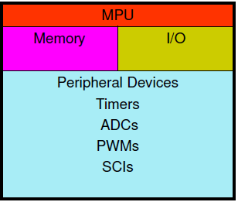
Microcontroller
A single-chip VLSI unit which, though having limited computational capabilities, processes enhanced input-output capabilities and a number of on-chip functional units.

Slide 3
Block Diagram of 8051
External interrupts
ROM
4 KB
Timer/Counter
Interrupt Control
RAM 128Bytes
Timer 1
Counter Inputs
Timer 0
CPU
Bus Control
Serial Port
4 I/O Ports
OSC
8
8
8
8
P0 P2 P1 P3
TxD RxD
Address/Data

Slide 4
8051 architecture contains the following:
8 bit CPU with registers A and B
16 bit program counter(PC) and data pointer(DPTR)
8 bit program status word(PSW)
8 bit stack pointer
Internal ROM of 4 KBytes
Internal RAM of 128 Bytes
– 4 register banks 00-1f
– 16 bytes(bit addressable) 20-2f
– 80 bytes of general purpose data memory 30-7f
32 I/O pins arranged as four 8 bit ports (P0 – P3)
2 16-bit timer/counters: T0 and T1
Full duplex serial data receiver/transmitter: SBUF
Control registers: TCON, TMOD, SCON, PCON, IP and IE
2 external and 3 internal interrupt sources
Oscillator and clock circuits

Slide 5
I/O Port Programming
Total 4 ports : P0,P1,P2, and P3.
All four are 8-bit ports.
Upon reset all ports are configured as input ports
To configure as output 0 should be written in to each port line.
To reconfigure as input 1 should be written in to each port line.

Slide 6
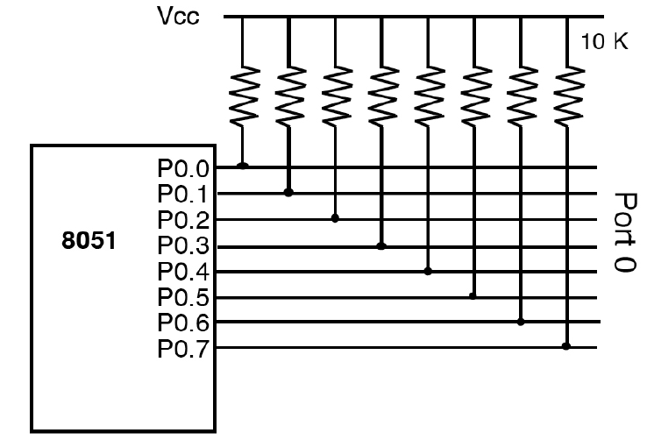
Port 0:
For input or output.
Also provides both address and data when 8051 connected to external memory.
Each pin must be connected to a 10K-ohm pull-up resistor.

Slide 7
Following code will continuously send out to Port 0 the alternating values of 55H and AAH
Org 0000h
Mov p0,#00 ;make p0 as output port
Re: Mov p0,#55h
Acall delay
Mov p0,#0aah
Acall delay
Sjmp re
Delay:Mov r2, #0ffh
K3:Mov r0,#0ffh
K2:Mov r1,#0ffh
K1:djnz r1,k1
Djnz r0,k2
Djnz r2,k3
Ret

Slide 8
Port 1:
Used as input or output.
Has internal pull-up resistors.
In the following code data is received from the port 1 and saved in R7 continuously.
Org 0h
Mov p1,#0ffh ;to configure p1 as input.
K: mov r7,p1
Sjmp k

Slide 9
Port 2:
Used as input or output.
Alternatively provides address along with P0 for external memory.

Slide 10
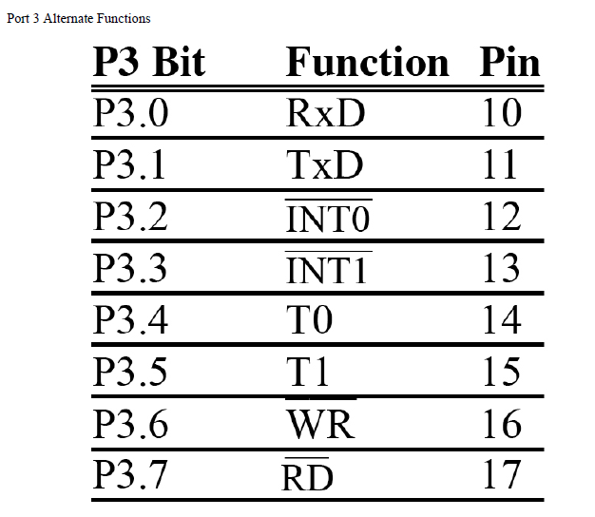
Port 3:
Simple I/O
Alternate functions.

Slide 12
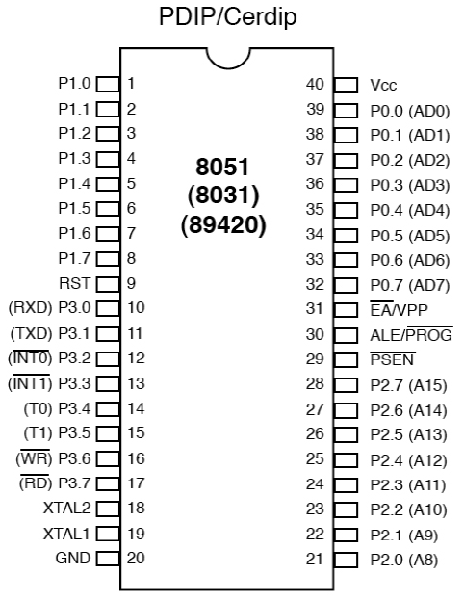
Pin Description of the 8051

Slide 13
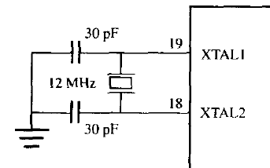
XTAL1 and XTAL2:
Quartz crystal oscillator is connected to XTAL1 and XTAL2.
We can observe frequency on XTAL2 pin using CRO.

Slide 14
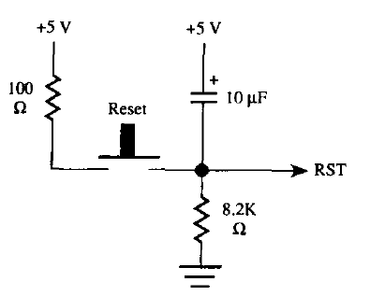
RST:
Active high (normally low).
Requires active minimum two machine cycles.

Slide 15
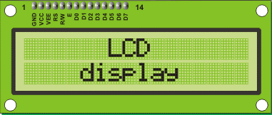
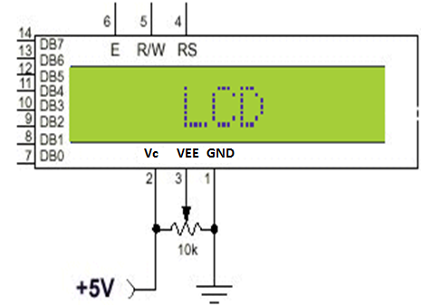
Able to display numbers, characters, and graphics.
It has 14 pins.

Slide 16
Pinout
8 data pins D7:D0
Bi-directional data/command pins.
Alphanumeric characters are sent in ASCII format.
RS: Register Select
RS = 0 -> Command Register is selected.
RS = 1 -> Data Register is selected.
R/W: Read or Write
0 -> Write, 1 -> Read.
E: Enable (Latch data)
Used to latch the data present on the data pins.
A high-to-low edge is needed to latch the data.
VEE : contrast control
While Vcc and Vss provide +5V and ground, respectively, VEE is used for controlling LCD contrast.

Slide 17
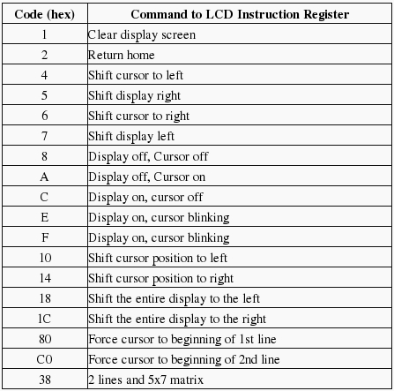

Slide 18
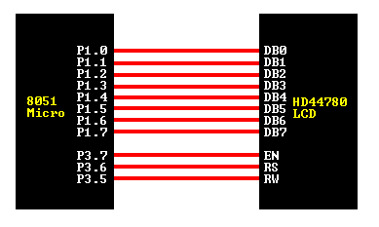
Interfacing LCD to 8051
Command write Routine
command: mov P1, A ;move acc. data to port clr P3.6 ;RS=0 for cmd clr P3.5 ;RW=0 for write setb P3.7 ;H->L pulse on E clr P3.7 ret
Data write Routine
data:
mov P1, A ;move acc. data to port setb P3.6 ;RS=1 data clr P3.5 ;RW=0 for write setb P3.7 ;H->L pulse on E clr P3.7 ret

Slide 19
Initialization
initialization:
mov A, #38H ; Initialize, 2-lines, 5X7 matrix. lcall Command mov A, #0EH ; LCD on, cursor on lcall Command mov A, #01H ; Clear LCD Screen lcall Command mov A, #06H ; Shift cursor right lcall Command
Display clear
clear: setb p3.7 ;enable EN clr 3.6 ;RS=0 for cmd. mov DATA,#01h clr p3.7 ;disable EN lcall ready RET
Displaying "HI“
lcall initialization lcall clear mov A,#'H' acall data mov A,#'I' lcall data

Slide 20
ADC0809
ADC
Analog
i/p
Digital
o/p
8-bit ADC.
8-channel multiplexer.
Successive approximation as conversion technique.
0-5V input rage with 5V power supply.
28-pin DIP.
With 5V as Vref(+) and 0V as Vref(-) it provides step size of ~20 mV.(5/256=19.53 mV).

Slide 21
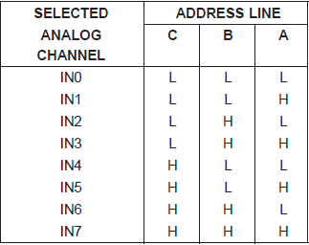

Slide 22
Steps to program the ADC0809
Select an analog channel using address pins A,B, and C.
Activate the ALE (L-to-H pulse).
Activate SC (L-to-H pulse).
Monitor EOC.H-to-L output indicates that the data is converted and ready to pick up.
Activate OE to read the data out of the ADC chip.

Slide 23
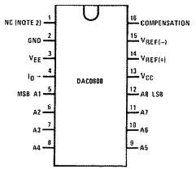
DAC 0808
DAC
Analog
o/p
Digital
i/p
Digital input to current.
Needs current to voltage converter.

Slide 24
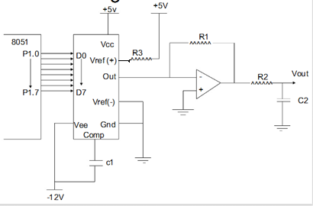
I_{OUT} =I_{ref}(D7/2 + D6/4 + D5/8 + ……. + D0/256)
Where I_{ref} = V_{ref}/2.5 K (~2mA)
D7 is MSB

Slide 25
Generation of saw-tooth wave form.
Mov r0,#64H ;generates ~4V aplitude.
Rpt:Mov a,#00H ;low limit
Back:Mov p1,a
Inc a
Cjnz a,ro,Back ; comparison for high limit
Sjmp Rpt
Iout = 0.78125 mA
Vout = 0.78125x10⁻³ x 5x10³
= 3.906 V

Slide 26
LM35 Temperature Sensor
Output voltage is linearly proportional to the centigrade temperature.
10 mV/⁰C.
Data acquisition system.
LM35
ADC 0809
8051
10 mV/⁰C
Step size 10 mV with Vref=2.5V

Slide 27
Temperature Vs. Vout for ADC
Temp.(C) | Vin (mV) | Vout (D7-D0)
0 | 0 | 0000 0000b (0d)
1 | 10 | 0000 0001b (1d)
2 | 20 | 0000 0010b (2d)
3 | 30 | 0000 0011b (3d)
10 | 100 | 0000 1010b (10d)
30 | 300 | 0001 1110b (30d)

Slide 28
Serial Communication
Bit serial transmission:
Two basic transmission modes:
Asynchronous: transmitter and receiver clocks are independent
Synchronous: transmitter and receiver are synchronized

Slide 29
Asynchronous transmission:
Data word is encapsulated between:
start bit
stop bits(s)

Slide 30
Transmission parameters:
transmission rate (9600bps, 19200bps, etc.) defines bit length in time
number of stop bits (1, 1.5, or 2)
Data bits(5,6,7, or 8 bits)
Error control: parity
In an N bit word: count number of 1s on the first N-1 positions
Insert 1 or 0 in the Nth position to get:
even (even parity - E)
odd (odd parity - O)

Slide 31
Synchronous transmission
Transmitter and receiver clocks synchronized
DTE accepts a clock signal generated by DCE
No start, stop bits, but still frame synchronization words are needed

Slide 32
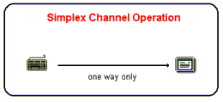
Communication Channels
1. Simplex
Data in a simplex channel is always one way
Example: interface between the keyboard and the computer.

Slide 33
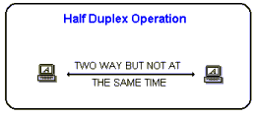
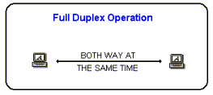
Half Duplex
A half duplex channel can send and receive, but not at the same time.
Example : Walky-Talky.
Full Duplex
Data can travel in both directions simultaneously
Example: Telephone

Slide 34
8051 Serial Port Programming
SBUF (serial buffer) register
A byte of data to be transferred via the TxD line must be placed in the SBUF register
SBUF holds the byte of data when it is received by the RxD line
Can be accessed like any other register
MOV SBUF,#'D' ;load SBUF=44H, ASCII for 'D‘
MOV SBUF,A ;copy accumulator into SBUF
MOV A,SBUF ;copy SBUF into accumulator

Slide 36
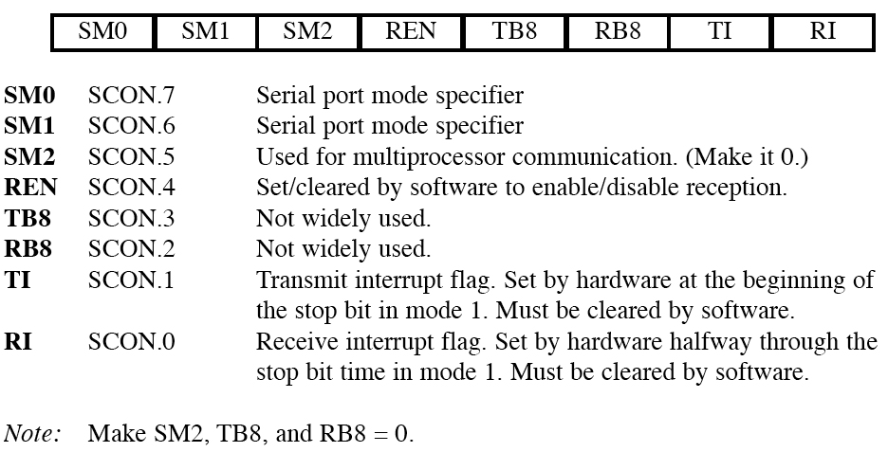
SCON (serial control) register
to program the start bit, stop bit, and data bits
SM0 | SM1 | Mode | Description | Baud Rate
0 | 0 | 0 | Shift register | f_{osc.}/12
0 | 1 | 1 | 8-bit UART | Variable
1 | 0 | 2 | 9-bit UART | f_{osc}./64 or f_{osc.}/32
1 | 1 | 3 | 9-bit UART | Variable

Slide 37
Example: Write a program to transfer letter "A" serially at 4800 baud, continuously.
s
s

Slide 38
8051 Interrupts Programming
An interrupt is an external or internal event that interrupts the microcontroller to inform it that a device needs its service.
The program which is associated with the interrupt is called the interrupt service routine (ISR) or interrupt handler.

Slide 39
Steps in executing an interrupt
Finish current instruction and saves the PC on stack.
Jumps to a fixed location in memory depend on type of interrupt
Starts to execute the Interrupt Service Routine until RETI (return from interrupt)
Upon executing the RETI the microcontroller returns to the place where it was interrupted. Get pop PC from stack

Slide 40
Interrupt Sources
Original 8051 has 6 sources of interrupts
Reset
Timer 0 overflow
Timer 1 overflow
External Interrupt 0
External Interrupt 1
Serial Port events (buffer full, buffer empty, etc)

Slide 41
Interrupt Vectors
Each interrupt has a specific place in code memory where execution of interrupt service routine begins.
Reset: 0000h
External Interrupt 0: 0003h
Timer 0 overflow: 000Bh
External Interrupt 1: 0013h
Timer 1 overflow: 001Bh
Serial : 0023h
Note: that there are only 8 memory locations between vectors.

Slide 42
Interrupt Enable (IE) register
All interrupt are disabled after reset
We can enable and disable them bye IE

Slide 43
Enabling and disabling an interrupt
By bit operation
SETB EA ;Enable All
SETB ET0 ;Enable Timer0 ovrf
SETB ET1 ;Enable Timer1 ovrf
SETB EX0 ;Enable INT0
SETB EX1 ;Enable INT1
SETB ES ;Enable Serial port
By mov instruction
MOV IE, #10010110B

Slide 44
External interrupt type control(TCON)
By low nibble of Timer control register TCON
IE0 (IE1): External interrupt 0(1) edge flag.
set by CPU when external interrupt edge (H-to-L) is detected.
Does not affected by H-to-L while ISR is executed(no int on int)
Cleared by CPU when RETI executed.
does not latch low-level triggered interrupt
IT0 (IT1): interrupt 0 (1) type control bit.
Set/cleared by software
IT=1 edge trigger
IT=0 low-level trigger
(MSB)
(LSB)
TF1
TR1
TF0
TR0
IE1
IT1
IE0
IT0
Timer 1 Timer0
for Interrupt

Slide 45
Interrupt Priorities
What if two interrupt sources interrupt at the same time?
The interrupt with the highest PRIORITY gets serviced first.
All interrupts have a power on default priority order.
External interrupt 0 (INT0)
Timer interrupt0 (TF0)
External interrupt 1 (INT1)
Timer interrupt1 (TF1)
Serial communication (RI+TI)
Priority can also be set to “high” or “low” by IP reg.

Slide 46
Interrupt Priorities (IP) Register
---
---
PT2
PS
PT1
PX1
PT0
PX0
IP.7: reserved
IP.6: reserved
IP.5: timer 2 interrupt priority bit(8052 only)
IP.4: serial port interrupt priority bit
IP.3: timer 1 interrupt priority bit
IP.2: external interrupt 1 priority bit
IP.1: timer 0 interrupt priority bit
IP.0: external interrupt 0 priority bit

Slide 47
Interrupt Priorities Example
---
---
PT2
PS
PT1
PX1
PT0
PX0
MOV IP , #00000100B or SETB IP.2 gives priority order
Int1
Int0
Timer0
Timer1
Serial
MOV IP , #00001100B gives priority order
Int1
Timer1
Int0
Timer0
Serial

Slide 48
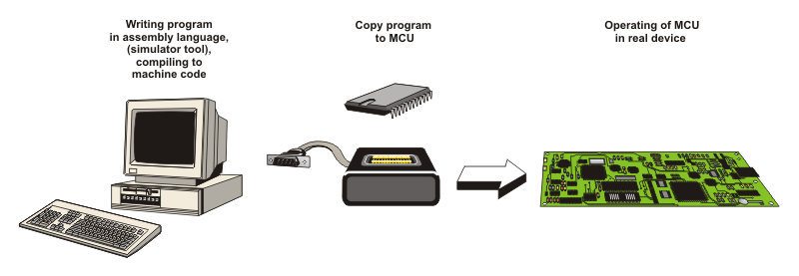

Slide 49
Thank you

