Slide 1
BRANCHES OF
GEOLOGY

Slide 2
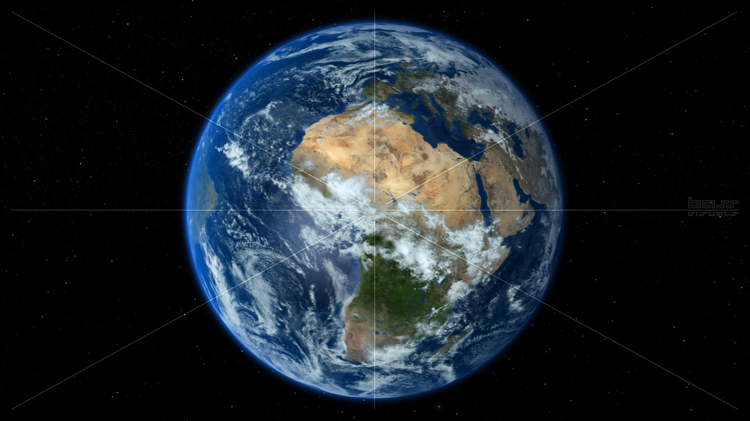
GEODESY

Slide 3
STRUCTURAL GEOLOGY

Slide 4
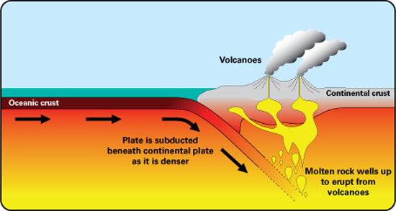
TECTONIC GEOLOGY

Slide 5
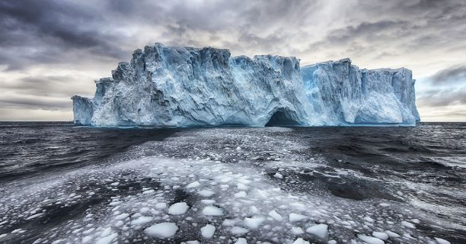
DYNAMICAL GEOLOGY

Slide 6
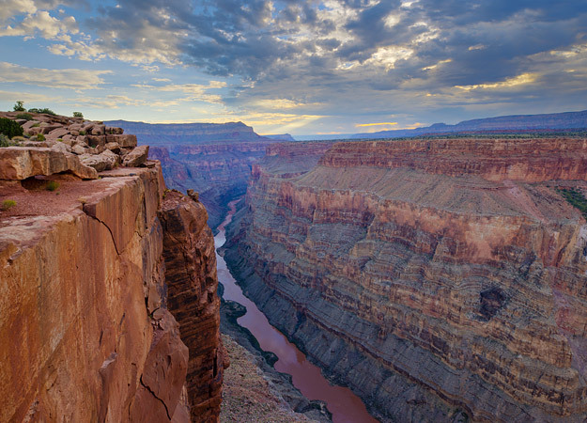
GEOMORPHOLOGY

Slide 7
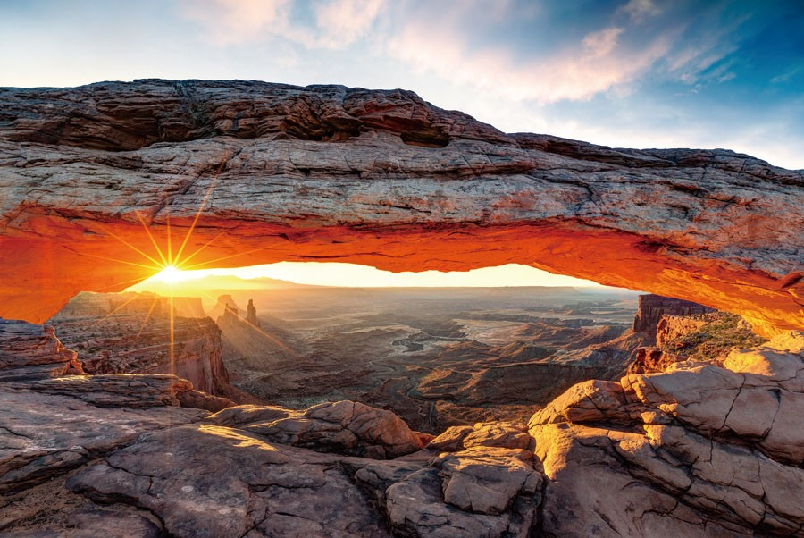

Slide 8
CRYSTALLOGRAPHY

Slide 15
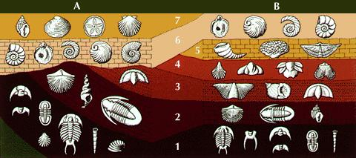
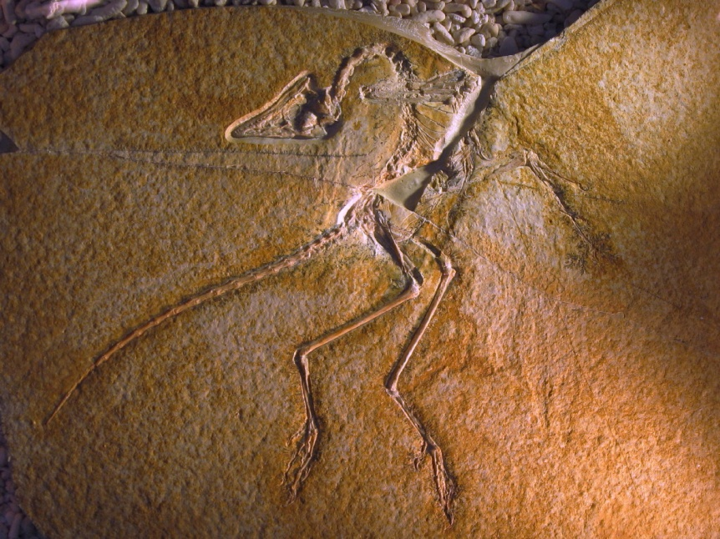
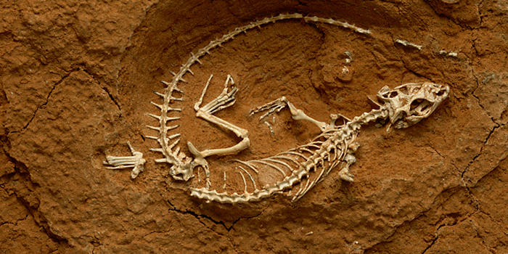

Slide 17
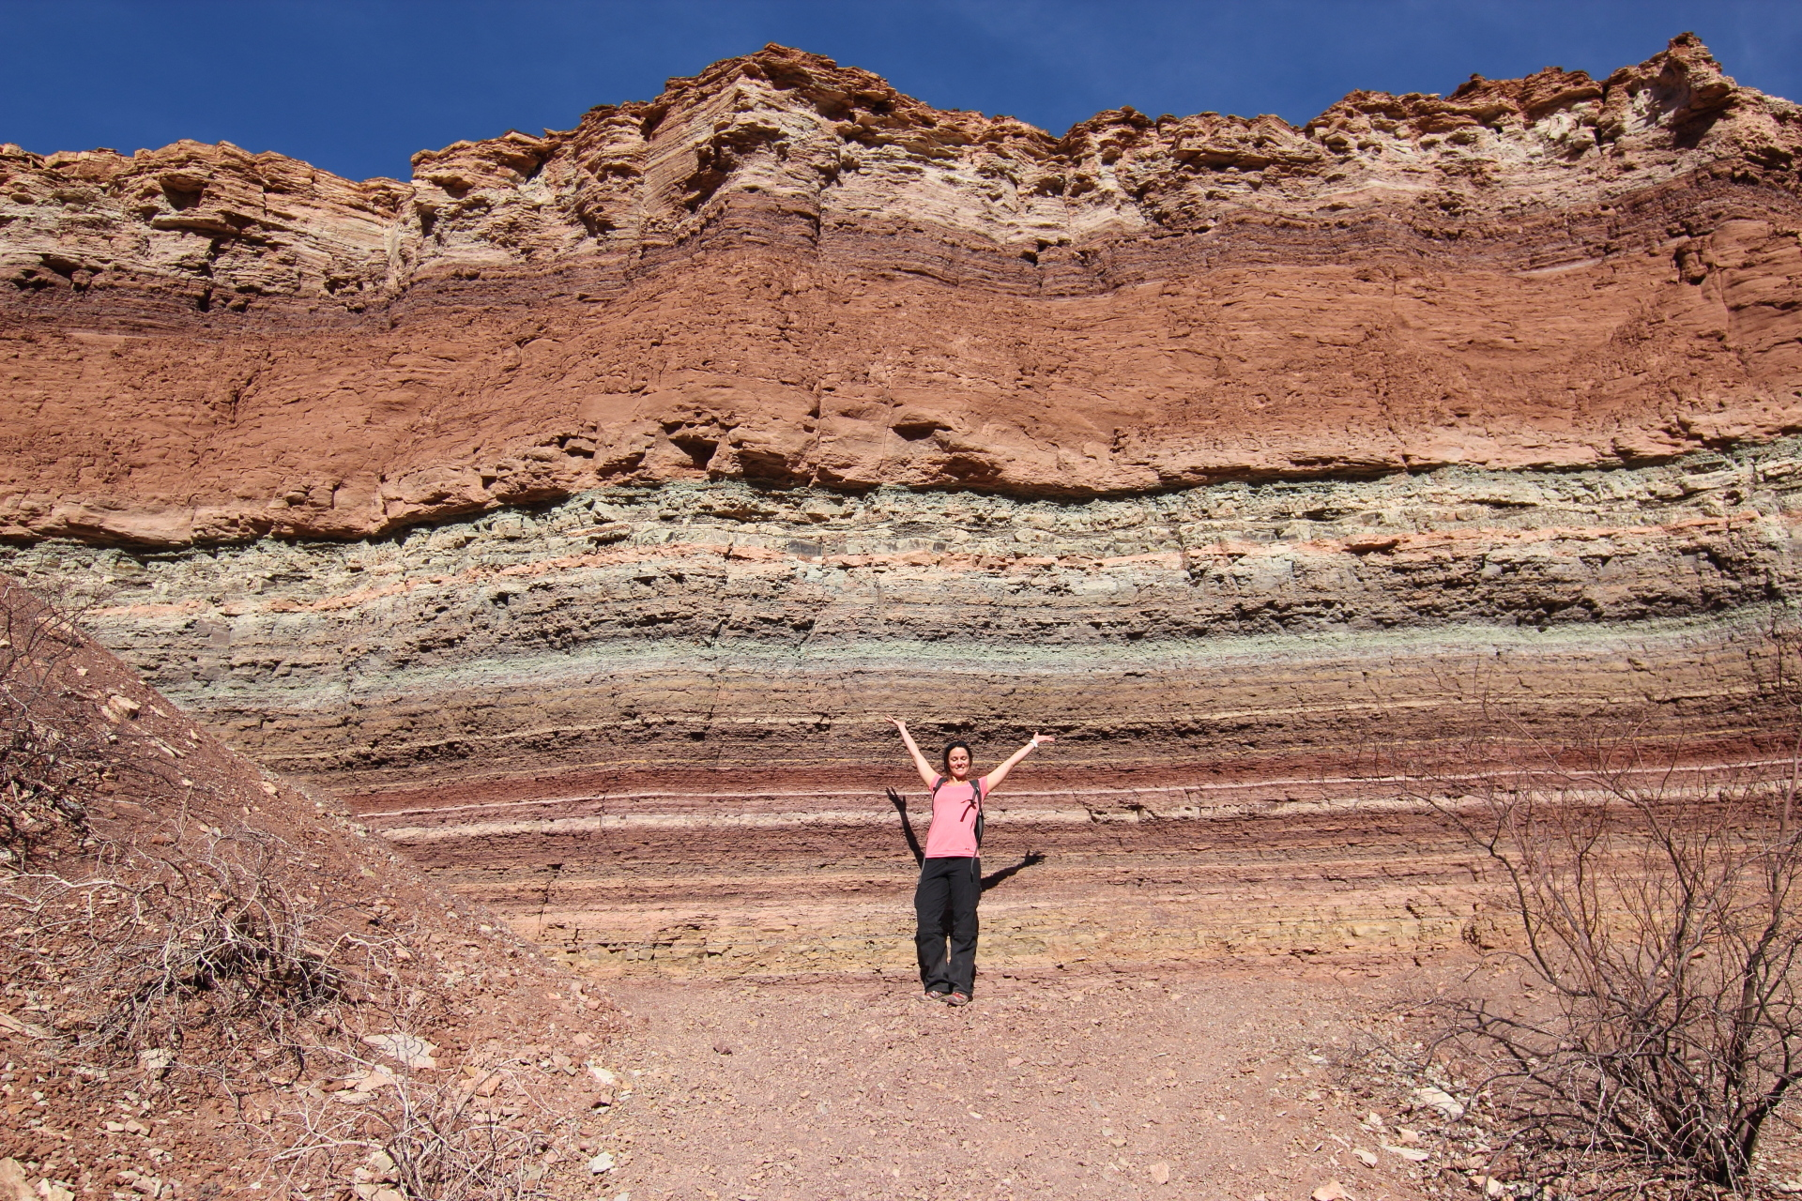

Slide 18
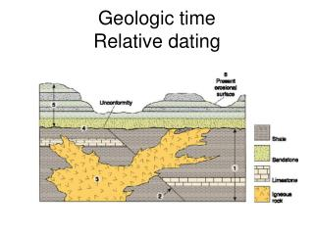
Geochronology

Slide 20
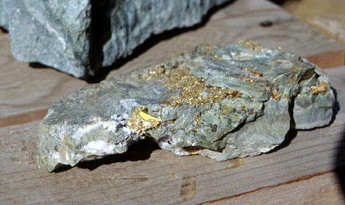

Slide 21
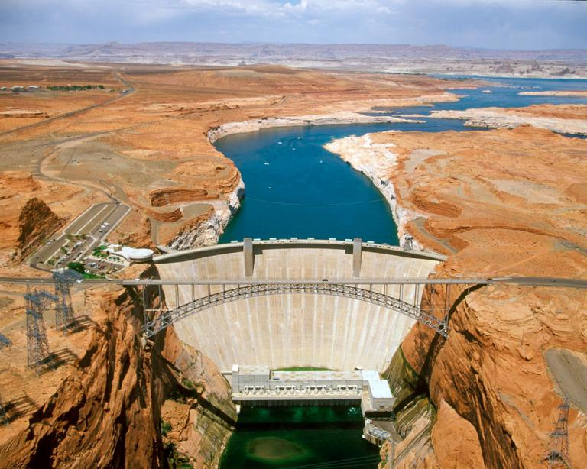
ENGINEERING GEOLOGY

Slide 22
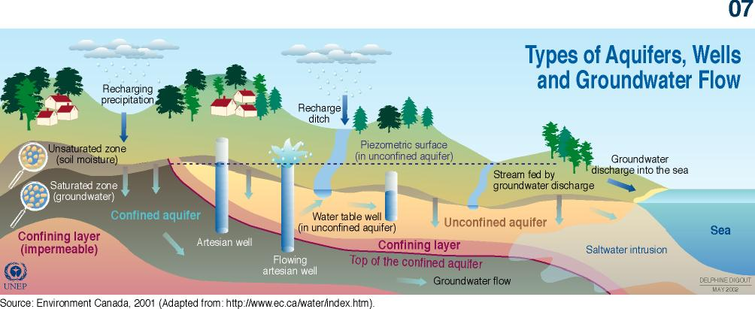
HYDROGEOLOGY

Slide 23
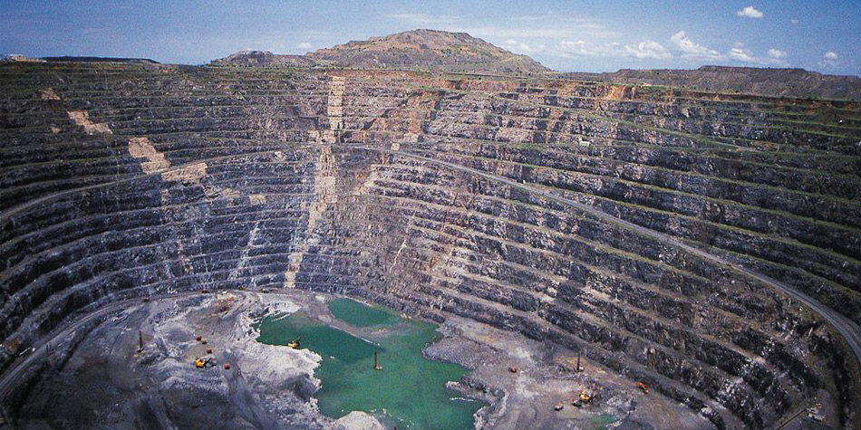
MINING GEOLOGY

Slide 24
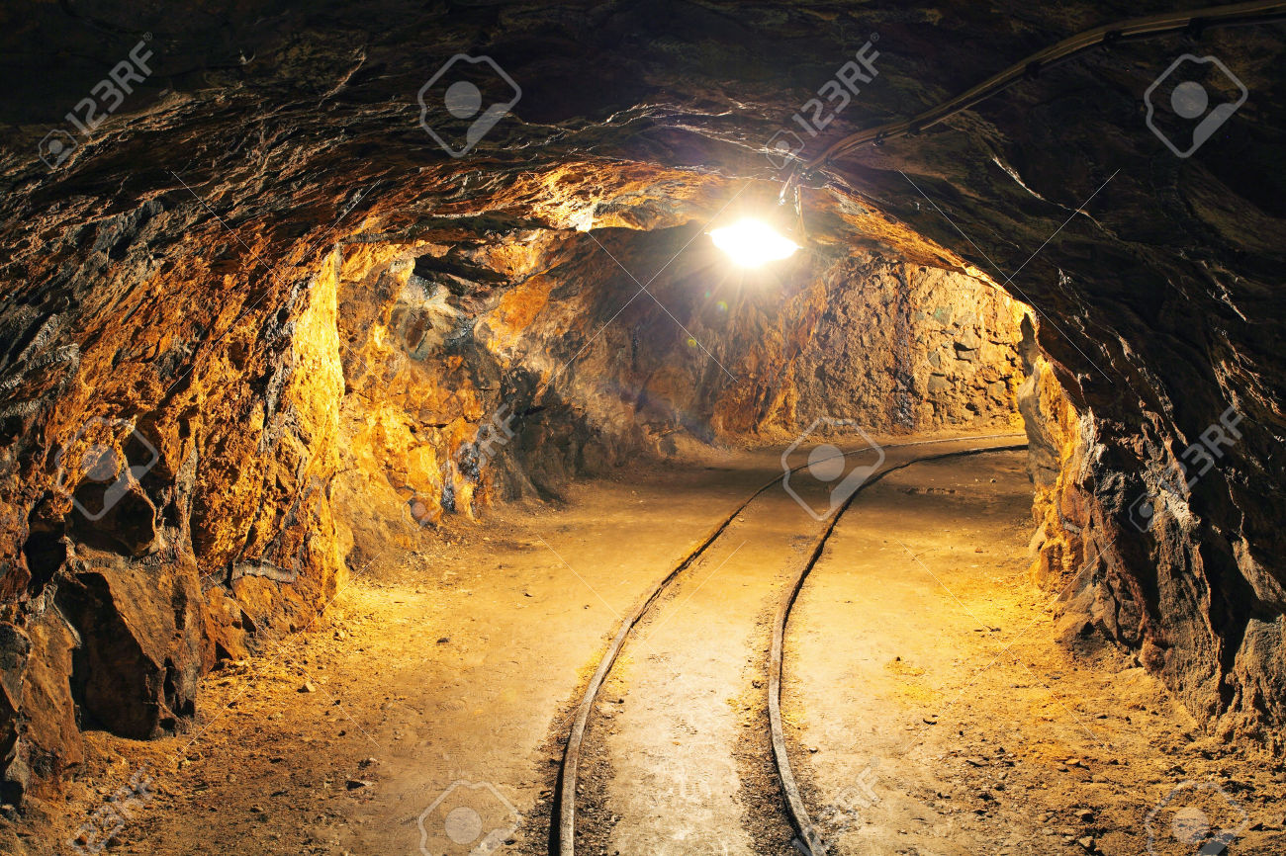

Slide 26
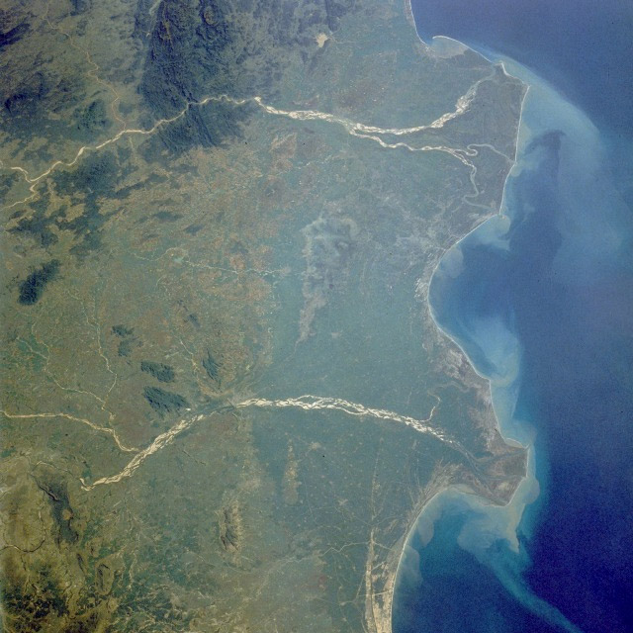
AERIAL PHOTOGRAPH

Slide 27
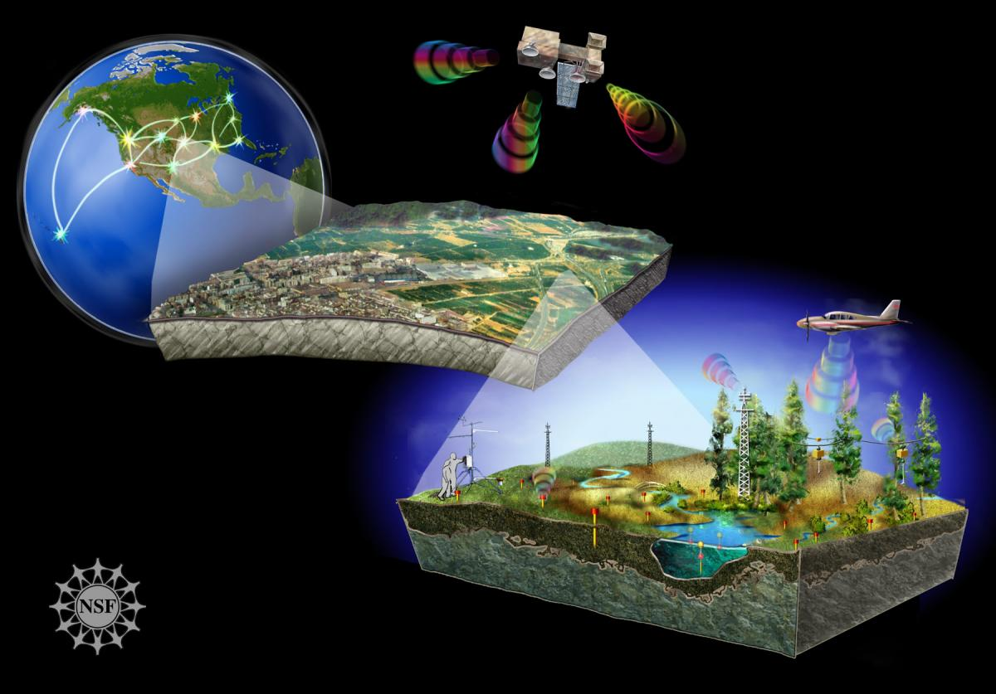
REMOTE SENSING

