Slide 1
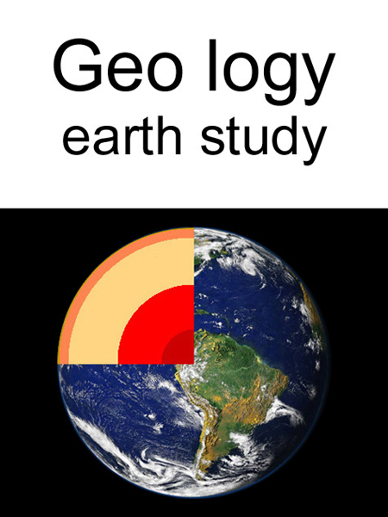
D.N.R.COLLEGE,
DEPARTMENT OF GEOLOGY

Slide 2
GEOLOGY
The word Geology is derived from the Greek words – “Geo” meaning the “Earth” and “Logos” meaning “discourse”. Geology is, therefore, the “Science of the Earth”.
As its name implies, it deals with the origin, constitution, structure and history of the earth and its past inhabitants.
Geology is the science that investigates the physical and chemical characteristics and processes of the earth, the origin, distribution, development and utilization, of earth materials and the land as a whole and the interaction between solid earth and the hydrosphere and atmosphere

