Slide 1
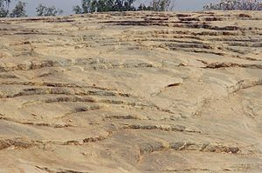
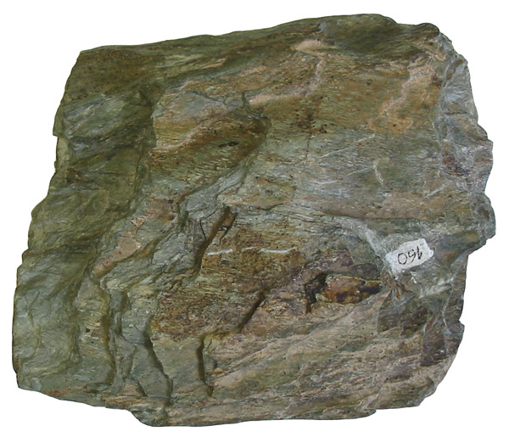
Succession of Archeans
2100 M.Y. | Porphyry and Felsite Dykes
2380 M.Y.
(Younger Greenstone belt) |  |  | Rannibennur Group-? | Least metamorphosed and gentle deformation
 |  |  | Chitradurga Group | Greenschist facies of metamorphism, Gentle to strong deformation
 |  |  | Bababuden Group | Greenschist to lower amphibolite facies of metamorphism
-------------UNCONFORMITY-----------
More than 2600 M.Y. |  |  |  | Migmatitic and amphibolite facies of metamorphism
More than 3200 M.Y. |  |  | Higher degree of metamorphism than Darwars | Upper amphibolite to granulite facies of metamorphism
More than 3500 M.Y.
Clospet Granite
Dharwar
super group
Peninsular Gneiss
(Fundamental Gneiss)
Sargur Schist Belt
(Older Greenstone belt)
Gorur Gneiss

Slide 2
Porphyry and Felsite Dykes
2380 M.Y.
Clospet Granite
Least metamorphosed and gentle deformation
Rannibennur Group
Dharwar
super group
Greenschist facies of metamorphism,
Gentle to strong deformation
Chitradurga Group
Greenschist to lower amphibolite facies of metamorphism
(Younger Greenstone belt)
Bababuden Group
------------------------UNCONFORMITY-------------------
Migmatitic and amphibolite facies of metamorphism
More than
2600 M.Y.
Peninsular Gneiss
(Fundamental Gneiss)
More than
3200 M.Y.
Sargur Schist Belt
(Older Greenstone belt)
Higher degree of metamorphism than Darwars
Upper amphibolite to granulite facies of metamorphism
More than
3500 M.Y.
Gorur Gneiss

Slide 3
BABUDAN GROUP | Mulaingiri Formation | Phyllites and rare ultramafic sills
 | Santaveri Formation | Metabasalts, silicious schists
 | Allampura Formation | Metabasalts, gabbros, quarzites
 | Kalasapura Formation | Metabalasts, gabbros, ultramafic schists, phyllites, quarzites

Slide 4
CHITRADURGA GROUP | Ranibennur Subgroup | Greywakes and mafic felsic volcanics
 | Vanivilas Subgroup | Manganese and Iron formations

Slide 5
South India | Central Province(M.P) | Bihar-Orissa | Rajasthan | Eastern Ghats (EGMB)
Clospet Granite | Amla Granites | Singhbum Granite | Bundelkhand Granite | Charnokite Granite Gneiss
Upper Dharwars | Bijawar Group | Singhbum Group | Railo Group | --
Middle Dharwars | Sakoli Group Chilipi Ghat Gr | Iron Ore Group | Aravalli Group | Bailadila Iron ore series
Lower Dharwars | Sausor Group | Gangpur Group |  | Bengal Series (khondalites & kodurites)

Slide 6
CUDDAPAH SUPER GROUP | KRISHNA/ SRISAILAM-300M | SRISAILAM FM | Quarzites and shales
 | UNCONFORMITY
 | NALLAMALAI GROUP- 3500-6000M | CUMBUM FM | Phyllites, Slates, quarzites, shales, dolomites
 |  | BAIRENKONDA FM | Quarzites, shales, conglomerates
 | ANGULAR UNCONFORMITY
 | CHITRAVATHI GROUP-5000M | GANDIKOTA FM | Quarzites and shales
 |  | TADIPATRI (Pullampet) FM | Shales, tuffs, quarzites, dolemites
 |  | PULIVENDULA (Nagri) FM | Conglomerates, quarzites
 | DISCONFORMITY
 | PAPAGHNI GROUP 2000M | VEMPALLE FM | Dolomites, chert breccia,quarzites with basic flows and intrusions
 |  | GULCHERU FM | Conglomerates, arkose, quarzites, shales
EPARCHEAN UNCONFORMITY

Slide 7
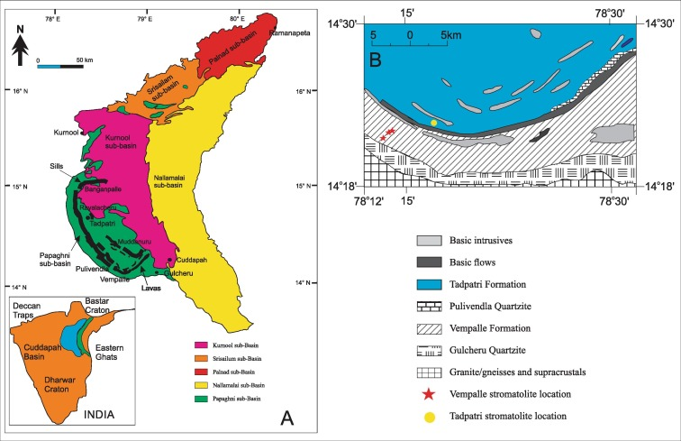

Slide 8
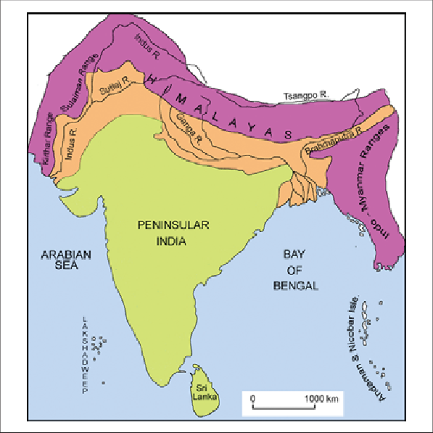
Physiographic divisions of india
India can be divided into three main divisions which differ from one another in physiography, structure and stratigraphy
a.) Peninsular India
b.) Indo-Gangetic Plain
c.) Extra-Peninsular India

Slide 9
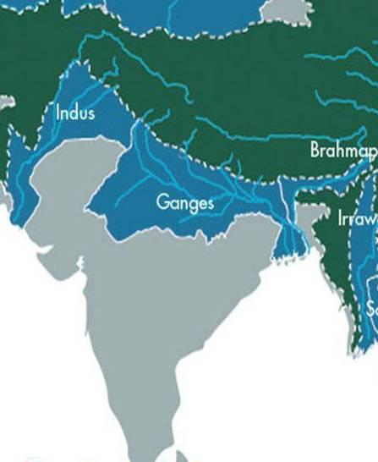
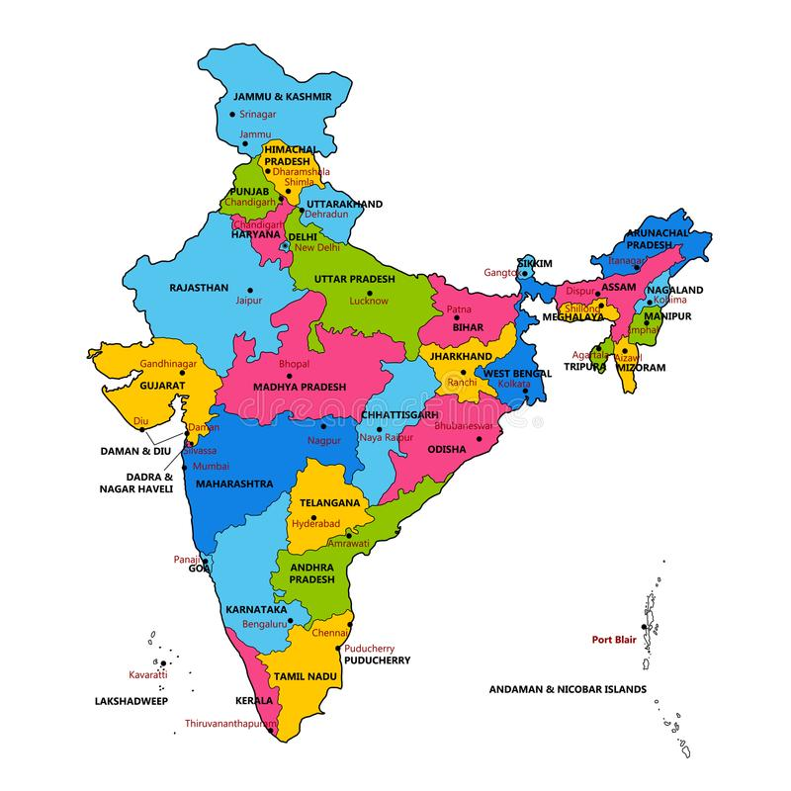
Peninsular India
The Peninsular lies on the south of the plains of Indus and Ganga river system

Slide 10
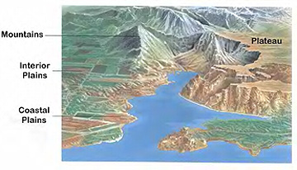
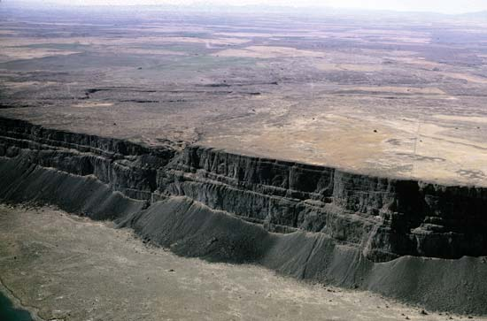
Physiography:
The Peninsular India has an extremely variable physiography. There are plateaus, peneplained ancient fold mountains, massifs, elongated graben like valleys and coastal plains. The western Ghats which forms a prominent physiographic feature exists at the western margin of the peninsular India. Most of the rivers have attained the base level of erosion and its mountains are of relict type.

Slide 11
Structure:
The Peninsular India is nearly a stable plateau which has remained unaffected by the orogenic movements of post Cambrian age. The normal and block faulting is however common.
The Narmada river flows in graben like valleys which trend in the E-W direction. The trend of the Mahanadi and Godavari valleys is in the NW-SE direction. The four distinct geomorphic and structural trends which have been recognised in the Peninsular India are:
NNW-SSE trend of southern parts of Western Ghats
NE-SW trend of Eastern Ghats
E-W trend of Satpura in Central India
NE-SW trend of Aravallis in Rajasthan

Slide 12
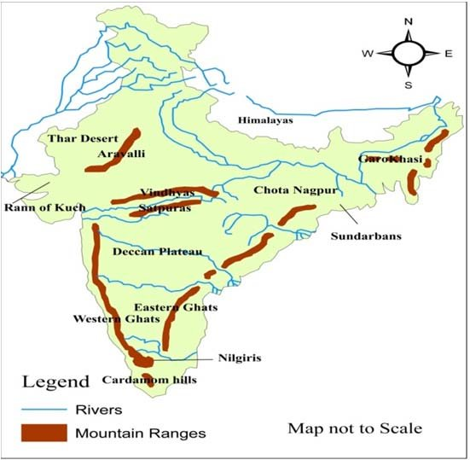

Slide 13
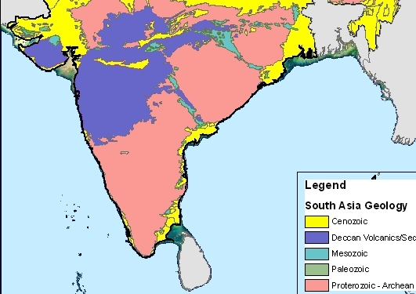
Stratigraphy:
The Peninsular India is primarily made up of rocks of Archean and Proterozoic age. The Archean rocks are metamorphesd to various degrees. In addition their exists the Deccan Traps and Rajmahal Traps of Jurassic to Eocene age.

Slide 14
Indo-Gangetic Plain
The Indo-Gangetic Plain is a deep crustal trough filled with Quaternary sediments. Its origin and structure is intimately related to the rise of the Himalayas. This plain extends from Assam in the east through Bengal, Bihar and U.P ., upto Punjab in the west.

Slide 15
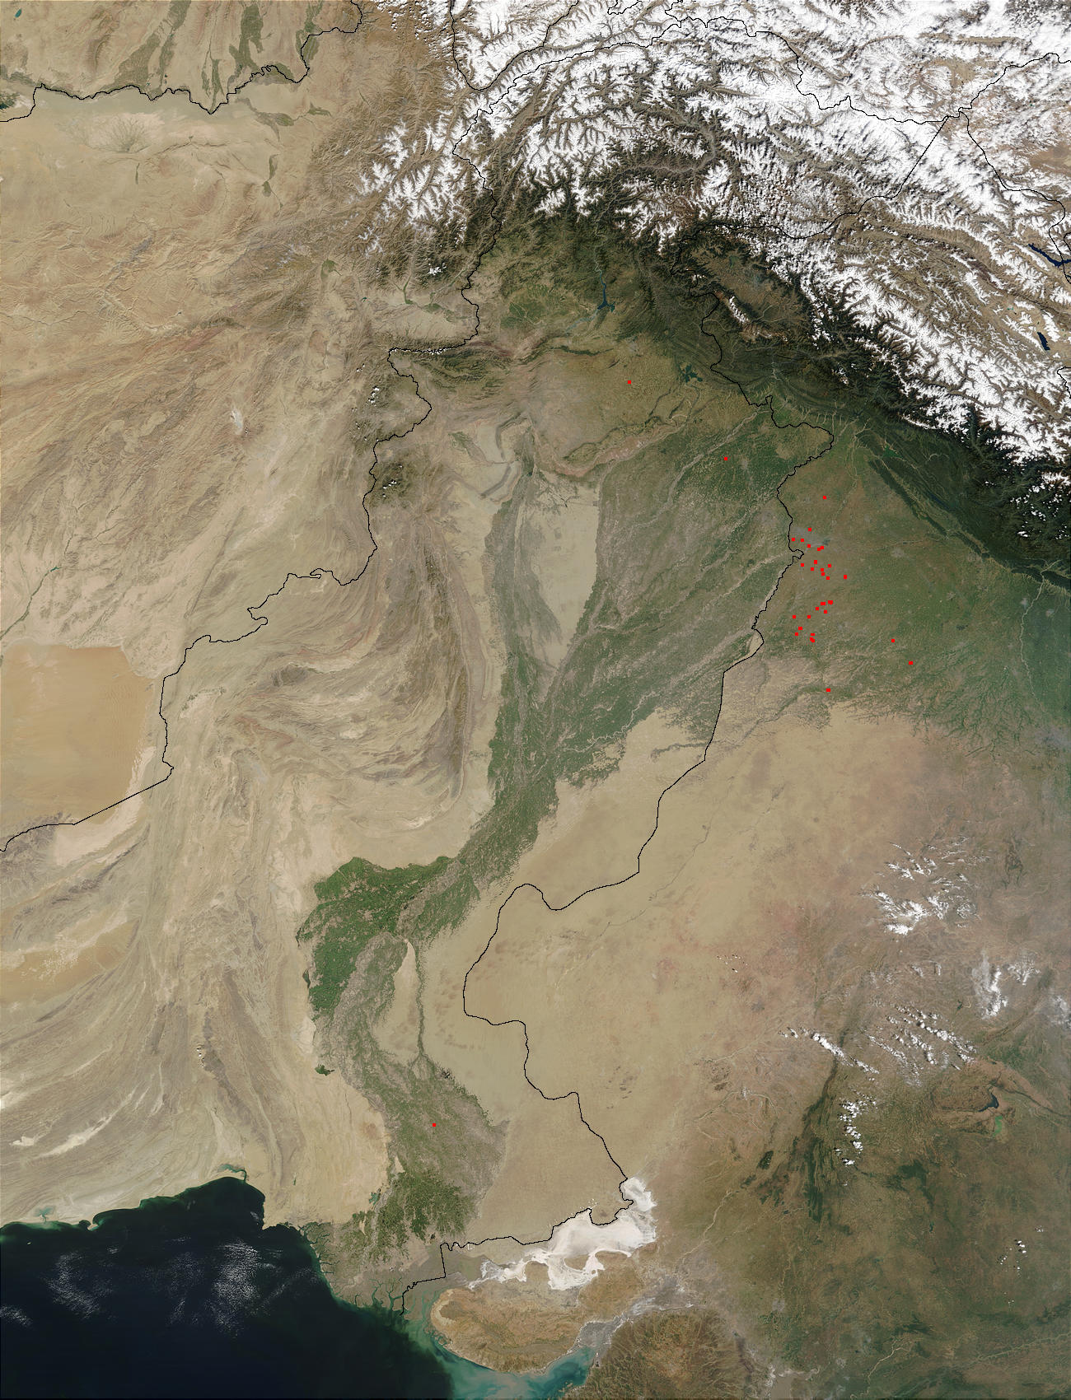
Physiography:
The Indo-Gangetic Plain is the very extensive alluvial plain (An alluvial plain is a largely flat landform created by the deposition of sediment over a long period of time by one or more rivers coming from highland regions) which is sloping with a very small gradient towards the sea.

Slide 16
Structure:
The Indo-Gangetic Plain is made up of the undisturbed layers of Quaternary sediments which have been deposited by the rivers of Himalayan region.
The bottom of this trough is not stable and some changes are still taking place which rise to earthquakes.
In Indo-Gangetic Plain, three transverse “Highs” have been recognised, they are
i) Delhi-Haridwar Ridge
Faizabad Ridge
Monghyr-Sahasra Ridge
These three highs divide the Indo-Gangetic Plain into four shelf areas
Punjab shelf (Trans Gangetic Plain)
West UP shelf (Upper Gangetic Plain)
East UP shelf (Middle Gangetic Plain)
Bengal shelf (Lower Gangetic Plain)

Slide 17
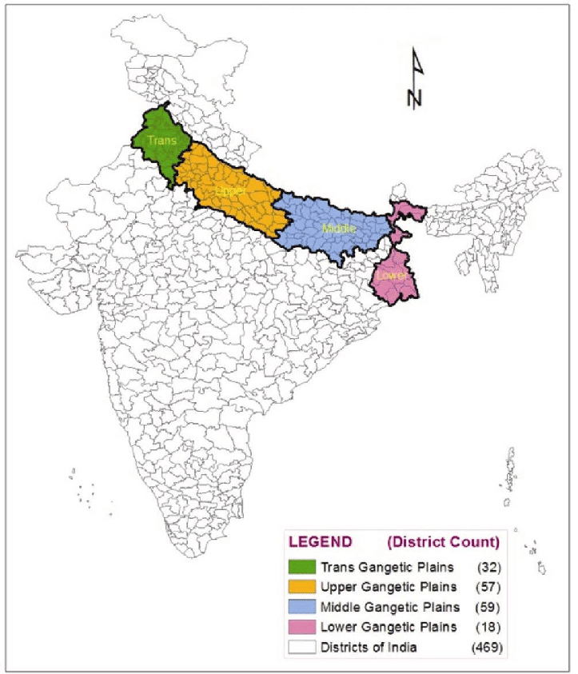

Slide 18
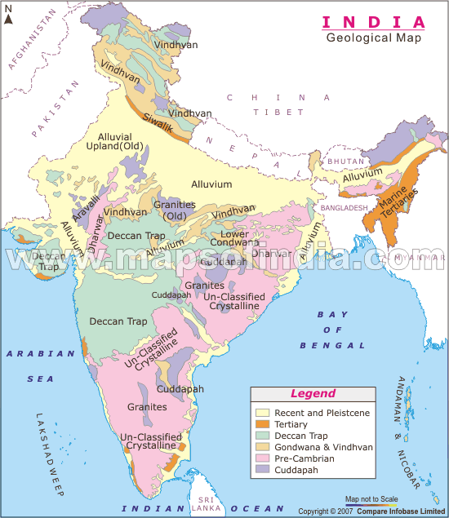
Stratigraphy:
The Indo-Gangetic Plain is chiefly made up of sands and clays of Pleistocene and Recent age. The basement of the Punjab shelf is made up of the Archean rocks, while that of the east and west U.P shelves contain Precambrian rocks. The Bengal shelf is believed to contain rocks of Gondwana age.

Slide 19
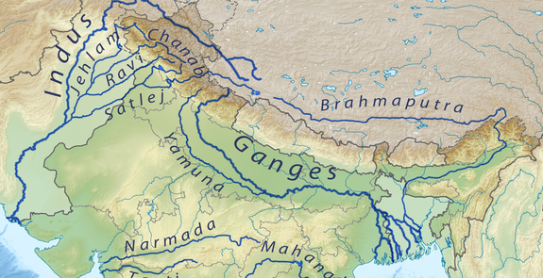
Extra Peninsular India
The Extra Peninsular India lies at the northern extremity of the country. It is made up of the Himalayan mountain ranges in the north and Arakan-Yoma ranges in the east. The upper reaches of Indus and Brahmaputra rivers mark its northern boundary.

Slide 20
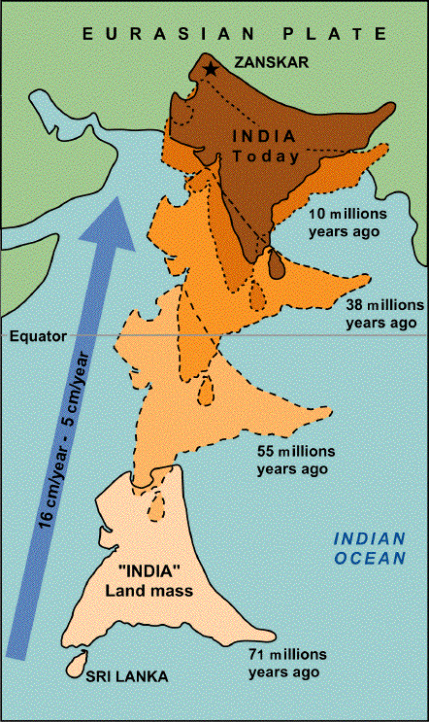
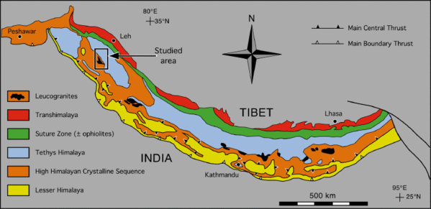
Physiography:
The Extra Peninsular India is made up of the tectonic mountains and the frontal foredeep belt of Tertiary age. The frontal foredeep belt is also called as “Siwalik Range” or “Outer Himalaya”
The Himalayan belt extends in the E-W direction and its about 2400km. At its western end as well as eastern end a sharp arcuate turn which is called as “Syntaxial bend”

Slide 21
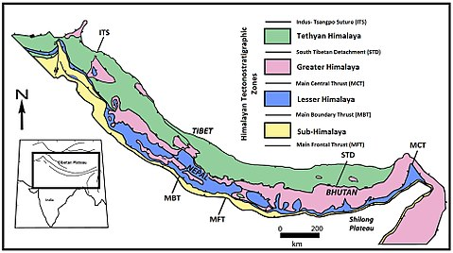
Structure and Stratigraphy:
The rock formations of the Extra-Peninsular India have been disturbed greatly by the complex folding, faulting and overthrusting. The Extra-Peninsular India has been subdivided into four longitudinal geomorphic zones:
Tethyan Himalayan zone
Central crystalline zone of the Higher Himalaya
Lesser Himalayan zone and
Foredeep folded belt.

Slide 22
Tethyan Himalayan Zone:
This zone is at the northern extremity of the Extra-Peninsular India. Here the Himalayan mountains rise to an average altitude of about 6000 meters. This zone consists of the marine rock beds of Palaeozoic and Mesozoic ages. This succession rests unconformably over the precambrian basement.
Central Zone of Higher Himalaya:
In this zone the average height of the mountains is also about 6000 meters but they are chiefly made up of the Precambrian basement and the granitic plutons of Tertiary age.

Slide 23
Lesser Himalayan Zone:
The average height of mountains in this zone is between 2000-3000 meters. Many antecedent rivers flow through this zone. These rivers originate in the Tethyan Himalayan zone and flow across the Higher Himalayan and Lesser Himalayan ranges by cutting deep gorges. The rockformations of this zone are relatively less metamorphosed. They are unfossiliferrous and therefore their correlation can not be done. The structure of these rocks is very complex. They are affected by a series of thrust faults due to which the stratigraphic succession has been reversed in many places. The lower part of the unfossiliferous rockformations is believed to be Precambrian age. These are overlain by rock-formations of Gondwana age. Above these are the rocks of Tertiary age.
Foredeep Folded Belt:
This zone lies at the southern margin of the Extra-Peninsular India. It is also called the”Siwalik Range”.The low lying hills of this belt are mainly made up of the sediments of Mio-Pliocene age. The southern boundary of this belt is marked by the “Main boundary faults”.

Slide 24
Divisions | Group/Series | Stage | Age | Krishna-Godavari districts(A.P.) | Pranhita-Godavari Valley
Upper Gondwana (Characteristic flora: Ptylophyllum) | Jabalpur | Umia | L. Cretaceous
 |  | Jabalpur | U. Jurassic | Tirupati S.St.
 |  | Chougan | U. Jurassic | Raghavapuram Sh. | Chikiala Gangapur
 | Rajmahal | Kota | M. Jurassic |  | Kota
 |  | Rajmahal | L. Jurassic
 | Mahadeva | Maleri | U. Triassic | Gollapalli S.St. | Dharmaram Maleri
 |  | Pachamari | M. Triassic |  | Bhimaram Yerrapalli
---------------Unconformity--------------
Lower Gondwana (Characteristic flora: Glossopteris and Gangamopteris) | Panchet | Panchet | L. Triassic
 | Damuda | Raniganj | U. Permian | Chintalapudi S.St. | Kamthi
 |  | Barren measures | M. Permian
 |  | Barakar | L. Permian
 |  | Karharbari | L. Permian
 | Talchir | Talchir | U.Carboniferous to L. Permian |  | Talchir
---------------Unconformity--------------
PRECAMBRIANS

