Slide 1
HYPSOGRAPHIC CURVE

Slide 2
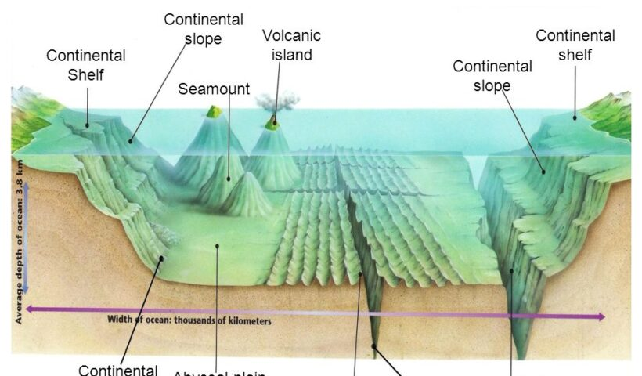
SEAMOUNTS & VOLCANIC ISLANDS

Slide 3
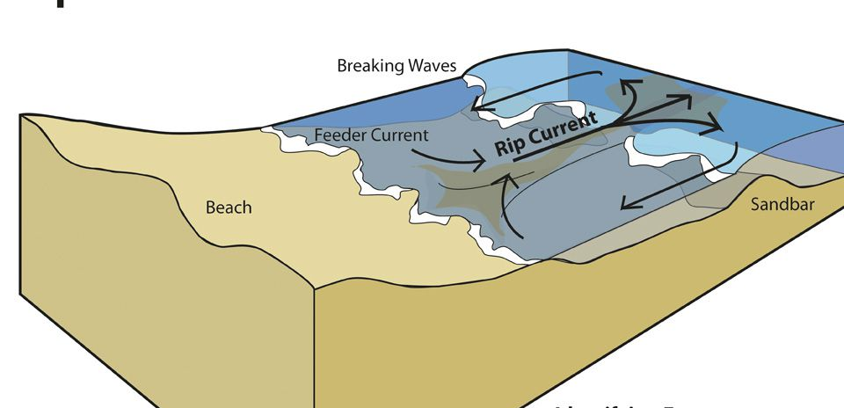
RIP CURRENTS

Slide 4
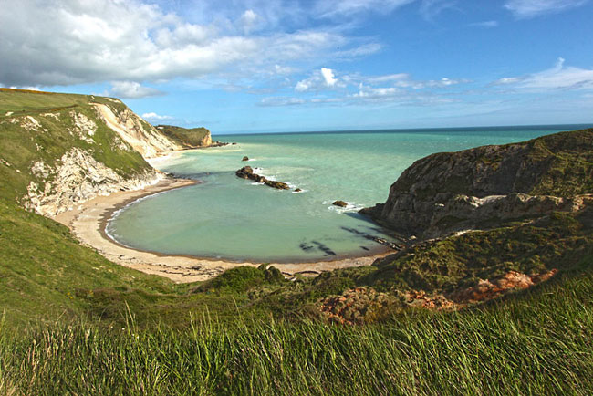
SEA COVE

Slide 5
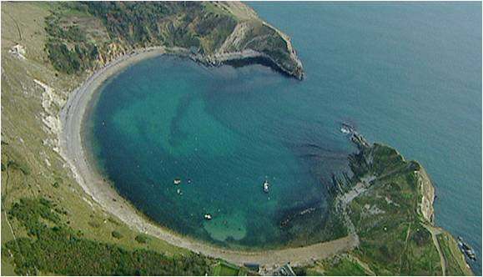
SEA COVE

Slide 6
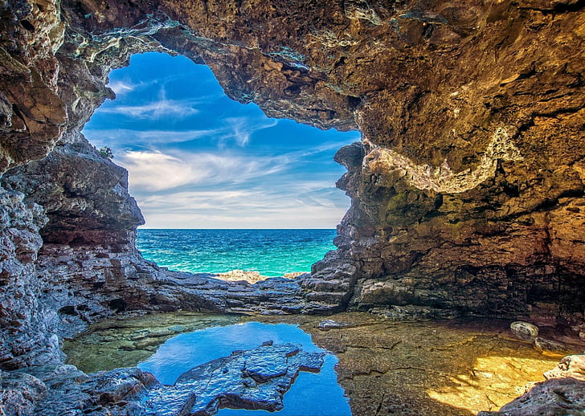
SEA CAVE

Slide 7
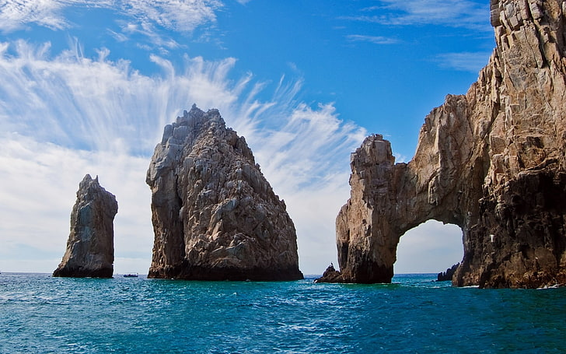
SEA ARCH & SEA STACK

Slide 8
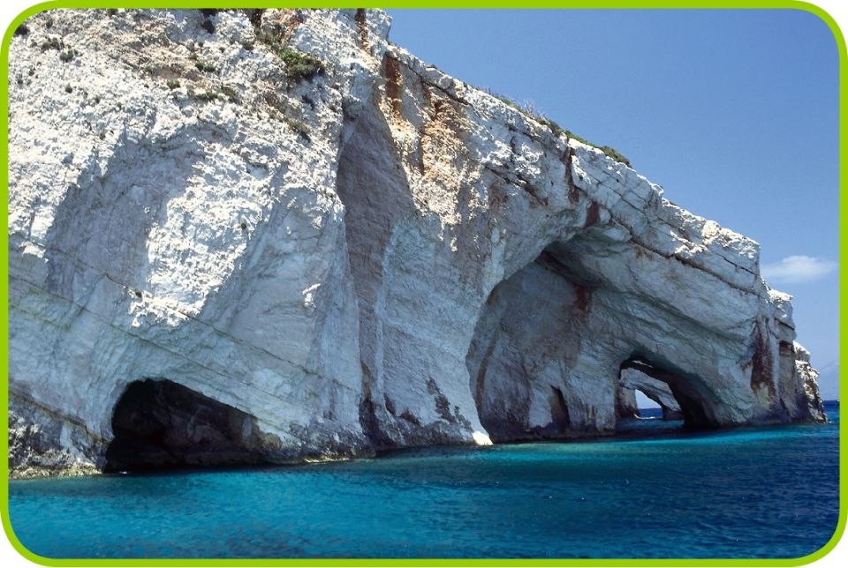

Slide 9
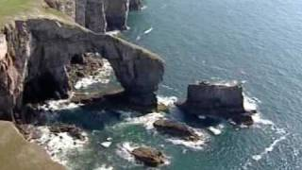

Slide 10
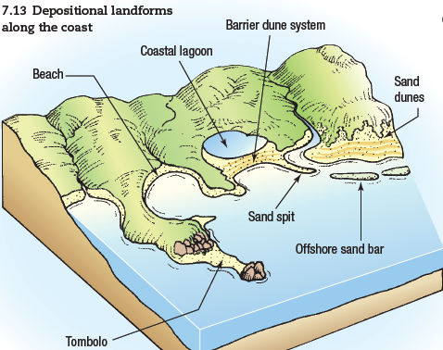
DEPOSITIONAL LANDFORMS

Slide 11
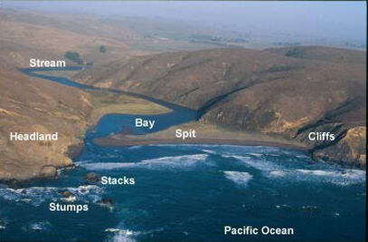
DEPOSITIONAL LANDFORMS

Slide 12
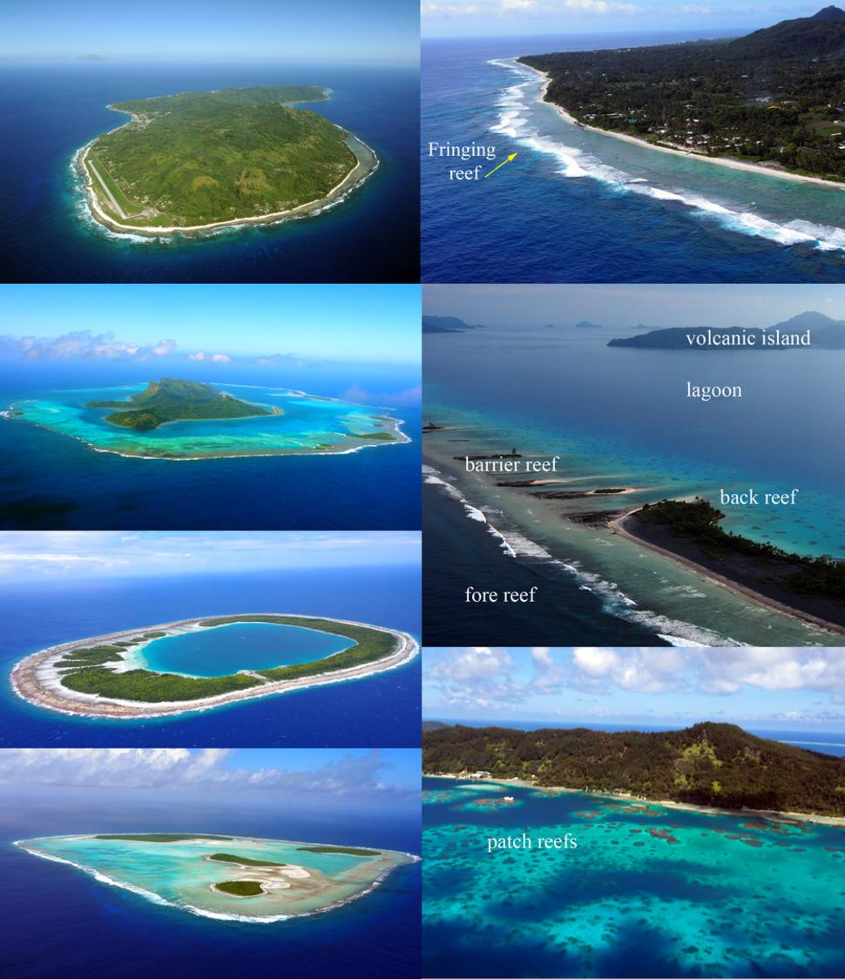
CORAL REEFS

