Slide 2
The figure shows relationship between the three
types of rocks, that is igneous, sedimentary and
metamorphic rocks.
One type of rock changes slowly to another type
of rock.
Primarly the magma may rise up and reach the
earth’s surface where it cools to form igneous
(primary)rocks.

Slide 3
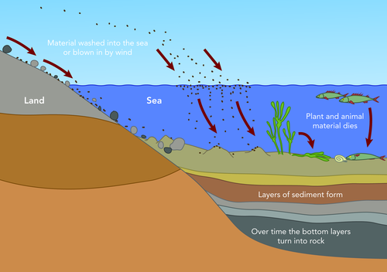
At the surface, igneous rocks are exposed to weathering and erosion produces sediments which is transported and deposited into deep basins under the sea.

Slide 4
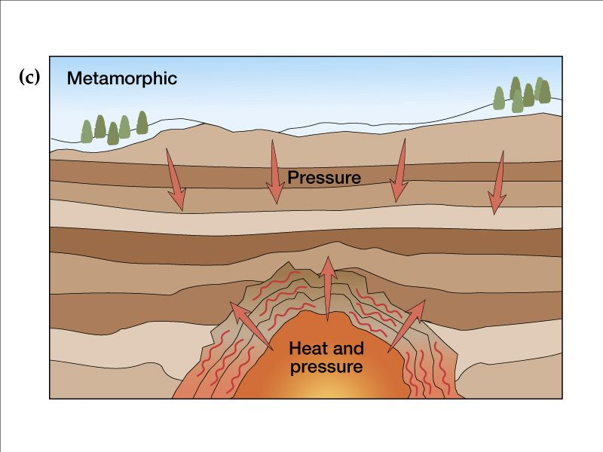
then the sediments compacted and cemented (hardnes) to form sedimentary (secondary)rocks.if these rocks are deeply buried, the temperature and pressure turn them into metamorphic rocks. then high temperature and great depths melts metamorphic rocks and produces magma.

