Slide 1
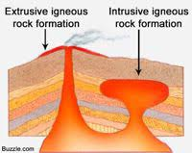
FORMS OF IGNEOUS BODIES
The igneous rock bodies are of two types
1.Extrusive igneous bodies:
Extrusive igneous rock bodies are
formed from magma poured out at
the earth’s surface. Ex: Lavaflows
2.Intrusive igneous bodies:
intrusive igneous bodies are formed by the consolidatio
of magma at some depth below the earth’s surface .
such rock bodies show considerable variations in their
size and shape.
Intrusive bodies are divided into two groups
1.Concordant bodies 2.discordant bodies

Slide 2
Discordant bodies | Concordant bodies
Batholiths | Lopoliths
Stocks | Laccoliths
Dykes & Ringdyke | Sills
Volconic pipes | Bysmalith
Cone-sheets | Phacoliths
Ethmolith | --------
Harpolith | --------
Chonolith | ---------

Slide 3
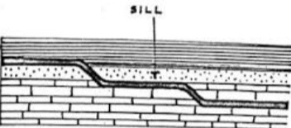
CONCORDANT BODIES
Sill : A Sill is a concordant body,few
Cm to >1km thick, produced when
Magma injected between layers of
older Sedimentary or volconic rock, and
are Generally composed of intermediate
to Basic composition of magma.
They may be horizontal,inclined or vertical
depending upon the attitude of strata in which they are intruded.
(OR)
It is a sheet like igneous body which runs
parallel to the bedding Planes of the
pre-existing strata.
Ex: dolerites and basalts.
Sill

Slide 4
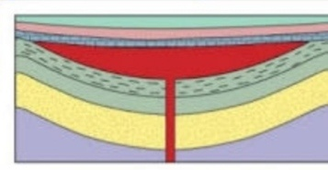
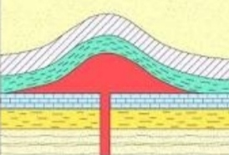
LOPOLITH :
A lopolith is a spoon-likeshaped
concordant body similar to a sill except
the floor and roof sag downward.
these are basin or saucer shaped
concordant Bodies with top nearly flat
and convex Bottom.
Its diameter is usually 10-20 times its thickness.
The coposition of lopoliths is commonly basic.
LACCOLITH :
It is concordant body,with flat bottom and
Convex upward.it is dome shaped.
When viscous magma is injected rapidly
Along the bedding, as it cannot spreads
it pushes up the overlying layers and
Keep on piling up.
It causes folding of the overlying rock layers.

Slide 5
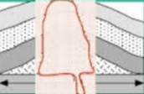
BYSMALITHS :
It is cylindrically shaped body.
it is developed when highly viscous magma is
Injected, because the lateral spreading along
the bedding is less it acquires to move
upwards and form cylindrical shape.
It causes breaking of overlying rock layers.
PHACOLITHS :
These are concordant bodies that occurs
along The crests and troughs of the folded
sedimentary strata

Slide 6
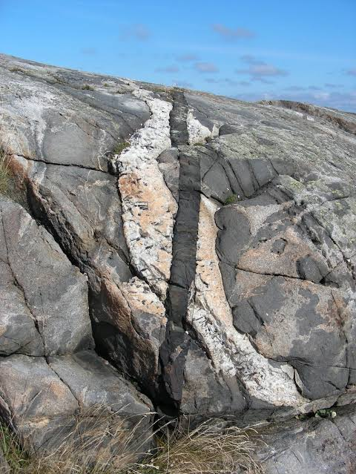
DISCORDANT BODIES
Dyke:
A dyke is a discordant body,
few cm to>100 m thick, produced
when magma is injected along fractures
In surrounding rock layers.
Dykes typically form from magmas of
basic to granitic composition.
A dyke is a wall like igneous body that
Cuts across the strata of the pre-exsiting
rocks.
Ring dyke : A dyke of arcuate out crop;
Occurring more or less in the form of a complete
or nearly complete circle.

Slide 7
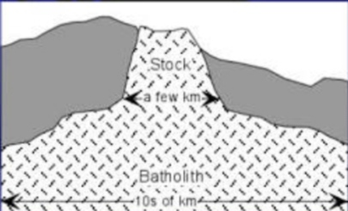
BATHOLITH :
Batholith are the largest kind of
(plutons) intrusive Igneous bodies
which have transgressive relation
with the adjacent country rocks.
their diameter is usually 100 km or
more and their outcrop at the surface
is roughly circular or oval.
Most batholiths are found in belts of deformation within the earth’s
crust and are granitic in composition.
These are the widening downwards to unknown depths.
STOCKS : Are smaller irregular bodies with 10 km in maximum dimension,and are associated with batholiths.
BOSSES : Stocks of circular outcrop upon the surface are known as bosses

Slide 8
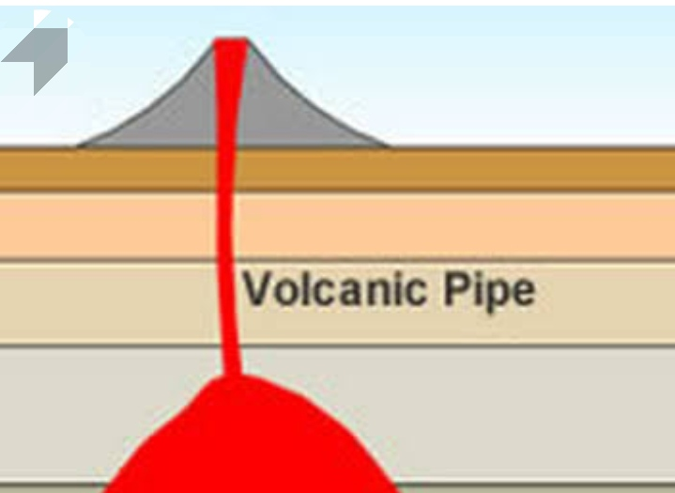
Volconic pipes and necks :
Volconic pipes and necks are discordant
bodies that represent the upper part of
the conduit that connects the volconic
vent(crater) with an underlying magma
source (magma chamber or reservoir).
Volconic necks are erosional remnants of
magma that solidified in the pipe or
conduit.
Ethmolith : These are funnel-shaped basic bodies with circular out crop.
Harpolith : These are sickle-shaped basic bodies formed by stretching of the strara after or during injection.
Chonolith : Any irregular intrusive igneous bodies.

