Slide 1
STRUCTURE OF IGNEOUS ROCKS
The structures of igneous rocks are large scale features
which are dependent on several factors like:
Composition of magma.
Viscosity of magma.
Temperature and pressure at which cooling and consolidation takes place.
Presence of gases and volatiles.
Igneous stuctures are mostly classified into three major groups,as follow:
1.Mega-structures.
2.Minor structures.
3.Micro-structures.

Slide 2
MEGA STRUCTURES
Vesicular and amygdaloidal.
Cellular and scoriaceous.
Lava-drain tunnels.
Block-lava.
Ropy-lava.
Pillow lava.
Sheet structure.
Platy structure.
Columnar structure.
Flow structure.
Rift and graon.

Slide 3
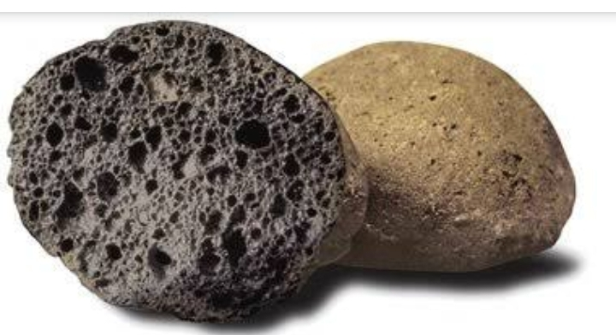
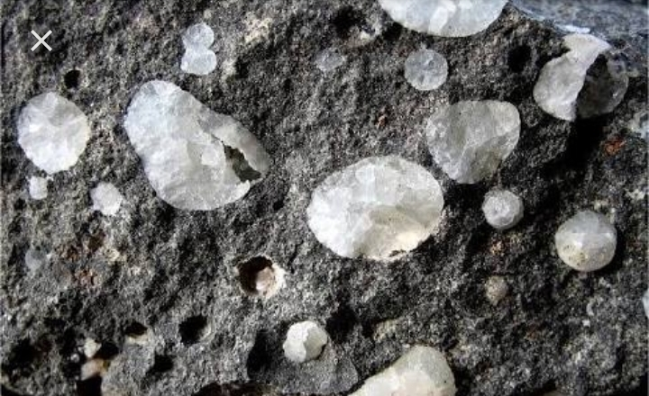
Vesicular and Amygdaloidal :
when lavas heavily charged with gases and other volatiles are
erupted on the surface, the gaseous constituents escapes from
the magma as there is a decrease in the pressure. Thus, near
the top of flow ,empty cavities of variabledimensions are
formed.The individual openings are known as vesicles and the
structure as a whole is vesicular structure.
If, however ,the vesicles thus formed are subsequently filled in
With some low-temperature secondary minerals, such as calcite
Zeolite, chalcedony etc., these infillings are called amygdales
Lavas containing amygdales are said to have amygdaloidal
Structure. These are the usual characteristic of basic lava flows.

Slide 4
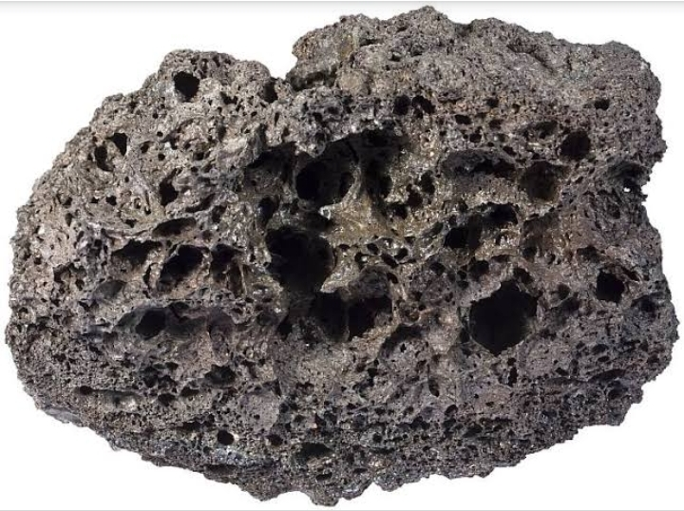
Cellular and scoriaceous structure :
By the bubbling out of the gases, from a
lava heavily charged with volatile and
gaseous constituents, numerous cavities
are formed withthe solidification of the
lava.When the cavities are very much
abundant, the term pumice or rock-froth
is applied. Such structures are known
as cellular or scoriaceousstructures and
are characteristicOf highly silicious lavas.

Slide 5
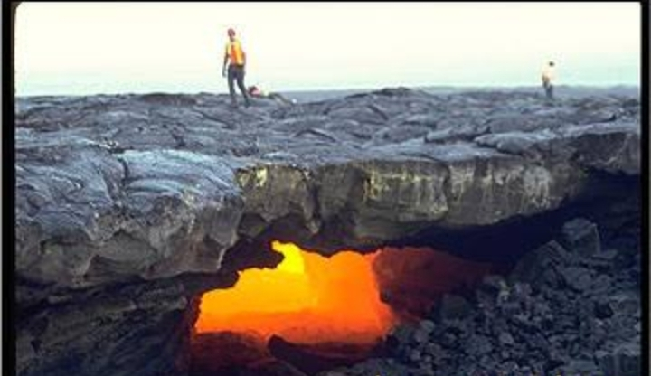
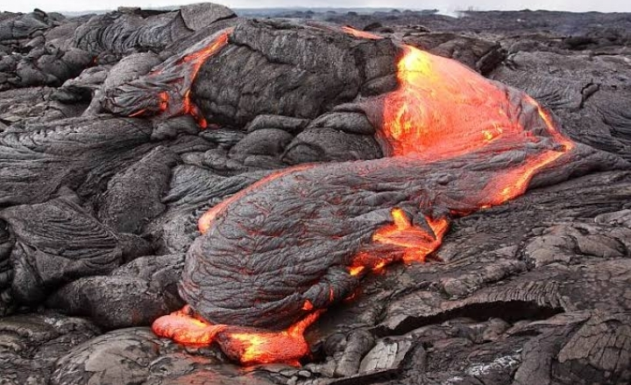
Lava-drain tunnels :
S0metimes while the upper surface
of the lava consolidates, the interior
may still remain fluid. When the
enclosed fluid lavadrains out through
Some weak-spots lying at the periphery
Of the flow, the resulting structure is
Knownas lava-drain tunnel.
Block-lava :
Since lavas of acidic composition, due to
their high viscosity don’t flow to greater
Distances,they after solidification are
Found to offer a very rough surface. Such
Lava flows are known as block lava.
It is also known as ‘‘aa” structure.

Slide 6
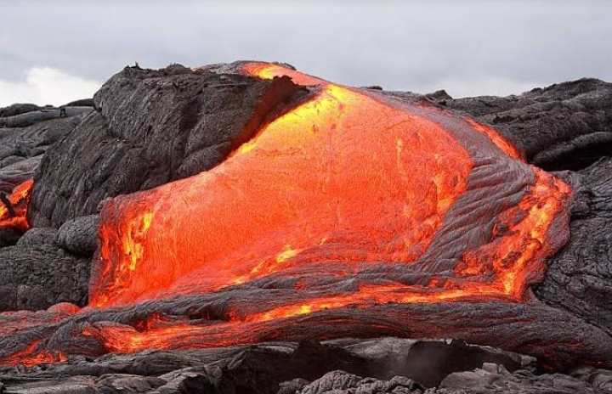
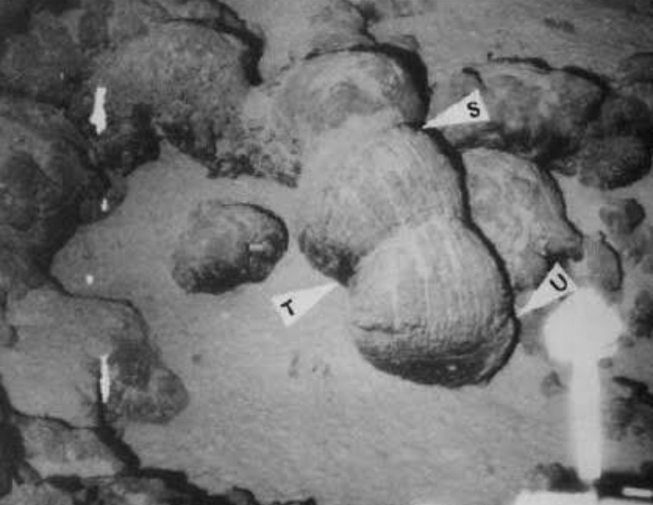
Ropy-lava :
Lavas of basic composition are
quite mobile because of theire
low viscosity and they can flow
to greater distances and after
Solidificatin offers very smooth
Surface. Such lava flows are known
as ropy lava and are also known as
“pahoehoe”structure.
Pillow-lava :
It consists of isolated pillow shaped
Masses piled one upon another.
These are produced by extrusion of
Lava into rain-soaked air, beneath
Ice-sheets, under water logged
Sediments or in sea water. Spliite,
A lava rich in albite characteristically
Exhibits pillow structure.

Slide 7
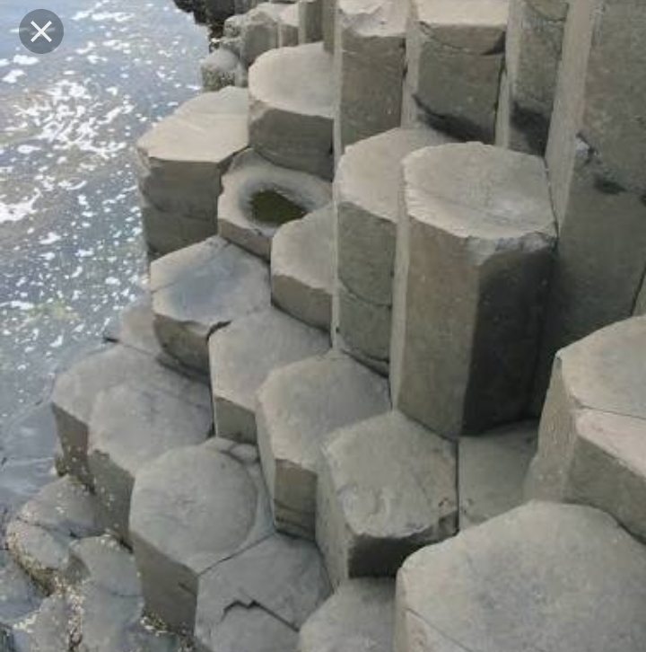
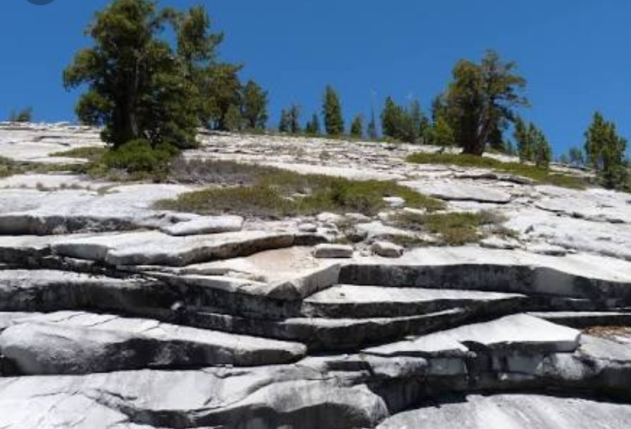
Columnar structure :
As a consequence ofcontractin due to
cooling, a few sets of vertical joints
develop. such joints,bring about the
formation of colimns,which may be
square,rectangular,rhombic or
hexagonal in outline.
Sheet structure :
The development of one set of well defined
joints, some times brings about a slicing
effect on themassive igneous rock body.
If all such slices are horizontal, the
structure is said to be sheet structure.

Slide 8
Platy structure :
Ths is also due to the development of different sets of joints,which
gives rise only plates of the rock mass, on striking the rock. Such a
feature is known as platy structure.
Flow structure :
Subsequent to eruption of lava upon the surface the viscous, varities
flow from one place to other with great difficulty and in their attempt
to do so, the dissimilar patches within the lava are drawn out in the
form of elongated lenticles.
Sometimes the already crystallised particles within the magma are
arranged parallel to the direction of the flow of the lava. They
naturally indicate the direction of flowing of the mass, prior to its
consolidation. These are also known as directional structure or more
commonly flow structure

Slide 9
MINOR&MICRO STRUCTURES
Primary foliation.
Banding in rocks.
Schlieren.
Reaction rims.
Myrmekite structure.
Graphic structure.
Xenolithic structure.
Orbicular structure.
Spherulitic structure

Slide 10
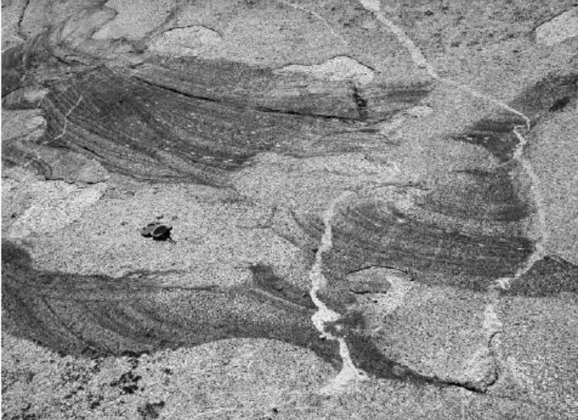
Schlieren :
These are somewhat wavy,
Streaky,irregular sheets,
Usually lacking sharp contact
With the surrounding igneous
Rocks. They may be altered
Inclusions, segregation or
May represent concentration
Of residual fluids into layers
In a rock that had crystallised.

Slide 11
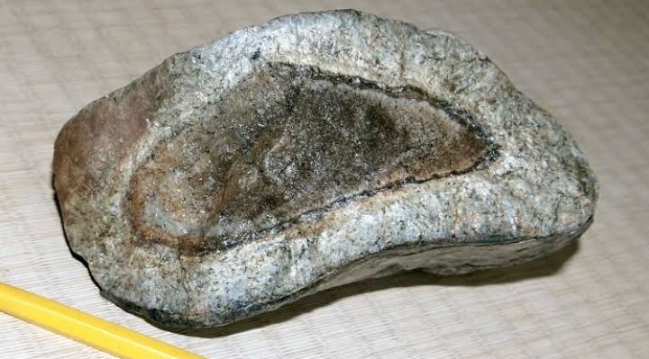
Micro structures :
These are formed due to reaction between an already solidified
Crystals react with the rest of the magma.
Reaction-rims :
When the reaction beween an
Already crystllized mineral and
The rest of the magam incom
-plete, the corroded crystals are
Found surrounded by the prod
-ucts of reaction i.e.,some new
Mineral. Such zones are known
as reactionrim. When the react
-ion rims are produced by
Primary magmatic reaction,
They are known as “corona structure’’ and “kelyphitic birders’’
when secondary

Slide 12
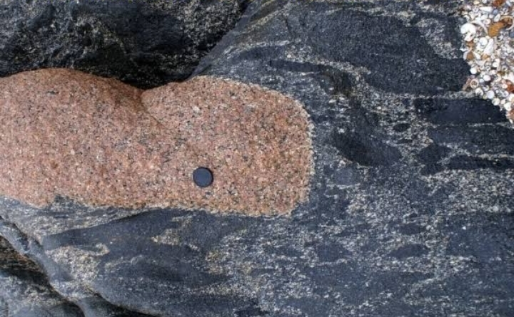
Xenolithic structure :
Occurrence of foreign rock fragments
Within an igneous rock gives rise to
Xenolithic structure.
The xenoliths are said to be ‘cognate’
when they are genetically related to
enclosing rocks and ‘accidental’when
they are fragments of countryrocks
without having any genetic relation
with the enclosing rock.
Xenolith is also called Enclaves.

Slide 13
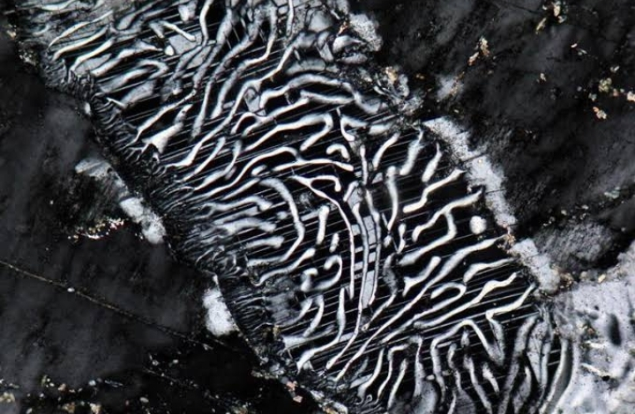
Myrmekite structure :
It is produced by an intergrowth
Of quartz and plagioclase feldspar
Where quartz occurs as blebs or
drops in plagioclase.
Graphic structure :
It results from an intergrowth of
Quartz and orthoclase feldspar

Slide 14
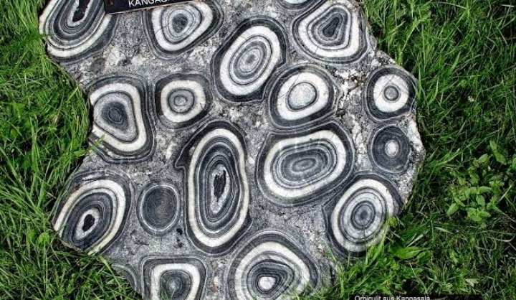
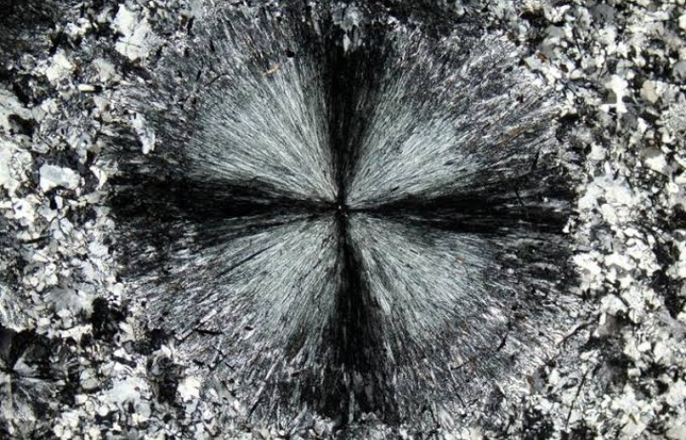
Orbicular structure :
These are spherical segregation
Consisting of concentric shells of
Different mineral composition and
Texture, which occasionally occurs
in granitic rocks.
Spherulitic structure :
Its essential feature is simultaneous
Crystallization of fibres with radiati
-ng arrangement about a common
Center. The large spherulites are
Known as ‘Lithophyse’. In basic lavas
And intrusions, they are called
‘vorioles’ and the rocks containing
Them variolites.

