Slide 1
STRUCTURAL GEOLOGY

Slide 4
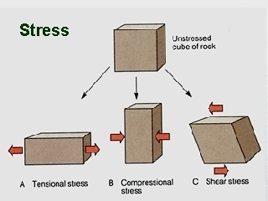

Slide 5
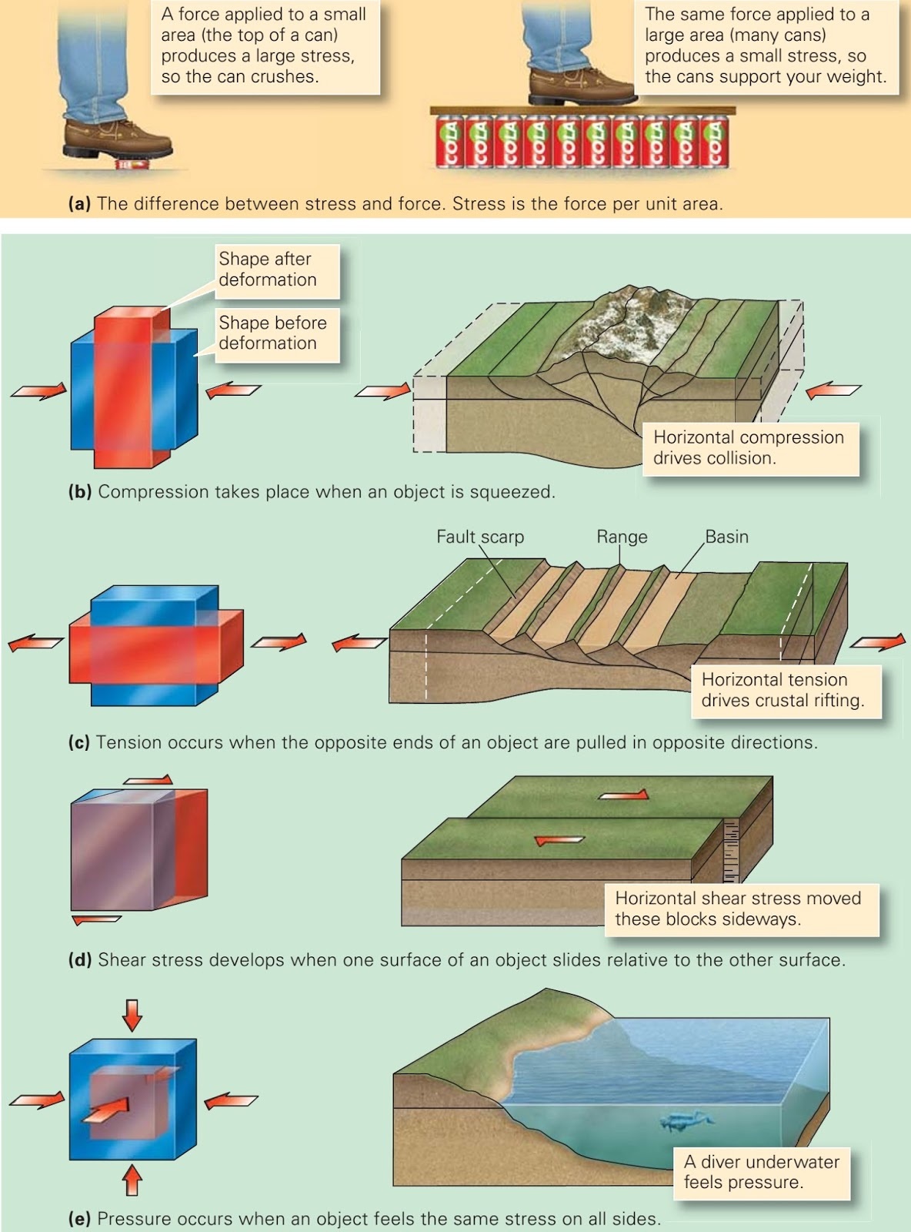

Slide 6
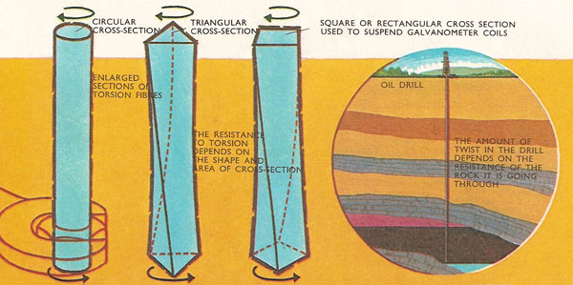

Slide 8
