Slide 1
SOIL PROFILE
Top soil layer called horizon A consists of 3 layers. A₀ is the top thin layer composed of leaf matter. A₁ is the dark layer composed of humus. A₂ is the light bleached layer (soluble material and clays are removed by downward movement of water after rainfall).
Horizon B is composed of materials leached out from the horizon A and is reddish in colour due to Iron element and has less organic matter.
Horizon C is composed of mixture of materials of B horizon and rock blocks. It has not been altered into soil.

Slide 2
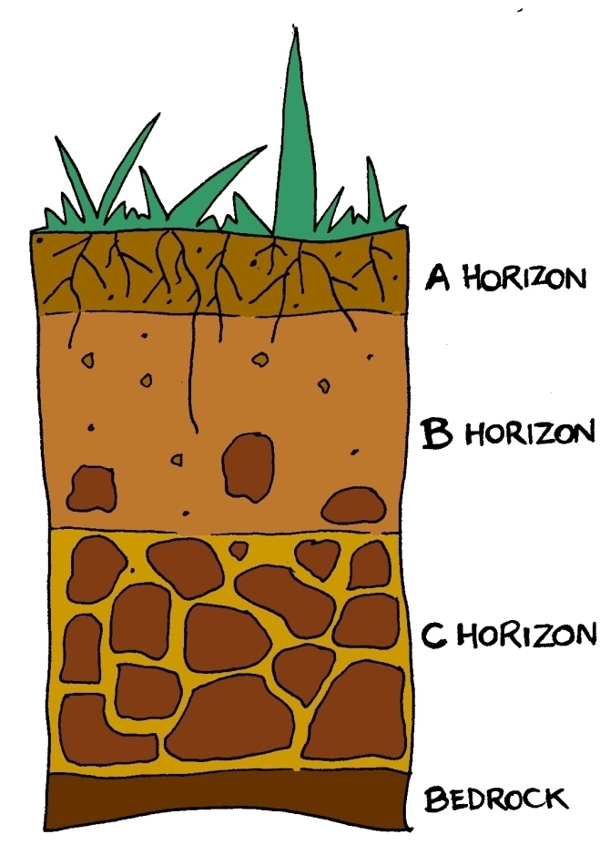

Slide 4
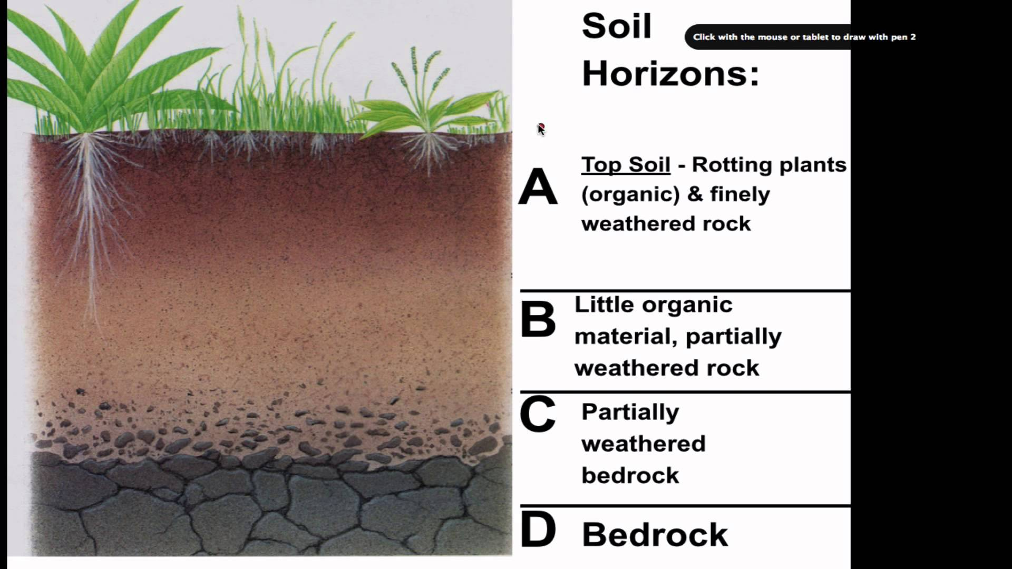

Slide 5
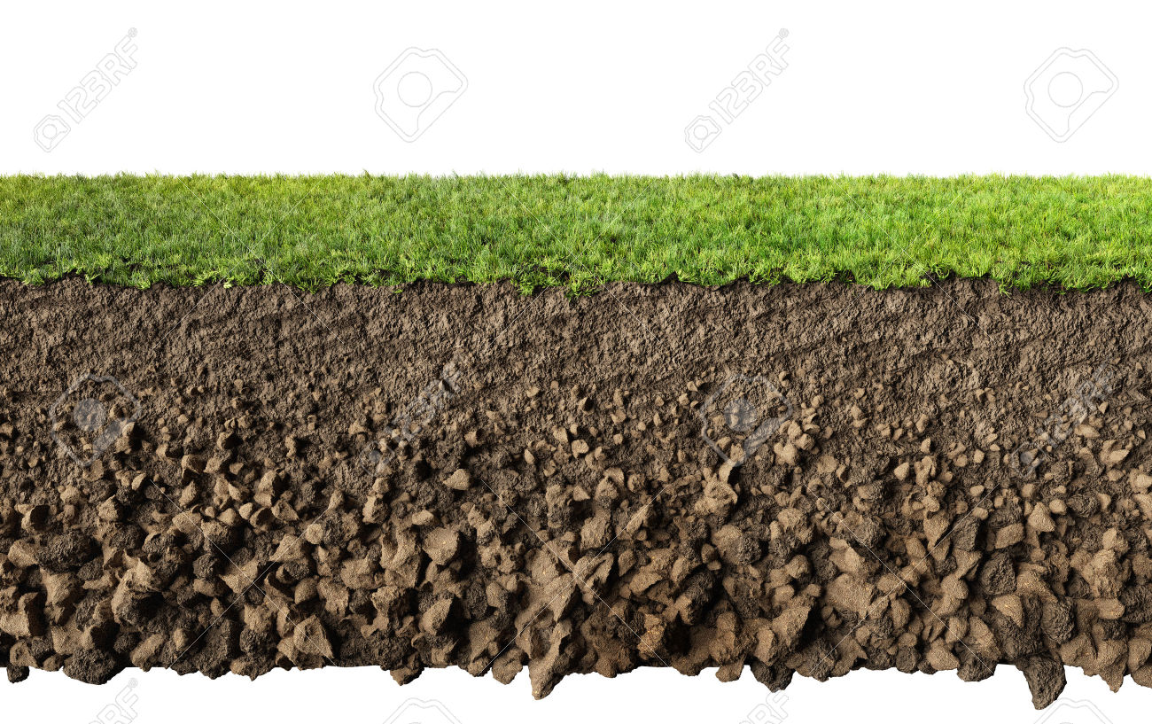

Slide 6
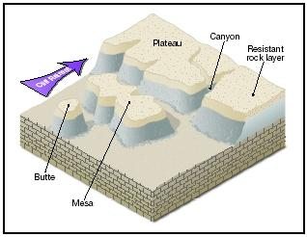
Landforms Produced by
Weathering
Mesas: Mesas are flat topped, isolated plateau like land forms produced as a result of weathering(in Britain they are called as Table Mountains).
Buttes: Buttes are similar land forms like Mesas but of smaller dimension with plat topped isolated land forms.

Slide 7
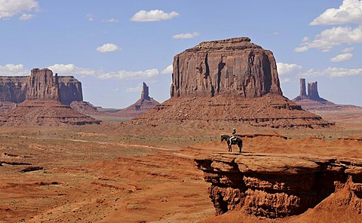
Mesa
Butte
Butte

Slide 8
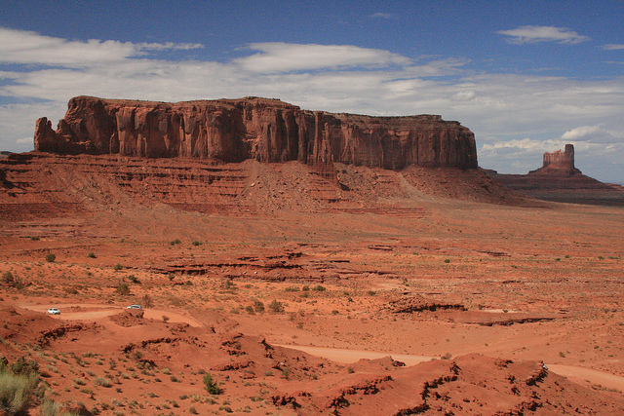
Mesa
Butte

Slide 9
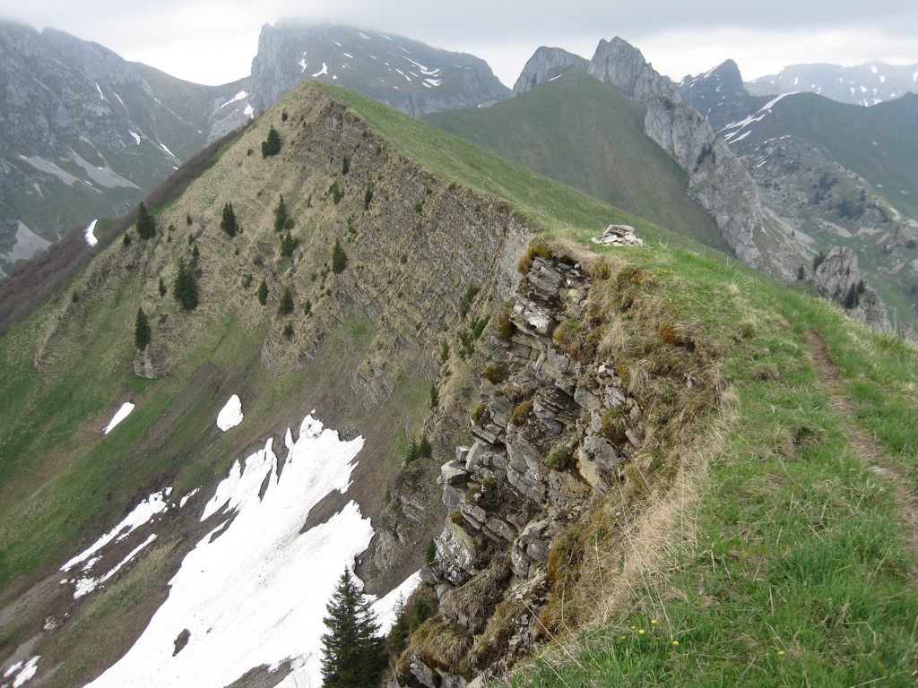
HogBack

Slide 10
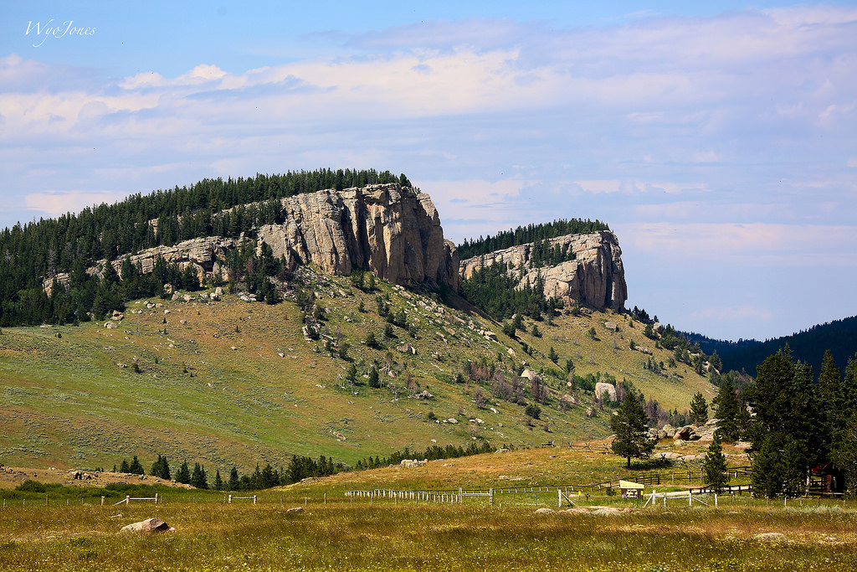
Cuetsa

