Slide 1
DANTULURI NARAYANA RAJU COLLEGE (Autonomous), BHIMAVARAM – 534 202
Department of History
Dr. B. Brahmaiah

Slide 2
Paper Title: Ancient Indian History and Culture (Earliest Times to 600 A.D.)
Brief overview of ancient Indian civilization
Importance of studying ancient history
Journey through the Cradle of Civilization
Stone Age cultures (Paleolithic, Mesolithic, Neolithic)
Important archaeological sites (e.g., Bhimbetka caves)

Slide 3
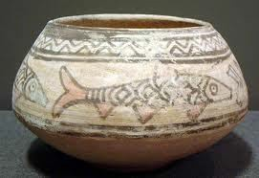
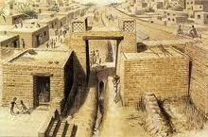



Indus valley civilization
The Big Idea
Indian civilization first developed on the Indus River.
Main Ideas
The geography of India includes high mountains, great rivers, and heavy seasonal rain.
Harappan civilization developed along the Indus River.
The Aryan invasion of India changed the region’s civilization.

Slide 4
Vedic Period (1500-600 B.C.)
Introduction to the Vedas and Vedic literature
Society and economy (varna system, tribal kingdoms)
Emergence of early Hinduism

Slide 5
Rise of Jainism
Thirthankaras and Parsvanatha
Life of Mahavira and teachings of Jainism
Ahimsa (Non-voilence) theory of Jainism

Slide 6
Buddhism ( 6th century B.C.)
Life of Siddhartha Gautama
Spread of Buddhism in India and beyond
Principles of Buddhism
Non-violence theory of Lord Buddha
Compassion towards all living beings of earth

Slide 7
Maurya Empire (322-185 B.C.)
Chandragupta Maurya and the founding of the empire
Administration under Ashoka, the Great
Legacy of Ashoka’s Dhamma and spread of Buddhism in all over world.

Slide 8
Gupta Empire (320-550 A.D.)
Chandragupta I and the establishment of Gupta rule
Achievements in science, mathematics, and literature
Cultural advancements and patronage of art
Golden age of the Gupta empire

Slide 9
Conclusion
Summary of key points covered
Legacy of ancient Indian civilization
Importance of studying ancient history

