Slide 1
D.N.R COLLEGE (A) BHIMAVARAM
DEPARTMENT OF MATHEMATICS
II B.Sc , PAPER V
LINEAR ALGEBRA

Slide 2
Linear Operators in Linear Algebra
Introduction to Linear Operators
What are Linear Operators?
A linear operator is a mapping T : V → V on a vector space V that preserves vector addition and scalar multiplication.

Slide 3
Definition and Properties
Definition and Properties
Linearity: T(av+bw)=aT(v)+bT(w) for all vectors v, w ∈ V and scalars a,b.
Examples of Linear Operators: Identity operator, zero operator, differentiation operator.

Slide 4
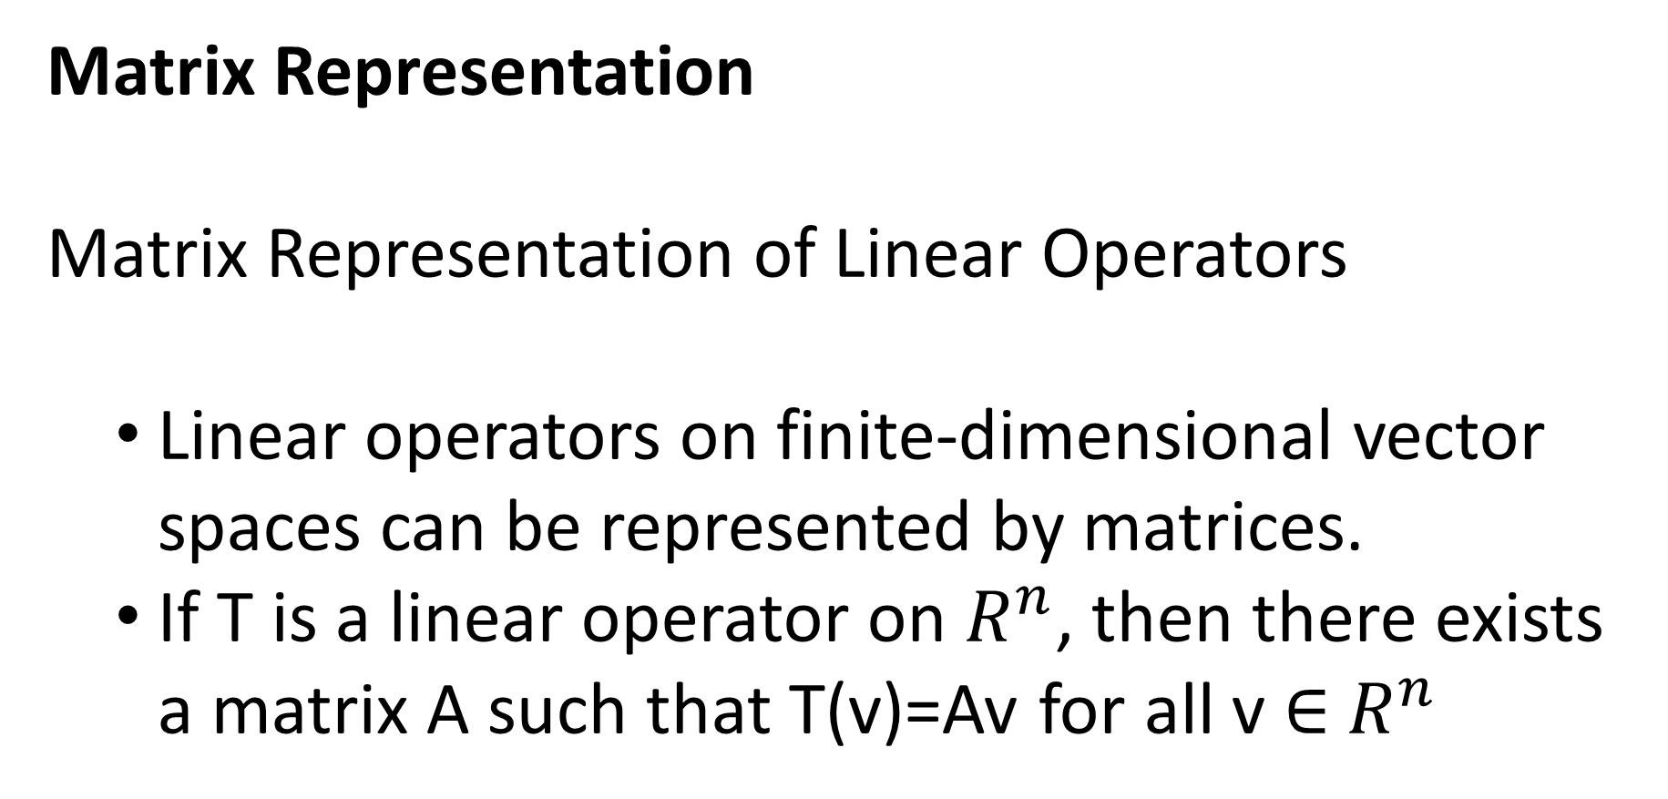
Matrix Representation
Matrix Representation of Linear Operators
  Linear operators on finite-dimensional vector spaces can be represented by matrices.
  If T is a linear operator on $R^{n}$, then there exists a matrix A such that T(v)=Av for all v ∈ $R^{n}$

Slide 5
Eigenvalues and Eigenvectors
  An eigenvector of a linear operator T is a non-zero vector v such that T(v)=λv for some scalar λ.
  λ is called the eigenvalue corresponding to v.

Slide 6
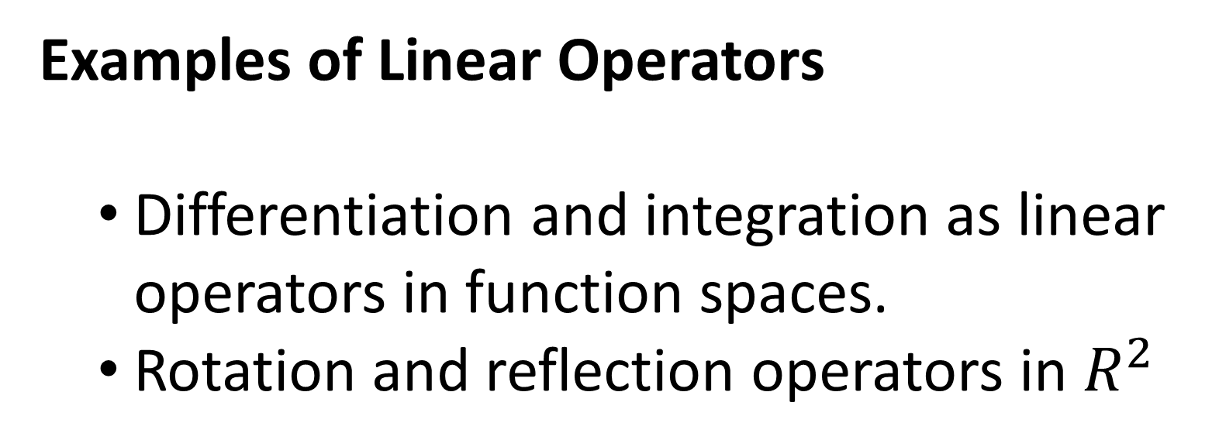
Examples of Linear Operators
  Differentiation and integration as linear operators in function spaces.
  Rotation and reflection operators in $R^{2}$

Slide 7
Applications of Linear Operators
Applications
  Quantum mechanics: Operators in Hilbert spaces.
  Computer graphics: Transformation matrices.
  Control theory: State-space representations.

Slide 8
THANK YOU

