Slide 1
D.N.R COLLEGE (A) BHIMAVARAM
DEPARTMENT OF MATHEMATICS
II B.Sc , PAPER V
LINEAR ALGEBRA

Slide 2
Orthonormal Sets in Linear Algebra
Introduction to Orthonormal Sets
What is an Orthonormal Set?
  Definition: A set of vectors in an inner product space is orthonormal if all vectors are orthogonal to each other and each vector has unit length.

Slide 3
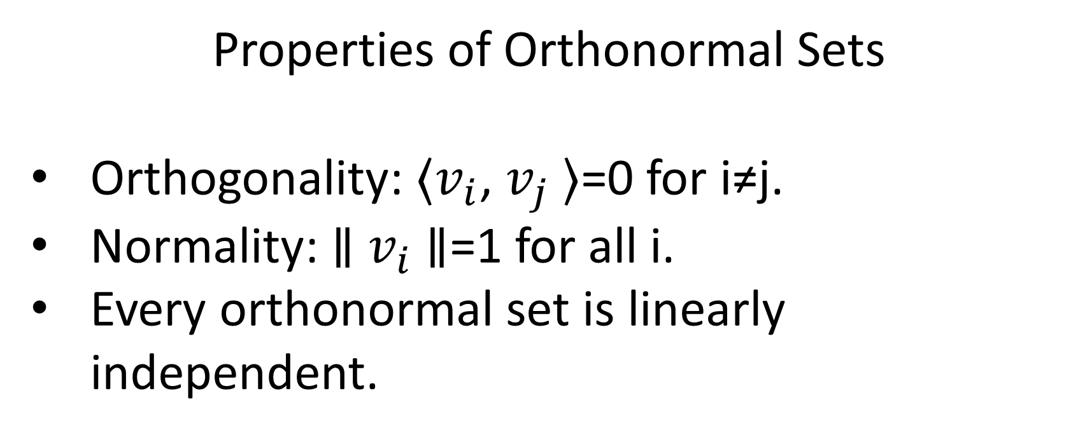
Properties of Orthonormal Sets
Orthogonality: ⟨$v_{i}$, $v_{j}$⟩=0 for i≠j.
Normality: ∥ $v_{i}$∥=1 for all i.
Every orthonormal set is linearly independent.

Slide 4
Importance of Orthonormal Sets
Simplifies calculations in inner product spaces.
Facilitates the process of finding coordinates in vector spaces.
Useful in constructing orthonormal bases.

Slide 5
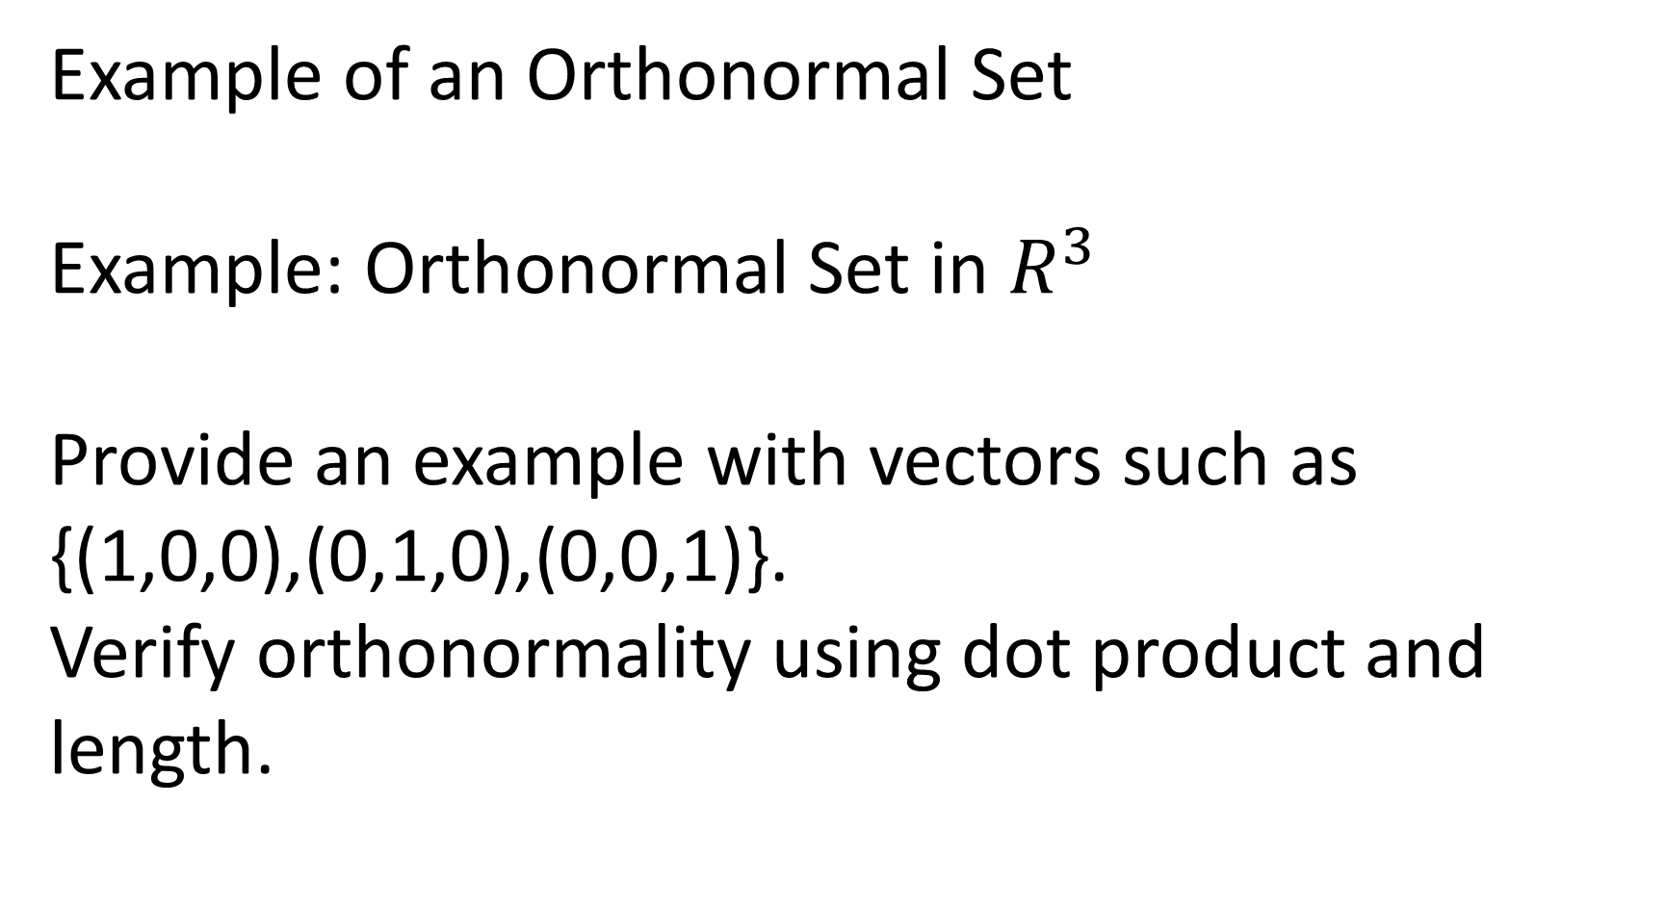
Example of an Orthonormal Set
Example: Orthonormal Set in $R^{3 }$
Provide an example with vectors such as {(1,0,0),(0,1,0),(0,0,1)}.
Verify orthonormality using dot product and length.

Slide 6
Applications of Orthonormal Sets
Fourier series and orthogonal functions.
Quantum mechanics and orthonormal bases in Hilbert spaces.
Signal processing and orthogonal waveforms.

Slide 7
Orthonormal Bases
  Definition: A basis composed of orthonormal vectors.
  Every vector in the space can be written as a linear combination of the orthonormal basis vectors.

Slide 8
THANK YOU

