Slide 1
Special Functions
Beta and Gamma Functions

Slide 2
Beta and Gamma Functions: Introduction
  Overview of special functions in mathematics
  Importance of Beta and Gamma functions

Slide 3
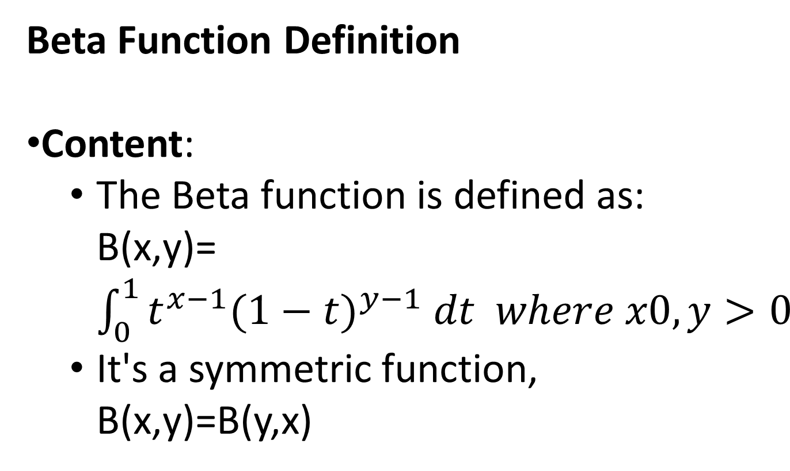
Beta Function Definition
Content:
  The Beta function is defined as: B(x,y)=$\int_{0}^{1}{t^{x−1}{(1−t)}^{y−1} dt where x0, y>0}$
  It's a symmetric function, B(x,y)=B(y,x)

Slide 4
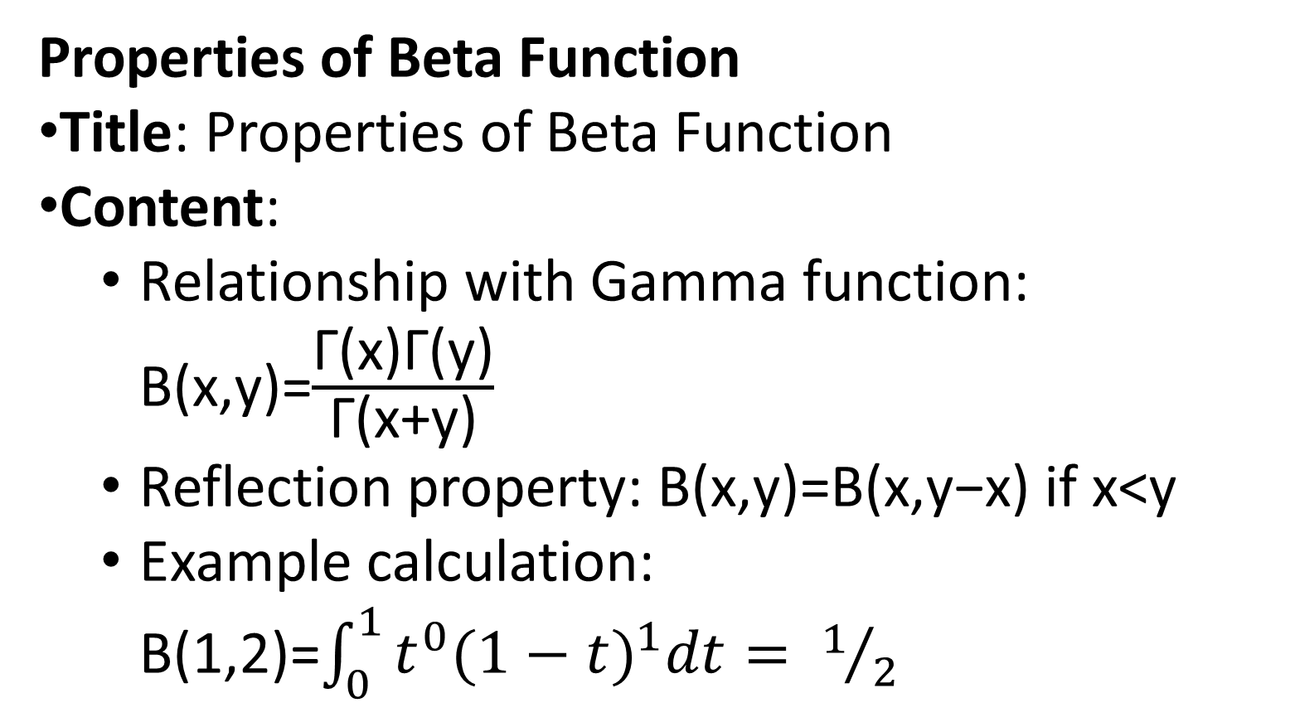
Properties of Beta Function
Title: Properties of Beta Function
Content:
  Relationship with Gamma function: B(x,y)=$\frac{\text{Γ}\text{(}\text{x}\text{)}\text{Γ}\text{(}\text{y}\text{)}}{\text{Γ}\text{(}\text{x}\text{+}\text{y}\text{)}}$​
  Reflection property: B(x,y)=B(x,y−x) if x<y
  Example calculation: B(1,2)=$\int_{0}^{1}{t^{0}{(1−t)}^{1}dt= 1/2}$​

Slide 5
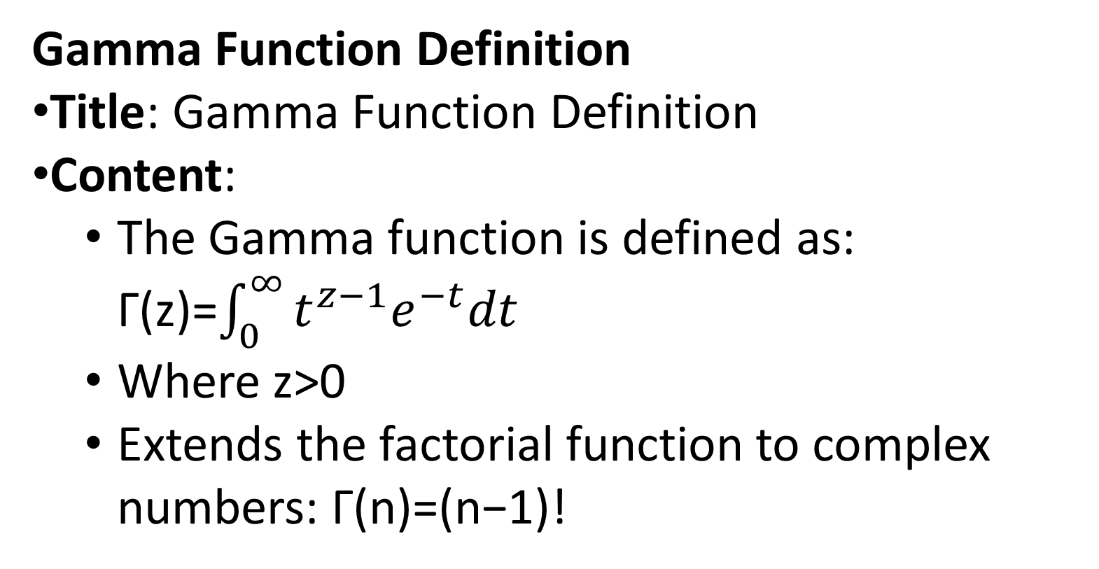
Gamma Function Definition
Title: Gamma Function Definition
Content:
  The Gamma function is defined as: Γ(z)=$\int_{0}^{∞}{t^{z−1}e^{−t}dt}$
  Where z>0
  Extends the factorial function to complex numbers: Γ(n)=(n−1)!

Slide 6
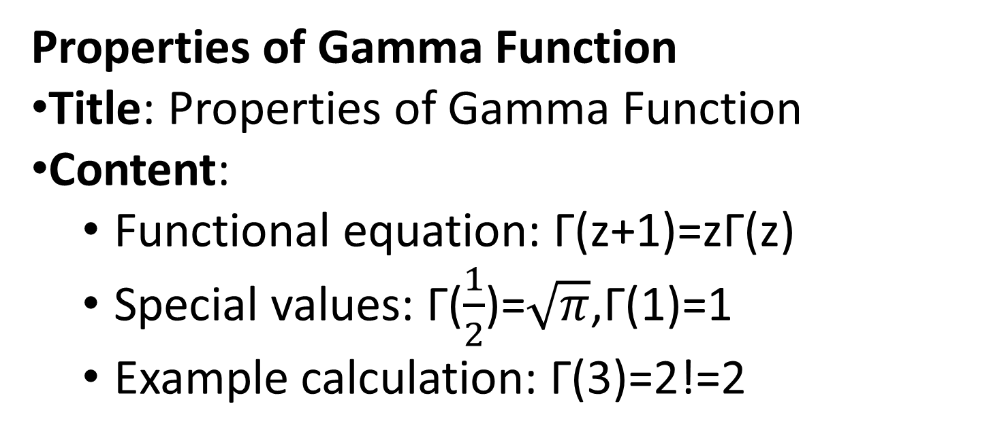
Properties of Gamma Function
Title: Properties of Gamma Function
Content:
  Functional equation: Γ(z+1)=zΓ(z)
  Special values: Γ($\frac{1}{2}$)=$\sqrt{π}$,Γ(1)=1
  Example calculation: Γ(3)=2!=2

Slide 7
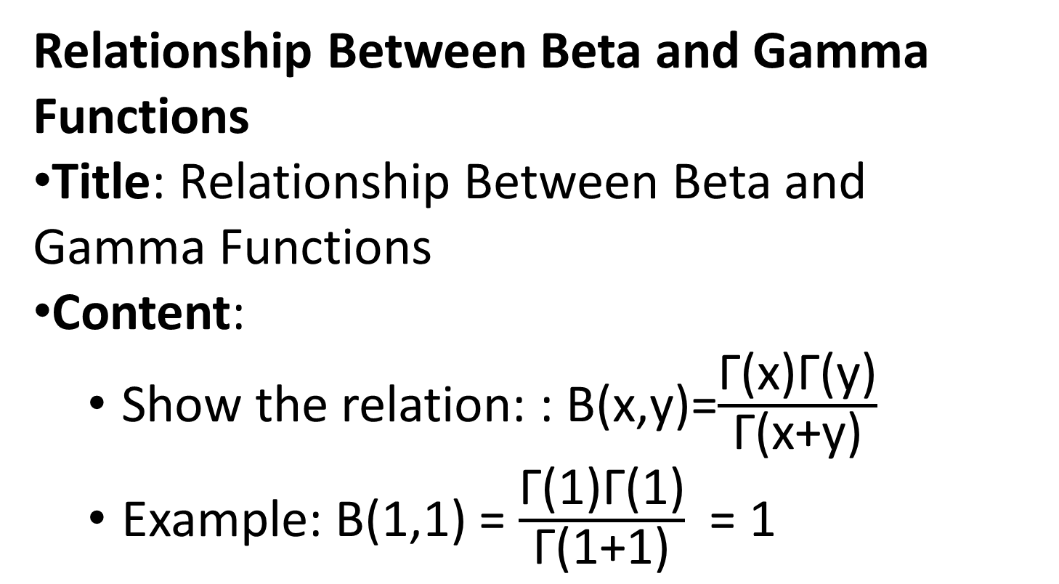
Relationship Between Beta and Gamma Functions
Title: Relationship Between Beta and Gamma Functions
Content:
  Show the relation: : B(x,y)=$\frac{\text{Γ}\text{(}\text{x}\text{)}\text{Γ}\text{(}\text{y}\text{)}}{\text{Γ}\text{(}\text{x}\text{+}\text{y}\text{)}}$ ​
  Example: B(1,1) = $\frac{\text{Γ}\text{(}\text{1}\text{)}\text{Γ}\text{(}\text{1}\text{)}}{\text{Γ}\text{(}\text{1}\text{+}\text{1}\text{)}}$ = 1

