Slide 1
Hermite Polynomials
An Introduction

Slide 2
Table of Contents
Introduction
Definition
Properties
Applications
Examples
Conclusion
References

Slide 3
Introduction
What are Hermite Polynomials?
  Classical orthogonal polynomials.
  Arise in various fields like probability, combinatorics, and physics.
  Named after the French mathematician Charles Hermite.

Slide 4
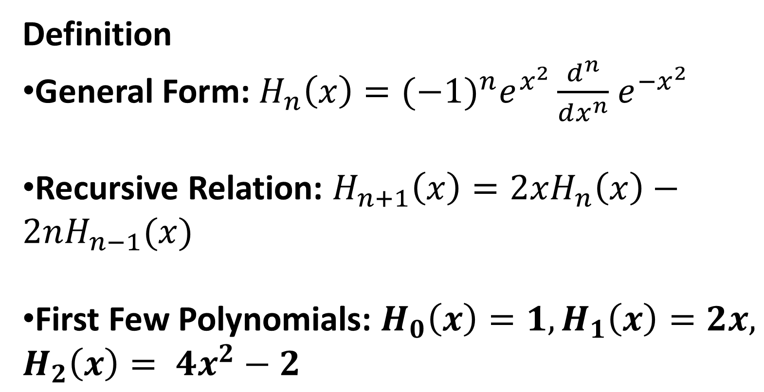
Definition
General Form: $H_{n}\left(x\right)={(−1)}^{n}e^{x^{2}}\frac{d^{n}}{dx^{n}}$ $e^{{−x}^{2}}$
Recursive Relation: $H_{n+1}\left(x\right)=2xH_{n}\left(x\right)−2nH_{n−1}(x)$
First Few Polynomials: $H_{0}\left(x\right)=1, H_{1}\left(x\right)=2x, H_{2}\left(x\right)= {4x}^{2}−2$

Slide 5
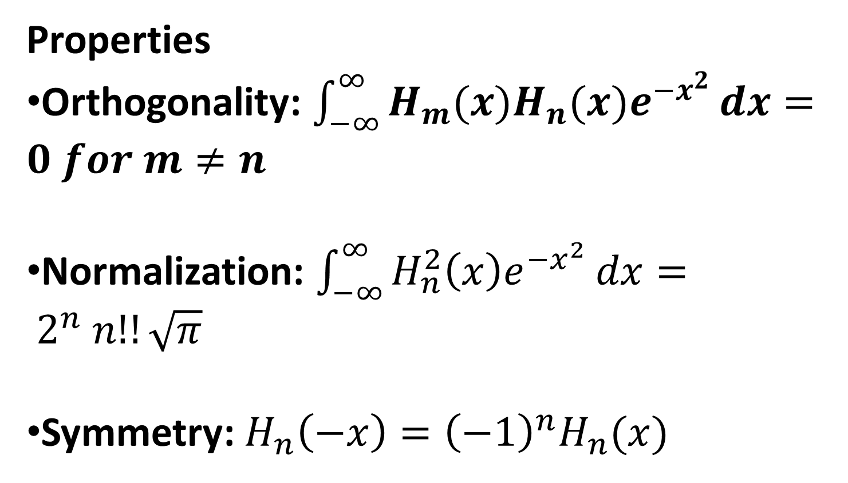
Properties
Orthogonality: $\int_{−∞}^{∞}{H_{m}(x)H_{n}(x)e^{−x^{2}}}dx=0 for m≠n$
Normalization: $\int_{−∞}^{∞}{H_{n}^{2}\left(x\right)e^{{−x}^{2}}}dx= 2^{n} n!!\sqrt{π}$
Symmetry: $H_{n}\left(−x\right)={\left(−1\right)}^{n}H_{n}(x)$

Slide 6
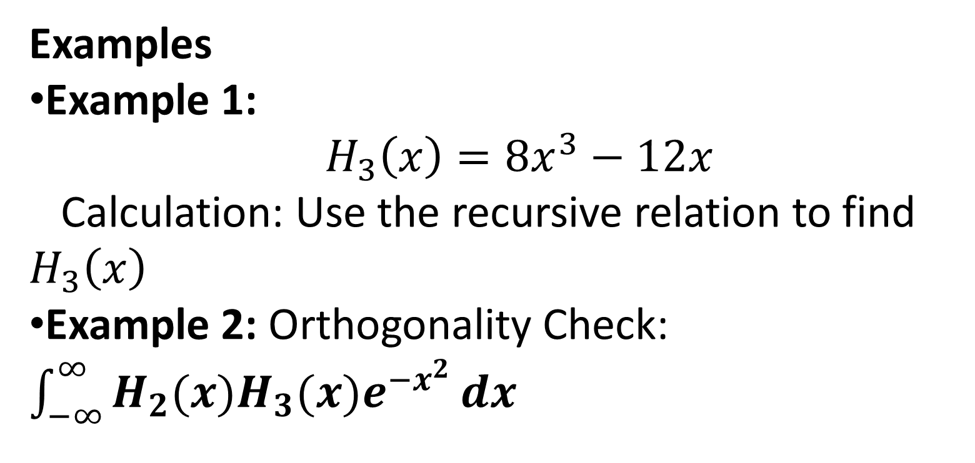
Examples
Example 1:
$H_{3}\left(x\right)=8x^{3}−12x$
Calculation: Use the recursive relation to find $H_{3}\left(x\right)$
Example 2: Orthogonality Check: $\int_{−∞}^{∞}{H_{2}(x)H_{3}(x)e^{−x^{2}}}dx$

