Slide 1
Introduction to Legendre Polynomials

Slide 2
What are Legendre Polynomials?
Definition and origin
Importance in mathematics and physics

Slide 3
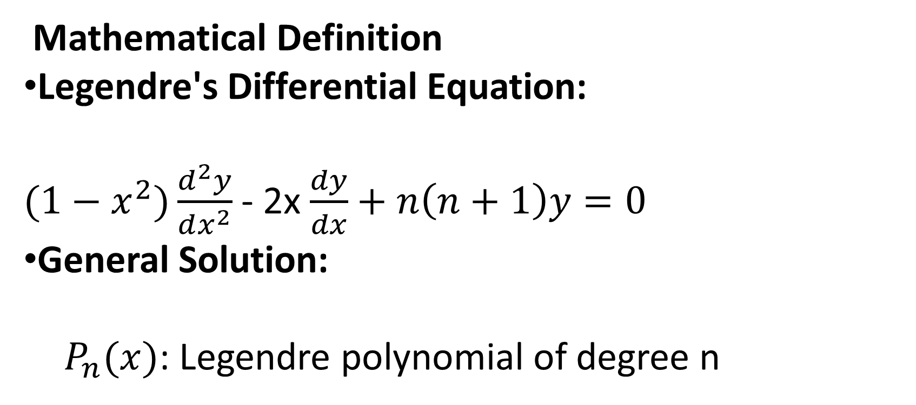
Mathematical Definition
Legendre's Differential Equation:
${(1−x}^{2})\frac{d^{2}y}{dx^{2}}$ - 2x $\frac{dy}{dx}+n\left(n+1\right)y=0$
General Solution:
  $P_{n}(x)$: Legendre polynomial of degree n

Slide 4
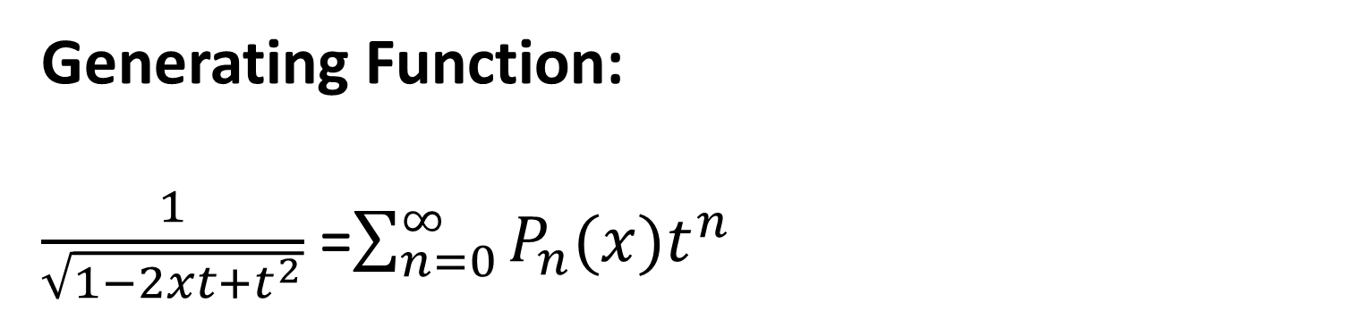
Generating Function:
$\frac{1}{\sqrt{1−2xt+t^{2}}}$ =$\sum_{n=0}^{∞}{P_{n}(x)t^{n}}$

Slide 5
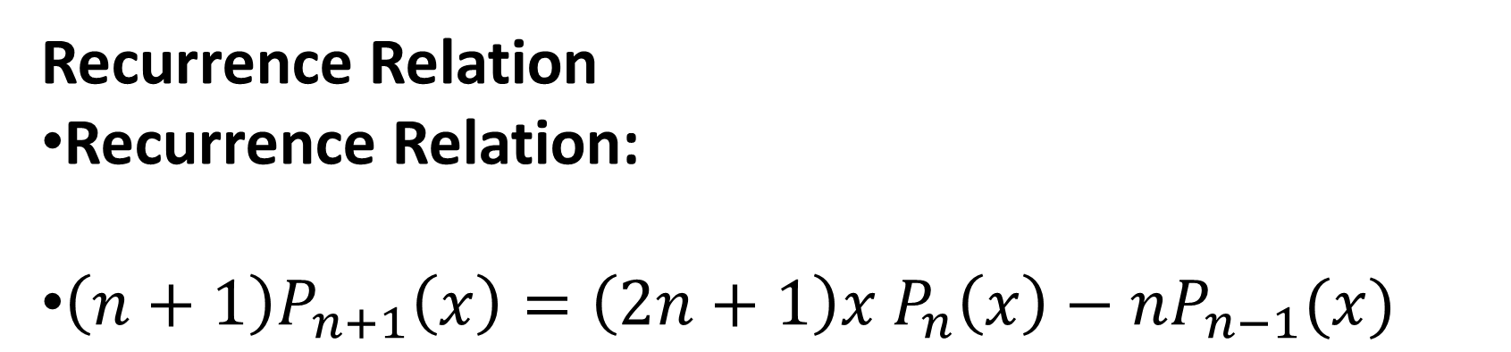
Recurrence Relation
Recurrence Relation:
$\left(n+1\right)P_{n+1}\left(x\right)=\left(2n+1\right)x$ $P_{n}\left(x\right)−nP_{n−1}(x)$

Slide 6
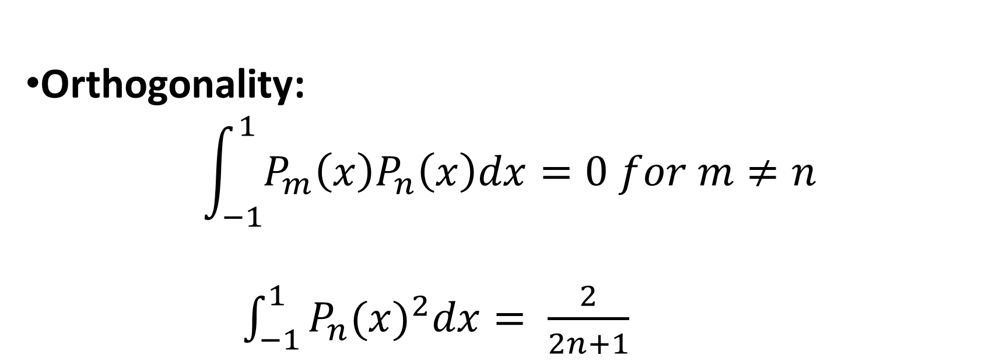
Orthogonality:
$$\int_{−1}^{1}{P_{m}\left(x\right)P_{n}\left(x\right)dx=0 for m≠n}$$
$\int_{−1}^{1}{P_{n}{(x)}^{2}dx= \frac{2}{2n+1}}$

Slide 7
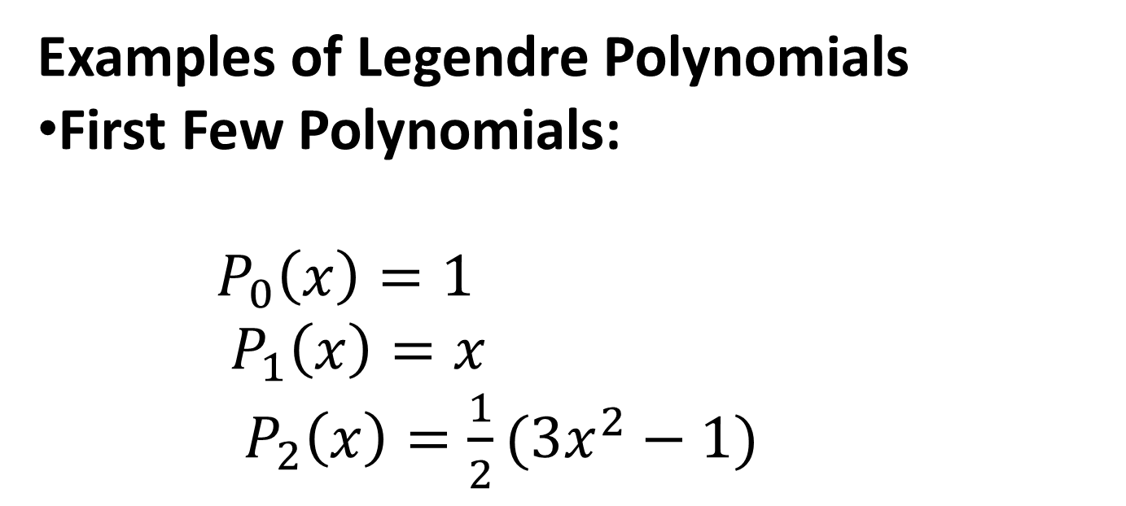
Examples of Legendre Polynomials
First Few Polynomials:
$P_{0}\left(x\right)=1$
$P_{1}\left(x\right)=x$
$P_{2}\left(x\right)=\frac{1}{2}(3x^{2}−1)$

