Slide 1
BESSEL FUNCTIONS

Slide 2
Introduction
What are Bessel Equations?
  Definition
  Historical background
  Importance in mathematics and physics

Slide 3
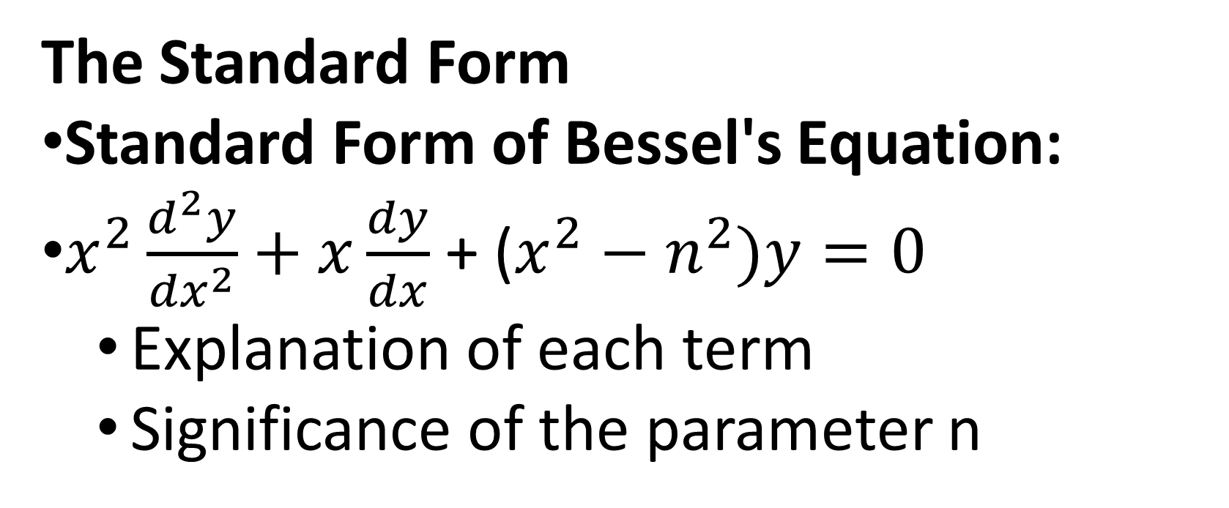
The Standard Form
Standard Form of Bessel's Equation:
$x^{2}\frac{d^{2}y}{{dx}^{2}}+x\frac{dy}{dx}$ + ($x^{2}−n^{2})y=0$
  Explanation of each term
  Significance of the parameter n

Slide 4
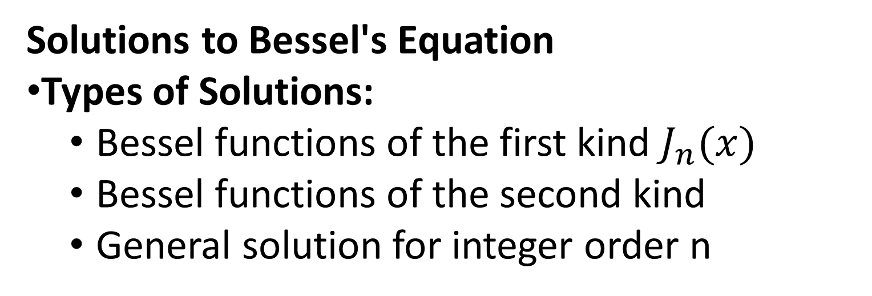
Solutions to Bessel's Equation
Types of Solutions:
  Bessel functions of the first kind $J_{n}(x)$
  Bessel functions of the second kind
  General solution for integer order n

Slide 5
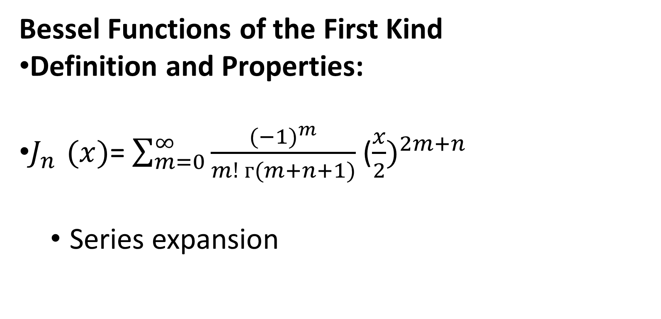
Bessel Functions of the First Kind
Definition and Properties:
$J_{n }(x)$= $\sum_{m=0}^{∞}{\frac{({−1)}^{m}}{m! ᴦ(m+n+1)}}$ (${\frac{x}{2})}^{2m+n}$
  Series expansion

Slide 6
Bessel Functions of the Second Kind
Definition and Properties:
  Relationship to first kind functions
  Series expansion

Slide 7
Generating Functions
Generating Functions:
  Definition and examples
  How they are used to derive properties of Bessel functions

Slide 8
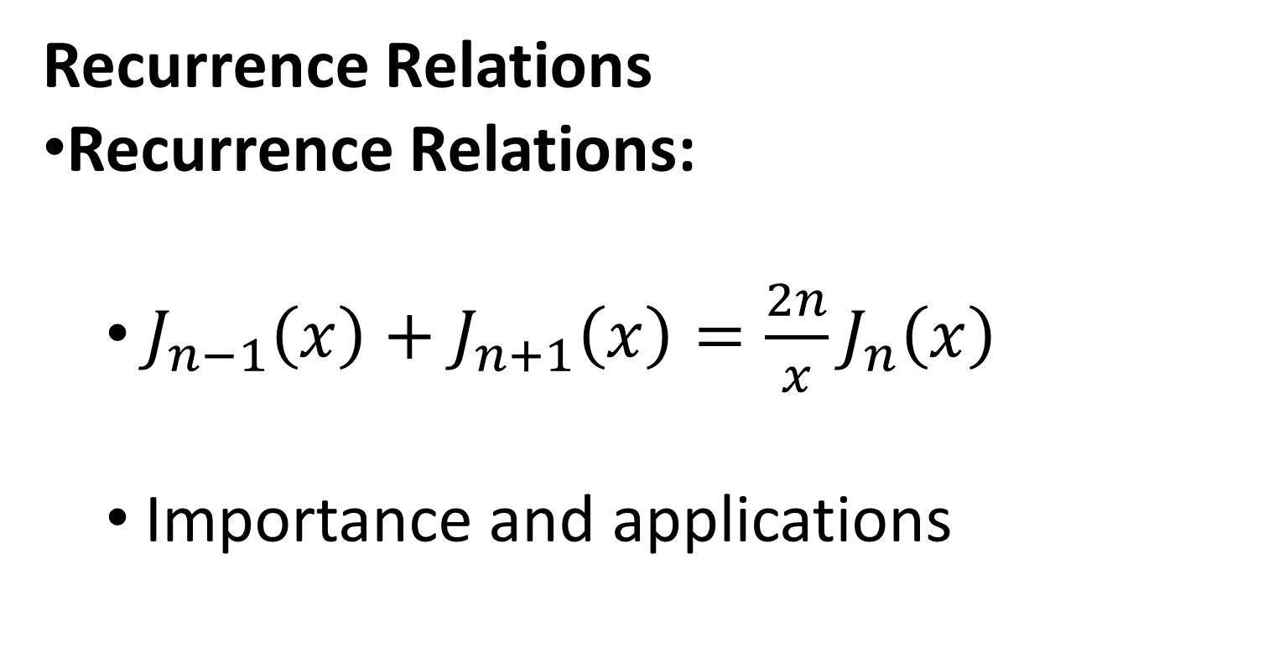
Recurrence Relations
Recurrence Relations:
  $J_{n−1}\left(x\right)+J_{n+1}\left(x\right)=\frac{2n}{x}J_{n}\left(x\right)$
  Importance and applications

