Slide 1
D.N.R COLLEGE (A),BHIMAVARAM
DEPARTMENT OF MATHEMATICS
II B.Sc PAPPER IV
REAL ANALYSIS

Slide 2
The Derivability of a Function in Real Analysis
Introduction to Differentiability
Definition of differentiability at a point
Differentiability vs. continuity: relationship and distinctions

Slide 3
Derivative of a Function
Definition of the derivative
Interpretation as the slope of the tangent line

Slide 4
Properties of Derivatives
Algebraic properties of derivatives (sum, difference, product, quotient rules)
Higher-order derivatives and their significance

Slide 5
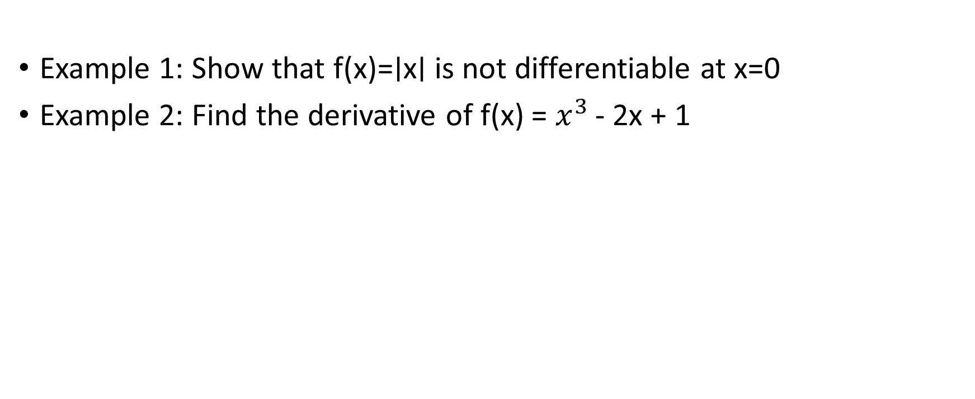
Examples of Differentiability
Example 1: Show that f(x)=∣x∣ is not differentiable at x=0
Example 2: Find the derivative of f(x) = $x^{3 }$- 2x + 1

Slide 6
THANK YOU

