Slide 1
D.N.R COLLEGE (A),BHIMAVARAM
DEPARTMENT OF MATHEMATICS
II B.Sc PAPPER IV
REAL ANALYSIS

Slide 2
Riemann Integral in Real Analysis
Introduction to Integration
Overview of integration in calculus
Importance of Riemann Integral in defining and computing areas

Slide 3
Definition of Riemann Integral
Formal definition of the Riemann Integral:
  Partition of interval [a,b]
  Riemann sum R(f,P)
  Limit as the norm of partition ∥P∥→0

Slide 4
Riemann Sums and Partition
Explanation of Riemann sums using partitions and sample points
Visual representation of partitions and their refinement

Slide 5
Properties of Riemann Integrals
Linearity of Riemann Integral
Monotonicity
Integrability of continuous and piecewise continuous functions

Slide 6
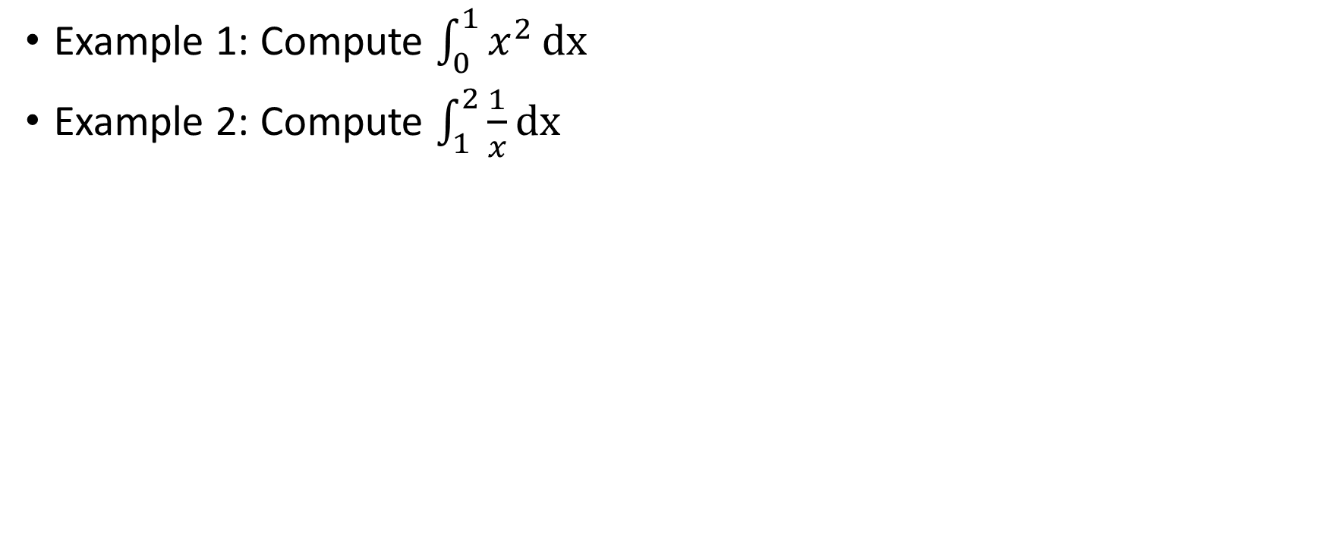
Examples of Computing Riemann Integrals
Example 1: Compute $\int_{0}^{1}{x^{2}}dx$
Example 2: Compute $\int_{1}^{2}{\frac{1}{x}}dx$

Slide 7
THANK YOU

