Slide 1
CARBOHYDRATES
U. SRAVYA
DEPARTMENT OF MICROBIOLOGY
DNR COLLEGE

Slide 2
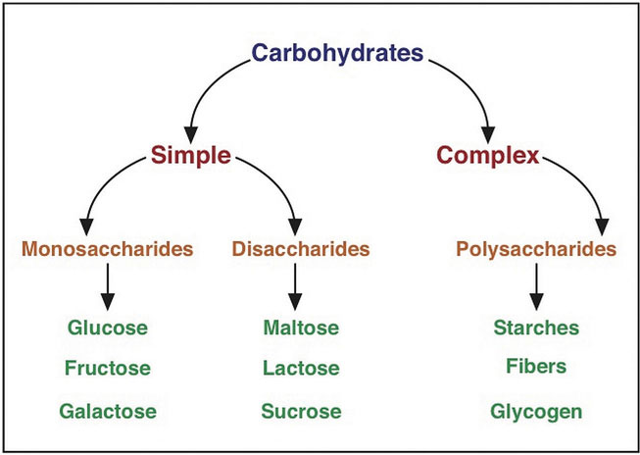
DEFINITION:
Carbohydrates are organic compounds composed of carbon, hydrogen, and oxygen atoms, typically with a hydrogen to oxygen atom ratio of 2:1, similar to that in water.
TYPES:

Slide 3
Monosaccharides:
These are the simplest form of carbohydrates, consisting of a single sugar molecule. They cannot be hydrolyzed into smaller carbohydrates. Common monosaccharides include:
Glucose: A primary source of energy for cells.
Fructose: Found in fruits and honey.
Galactose: Part of lactose, the sugar found in milk.

Slide 4
Disaccharides:
These carbohydrates are composed of two monosaccharide molecules linked by a glycosidic bond. They can be hydrolyzed into their constituent monosaccharides. Examples include:
Sucrose: Common table sugar, composed of glucose and fructose.
Lactose: The sugar in milk, composed of glucose and galactose.
Maltose: Found in malted foods and beer, composed of two glucose molecules.

Slide 5
Oligosaccharides:
These are carbohydrates that contain 3 to 10 monosaccharide units. They play various roles, including in cell recognition and signaling. Examples include:
Raffinose: Composed of galactose, glucose, and fructose, found in beans, cabbage, and other vegetables.
Stachyose: Contains two galactose units, one glucose unit, and one fructose unit, also found in beans and legumes.

Slide 6
Polysaccharides:
These are complex carbohydrates made up of long chains of monosaccharide units. They can be linear or branched and serve various functions, such as energy storage and structural support. Examples include:
Starch: The storage form of glucose in plants, found in foods like potatoes, rice, and corn.
Glycogen: The storage form of glucose in animals, primarily stored in the liver and muscles.
Cellulose: A structural component of plant cell walls, not digestible by humans but important for dietary fiber.
Chitin: Found in the exoskeletons of insects and crustaceans and the cell walls of fungi.

Slide 7
Functions of Carbohydrates:
Energy Source: Carbohydrates are the primary source of energy for the body. They are broken down into glucose, which is used by cells to produce ATP (adenosine triphosphate), the energy currency of the cell.
Energy Storage: Excess glucose is stored as glycogen in the liver and muscles. Plants store carbohydrates in the form of starch.
Structural Function: Some carbohydrates, like cellulose in plants and chitin in fungi and exoskeletons of insects, provide structural support.
Biological Recognition Processes: Carbohydrates on cell surfaces are involved in cell-cell recognition and signaling.

Slide 8
Structural Properties:
Molecular Structure:
Monosaccharides: Simple sugars with the general formula (CH₂O)ₙ, where n can range from 3 to 7. Common monosaccharides include glucose, fructose, and galactose.
Disaccharides: Formed by the linkage of two monosaccharides via a glycosidic bond. Examples include sucrose (glucose + fructose), lactose (glucose + galactose), and maltose (glucose + glucose).
Oligosaccharides: Short chains of 3-10 monosaccharides. Examples are raffinose and stachyose.
Polysaccharides: Long chains of monosaccharide units, which can be branched or unbranched. Examples include starch, glycogen, cellulose, and chitin.

Slide 9
Chemical Properties:
Reducing and Non-Reducing Sugars:
Reducing sugars: Sugars that have a free aldehyde or ketone group, which can act as reducing agents. Examples include glucose, fructose, and lactose.
Non-reducing sugars: Sugars in which the anomeric carbon is involved in a glycosidic bond, preventing the free aldehyde or ketone group from reacting. An example is sucrose.

Slide 10
Physical Properties:
Solubility:
Monosaccharides and disaccharides are generally soluble in water due to their hydroxyl groups forming hydrogen bonds with water molecules.
Polysaccharides have variable solubility. Starch and glycogen are moderately soluble, forming colloidal dispersions, while cellulose is insoluble in water due to its extensive hydrogen bonding network.
Sweetness:
Simple sugars like glucose and fructose are sweet-tasting, whereas polysaccharides are generally not sweet.
Hygroscopicity:
Carbohydrates can absorb water from the atmosphere, which is important for their role in food preservation and texture.

Slide 11
Biological Properties:
1. Energy Source:
Carbohydrates are the primary source of energy for most organisms. Glucose is especially crucial as it is the main fuel for cellular respiration.
2. Storage:
Glycogen (in animals) and starch (in plants) serve as storage forms of glucose, providing a reserve of energy that can be mobilized when needed.
3. Structural Role:
Cellulose provides structural support in plant cell walls.
Chitin is a structural component in the exoskeletons of arthropods and fungal cell walls.
4. Dietary Fiber:
Indigestible carbohydrates like cellulose contribute to dietary fiber, which aids in digestion and prevents constipation.

Slide 12
Dietary Importance:
Carbohydrates are a vital part of a balanced diet. They are found in foods like grains, fruits, vegetables, and dairy products. Dietary guidelines recommend that a significant portion of daily caloric intake comes from carbohydrates, with a focus on complex carbohydrates and fiber for sustained energy and digestive health. Reducing simple sugars can help manage weight and reduce the risk of certain health conditions like diabetes and heart disease.

