Slide 1
CLONING VECTORS
B.MOUNIKA
DEPARTMENT OF MICROBIOLOGY
DNR COLLEGE

Slide 2
INTRODUCTION
A cloning vector is a DNA molecule in which foreign DNA can be inserted or integrated and which is further capable of replicating within host cell to produce multiple clones of recombinant DNA.
Examples: Plasmids,phage or virus

Slide 3
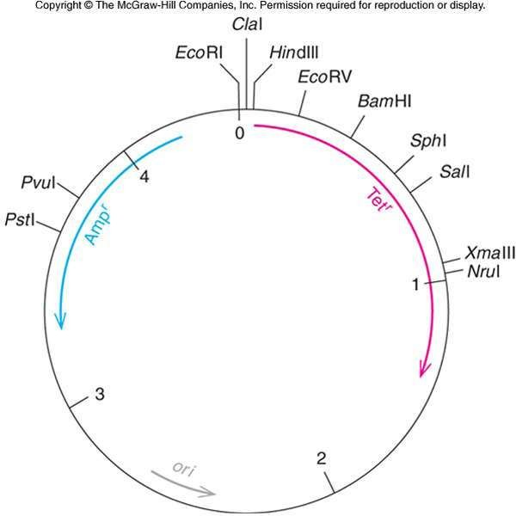
Characteristics
It should be able to replicate autonomously.
Origin of replication.
Selectable markers.
Restriction sites.
Small size.
Low molecular weight.
Easily isolated & purified.
Easily isolated into host cell.

Slide 4

Plasmid
Extra chromosomal DNA molecules.
Self replicating.
Double stranded.
Short sequence of DNA.
Circular DNA molecules.
Found in prokaryotes.
CHARACTERISTICS
a. Minimum amount of DNA.
b. Two suitable markers for identification .
C. Relaxed replication control.
D. Restriction endonuclease enzyme.

Slide 5
THREE TYPES OF PLASMID
1. Fertility plasmids:- can perform conjugation.
2. Resistance plasmids:- contain genes that build a resistance against antibiotics or poisons.
3. Col plasmids:- contain genes that code for proteins that can kill bacteria.

Slide 6
Plasmid pBR322
The pBR322 is an artificial plasmid .
Its DNA is derived from three different but naturally occurring plasmids.
The size of pBR322 is 2.9 M Da or 4363 bp.
It is isolated from E.cori strain RPI.
It contain genes that give resistance against two antibiotics, namely ampicillin(Ampᴿ) and tetracyclin(Tetᴿ).

Slide 7
The plasmid has restriction site for over 20 restriction enzymes.
Nomenclature
p =plasmid
BR = Boliver Rodriguez ( they construct them)
322 = it is number given to distinguish this plasmid from other developed in same laboratory.

Slide 8
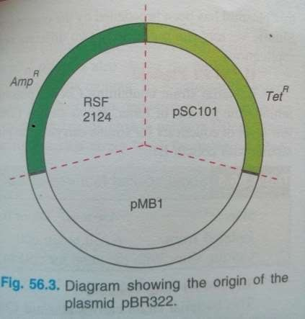
Origin of plasmid
Three different plasmid
Gene ampicilin resistance =RSF2124
Gene for tetracyclin resistance = pSC101
Origin of replication = pMB1

Slide 9
Advantage of pBR322
Most commonly used plasmid in gene cloning experiment.
It is very smaller than other natural plasmid.
Small size of it increases the uptake by bacteria during transformation.
In this plasmid 6 kb (length of foreign DNA) DNA can be inserted.

Slide 10
pUC18
pUC18 is one of a series of plasmid cloning
vectors created by Joachim Messing and co-workers.
The designation "pUC" is derived from the classical "p“ (denoting "plasmid") and the abbreviation for the University of California, where early work on the plasmid series had been conducted.
It is a circular double stranded DNA and has 2686 base pairs.
pUC19 is one of the most widely used vector molecules as the recombinants, or the cells into which foreign DNA has been introduced, can be easily distinguished from the non-recombinants based on color differences of colonies on growth media.

Slide 11
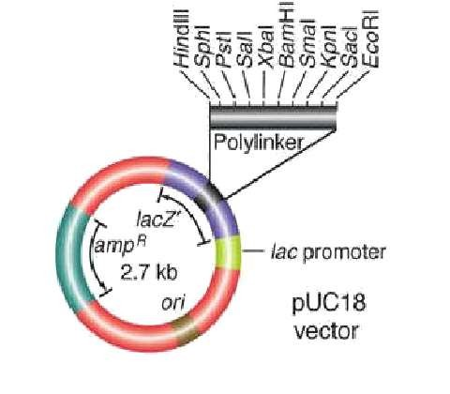
pUC18
(1) a gene for antibiotic
resistance to Ampicillin (amp^{R}), and
(2) a gene (and its promoter) for the enzyme beta-galactosidase (lacZ). The lacZ gene contains a
(3) polylinker region, with a series of unique restriction sites found nowhere else in the plasmid.
Digestion with any one of these endonucleases will make a single cut that linearizes the circular
plasmid DNA, and allow it to recombine with foreign DNA that has been cut with the same endonuclease.

Slide 12
pET21
pET - Plasmid for Expression by T7 RNA polymerase
Originally constructed by Studier and colleagues.
Size 5700 bp.
These are a family of expression vectors that utilize phage T7 promoters to regulate synthesis of cloned gene products.
Derived from the pBR322 plasmid, pET vectors engineered to take advantage of the features of the T7 bacteriophage gene that promote high-level transcription and translation.

Slide 13
pET vector expression system usually consist of-
1. Site of transcription with lac operon and gene of interest
2. Origin of replication and antibiotic resistance gene
3. lacI for production of Lac operon repressor protein
Normal function- no protein expression
(LacI protein represses transcription by blocking T7 RNA polymerase expression)
Altered function- protein expression
(IPTG binds to Lac repressor protein and expresses T7 RNA polymerase for transcription) .

Slide 14
Regulation of expression of genes cloned into pET vector
The gene for T7 RNA polymerase (gene 1) is inserted into the chromosome of E. coli and transcribed from the lac promoter; therefore, it will be expressed only if the inducer IPTG is added.
The T7 RNA polymerase will then recognise the T7 promoter on the vector and transcribe the gene cloned into the pET vector.
If the protein product of the cloned gene is toxic, it may be necessary to further reduce the transcription of the cloned gene before induction.
The T7 lysozyme encoded by a compatible plasmid, pLysS, will bind to any residual T7 RNA polymerase made in the absence of induction and inactivate it.
Also, the presence of lac operators between the T7 promoter and the cloned gene will further reduce transcription of the cloned gene in the absence of the inducer IPTG.

Slide 15
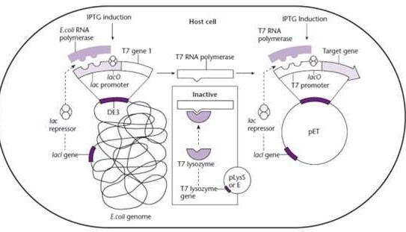

Slide 16
Bacteriophage vector
The cloning of single genes is uaually carried out using plasmid , since the insert will rarely be larger than about 2 kb.
For larger pieces of DNA this plasmid are not suitable .
large DNA molacule can be injected in host bacterial cell by viral partical. known as bacteriophage .
E.g -M13 ,f1, fd and lambda phage.

Slide 17
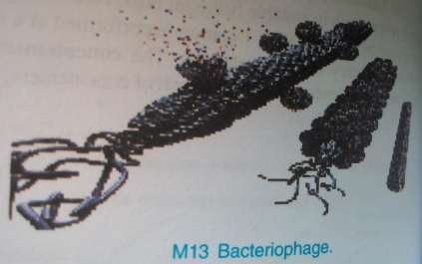
M13 Bacteriophage
M13 is a filamentous bacteriophage of E.coli.
this virion are long and thin and contain a closed loop of single stranded DNA .
Because it readily accept insert of foreign DNA and supply one strand of that DNA in isolated form

Slide 18
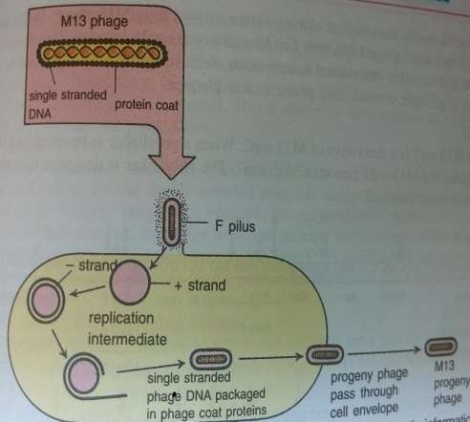
Life cycle of M13 bacteriophage
The genetic information of the virus is stored in single stranded DNA .
The virus entered E.coli
through F pillus .
The coat protein removed from DNA and viral DNA replicate by rolling circle mechanism.
Progeny single strands of DNA are packaged in new coat and extruded through the cell envelope without killing the host.

Slide 19
Phage lambda as a vector
commonly known vector .
It infect the E.coli cells .
DNA of lambda phage is 48.5 kb in length.
At its ends are the cos sites , which consist of 12 bp cohesive ends .
The cos end allow the DNA to be circularized in host cell.

Slide 20
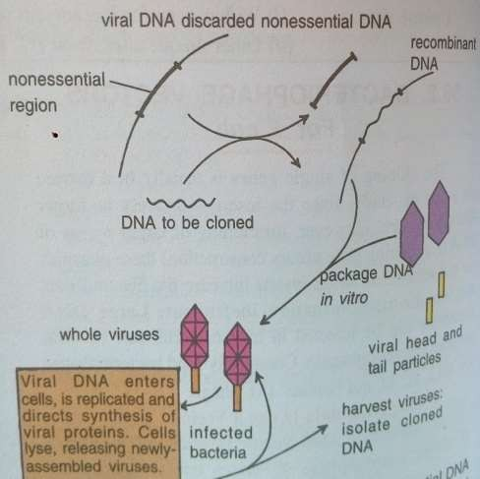
For cloning of large DNA fragments, upto 20kb , non essential lambda DNA is removed and replaced by insert.
Recombinant DNA is then packaged within viral particle .these are allowed to infect the bacterial cell.

Slide 21
Cosmids
Cosmid are hybrid DNA molecules
They combine features of both plasmid and lambda phage.
Their plasmid part enables them to replicate as it has origine of replication. Plasmid part also help in selection due to presence of marker gene.
Their lambda part (cos sequence)allow them to be packaged in a phage coat and to be transduce to a recipient by the lambda infection machinery.
It has no genes for viral protein, there fore viral particle are not formed in host.
Host cell lysis are also absent.

Slide 22
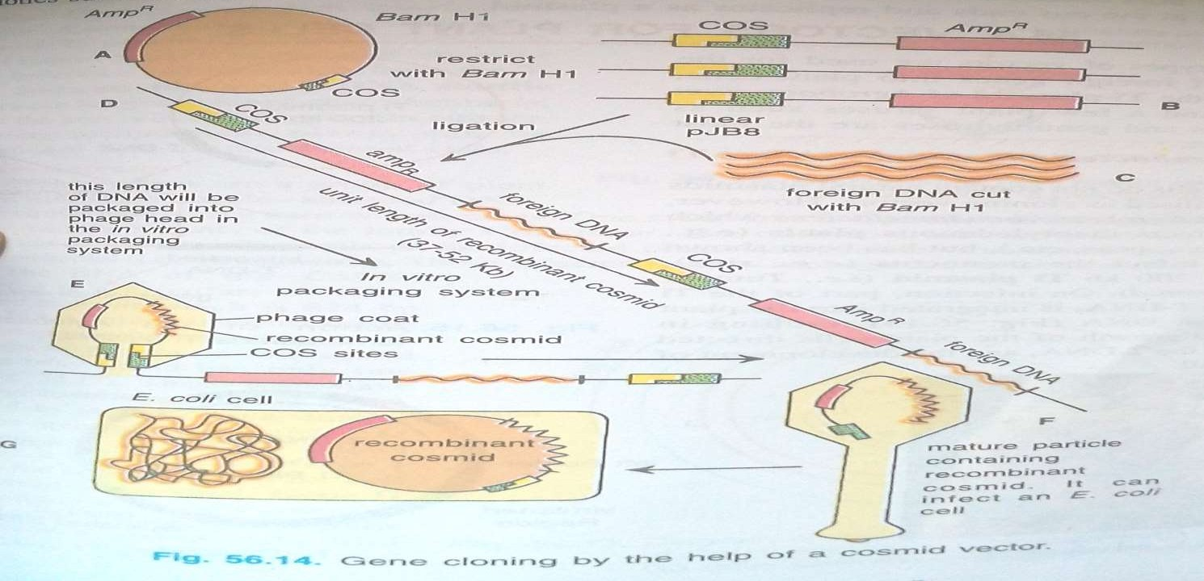

Slide 23
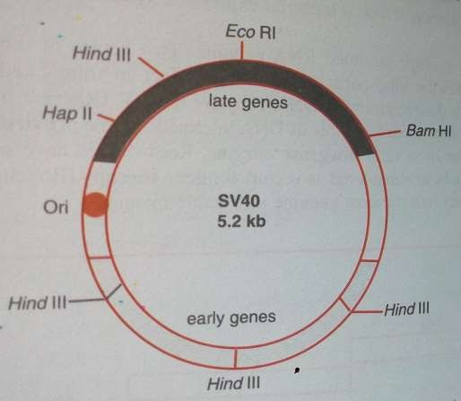
Simians virus 40 (SV40)
Cloning in mammalian cells is done by using vectors derived from certain mammalian viruses.
One such virus is simians virus 40 belonging to group of papoviruses.

Slide 24
Characteristic of SV40
spheriacal virus
Its coat protein (capsomere) are arranged in icosahedral symmetry.
Each capsomere is a 47000 kDa polypeptide.
It contain a double stranded circular DNA (5.24kb) molecule.
SV40 DNA becomes integrated into the host genome and are often amplified and
rearranged in such transformed cell’s DNA.

Slide 25
It has a replication origin and in it genes are grouped as
Early genes
Late genes
Early genes are needed for replication of DNA.
Late genes code for viral coat,viral particle adsorbs to the host cell surface and is endocytosed into the cytoplasm ,where the viral coat shed.

Slide 26
The SV40 virus has two types of life cycle.
Lytic cycle
Non lytic life cycle
The lytic cycle of SV40 takes place in permissive cells which are obtained from the african green monkey.
The non lytic life cycle of SV40 take place in non permissive cells derived from rodent .

Slide 27
Permissive and Non permissive
Host cell capable of supplying the metabolic requirement of virus replication are said to be permissive .
Host which can not provide the necessary requirement for virus replication are said to be non permissive

Slide 28
Shuttle vector
Certain vectors can replicate in different host system for example in e.coli and in yeast . Such vector are called shuttle vectors.
Shuttle vector carry diferent origin of replication which are characterised by different host system.
E.g yeast episomal plasmid are shuttle vectors.

Slide 29
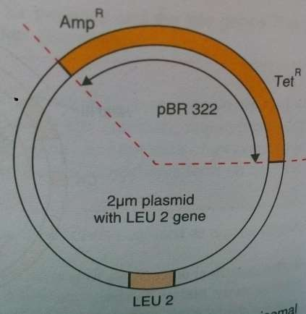
Yeast episomal plasmids
The pJDB219 ia an example of yeast episomal plasmid .
it include :-
The 2 micron plasmid
LEU 2 gene
The pBR 322

Slide 30
Expression vectors
Sometimes, the foreign gene is recipient cell may not be expressesd. This may be due to following reasons.
Transcription of the gene does not occur due to absence of an effective promoter.
The initiation codon for perticular protein is absent.
The mRNA lacks a suitable shine-dalgarno sequence .
The vector which are constructed in such a way that they contain suitable expression signals are callad expression vector.

Slide 31
A foreign gene carried by an expression vector into the recipient cell will have complete expression i.e., the gene will be transcribed into mRNA and then translated into the protein .
Two strategies used for construction of expression vector include:
Using vector which allow the synthesis of fusion protein.
Vector that can synthesize pure unfused foreign protein.

Slide 32
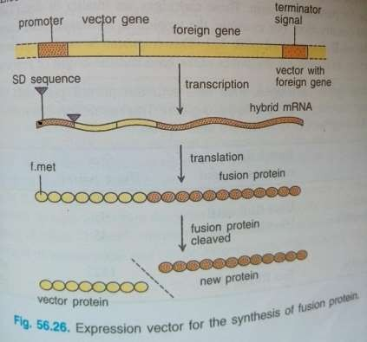
Vector for synthesis of fusion protein
The foreign gene is inserted into a vector gene in such a way that the reading frame of vector is conserved .
Results in formation of hybrid mRNA during transcription.
Transcription is initiated by the
promoter of vector gene.
The hybrid mRNA is translated to yield a hybrid protein consisting of vector and foreign protein.
Translation begins with start codon of the vector gene and ends at the stop codon of foreign gene.

Slide 33
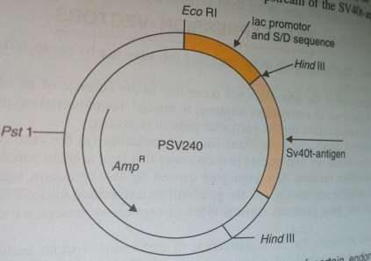
Vector for synthesis of pure unfused protein
Vector that can produce only protein that encoded by foreign gene can be constructed by linking a suitable and strong prokaryotic promoter,
A bacterial shine delgarno
sequence and
The start codon upstream of desired structural gene.
This will allow the synthesis of corresponding gene product as a pure unfused protein.

Slide 34
Artificial chromosome
Very large genomic fragments from humans and other species have been cloned in E.coli as bacterial artificial chromosome (BAC) and In S.cerevisae as yeast artificial chromosomes (YAC).
They are also called minichromosome.

Slide 35
YAC vector
The YAC vector are linear DNA segment that contain all molecular component which are required for replication in yeast .
A replication origin known as autonomously replicating sequence (ARE).
A centromere
the telomeres
DNA of several hundred kb can be introduced into YAC and successfully cloned.

Slide 36
BAC vector
BAC vector were developed to overcome one and two problem with use of YAC .
YAC accommodate very large fregment but they are unstable .
BAC are able to accommodate upto around 300-350 kb of insert sequence, less than YAC.
They are also used for speed of growth of
E.coli host and they are simpler to purify .

