Slide 1
MYCOBACTERIUM TUBERCULOSIS
M. SATYA SUMANJALI
DEPARTMENT OF MICROBIOLOGY
DNR COLLEGE

Slide 2
MYCOBACTERIUM-INTRODUCTION
Mycobacterium is a genus within the order Actinomycetales that comprises a large number of well characterised species, several of which are associated with human and animal disease such as tuberculosis and leprosy.
Aerobic bacilli -non spore forming
Non motile, rod shaped.
Cell wall-rich in lipids
Acid-fast bacilli
Very slow growing

Slide 3
CULTURE-m.tuberculosis
It includes non-selective and a selective media.
There are three general formulation that can be used for both the media they are:
Semisynthetic agar media
Inspissated egg media
Broth media

Slide 4
Mycobacterium tuberculosis
The bacterium that causes tuberculosis.
M. tuberculosis has unusually waxy walls, is slow-growing and among the most recalcitrant bacteria to treatment.
Thin straight rods-0.4x 3m.
On artificial media, coccoid and filamentous forms are seen with variable morphology from one species to another.
Cannot be classified as either gram-positive or gram-negative.
The Ziehl-Neelsen technique of staining is employed for identification of acid-fast bacteria.

Slide 5
CONSTITUENTS OF TUBERCLE BACILLI
The constituents listed below are found mainly in cell walls.
Mycobacterial cell walls can induce delayed hypersensitivity and some resistance to infection.
Lipids-mycolicacid, waxes, phosphatides
Proteins-induce tuberculin sensitivity
Polysaccharides

Slide 6
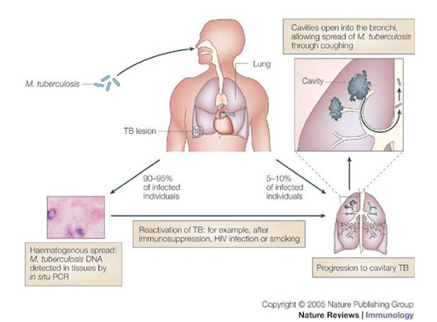

Slide 7
PRIMARY INFECTION TYPE OF TB
When a host has first contact with tubercle bacilli, the following features are usually observed:
An acute exudative lesion develops and rapidly spreads to the lymphatics and regional lymph nodes. The exudative lesion in tissue often heals rapidly.
The lymph node undergoes massive caseation, which usually calcifies.
The tuberculin test becomes positive.
This primary infection type occurred in the past, usually in childhood but now frequently in adults who have remained free from infection and therefore tuberculin-negative in early life.
In primary infections, the involvement may be in any part of the lung but is most often at the base.

Slide 8
REACTIVATION TYPE OF TB
The reactivation type is usually caused by tubercle bacilli that have survived in the primary lesion.
Reactivation tuberculosis is characterized by chronic tissue lesions, the formation of tubercles, caseation, and fibrosis.
Regional lymph nodes are only slightly involved, and they do not caseate.
The reactivation type almost always begins at the apex of the lung, where the oxygen tension (PO₂) is highest.
These differences between primary infection and reinfection or reactivation are attributed to
(1) resistance and
(2) hypersensitivity induced by the first infection.

Slide 9
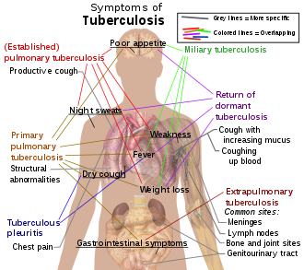

Slide 10
DIAGNOSIS
Specimens fresh sputum, gastric washings, urine, pleural fluid, cerebrospinal fluid, joint fluid, biopsy material, blood, or other suspected material.
Smears Sputum, exudates, or other material is examined for acid-fast bacilli by Ziehl-Neelsen staining.
Stains of gastric washings and urine generally are not recommended, because saprophytic mycobacteria may be present and yield a positive stain.
Fluorescence microscopy with auramine-rhodamine stain is more sensitive than acid-fast stain.
If acid-fast organisms are found in an appropriate specimen, this is presumptive evidence of mycobacterial infection.

Slide 11
TUBERCULIN TESTS
In an individual who has not had contact with mycobacteria, there is no reaction.
An individual who has had a primary infection with tubercle bacilli develops induration, edema, erythema in 24-48 hours, and, with very intense reactions, even central necrosis.
The skin test should be read in 48 or 72 hours.
It is considered positive if the injection of 5 TU[Tuberculin units] is followed by induration 10 mm or more in diameter.
Positive tests tend to persist for several days. Weak reactions may disappear more rapidly.

Slide 12
Interpretation of Tuberculin Test
A positive tuberculin test indicates that an individual has been infected in the past.
It does not imply that active disease or immunity to disease is present.
Tuberculin-positive persons are at risk of developing disease from reactivation of the primary infection, whereas tuberculin-negative persons who have never been infected are not subject to that risk, though they may become infected from an external source.

Slide 13
TREATMENT
Anti-tuberculous drugs
INAH
Rifampicin
Ethambutol
Pyrazinamide
Multi-drug resistant tuberculosis

