Slide 1
RESTRICTION ENDONUCLEASES
R.SAKUNTALA
D.N.R COLLEGE

Slide 2
What are restriction enzymes?
Molecular scissors that cut double stranded DNA molecules at specific points.
Found naturally in a wide variety of prokaryotes
An important tool for manipulating DNA.

Slide 3
Biological Role
Most bacteria use Restriction Enzymes as a defence against bacteriophages.
Restriction enzymes prevent the replication of the phage by cleaving its DNA at specific sites.
The host DNA is protected by Methylases which add methyl groups to adenine or cytosine bases within the recognition site thereby modifying the site and protecting the DNA.

Slide 4
Restriction enzymes are molecular scissors

Slide 5
History Of Restriction Enzyme
First restriction enzyme was isoltaed in 1970 by Hindll.
He also done the subsequent discovery and characterization of numerous restriction endonucleases.
From then Over 3000 restriction enzymes have been studied in detail, and more than 600 of these are available commercially and are routinely used for DNA modification and manipulation in laboratories.

Slide 6
Mechanism of Action
Restriction Endonuclease scan the length of the DNA
, binds to the DNA molecule when it recognizes a specific sequence and makes one cut in each of the sugar phosphate backbones of the double helix – by hydrolyzing the phoshphodiester bond.
Specifically,the bond between the 3’ O atom and the P atom is broken.

Slide 7
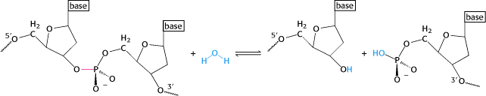
Direct hydrolysis by nucleophilic attack at the phosphorous atom
3’OH and 5’ PO₄³⁻ is produced. Mg²⁺ is required for the catalytic activity of the enzyme. It holds the water molecule in a position where it can attack the phosphoryl group and also helps polarize the water molecule towards deprotonation .

Slide 8
Palindrome Sequences
The mirror like palindrome in which the same forward and backwards are on a single strand of DNA strand, as in GTAATG
The Inverted repeat palindromes is also a sequence that reads the same forward and backwards, but the forward and backward sequences are found in complementary DNA strands (GTATAC being complementary to CATATG)
Inverted repeat palindromes are more common and have greater biological importance than mirror- like palindromes.

Slide 9
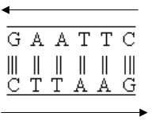

Slide 10

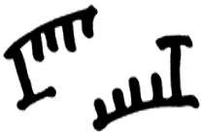
Ends Of Restriction Fragments
Blunt ends
Sticky ends

Slide 11
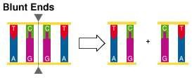
Blunt ends
Some restriction enzymes cut DNA at opposite base
They leave blunt ended DNA fragments
These blunt ended fragments can be joined to any other DNA fragment with blunt ends.
Enzymes useful for certain types of DNA cloning experiments
.

Slide 12
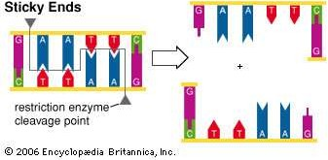
Sticky ends
Most restriction enzymes make staggered cuts
Staggered cuts produce single stranded “sticky-ends”

Slide 13
“Sticky Ends” Are Useful
DNA fragments with complimentary sticky ends can be combined to create new molecules which allows the creation and manipulation of DNA sequences from different sources.

Slide 14
ISOSCHIZOMERS & NEOSCHIZOMERS
Restriction enzymes that have the same recognition sequence as well as the same cleavage site are Isoschizomers
Restriction enzymes that have the same recognition sequence but cleave the DNA at a different site within that sequence are Neoshizomers
Eg: SmaI and XmaI C C C G G G
C C C G G G
G G G C C C
G G G C C C
Xma I
Sma I

Slide 15
NOMENCLATURE OF RESTRICTION ENZYME
Each enzyme is named after the bacterium from which it was isolated using a naming system based on bacterial genus, species and strain.
For e.g EcoRI
Derivation of the EcoRI name
Abbreviation | Meaning | Description
E | Escherichia | genus
co | coli | species
R | RY13 | strain
I | First identified | order of identification in the bacterium

Slide 16
TYPES OF RESTRICTION ENZYMES
Restriction endonucleases are categorized into three general groups.
Type I
Type II
Type III

Slide 17
These types are categorization based on:
Their composition.
Enzyme co-factor requirement.
the nature of their target sequence.
position of their DNA cleavage site relative to the target sequence.

Slide 18
Type I
Capable of both restriction and modification activities
The co factors S-Adenosyl Methionine(AdoMet), ATP, and mg+are required for their full activity
Contain:
two R(restriction) subunits two M(methylation) subunits one S(specifity) subunits
Cleave DNA at random length from recognition sites

Slide 19
Type II
These are the most commonly available and used restriction enzymes
They are composed of only one subunit.
Their recognition sites are usually undivided and palindromic and 4-8 nucleotides in length,
they recognize and cleave DNA at the same site.
They do not use ATP for their activity
they usually require only Mg2+ as a cofactor.

Slide 20
Type III
Type III restriction enzymes ) recognize two separate non-palindromic sequences that are inversely oriented.
They cut DNA about 20-30 base pairs after the recognition site.
These enzymes contain more than one subunit.
And require AdoMet and ATP cofactors for their roles in DNA methylation and restriction

Slide 21
Type IV
Cleave only normal and modified DNA (methylated, hydroxymethylated and glucosyl- hydroxymethylated bases).
Recognition sequences have not been well defined
Cleavage takes place ~30 bp away from one of the sites

Slide 22
APPLICATION OF RESTRICTION ENZYMES
They are used in gene cloning and protein expression experiments.
Restriction enzymes are used in biotechnology to cut DNA into smaller strands in order to study fragment length differences among individuals (Restriction Fragment Length Polymorphism – RFLP).
Each of these methods depends on the use of agarose gel electrophoresis for separation of the DNA fragments.

Slide 23
What is RFLP
RFLP is a difference in homologous DNA sequences that can be detected by the presence of fragments of different lengths after digestion of the DNA samples.

Slide 24
Method of DNA analysis by RFLP
The method of analysis of DNA by RFLP involves the following steps:
1- In the first step fragmentation of a sample of DNA is done by a restriction enzyme, which can recognize and cut DNA wherever a specific short sequence occurs, in a process known as a restriction digest.

Slide 25
The resulting DNA fragments are then separated by length through a process known as agarose gel electrophoresis.
Then transferred to a membrane via the Southern blot procedure.
Hybridization of the membrane to a labeled DNA probe will done and then determines the length of the fragments which are complementary to the probe.

Slide 26
5- Then we will observe the fragments of different length.
An RFLP occurs when the length of a detected fragment varies between individuals. Each fragment length is considered an allele, and can be used in genetic analysis.

