Slide 1
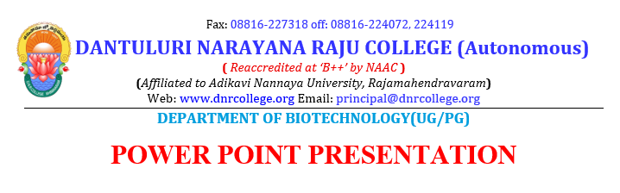
Presented By:
V RAMESH M.Phil
ASSISTANT PROFESSOR

Slide 2
Proteins

Slide 3
AMINO ACID: STRUCTURE AND CLASSIFICATION.
Amino Acids are the building units of proteins. There are about 300 amino acids occur in nature. Only 20 of them enter in proteins synthesis.
Structure of amino acids:
Four different groups are attached to α- carbon: amino group
COOH group
Hydrogen atom
and side Chain (R).

Slide 5
At physiological pH (7.4), -COOH group is dissociated forming a negatively charged carboxylate ion (COO- ) and amino group is protonated forming positively charged ion (NH3 + ) forming Zwitter ion .

Slide 6
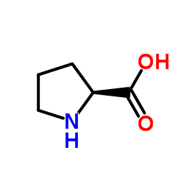
• Proline is an imino acid not amino acid .

Slide 7
Classification of Amino Acids:
I. Classification by R group
II. Chemical Classification
III. Nutritional Classification
IV. Metabolic Classification

Slide 8
Classification by R group

Slide 9
Classification according to polarity of side chain (R):
Polar amino acids: in which R contains polar hydrophilic group so can forms hydrogen bond with H2O. In those amino acids, R may contain:
OH group : as in serine, threonine and tyrosine
- SH group : as in cysteine
amide group: as in glutamine and aspargine
NH2 group or nitrogen act as a base (basic amino acids ): as lysine, arginine and histidine
COOH group (acidic amino acids): as aspartic and glutamic .

Slide 10
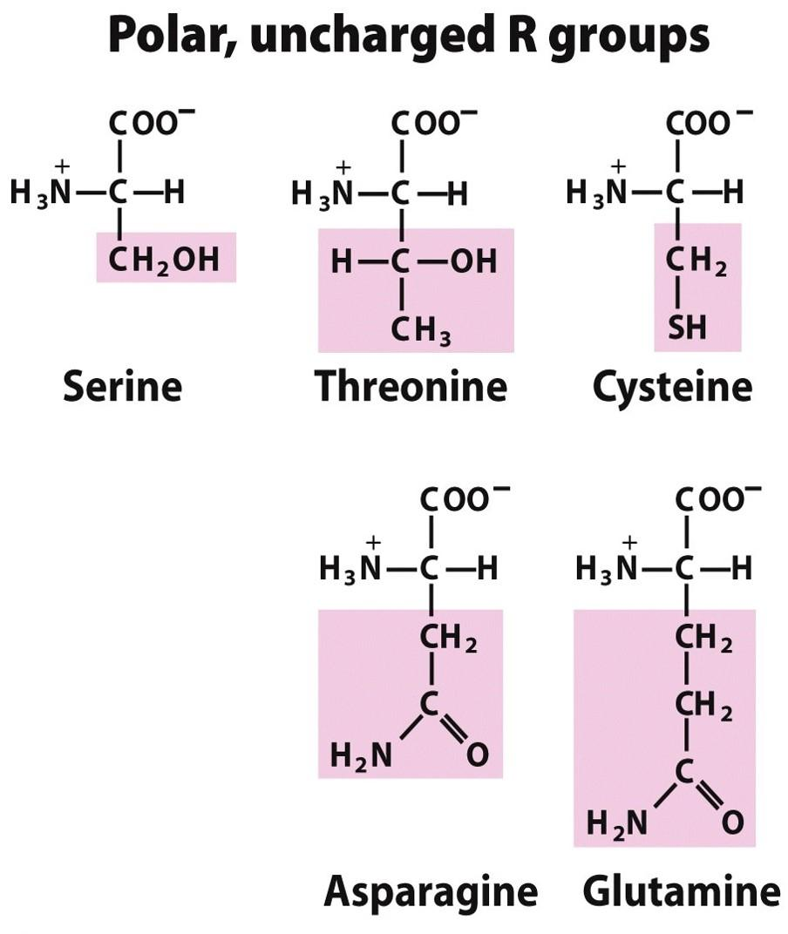

Slide 11
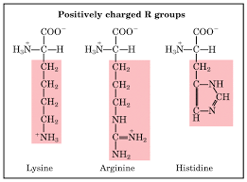

Slide 12
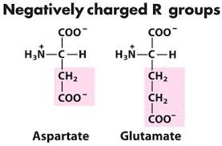

Slide 13
Non polar amino acids: R is alkyl hydrophobic group which can’t enter in hydrogen bond formation.
9 amino acids are non-polar ( glycine, alanine, valine, leucine, isoleucine, phenyl alanine, tryptophan, proline and methionine).

Slide 14
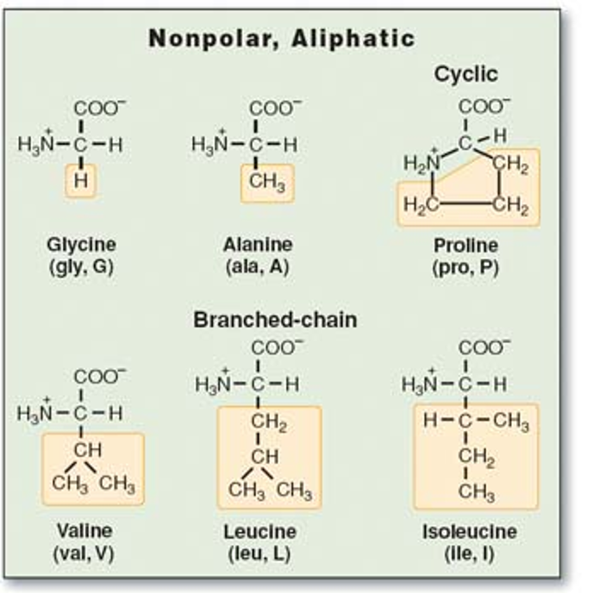

Slide 15
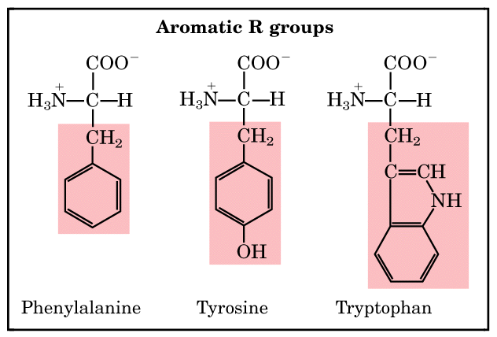

Slide 16
The twenty common amino acids are often referred to using three-letter abbreviations. The structures, names, and abbreviations for the twenty common amino acids are shown below. Note that they are all α-amino acids.

Slide 17
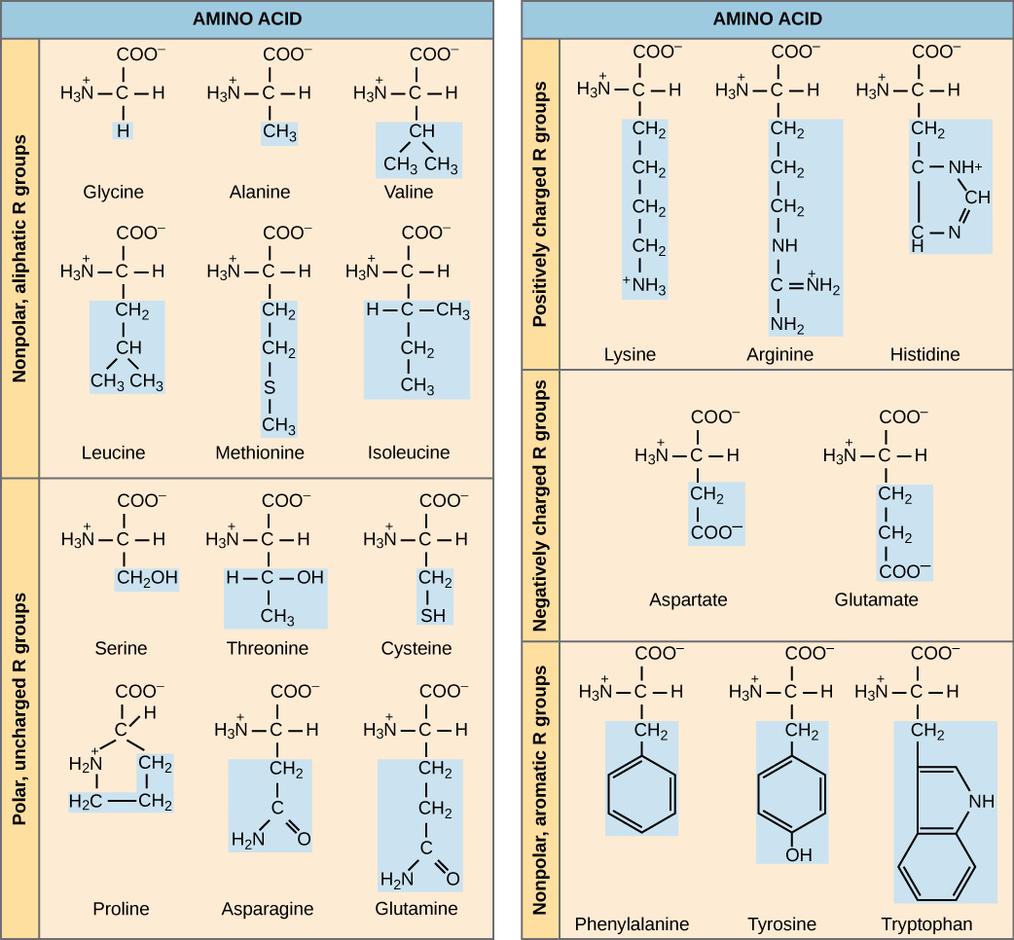

Slide 18
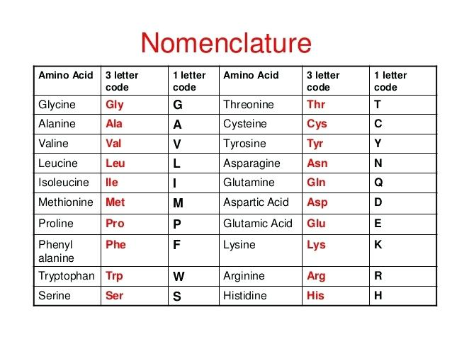
Each amino acid, aside from its name, has a three letter abbreviation and a one letter code.

Slide 19
Nutritional Classification
1- Essential Amino Acids 10 in number, Can’t be synthesized in the body, essential to be taken in diet. Their deficiency affects growth, health and protein synthesis.
2- Semi-essential formed in the body but not in sufficient amount for body requirements especially in children. Arginine and histidine are semi-essential .
3- Non-essential can be synthesized in the body.

Slide 20
Non Standard Amino Acids
> 700 non standard amino acids have been detected in living organisms. Many are metabolic intermediates eg. ornithine and citrulline are intermediates in urea biosynthesis
Amino Acid Derivatives
Chemical derivatives of amino acids also have important biological functions, eg. Catecholamines (below) lack the a-carboxylate of amino acids

Slide 21
GABA & Dopamine are neurotransmitters. Histamine mediates parts of the immune response.

Slide 22
Functions of Amino Acids
Apart from being the monomeric constituents of proteins and peptides, amino acids serve variety of functions.
(a) Some amino acids are converted to carbohydrates and are called as glucogenic amino acids.

Slide 23
(b) Specific amino acids give rise to specialised products, e.g.
• Tyrsione forms hormones such as thyroid hormones, (T3, T4), epinephrine and norepinephrine and a pigment called melanin.
• Tryptophan can synthesise a vitamin called niacin.
• Glycine, arginine and methionine synthesise creatine.

Slide 24
• Glycine and cysteine help in synthesis of Bile salts.
•Glutamate, cysteine and glycine synthesis glutathione.
• Histidine changes to histamine on decarboxylation.
• Serotonin is formed from tryptophan.
• Glycine is used for the synthesis of haem.
.

Slide 25
• Pyrimidines and purines use several amino acids for their synthesis such as aspartate and glutamine for pyrimidines and glycine, aspartic acid, Glutamine and serine for purine synthesis
c) Some amino acids such as glycine and cysteine are used as detoxicants of specific substances.
(d) Methionine acts as “active” methionine
(S-adenosylmethionine) and transfers methyl group to various substances by transmethylation.
(e) Cystine and methionine are sources of sulphur

