Slide 1
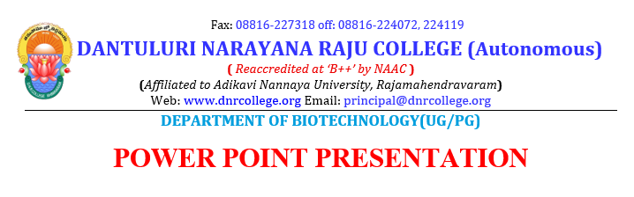
Presented By:
V RAMESH M.Phil
ASSISTANT PROFESSOR

Slide 2
Carbohydrates , one of nature’s three classes of organic compounds, the other two being fats and proteins.
carbon, hydrogen and oxygen only.
three broad categories ➔ monosaccharides, oligosaccharides and polysaccharides.
Monosaccharides cannot be further hydrolyzed.
form building blocks of more complex carbohydrates.
Oligosaccharides comprise low molecular weight polymers → disaccharides and trisaccharides and compounds with as many as ten monosaccharides.

Slide 3
Classification of carbohydrates :
I. Monosaccharides
1. Trioses, C3H6O3, e.g. dihydroxy acetone and glyceraldehydes
2. Tetroses, C4H8O4, e.g. erythrose and threose
3. Pentoses, C5H10O5, e.g. arabinose, deoxyribose, ribose and xylose
4. Hexoses, C6H12O6, e.g. galactose, glucose, fructose and mannose
II. Oligosaccharides
1. Disaccharides, C12H22O11, e.g. lactose, maltose and sucrose
2. Trisaccharides, C18H32O16, e.g. raffinose
3. Tetrasaccharides, C24H42O21, e.g. Stachyose
III. Polysaccharides
1. Pentosans, e.g., araban and xylan
2. Hexosans, e.g., cellulose, gallactan , glycogen, mannan and Starch
3. Complex polysaccharides, e.g. gums, hemicelluloses and pectins

Slide 4
Polysaccharides
carbohydrates → > 10 monosaccharide units → hydrolyzed into hundred or even thousands of monosaccharide units.
suffix –ose in sugar → changed to –ans → the corresponding polysaccharide.
Examples:
(1) Pentosans
(a) Xylans
(b) Arabans
(2) Hexosans
(a) Galactans
(b) Mannans
(c) Glucans à starch, dextrin, glycogen, cellulose, inulin
(3) Complex polysaccharides
(a) Gums
(b) Mucilages
(c) Algal polysaccharides à Alginic acid and carrageenan
(d) Bacterial polysaccharides à Xanthan gum.
(e) Pectins or pectic substances

Slide 5
Classification of polysaccharides
Different structural types
Infinite variety
Broadly classified :
homopolysaccharides and
heteropolysaccharides
1.Homopolysaccharides:
either simple linear structure or branched structures → varying complexity with > one type of inter unit linkage.
same structural units throughout.
Example- fructans, glucans (starch and glycogen), mannans etc.

Slide 6
Perfectly linear polysaccharides:
Single neutral monosaccharides structural unit ➔ only one type of linkage .
insoluble in water
can be solublized only under drastic conditions.
Also have tendency to precipitate from solution ➔ retrogradation.

Slide 7
Branched polysaccharides:
chain-chain interaction are less pronounced than linear polysaccharides .
more soluble in water
solution have lowest viscosity and lower tendency to precipitate
form sticky paste at higher concentration → due to side chain – side chain interaction.
suitable as binder or adhesives.

Slide 8
Linearly branched polysaccharides:
properties ➔ combination of perfect linear and branched polymers.
long backbone chains with short-side chain e.g., alkyl cellulose.
long backbone chain ➔ high viscosity of solution.
numerous short-side chains weakens the interaction b/w molecules ➔ good solubility and rehydration rates → stability → highly concentrated solutions.

Slide 9
Modified Polysaccharides:
physical and chemical methods can modify ➔ properties of polysaccharides ➔ products suitable for specific purposes.
Binding of neutral subsituents to linear polysaccharide chain e.g. hydroxypropyl cellulose ➔ increased solubility, viscosity and stability of solutions.
Binding acid groups (carboxymethyl, sulphate groups) ➔ increased solubility and viscosity.

Slide 10
2. Heteropolysaccharides:
two or more types of monomer units.
Example: glucomannans, arabinoxylans
can be linear or branched to varying degrees with different types of branch points.
Typical sugar units found in polysaccharides are :
  D- Fructose (Fru)
  D-Galactose (Gal A)
  D-Galacturonic acid (Gal A)
  D-Glucose (Glu)
  D-Glucuronic acid (Glu A)
  D-mannose (Man)
  D-Mannuronic acid (Man A)
  D-Xylose (Xyl)
  L-Rhamnose (Rha)
  L-Arabinose (Ara)

Slide 11
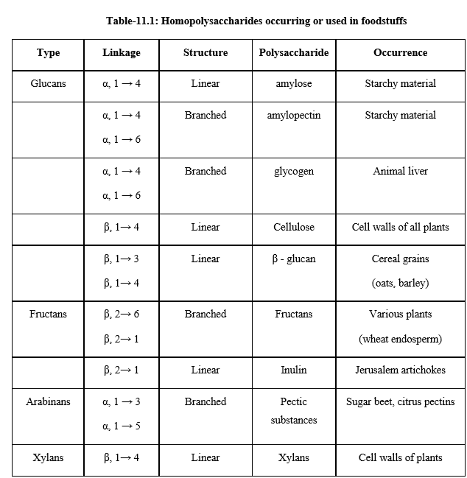

Slide 12
