Slide 2
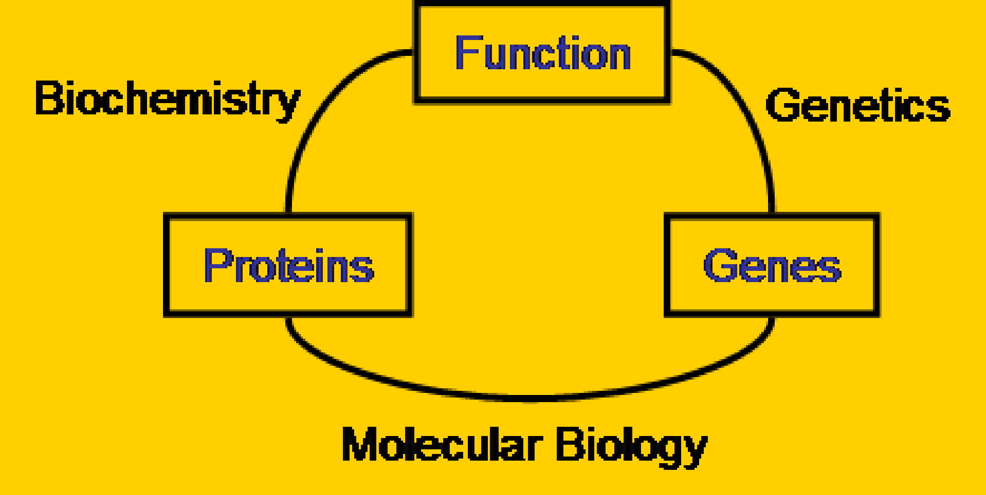

Slide 3
The Central Dogma

Slide 4
Molecular Biology (Continued)
Chapter 6: DNA mutation, damage, and repair
Chapter 7: Gene regulation in prokaryotes Chapter 8: Gene regulation in eukaryotes Chapter 9: Techniques in molecular biology
Textbook: Watson et al.
Molecular Biology of the Gene, 5th ed., 2004

Slide 5
CHAPTER 6: DNA Mutation, damage, and Repair
Mutation refers to any heritable change in the base sequence of a DNA molecule.
Mutagen is a physical or chemical agent that causes mutations to occur (or increase the frequency of their occurrence).
Mutagenesis is the process of producing a mutation.
3学时，April 28 & May 5

Slide 6
Life and biodiversity depend on the balance between mutation and its repair
If the mutation rates are too high, the species or the individual would be destroyed.
If there is no mutation, evolution would not go on and new species, including humans, would not have arisen.

Slide 7
Important sources for mutation
Inaccuracy in DNA replication: Errors
Damage to the genetic material (spontaneously or assaulted by chemical agents and radiation)
Insertions generated by transposition (Chapter 5)

Slide 8
Part 1: Replication errors and their repair

Slide 9
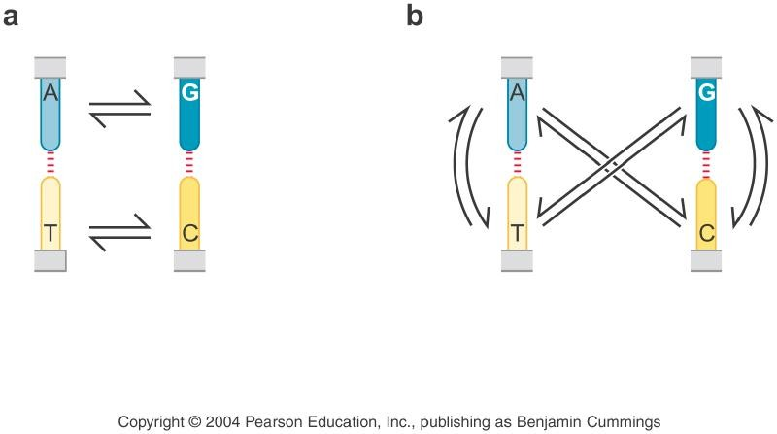
The nature of mutations
1. Point mutations
a. Transitions 转换 (pyrimidine to pyrimidine, purine to purine)
b. Transversions 颠换 (pyrimidine to purine, purine to pyrimidine)
Figure 6-1 Switches of one base for another

Slide 10
The nature of mutations (continued)
Insertions
Deletions
Gross rearrangement of chromosome.
These mutations might be caused by insertion by transposon or by aberrant action of cellular recombination processes.

Slide 11
Rate of spontaneous mutation at any given site on chromosome ranges from 10⁻⁶ to 10⁻¹¹ per round of DNA replication, with some sites where mutations arise at high or low frequency.
Some mutation-prone sequences in human genome are repeats of simple di-, tri- or tetranucleotide sequences (e.g., the CA repeats), known as DNA microsatellites. These sequences (1) are important in human genetics and disease, (2) hard to be copied accurately during replication and highly polymorphic in the population.

Slide 12
Some replication errors escape proofreading
The proofreading 3’-5’ exonuclease activity of replisome, which removes wrongly incorporated nucleotides, improves the fidelity of DNA replication by about 100- fold.
Some mis-incorporated nucleotides escape detection and become a mismatch between the newly synthesized strand and the template strand. If the mismatch is not repaired, it will result in a mutation.

Slide 13
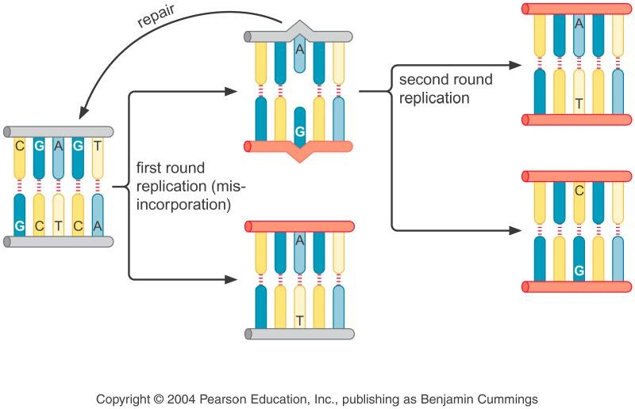
Second Round
First Round
(Mis-incorporation)
Figure 6-2 Generation of Mutation During Replication

Slide 14
Mismatch repair removes errors that escape proofreading
Increase the accuracy of DNA synthesis by 2-3 orders of magnitude.
Two challenges: (1)rapidly find the mismatches/mispairs, (2) accurately correct the mismatch

Slide 15
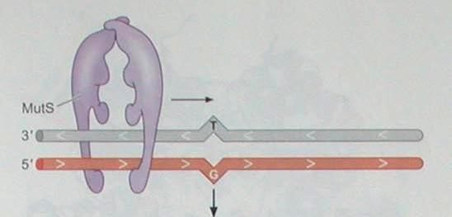
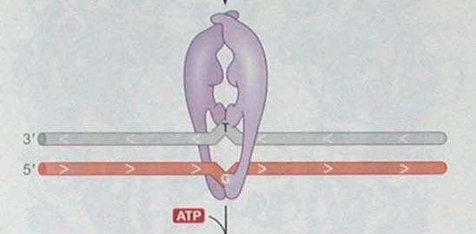
In E. coli, a dimer of mismatch repair protein MutS scans the DNA, recognizing the mismatch from the distortion they cause in the DNA backbone
MutS embraces the mismatch-containing DNA, inducing a pronounced twist in the DNA and a conformational change in MutS itself
MutS
Figure 6-3 Detection of mismatch by MutS

Slide 16
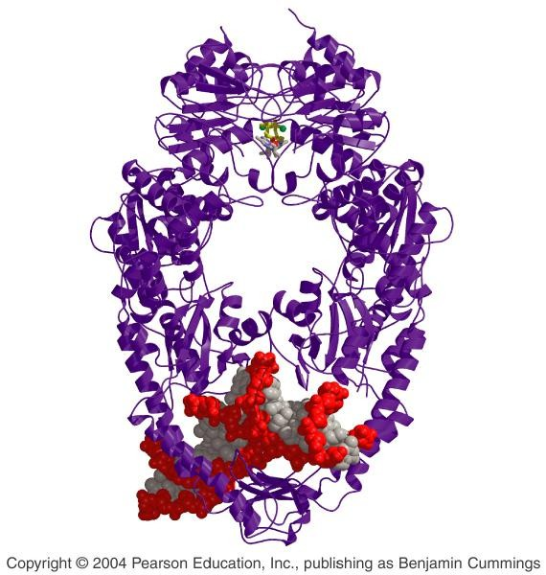
MutS is a dimer
Figure 6-4 Crystal structure of MutS

Slide 17
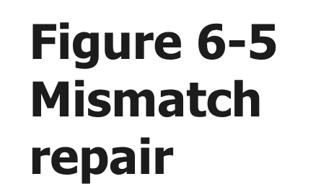
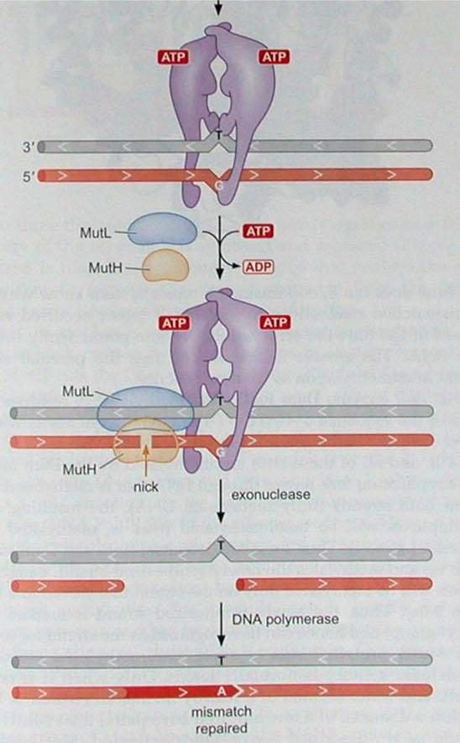
Figure 6-5 Mismatch repair
T
G
MutL
MutH
MutL
T G
MutH
nick
Exonuclease
Helicase (UrvD) _{T}
DNA polymerase III
Sealed with DNA ligase
T A
Mismatch repaired

Slide 18
How does the mismatch repair system know which of the two mismatched nucleotides to replace?
Unlike the template, the newly synthesized strand is not methylated by Dam methylase until a few minutes after the synthesis.

Slide 19
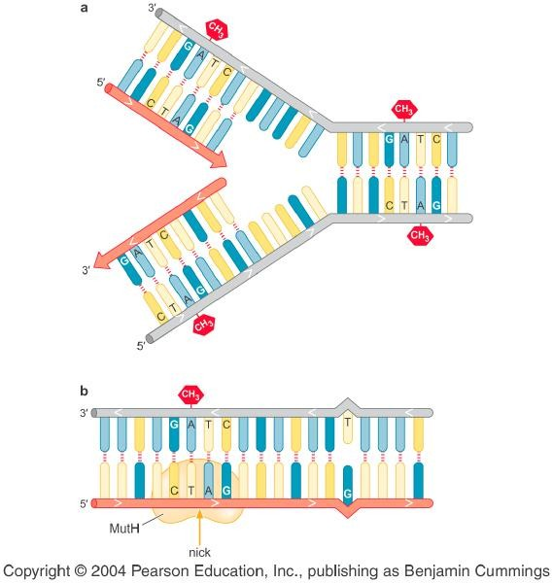
CH3
CH3
CH3
CH3
CH3
MutH
nick
Figure 6-6 Dam methylation at replication fork

Slide 20
Summary for the mismatch repair pathway
MutS embraces the mismatch-containing DNA, and then recruits MutL, which in turn activates MutH.
MutH is an enzyme causing an incision or nick on the unmethylated, newly synthesized strand near the site of the mismatch.
Nicking is followed by the action of a specific helicase (UrvD), which unwinds the DNA, and one of three exonucleases.
The gap is filled by Pol III and sealed with DNA ligase

Slide 21
Eukaryotic cells also repair mismatches using homologs to MutS (MSH) and MutL (MLH). But, they lack MutH,
which creates the nick, and E. coli’s hemimethylation, which mark the newly synthesized strand.

Slide 22
Part 2: DNA damage
DNA damage can be caused by environmental mutagens, but can also result from the action of water.

Slide 23
DNA undergoes damage spontaneously from hydrolysis, such as deamination (most frequently) and depurination.

Slide 24
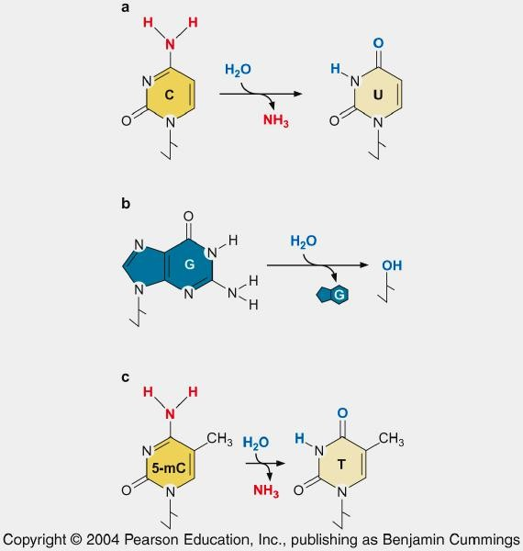
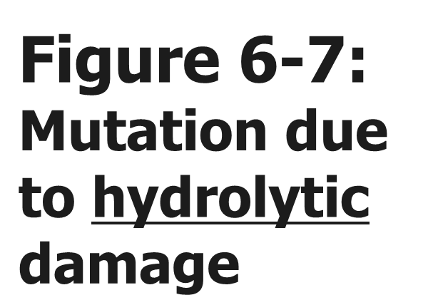
Deamination C→U
Figure 6-7: Mutation due to hydrolytic damage
Apurinic deoxyribose
Deamination 5-mC → T

Slide 25
The presence of U and apurinic deoxyribose in DNA resulted from hydrolytic reactions is regarded as unnatural, and thus is easily recognized and repaired.
Vertebrate DNA frequently contains 5-methyl cytosine in place of cytosine as a result of the action of methyl transferase. This modified base plays a role in the transcriptional silencing.
第二节
5-mC → T, which can not be recognized as an abnormal base. So, methylated Cs are hotspots for mutations in vertebrate DNA.

Slide 26
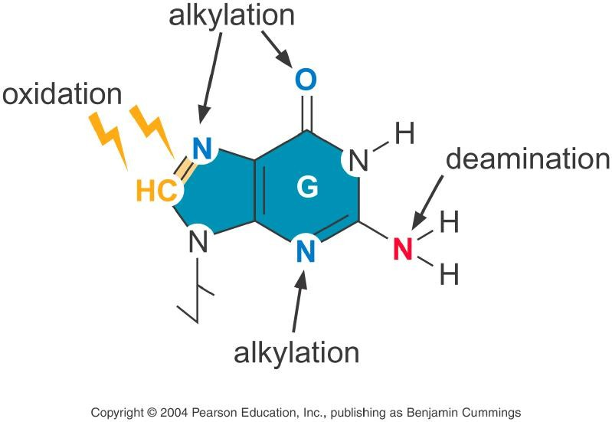
DNA can be damaged by alkylation , oxidation and radiation
Alkylating chemical: Nitrosamines (亚硝胺)
O⁶-methylguanine pairs with thymine
Figure 6-8 G modification

Slide 27
Reactive oxygen species
(O ^{.-}, H O , HO.)
2 2 2
O₂
.-
Superoxide
H₂O₂ Hydrogen Peroxide
HO. Hydroxyl Radical
Oxidation of guanine generates 7,8-dihydro-8- oxoguanine or oxoG, which can pair with A or C, leading to G:C to T:A transversion.

Slide 28
The Journal of Biological Chemistry, 271:31915-31921, 1996

Slide 29
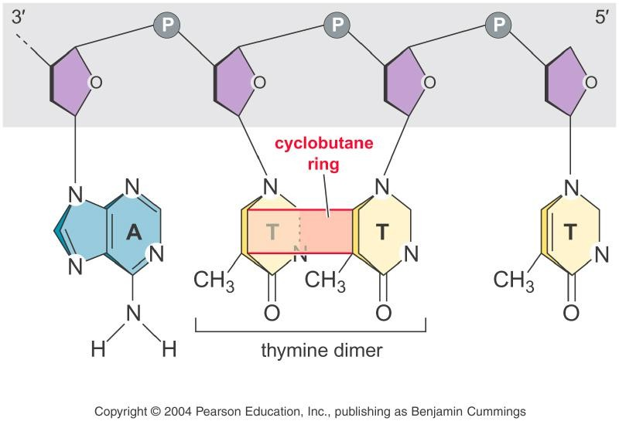
Figure 6-9 Thymine dimer. UV induces a cyclobutane (环丁烷) ring between adjacent T.

Slide 30
Ionizing Radiation
Gamma radiation and X-rays (ionizing radiation) cause double-strand breaks, which are particularly hazardous.
Certain anticancer drugs, such as bleomycin, also
cause DNA breaks.

Slide 31
Mutations are also caused by base analogs and intercalating (插入) agents
Base analogs: similar enough to the normal bases to be processed by cells and incorporated into DNA during replication.
But they base-pair differently, leading to mispairing during replication.
The most mutagenic base analog is 5- bromoUracil (5-BrU) (溴尿嘧啶), an analogue of thymine.

Slide 32
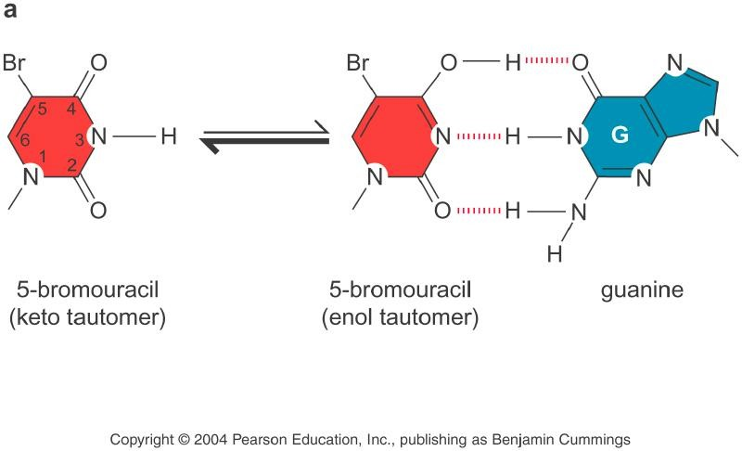
Unlike thymine, 5-bromouracil pairs with guanine, instead of adenine
酮异构体
烯醇异构体
Figure 6-10 Base analogues

Slide 33
Intercalating agents are flat molecules containing several polycyclic rings that bind to the equally flat purine or pyrimidine bases, causing the deletion or addition of a base pair or, even a few base pairs.

Slide 34
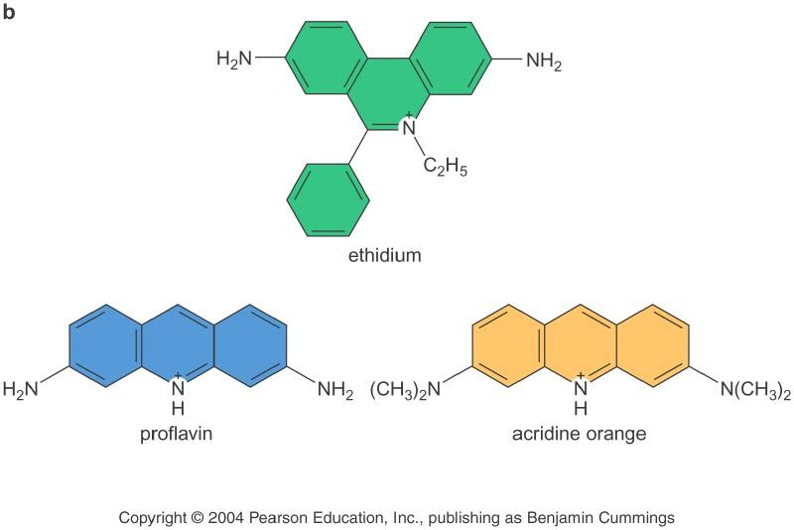
溴乙非啶
二氨基吖啶/原黄素
吖啶, 氮蒽
Figure 6-11 Intercalating agents

Slide 35
The Ames Test is used to detect mutagens and carcinogens
Bruce Ames, University of California at Berkeley
In the Ames test, reversion mutation is used as a means of detecting mutagens and carcinogens.
The test system includes:
A strain of Salmonella typhimurium with the mutant operon responsible for the biosynthesis of the amino acid histidine (his⁻);
A mixture of liver enzymes;
Potential mutagens or carcinogens

Slide 36
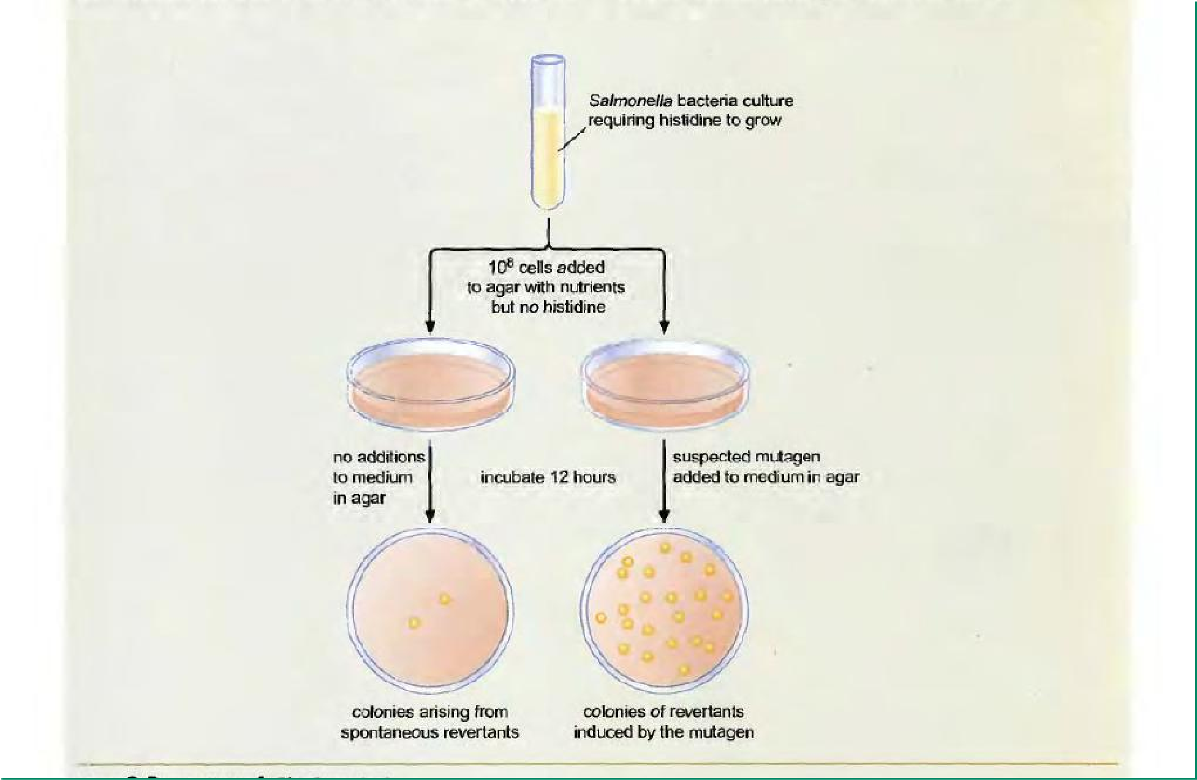
Figure 6-12 The Ames Test
 | 10⁸ cells added | Salmonella bacteria culture requiring histidine to grow
Medium with nutrients
but no histidine
Incubate 12 h
No addition
Suspected mutagen
Colonies
Spontaneous revertants
Induced revertants

Slide 37
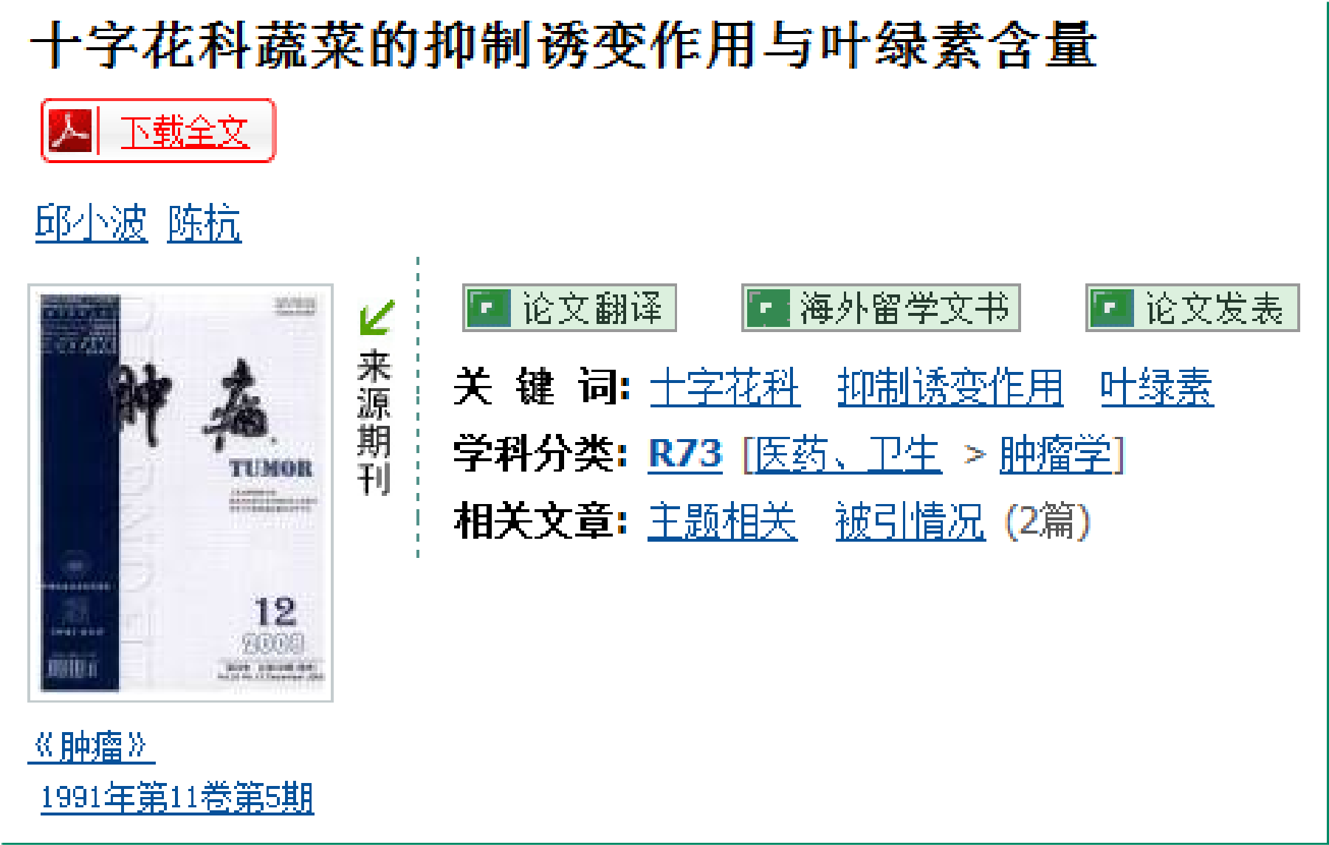
The Ames Test can also be used for screening anti-mutagenic agents

Slide 38
Part 3: Repair of DNA damage

Slide 39
Two consequences of DNA damage
Some damages, such as thymine dimer, nicks or breaks in the DNA backbone, create impediments to replication or transcription.
Some damages create altered bases that have no effect on replication but cause mispairing, which in turn can be converted to mutation.

Slide 40
DNA Repair Systems
Type of repair
Direct reversal
Base excision repair Nucleotide excision repair Recombinational repair Translesion DNA synthesis
Damage
Pyrimidine dimer Methylated base Damaged base
Pyrimidine dimer Bulky adduct Double-strand breaks Pyrimidine dimer Apurinic site

Slide 41
Direct reversal of DNA damage
Photoreactivation
Methyltransferase

Slide 42
Figure 6-13 Photoreactivation
DNA
photolyase
light
UV
dark
Monomerization of thymine dimers by DNA photolyases in the presence of visible light.

Slide 43
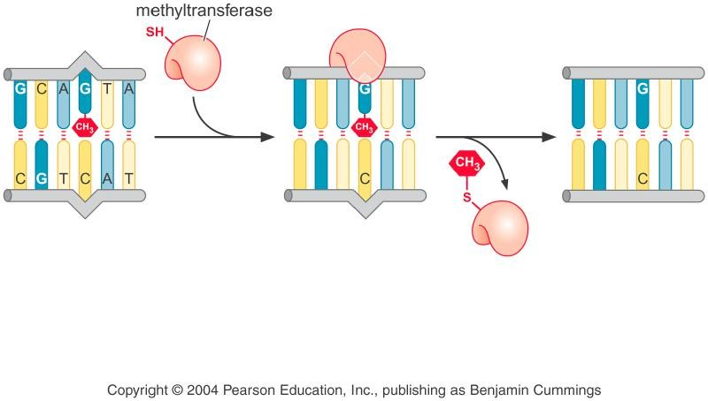
Methyltransferase
Figure 6-14
Removes the methyl group from the methylated O⁶-methylguanine. The methyl group is transferred to the protein itself, inactivating the protein.

Slide 44
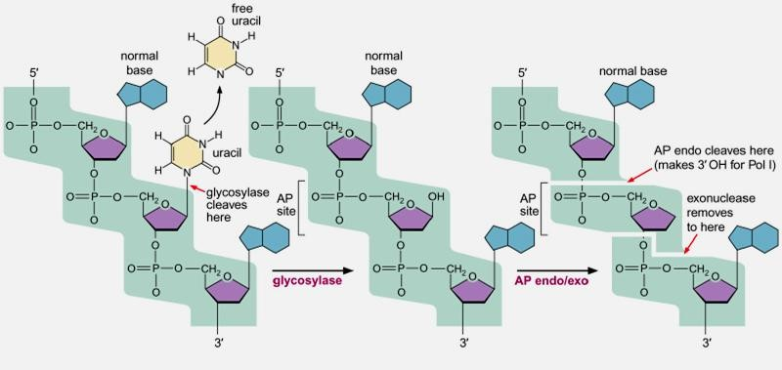
Figure 6-14: Base excision repair removes the damaged base and repair
Uracil
AP endo
Exonu clease
Glyco- sylase

Slide 45
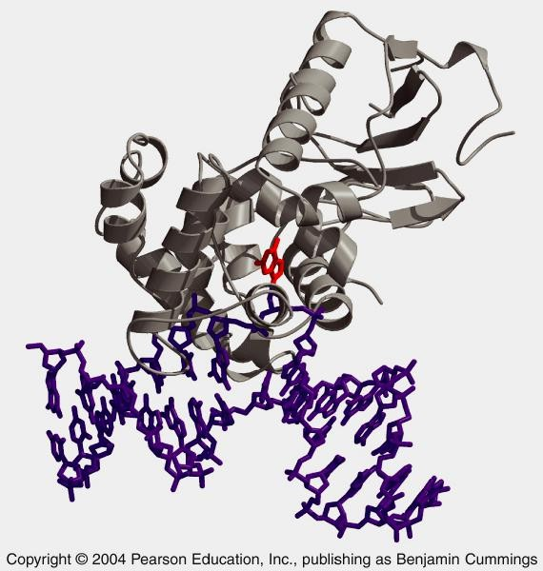
Red: oxoG Purple: DNA Gray: enzyme
Figure 6-15: Base-flipping recognition by glycosylase

Slide 46
Base excision repair enzyme removes damaged bases by a base-flipping mechanism
Glycosylase recognizes the damaged base, and removes the damaged base.
AP endonuclease cleaves the abasic sugar-phosphate backbone.
Exonuclease, DNA polymerase, and ligase work sequentially to complete the repair event.

Slide 47
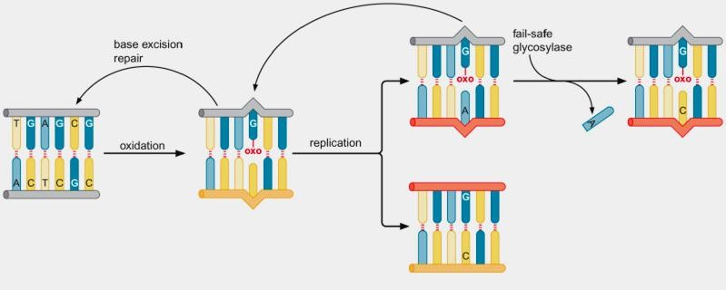
Figure 6-16: Fail-safe systems
Fail-safe Glycosylase
Base excision repair
Oxida- tion
oxoG:A repair. A glycosylase recognizes the mispair and removes A. A fail-safe glycosylase also removes T from T:G mispairs, as if it knows that T is produced from the deamination of 5-methyl-cytosine.

Slide 48
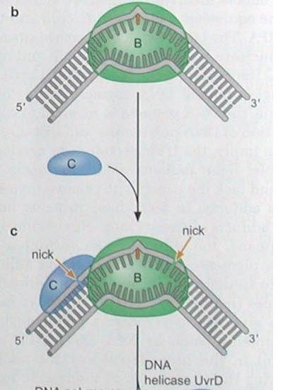
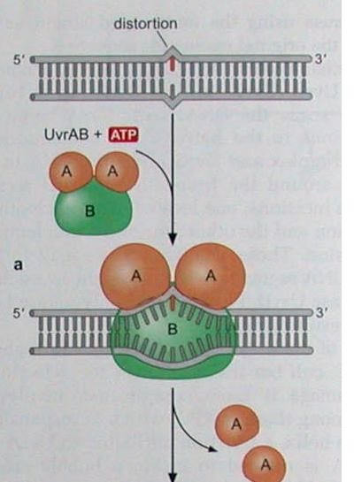
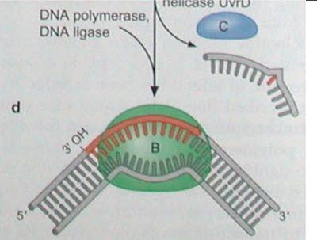
Figure 6-17 Nucleotide excision repair in E. coli
UvrC
UvrAB
DNA polymerase, ligase
Helicase UvrD

Slide 49
Nucleotide excision repair
UvrA and UvrB recognize distortions of the DNA double helix, and UvrB melts the DNA locally around the lesion.
UvrC creates nicks at the both sides of the lesion.
DNA helicase UvrD unwinds the DNA, and releases the short single-stranded segment that includes the lesion.
DNA polymerase and ligase fill in the gap.

Slide 50
The nucleotide excision repair in higher cells is similar to that in E. coli, but more complicated, involving 25 or more polypeptides.
As UvrA in E. coli, XPC is responsible for detecting distortions to the helix.
XPA and XPD (equivalent to UvrB) and RPA are involed in the formation of the bubble.
Nucleases XPF and XPG, like UvrC, create nicks, resulting in 24-32 nucleotide segment, instead of 12-13 nucleotides in E. coli.
The mutation of above XP genes are associated with a human genetic disease called Xeroderma pigmen- tosum, which renders the patients highly sensitive to sunlight and results in skin lesions, including skin cancer.

Slide 51
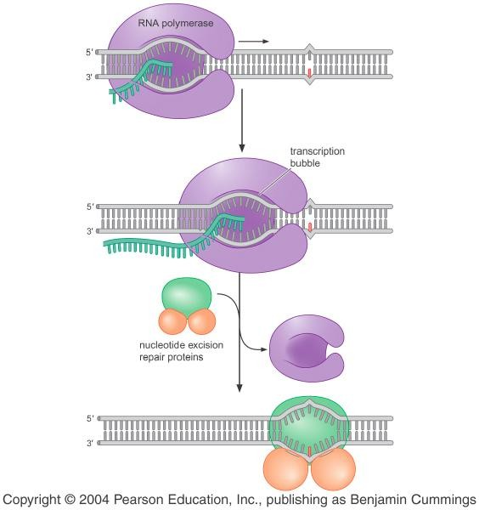
RNA polymerase
Figure 6-19. Transcription- coupled repair:
In eukaryotes, TFIIH is a transcription factor with subunits including XPA and XPD (UvrB)
Nucleotide excision repair proteins

Slide 52
Recombination repairs DNA double- strand breaks by retrieving sequence information from undamaged DNA
DNA damages are repaired by a recombination mechanism known as sister-strand exchange.
第三节

Slide 53
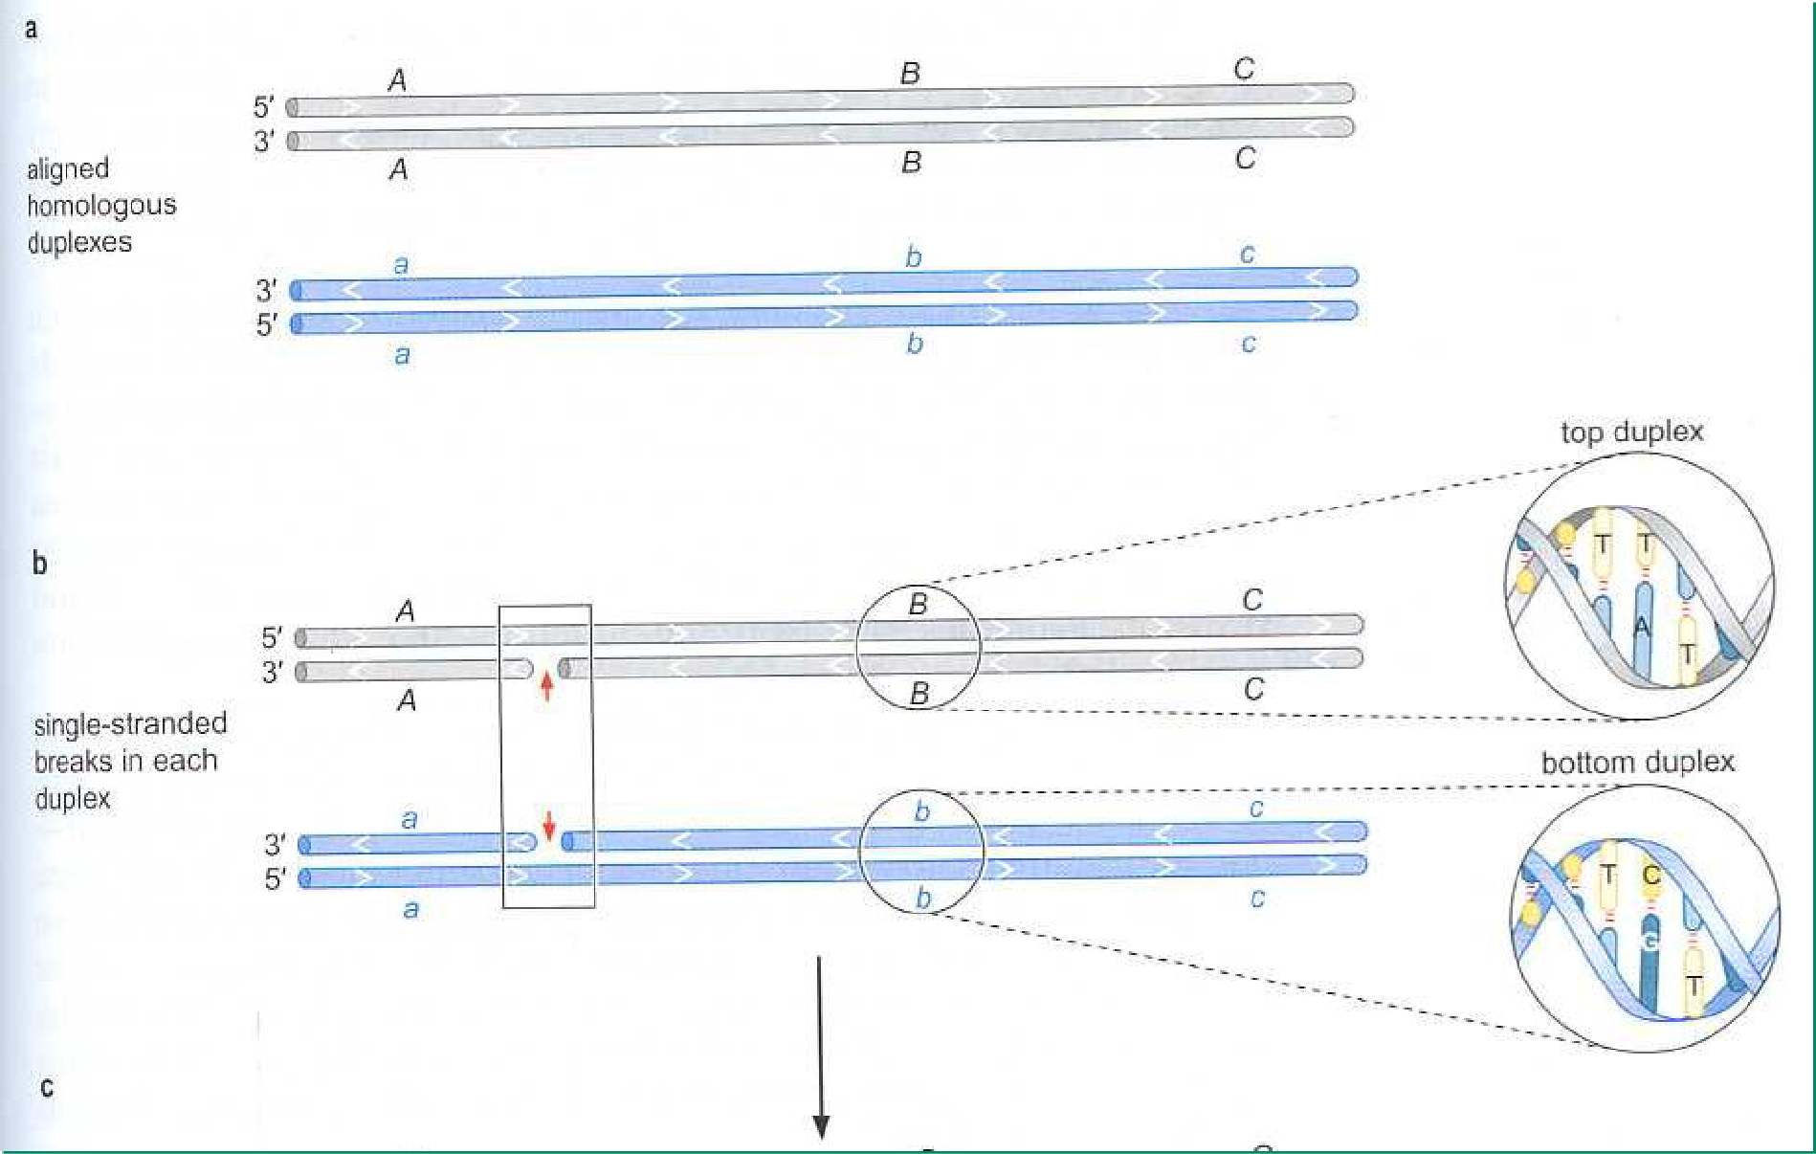
Aligned homologous duplexes
Single- stranded breaks
FIGURE 6-20 Holliday model through the steps of branch migration

Slide 54
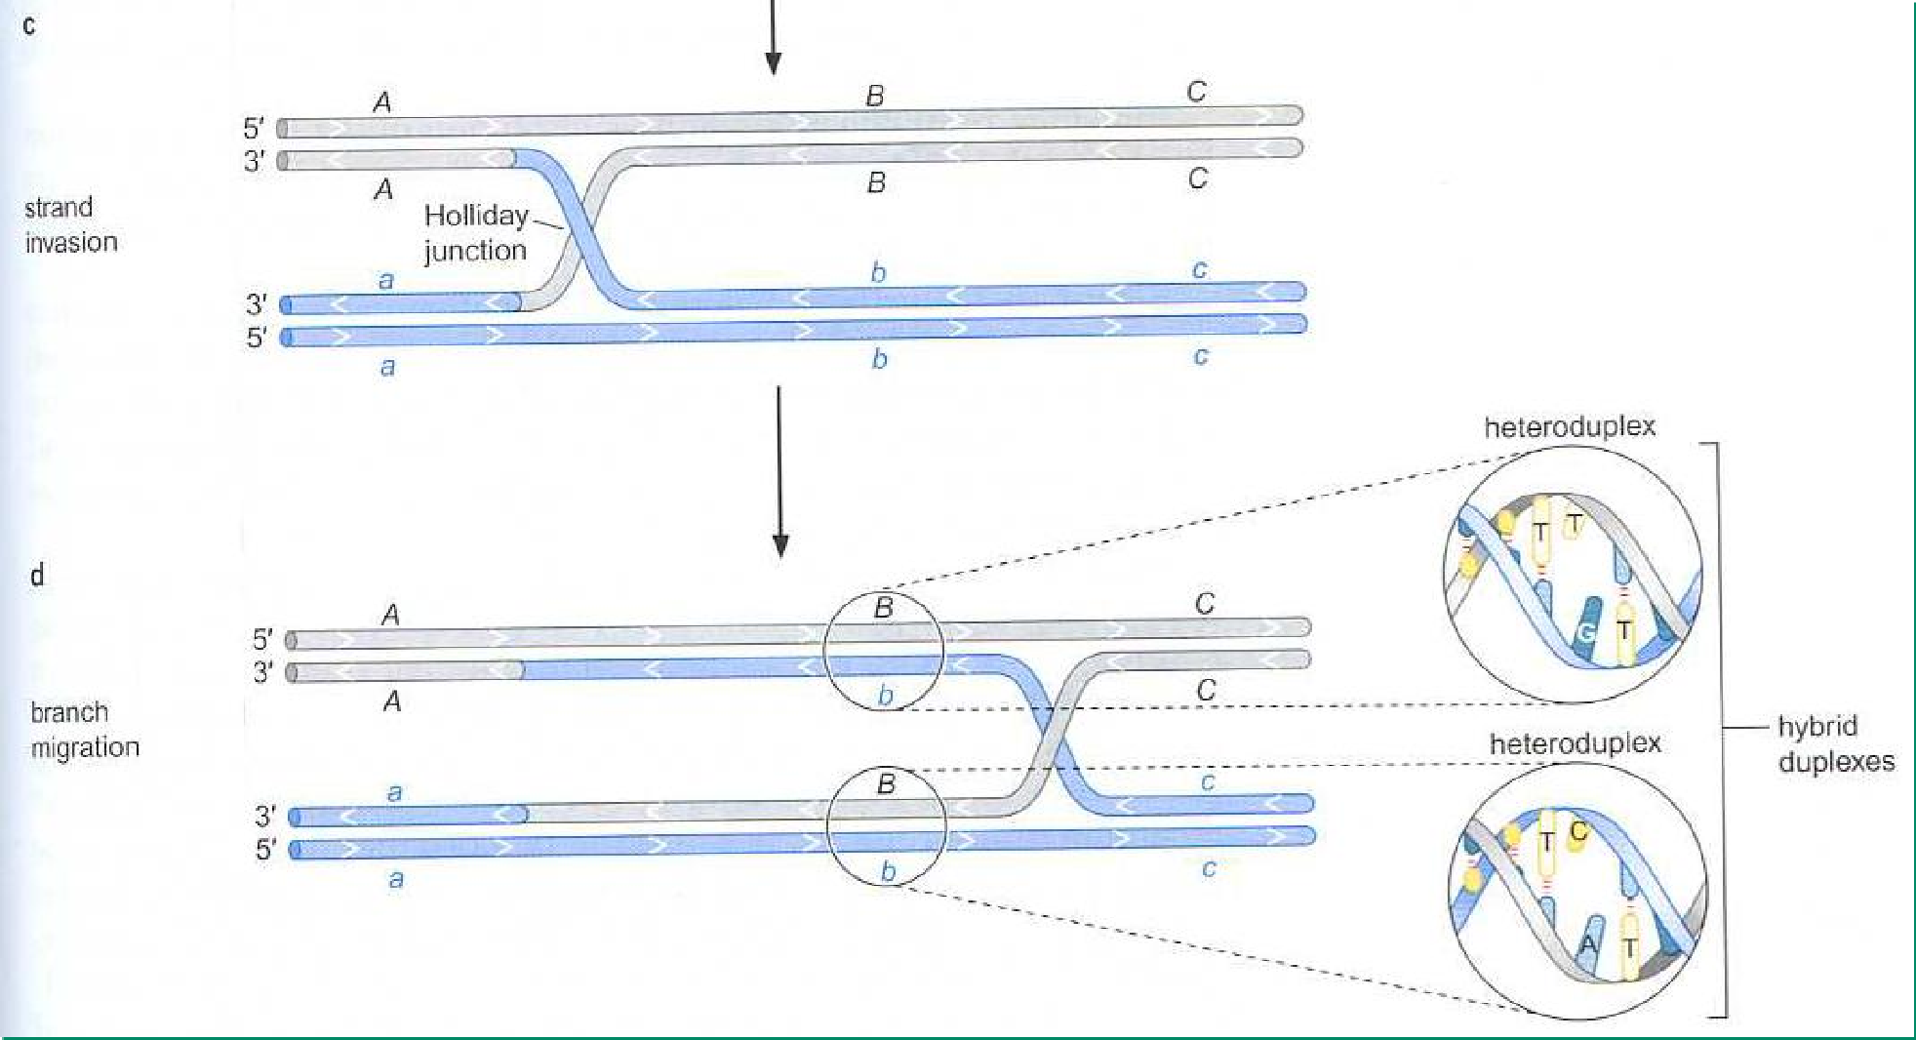
Strand invasion
Branch migration
FIGURE 6-20 Holliday model through the steps of branch migration (continued)

Slide 55
[Watch the animation-The Holliday Model]

Slide 56
Conclusion for the Holliday model

Slide 57
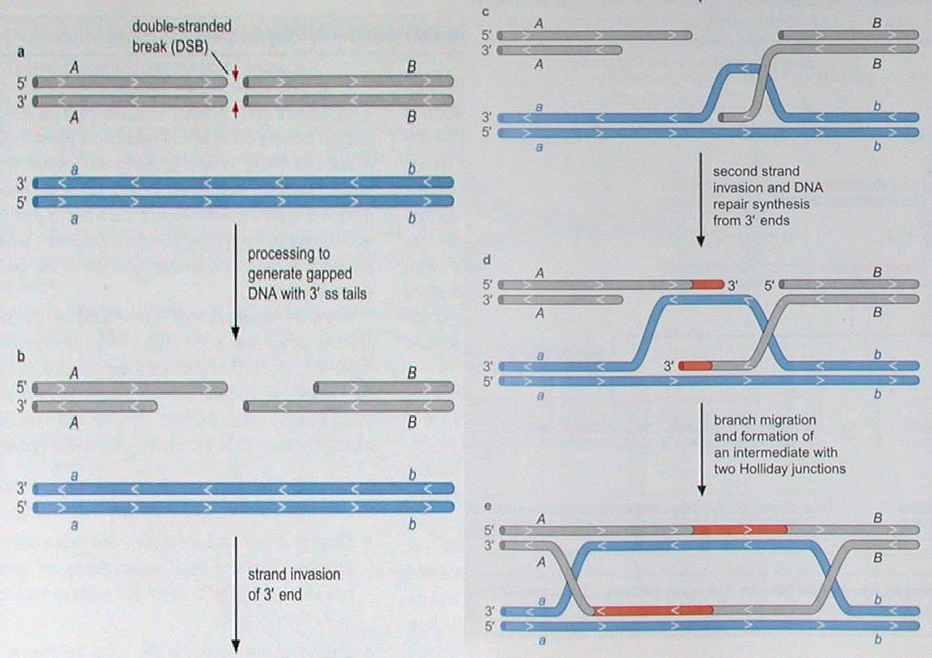
c
a
Double-strand breaks
DNA repair synthesis
from 3’ ends
Generate gapped DNA with 3’ end
d
RecBCD
b
Branch migration
RuvAB
e
Strand invasion of 3’ end
RecA
FIGURE 6-21 DSB repair model for homologous recombination (RecBCD pathway)

Slide 58
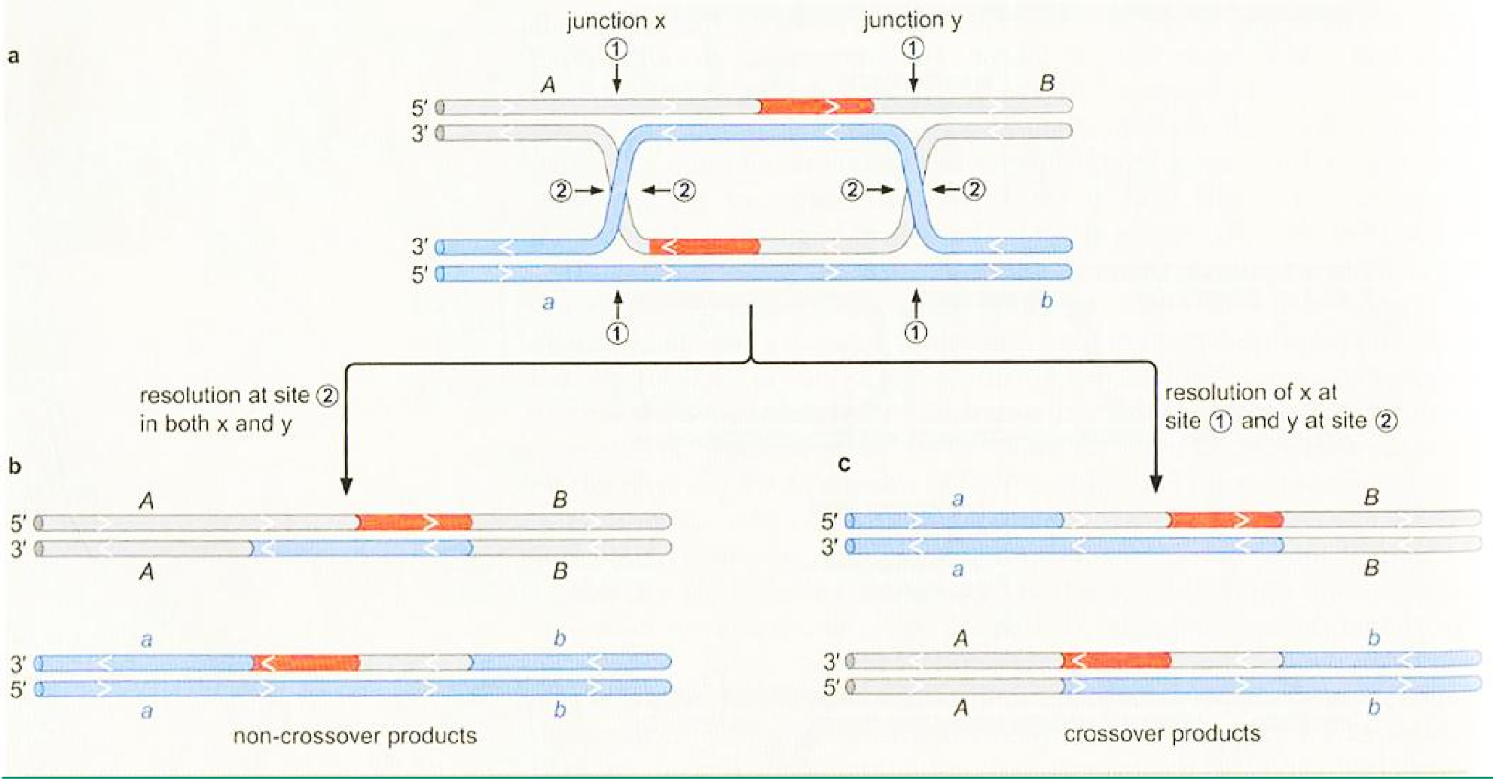
Junction x Site 1
Junction y Site 1
a
Site 2
RuvC
Resolution at site 2 in both x and y
Resolution of
x at site 1 and
b
y at site 2
Non-crossover products Crossover products
FIGURE 6-22 Resolving an intermediate with Holliday junctions by RuvC

Slide 59
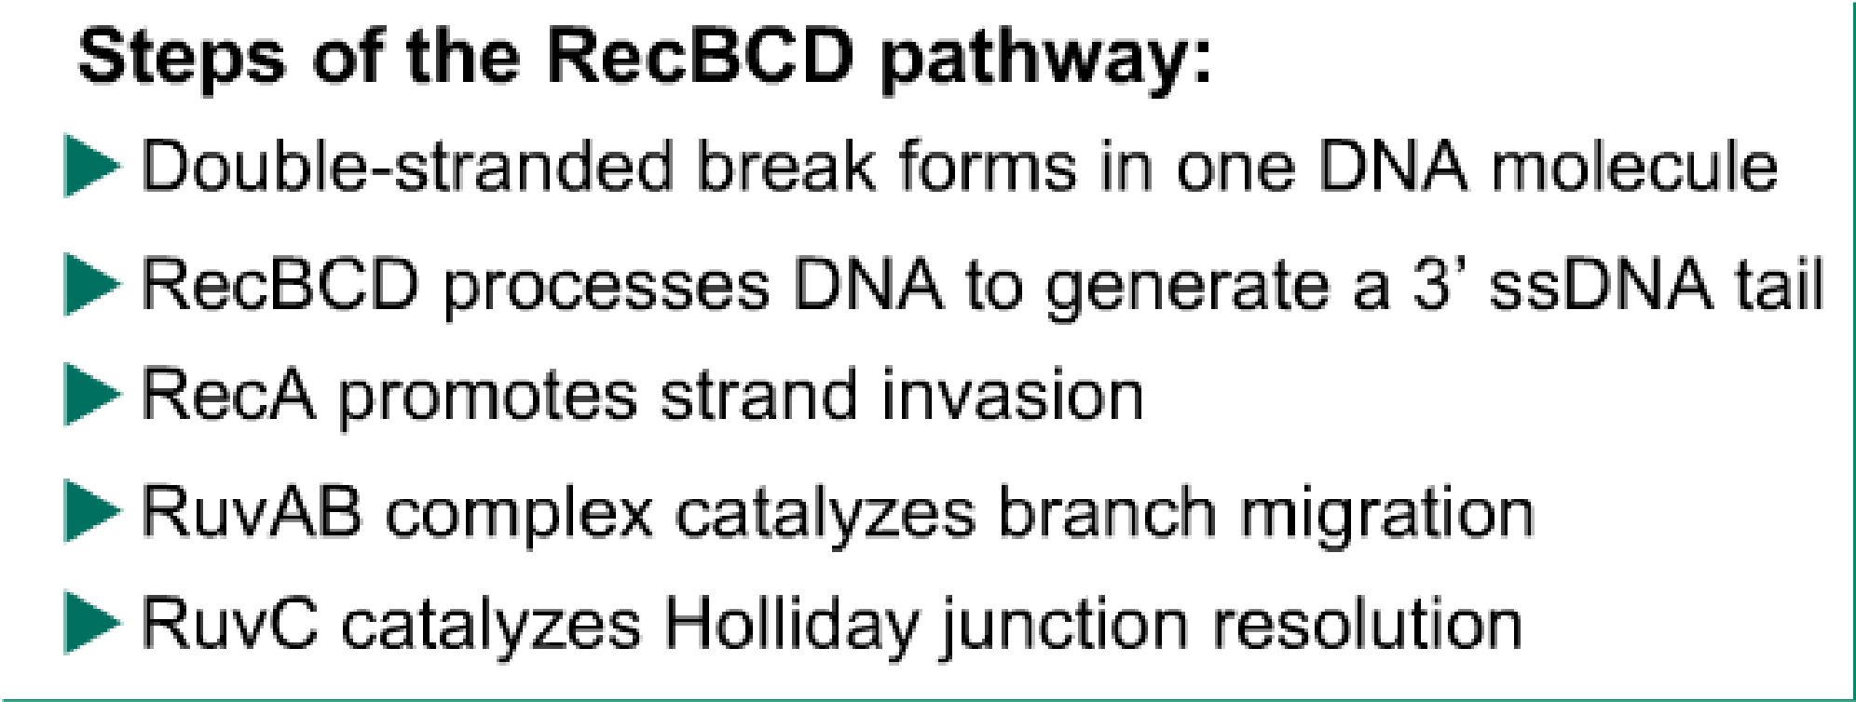

Slide 60
Difference between RecBCD pathway and Holliday model

Slide 61
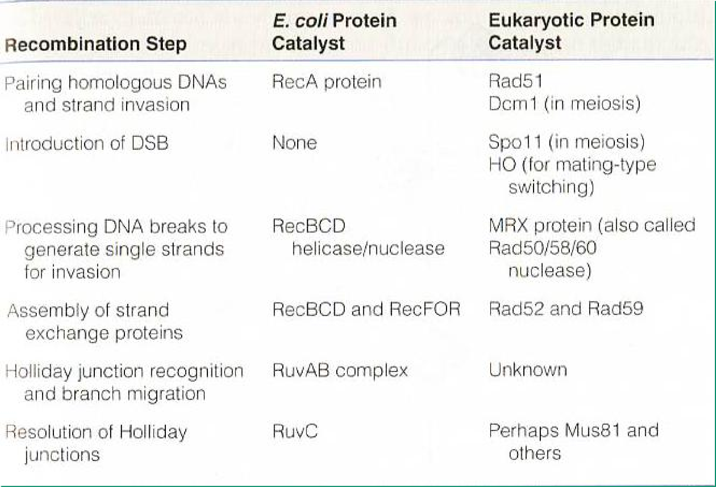
Prokaryotic and eukaryotic factors that catalyze recombination steps

Slide 62
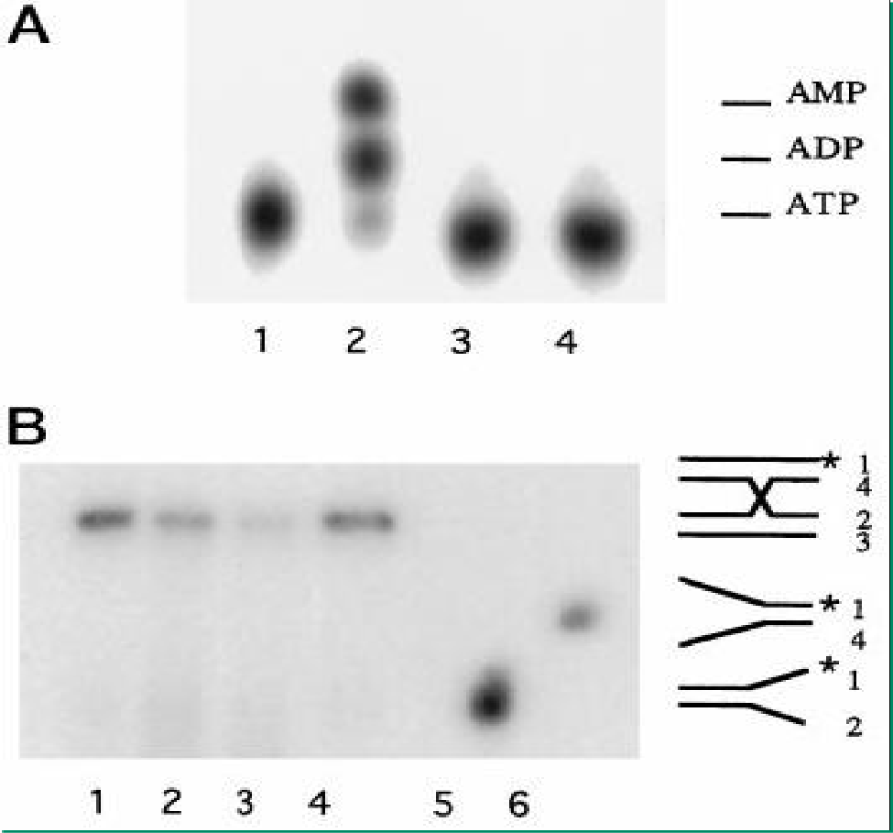
An Eukaryotic RuvB-like Protein (RUVBL1) Essential for Growth
Xiao-Bo Qiu
et al.
THE JOURNAL OF BIOLOGICAL CHEMISTRY Vol. 273, No. 43, pp. 27786–27793, 1998

Slide 63
Translesion DNA synthesis enables replication to proceed across DNA damage
Error-prone repair***
Occurs when the other repairs are not efficient enough
Translesion synthesis is catalyzed by a specialized class of DNA polymerases, translesion polymerases, that synthesize DNA directly across the damage site.

Slide 64
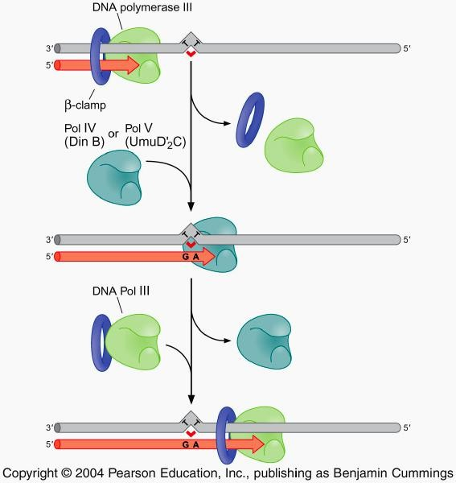
DNA polymerase III
FIGURE 6-23
Translesion DNA synthesis in E. coli
DNA pol IV
DNA pol III

Slide 65
In E. coli, translesion polymerase , expressed as part of the SOS response, is induced only in response to the DNA damage.

Slide 66
Summary for Chapter 6
Replication errors and their repair
Nature of mutations and Mismatch repair system
DNA damage
Hydrolysis (e.g., deamination), alkylation, oxidation, radiation, base analogs, and intercalating agents, Ames test
Repair of DNA damage
Direct reversal of DNA damages
Base excision repair
Nucleotide excision repair
Recombination repair
Translesion synthesis

