Slide 1
TRANSCRIPTION
Miss B Krishnaveni
Assistant Professor
Department of Biotechnology
D.N.R. College(A),Bhimavaram

Slide 2
Transcription
It is the process of transcribing or making a copy of Genetic information stored in a DNA strand into a Complementary strand of RNA (messenger RNA or mRNA) with the aid of RNA polymerase.
Or
The process by which RNA molecules are initiated, elongated and terminated is called transcription.

Slide 3
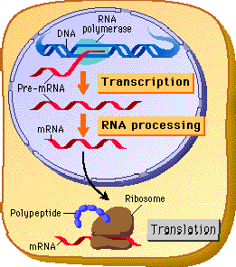
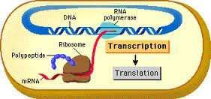
Transcription site in Prokaryotes & Eukaryotes
Eukaryotic transcription takes place in nucleus.
Prokaryotic transcription takes place in side the cell as there is no separation by nuclear membrane.

Slide 4
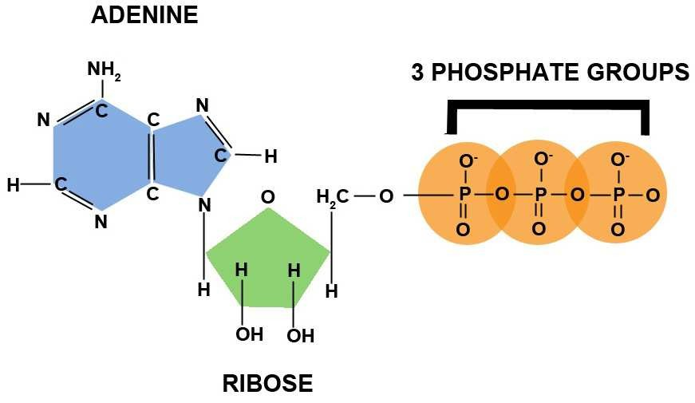
Basic Features of RNA Synthesis
1.Precursors i.e., the four ribonucleoside 5'- triphosphates (ATP, GTP, CTP, UTP) are required
ATP
www.hbmahesh.weebly.com

Slide 5
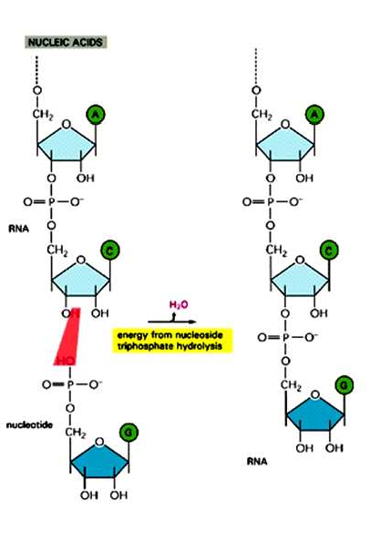
2. Polymerization Reaction
A 3'-OH group of one nucleotide reacts with the 5'-triphosphate of a second nucleotide;
www.hbmahesh.weebly.com

Slide 6
3.The sequence of bases in RNA molecule is determined by the base sequence of the DNA.
Template Strand
www.hbmahesh.weebly.com

Slide 7
4. The DNA molecule being transcribed is double-
stranded, yet in any particular region only one strand serves as a template.
Template Strand
Coding Strand
www.hbmahesh.weebly.com

Slide 8
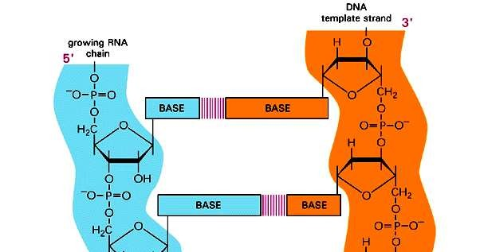
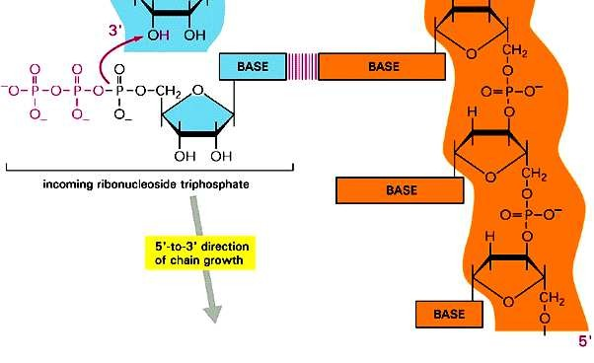
5. Chain Growth is 5’-3’
Nucleotides are added only to the 3' -OH end of the growing chain.
www.hbmahesh.weebly.com

Slide 9
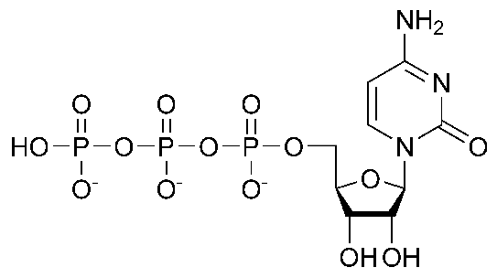
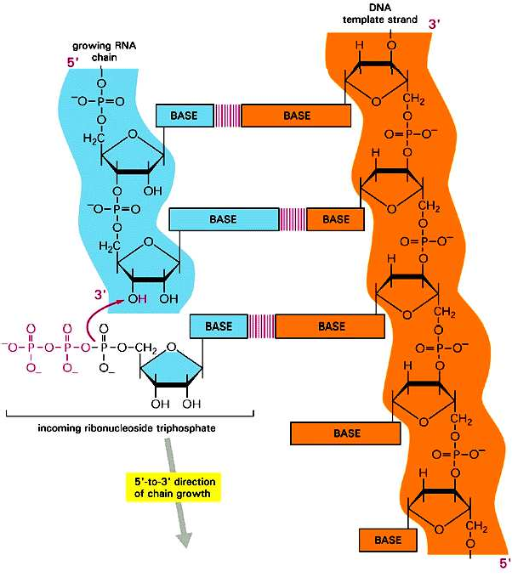
6. No primer Required
Triphosphates
7. 5’ po4 & 3’OH……….. The first base to be laid down in the initiation event is a triphosphate. Its 3' -OH group is the point of attachment of the subsequent nucleotide. Thus, the 5' end of a growing RNA molecule terminates with a triphosphate.
3
2
1
www.hbmahesh.weebly.com

Slide 10
Requirements
Template- Double stranded DNA
Activated precursors:- ATP, GTP, UTP, CTP
Divalent Metal Ions:- mg⁺⁺, mn⁺⁺
RNA polymerase:- Enzyme
www.hbmahesh.weebly.com

Slide 11
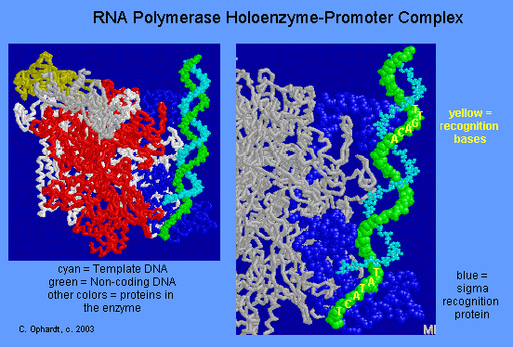
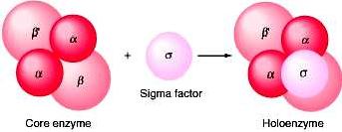
RNA polymerase is a key enzyme and was isolated from E. coli by Chamberlin and Berg (1962)
The term core enzyme is used to describe
the σ-free unit-namely, α₂, β, β'.
The complete enzyme,
α₂, β, β' σ is called the holoenzyme.
www.hbmahesh.weebly.com

Slide 12
Sub Units of RNA polymerase and their functions
Sl. No. | Sub Unit | M.W. | Function
1 | β’ | 1,60,000 | Binding of RNA polymerase to DNA i.e., Template strand
2 | β | 1,50,000 | Helps in binding with incoming nucleotides & forms 1st phosphodiester bond formation
3 | 2 α | 40,000 | Needed for assembly of core enzyme & Promoter Recognition
4 |  | 90,000 | Recognition of start signal & directs to bind to the promoter region of DNA
www.hbmahesh.weebly.com

Slide 13
Promoter : A site in a DNA molecule at which RNA polymerase and transcription factors bind to initiate transcription of mRNA.
www.hbmahesh.weebly.com

Slide 14
Transcription
Initiation
Elongation
Termination
Template binding at a polymerase recognition site Binding to initiation site
Establishment of open promoter complex
www.hbmahesh.weebly.com

Slide 15
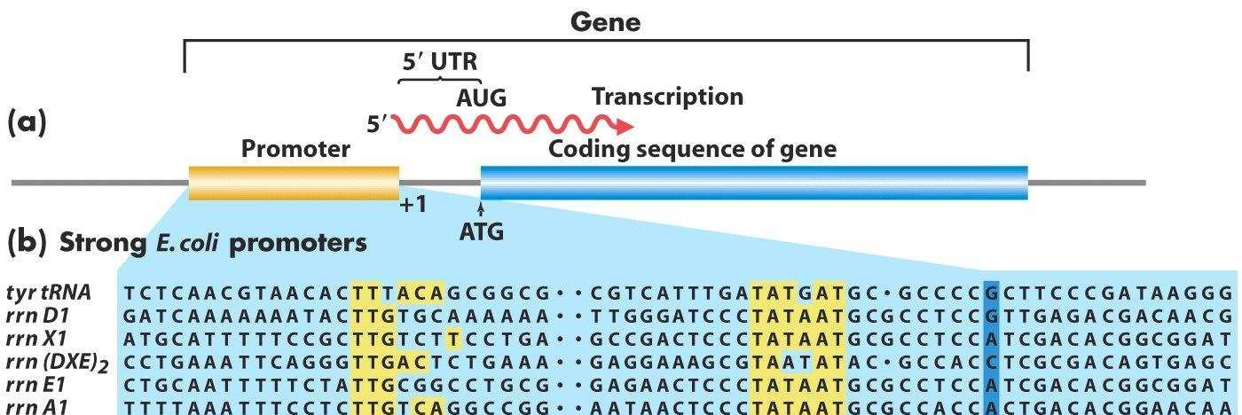
www.hbmahesh.weebly.com

Slide 16
INITIATION OF SYNTESIS
www.hbmahesh.weebly.com

Slide 17
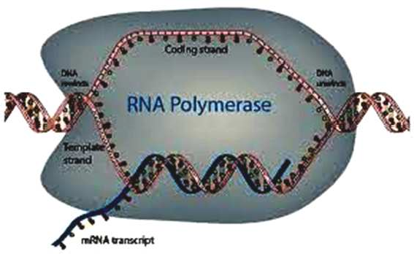
RNA polymerase is a huge enzyme it binds around 60 nucleotides at a time
www.hbmahesh.weebly.com

Slide 18
www.hbmahesh.weebly.com

Slide 19
www.hbmahesh.weebly.com

Slide 20
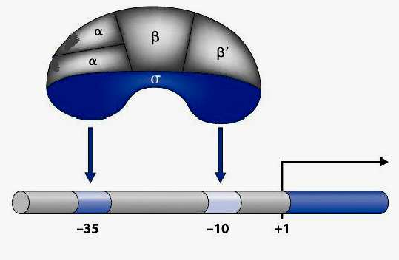
Figure shows a general promoter and where the RNA Polymerase sigma factor binds.
www.hbmahesh.weebly.com

Slide 21
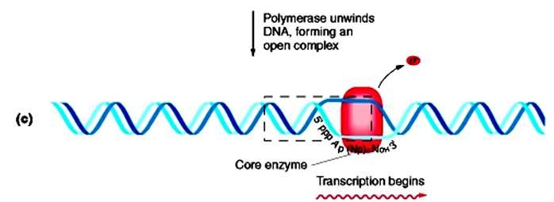
www.hbmahesh.weebly.com

Slide 22
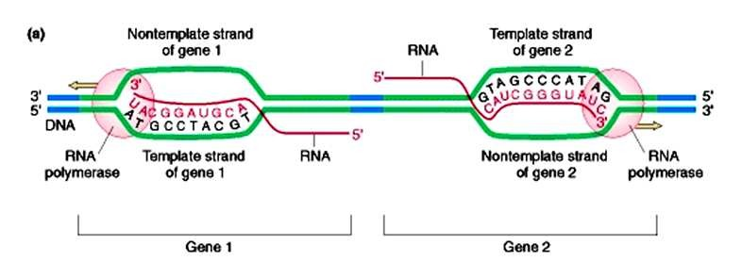
www.hbmahesh.weebly.com

Slide 23
Synthesis continues
www.hbmahesh.weebly.com

Slide 24
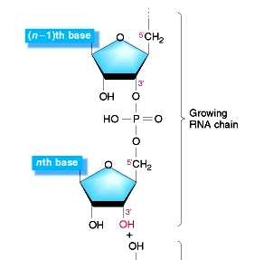
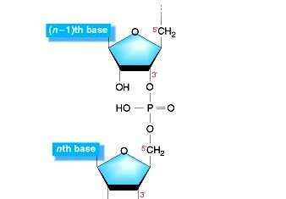
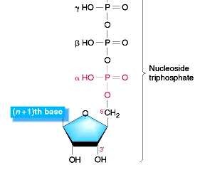
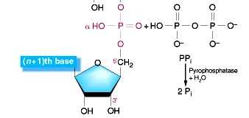
ELONGATION OF CHAIN Mechanism
www.hbmahesh.weebly.com

Slide 25
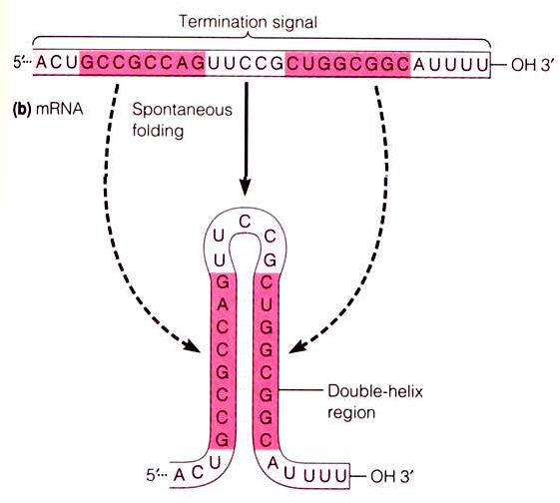
TERMINATION OF SYNTHESIS
Termination of RNA synthesis occurs at specific base sequences within the DNA molecule.
These sequences are of two types,
1. Simple terminators & 2. Termination factors dependent.
1. Simple Termination
Features are
Sequence in one DNA strand would read like ABCDE-XYZ- E'D'C'B'A'. Thus, this sequence is capable of intrastrand base pairing, forming a stem-and- loop in the RNA transcript
Near the loop end there is a high G + C sequence.
3. This is followed by a sequence of 6-8 U’s.
www.hbmahesh.weebly.com

Slide 26
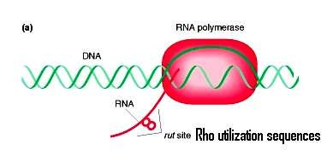
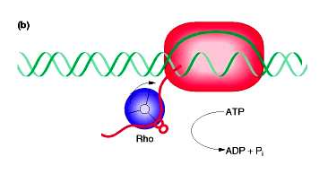
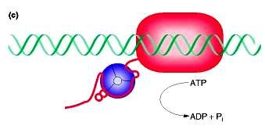
2. Rho dependant Termination
As polymerization proceeds
and rut sites are exposed Rho factor recognizes and attaches to it
As polymerization proceeds and C-rich segments are made, the ATPase activity of Rho increases until no further polymerization is possible,
As no polymerization, RNA polymerase stops
its action. However, since no sigma factor in core enzyme it can not restart the process
Hence separation of all units.
www.hbmahesh.weebly.com

Slide 27
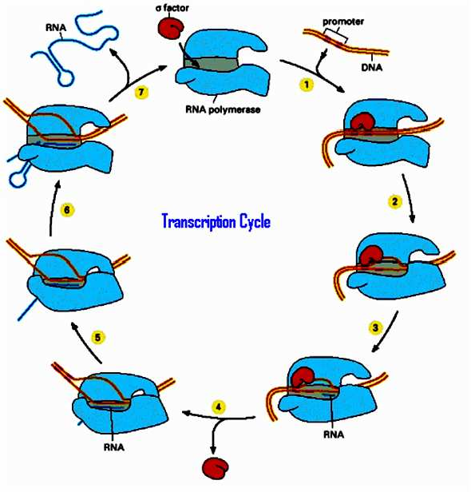
www.hbmahesh.weebly.com

Slide 28
Acknowledgements
to
INTERNET
FOR
PICTURES
www.hbmahesh.weebly.com

