Slide 1
Presented By:
P D R SATISH
ASSISTANT PROFESSOR

Slide 3
Outline
Introduction to Biodiesel
Biodiesel vs. Petrol Diesel
Oil Sources
Our Source
Location Selection
Genetic Modification
Scenarios Evaluated
Transesterfication
Byproducts
Economics
Conclusions

Slide 4
Introduction
What is Biodiesel?
Biodiesel is a completely natural, alternative fuel source that is applicable in almost all situations in which petrol diesel is used.
Transesterification
Base Catalyst
Triglyceride + Alcohol (Oil)
Methyl Esters + Glycerol (Biodiesel)
– Oil can come from animal oil / fats, vegetable oil, and waste oil from restaurants (after degumming)

Slide 5
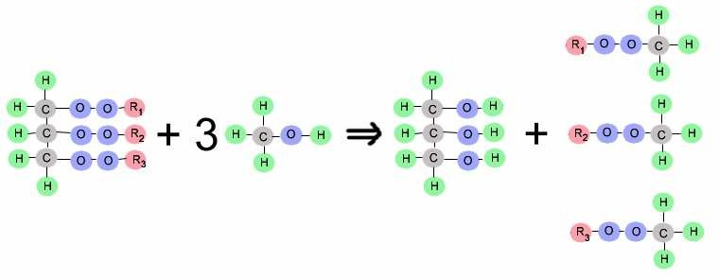
Triglycerides Alcohol Glycerol Methyl Esters

Slide 6
Biodiesel vs. Petrol-Diesel
Biodiesel • Petroleum Diesel
Reduces emissions
Cetane #: 48-65
Increases lubricity
Longer engine life
Higher Flash Point
Requires no modification
Dissolves rubber and some plastic
Slightly lower heating value
High emissions
Cetane #: 40-55
Low sulfur diesel lacks lubricity
High sulfur
poisons catalyst in exhaust system
Reduces effective reduction of emissions in exhaust system

Slide 7
http://www.biodiesel.org/pdf_files/fuelfactsheets/BTU_Content_Final_Oct2005.pdf

Slide 8
http://www.biodiesel.org/resources/reportsdatabase/reports/gen/19940101_gen-297.pdf

Slide 9
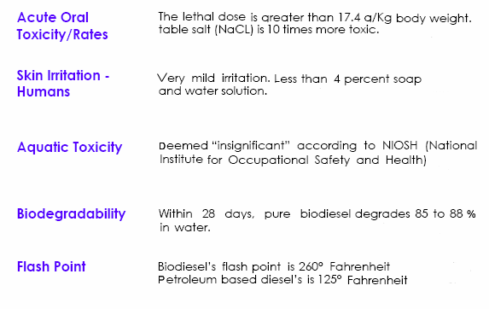
http://www.biodiesel.org/pdf_files/fuelfactsheets/Environment_Safety1.pdf

Slide 10
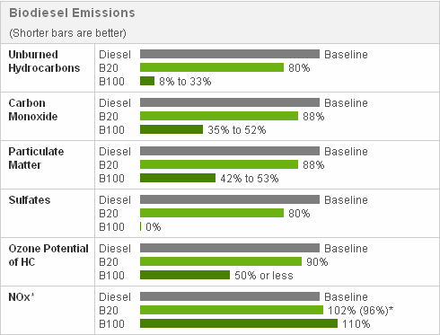
http://www.propelbiofuels.com/site/aboutbiodiesel.html

Slide 11
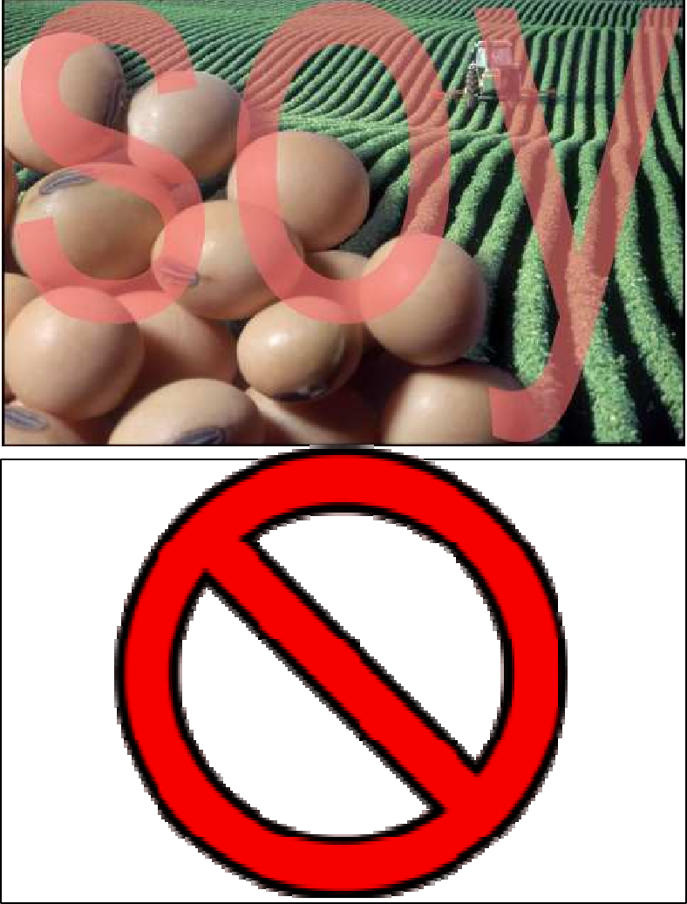
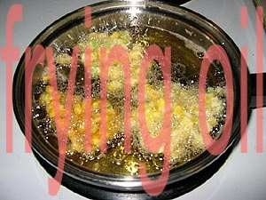
Potential Oil Sources

Slide 12
Algae
NREL Aquatic Species Program Study (National Renewable Energy Laboratory)
Factors to consider
High adaptability to variety of environments
Large growth rate
Higher lipid content

Slide 13
Algae Requirements
Growth 6H₂O + 6CO₂ → C₆H₁₂O₆+ 6O₂
Sunlight
CO₂
Nutrients (N and Si)
Water (can be saline)
Warm Climate
Circulation or Aeration

Slide 14
The Process
Algae Harvesting/ Oil Extraction
Xanthan Gum
Fermentation Plant
Sugars
Protein
Glycerol
Oil
Biodiesel Plant
Biodiesel to Market
Algae and Water
Algae and Water
Algae and Water
Diesel Refinery
Ponds
Ponds
Ponds
2
2
CO
CO
CO
2
Natural Gas Plant

