Slide 1
Presented By:
P D R SATISH
ASSISTANT PROFESSOR

Slide 2
What is Bioleaching? At the interface between Micro-Organisms (biology) and Minerals
(geology)…
Current status and case study (reprocessing of
mine wastes)
Some challenges and perspectives
> 3

Slide 3
What is « Bio-Hydrometallurgy »?
ORE
Hydrometallurgical reactions assisted with microbial activities:
SIZE REDUCTION
Bio-flotation: modification of mineral surfaces to enhance or depress flotation
Bio oxidation: microbial catalyzed oxidation (especially of Fe²⁺ and S species)
Bio-complexation: generation of organic compounds that favorably complex with metal species
Bio-sorption/ -accumulation: incorporation of metal species from solution into biomass
HIGH TEMPERATURE PRE-TREATMENT
PHYSICAL CONCENTRATION
concentrate
LEACHING
S/L SEPARATION
SOLUTION
PURIFICATION
solution
PRECIPITATION / ELECTROLYSIS
METAL
Typical hydrometallurgical processes - Hayes, 1993

Slide 4
What is « Bioleaching »?
Microbially assisted leaching of certain minerals (Bio- oxidation/Bio-complexation):
Bioleaching can be applied to various ore types through microbial generation of leach agents:
e.g.1: H⁺ and Fe³⁺ leaching mineral sulfides -> Bio-oxidation
e.g.2: organic acids leaching oxides and laterites -> Bio-complexation
e.g.3: biogenic cyanide for gold leaching -> Bio-complexation
Organic acid and cyanide bio-production remains at laboratory stage:
slow rates and low yields of metal extraction as well as the cost of microbial substrates (glucose, etc.) and the production of excess biomass have precluded these approaches being developed as commercial operations
Most R&D has focused on BIO-OXIDATION which is the only bioleaching process to reach industrial implementation.

Slide 5
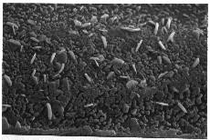
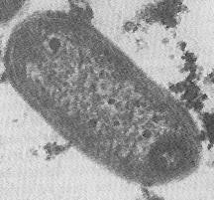
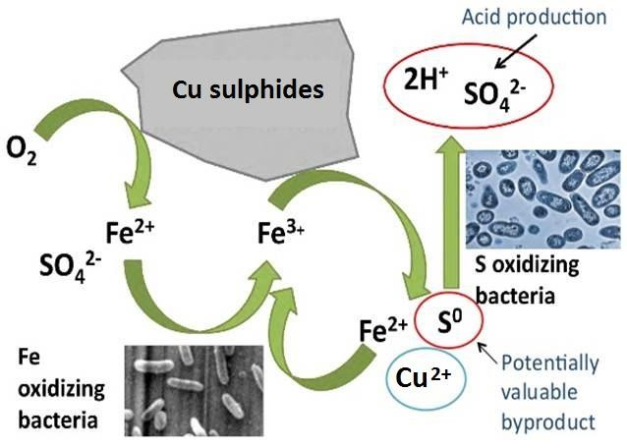
Bioleaching/Biooxidation
How does it work?
Bacterial degradation of the sulfide matrix:
Oxidation of ferrous iron and sulfur = energy source
Liberation and/or solubilisation of the
metals in acidic media
H₂SO₄ = a product of the bacterial metabolism
Acidophilic, autotrophic bacteria (heterotrophic), from 30°C to 80°C (mesophiles, moderate thermophiles, thermophiles)
Leptospirillum ferriphilum, Acidithiobacillus caldus, Sulfobacillus benefaciens , Sulfolobus sp…
aerobic
MS + 2Fe³⁺ ⭢ M²⁺ + 2Fe²⁺ + S⁰
2Fe²⁺ + 0.5O₂ + 2H⁺ ⭢ 2Fe³⁺ + H₂O (bact.)
S⁰ + 1.5O₂ + H₂O ⭢ 2H⁺ + SO ²⁻ (bact.)
4

Slide 6
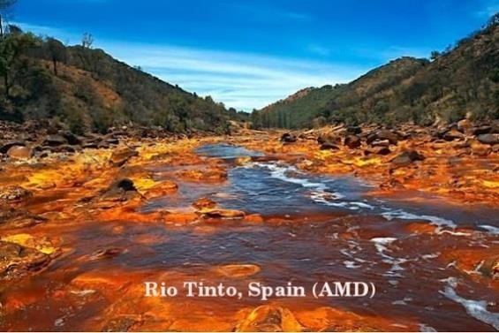
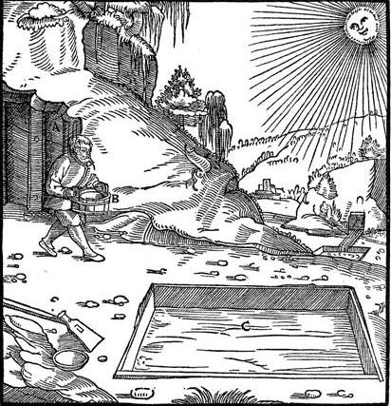
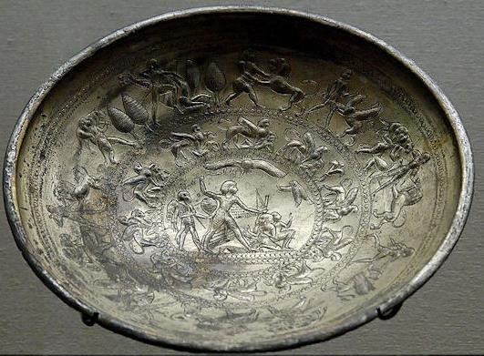
Bioleaching/Biooxidation
Solubilisation of metals (associated to sulfide matrix) by bacteria, a natural phenomenon known and used since earliest Antiquity:
Acid mine drainage
Metals recovery, especially Cu
→ Rio Tinto: Cu exploitation from Phoenician times; 1st heap bioleaching attested in the 17th century
Re Metallica – Georgius Agricola (1494-1555)

Slide 7
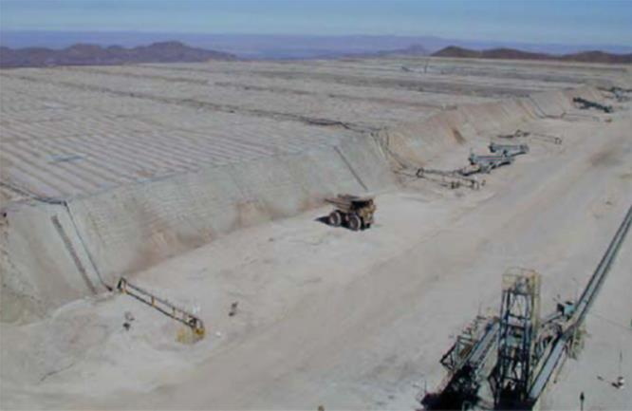
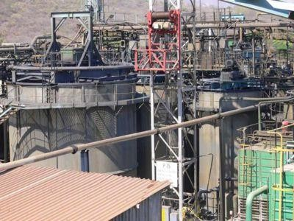
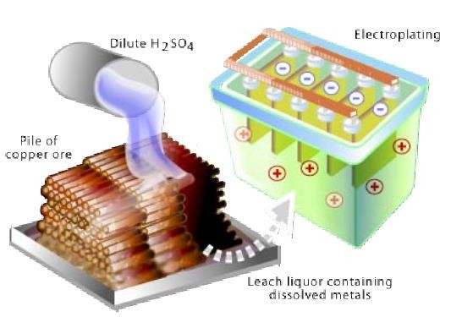
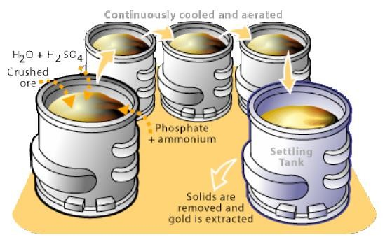
Bioleaching/Biooxidation
Bioleaching = an established technology and an industrial reality for ore processing Heap leaching Stirred tank reactor
Current status
Current status
Mainly applied for the treatment of Cu Ores
Many bioheap processes have targeted extraction of marginal ores not suitable for concentration and smelting
Main operators : Newmont Mining, BHP Billiton, RioTinto, Codelco,…
Mainly applied to refractory gold (Biox process) and some base metals (Co, Ni, Cu…)
More than 15 plants in operation at industrial or demonstration scale
Main operators : Newmont Mining, BHP Billiton, RioTinto, Codelco,…

Slide 8
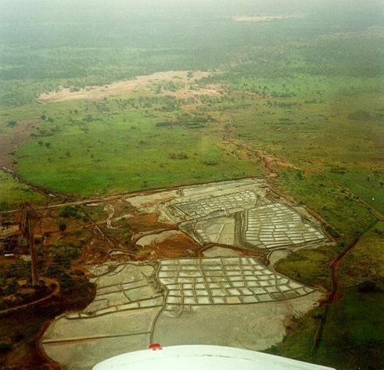
KCC (Kasese Cobalt Company): An industrial project of cobalt recovery
using bioleaching technology as an answer to an environmental issue
Bioleaching application for mine tailings reprocessing and metal recovery
Pollution of the National Park
Context: Kilembe Mine - Kasese (Uganda)
Former Cu mine -> 1,1 million tons of tailings
Fine (<200µm) and heavy material (d ± 4.5)
Pyrite FeS2: 80%
1.38% cobalt disseminated in the pyrite lattice
Biology:
Identification of a biological activity around the stockpiles and in the drainage: natural bioleaching process
Mesophile to moderate thermophile microbial consortium (Leptospirillum ferriphilum, Acidithiobacillus caldus, Sulfobacillus benefaciens…)
Preliminary bioleach amenability tests in lab: more than 95% of Co recovery
Mining Stockpiles
A way to stop the discharge trail from the KASESE site to the Queen Elisabeth
National Park due to runoff and natural bioleaching of the concentrate
An alternative to technologies which are air-polluting (roasting), or energy consuming (roasting and high-pressure leaching)

