Slide 1
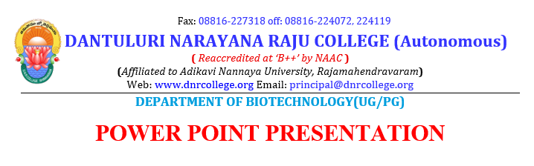
Presented By:
P D R SATISH
ASSISTANT PROFESSOR

Slide 2
BIOREMEDIATION

Slide 3
Bioremediation
Bioremediation is the use of microorganisms to destroy or immobilize waste materials
Microorganisms include: Bacteria (aerobic and anaerobic) Fungi
Actinomycetes (filamentous bacteria)

Slide 4
Bioremediation mechanism
Microorganisms destroy organic contaminants in the course of using the chemicals for their own growth and reproduction
Organic chemicals provide:
carbon, source of cell building material electrons, source of energy
Cells catalyze oxidation of organic chemicals (electron donors), causing transfer of electrons from organic chemicals to some electron acceptor

Slide 5
Electron acceptors
Electron acceptors:
In aerobic oxidation, acceptor is oxygen
In anaerobic, acceptor is (with decreasing efficiency):
nitrate manganese iron
sulfate
Microorganisms also need essential nutrients such as nitrogen and phosphorus

Slide 6
Bacterial growth
Typically very rapid if food (carbon source) is present: population doubles every 45 minutes
Pristine soils contain 100 to 1000 aerobic bacteria per gram of soil
Increases to 10⁵ within one week if carbon source is introduced

Slide 7
Limitations to biodegradation
Adequate bacterial concentrations (although populations generally increase if there is food present)
Electron acceptors
Nutrients (e.g., nitrogen and phosphorus)
Non-toxic conditions (NAPL pools are likely to be toxic)
Minimum carbon source (which may exceed regulatory limits for toxic chemicals)
Note that rapid growth may be limited by diffusive or advective transport of any of the above

Slide 8
History of bioremediation
1972 - First commercial application: Sun Oil pipeline spill in Ambler, Pennsylvania
1970s - Continuing bioremediation projects by Richard Raymond of Sun Oil
mid-1980s - emphasis on bioengineering organisms for bioremediation. This technology did not live up to its initial promise
1990s - emphasis switched to greater reliance on natural microorganisms and techniques to enhance their performance

Slide 9
Relative biodegradability
Simple hydrocarbons and petroleum fuels
degradability decreases as molecular weight and degree of branching increase
Aromatic hydrocarbons
one or two ring compounds degrade readily, higher molecular weight compounds less readily
Alcohols, esters
Nitrobenzenes and ethers degrade slowly Chlorinated hydrocarbons
decreasing degradability within increasing chlorine
substitution – highly chlorinated compounds like PCBs and chlorinated solvents do not appreciably degrade aerobically
Pesticides are not readily degraded
Increasing biodegradability

Slide 10
Bioremediation technologies for soil
Composting – addition of moisture and nutrients, regular mixing for aeration
Biopiles – ex-situ aeration of soil Bioventing – in-situ aeration of soil
Land treatment – application of organic materials to natural soils followed by irrigation and tilling

Slide 11
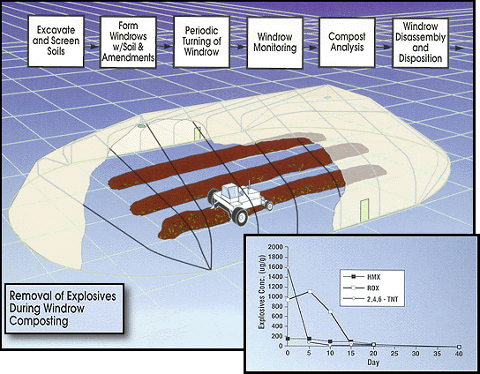
Composting
Source: U.S.AEC, 2000. Windrow Composting of Explosives-Contaminated Soil. U.S. Army Environmental Center. (http://aec.army.mil/prod/usaec/et/restor/ windrow.htm)
Composting is a process by which organic wastes are degraded by microorganisms, typically at elevated temperatures. Typical compost temperatures are in the range of 55° to 65° Celsius. The increased temperatures result from heat produced by microorganisms during the degradation of the organic material in the waste.
Windrow composting has been demonstrated using the following basic steps. First, contaminated soils are excavated and screened to remove large rocks and debris. The soil is transported to a composting pad with a temporary structure to provide containment and protection from weather extremes. Amendments (straw, alfalfa, manure, agricultural wastes and wood chips) are used for
bulking agents and as a supplemental carbon source. Soil and amendments are layered into long piles, known as windrows. The windrow is thoroughly mixed by turning with a commercially
available windrow turning machine. Moisture, pH, temperature, and explosives concentration are monitored. At the completion of the composting period the windrows would be disassembled and the compost is taken to the final disposal area.
PROCESS PERFORMANCE
Windrow composting has been demonstrated as an effective technology for treatment of explosives-contaminated soil. During a field demonstration conducted by USAEC at UMDA, TNT reductions were as high as 99.7% at 30% soil in 40 days of operation, with the majority of removal occurring in the first 20 days of operation. Maximum removal efficiencies for RDX and HMX were 99.8% and 96.8% respectively.

Slide 12
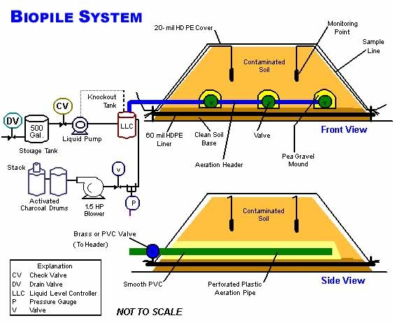
Source: USAEC, 2000. Biopiles of POL Contaminated Soils. U.S. Army Engineer Environmental Center. (http://aec.army.mil/prod/usaec/et
/restor/pol01.htm)
Biopile treatment is a full-scale technology in which excavated soils are mixed with soil amendments, placed on a treatment area, and bioremediated using forced aeration. The contaminants are reduced to carbon dioxide and water.
Developed by the Naval Facilities Engineering Service Center, the basic biopile system includes a treatment bed, an aeration system, an irrigation/nutrient system and a leachate collection system. Moisture, heat, nutrients, oxygen, and pH are controlled to enhance biodegradation. The irrigation/nutrient system is buried under the soil to pass air and nutrients either by vacuum or positive
pressure. Soil piles can be up to 20 feet high and may be covered with plastic to control runoff, evaporation and volatilization, and to promote solar heating. If volatile organic compounds (VOCs) in the soil volatilize into the air stream, the air leaving the soil may be treated to remove or destroy the VOCs before they are discharged into the atmosphere. Treatment time is typically 3 to 6 months.

Slide 13
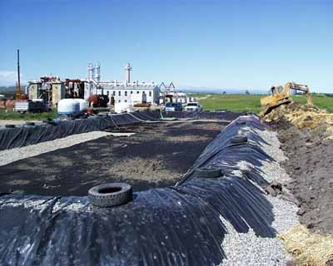
Biopile
Source: Environmental Protection Agency, Tech Trends newsletter, June 2001. http://www.epa.gov/swertio1/do wnload/newsltrs/tt0601.pdf.
Accessed May 11, 2004.
Researchers at the University of North Dakota’s Energy & Environmental Research Center began studying related site-specific issues and remediation options for soil contaminated with amines, amine byproducts, and salts at a decommissioned gas plant near Calgary, Alberta.
Construction of the biopile (Figure 1) was completed over an 8-day period in July 1998. The completed containment cell measured 40 meters long by 10 meters wide and 1.5 meters deep. Above a
25-mil reinforced polyethylene bottom liner in the cell was a thin layer of crushed gravel covered by a filter fabric. The overlaying soil layer was mounded and enclosed by another liner. Approximately 450 cubic meters of treatment soils were housed within the constructed cell.
Soil additives to the system included 2.58 cubic meters of calcium chloride to increase soil permeability, as well as 2,036 kilograms of 10-34-00 (percent nitrogen-phosphorus-potassium) liquid
fertilizer for increasing the microbial population and consequent biodegradation rate. To act as a bulking agent for increased porosity and permeability in the biopile, 50 cubic meters of straw were added within the treatment cell.
One 100-mm, perforated polyvinyl chloride air vent powered by an external blower unit provided system aeration, along with four equally spaced, 50-mm flow ducts running the entire length of the cell. Microbial activity was enhanced by the addition of water through an irrigation system comprising five semipermeable hoses extending the cell length and powered by an external fresh water
supply. The frequency and amount of water application were determined by weekly soil moisture measurements. Excessive salt leachate was collected in a sump located directly below the crushed gravel layer, temporarily stored in a reinforced external tank, and ultimately disposed in an onsite injection well.
Following approximately three months of treatment in 1998 and two months in 1999, data indicated that biodegradation of the amine-related materials likely was complete. The remaining material was considered to be leachable but not biodegradable. At that point, the system began operating in a leaching mode and continued in this way for the remaining two months of treatment in 1999 and
four months in 2000. Over the course of leaching mode operation, approximately 85,000 Imperial gallons of water (approximately 3 pore volumes) were applied to the biopile.
Soil sampling was conducted at project start-up and bimonthly throughout the active treatment periods. Key soil character parameters used to evaluate general activity of the biopile included total Kjeldahl nitrogen (TKN, a measure of both ammonia and organic nitrogen), ammonia nitrogen (NH3-N), nitrate plus nitrite nitrogen (NOx-N) compounds, and total organic carbon. Based on the results of 20 sampling events over the course of treatment, data showed that TKN and total organic nitrogen concentrations decreased, while concentrations of ammonia and NOx-N (the byproducts of alkanolamines and other organic nitrogenous compounds) increased. During final stages of the study, however, TKN and total organic carbon levels remained steady while ammonia and nitrogen compound levels dropped significantly, thus indicating that the biodegradation of alkanolamines and the formation of thermal/oxidative products were complete. Final analysis showed that alkanolamine concentrations were reduced to levels below the detection limit following treatment, from an initial concentration of 15,000 mg/kg.
The estimated cost of treating contaminated soil at this site through use of the biopile was $45 per cubic meter ($34.40 per cubic yard), exclusive of engineering and analytical costs. Researchers estimate that this cost could be reduced further in large-scale applications and if containment liners are not required. For more information, contact J.R. Gallagher (University of North Dakota).

Slide 14
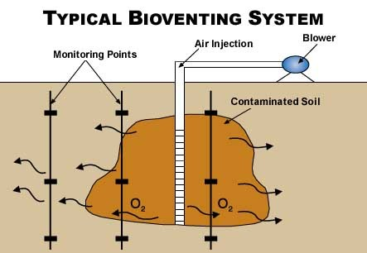
Bioventing
Source: USAEC, 2000.
Bioventing of POL Contaminated Soils.
U.S. Army Environmental Center. (http://aec.army.mil/pro d/usaec/et/restor/pol03
.htm)
Developed by the Air Force Center for Environmental Excellence, bioventing stimulates the in-situ biodegradation of POLs by providing oxygen to microorganisms in the soil. The system supplies oxygen by injecting air directly into the residual contamination (see below). In contrast to soil vapor vacuum extraction (SVE), bioventing uses low airflow rates to provide only enough oxygen to sustain microbial activity. Optimal flow rates maximize biodegradation as vapors move slowly through biologically active soil while minimizing volatilization of contaminants.
A basic bioventing system includes a well and a blower, which pumps air through the well and into the soil. Bioventing has been approved in 38 states and all 10 Environmental Protection Agency (EPA) regions.

Slide 15
Bioremediation technology for floating product
Bioslurping – two-phase vapor extraction that also encourages biodegradation

Slide 16
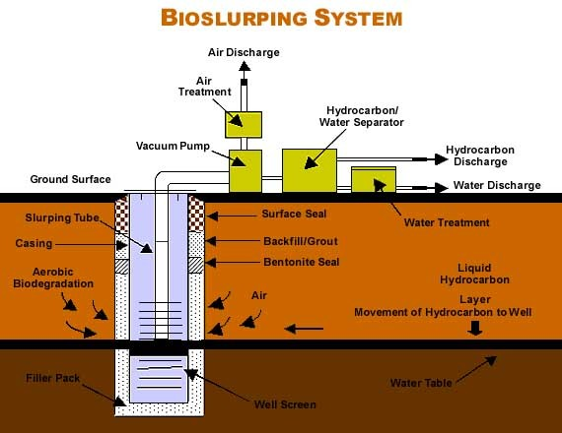
Source: USAEC, 2000.
Bioslurping of POL Contaminated Soils. U.S. Army Environmental Center. (http://aec.army.mil/prod/us aec/et/restor/pol02.htm)
Now comes a dynamic new technology that accomplishes both actions at once. Bioslurping teams vacuum-assisted free-product recovery with bioventing to simultaneously recover free product and remediate the vadose zone.
Developed by the Air Force Center for Environmental Excellence, the bioslurper system uses a "slurp" tube that extends into the free-product layer. Much like a straw draws soda and air through crushed ice in a drinking glass, the pump draws liquid (including free product) and soil gas up the tube in the same process stream. The driving force of the vacuum provides better product recovery
than conventional methods that rely only on gravity.
The product flow proceeds horizontally, reducing the entrapment or "smearing" typical of conventional pump systems. Bioventing occurs as the system extracts soil gas from the subsurface - oxygen flow from the entering air promotes aerobic biodegradation throughout the affected vadose zone and capillary fringe.

Slide 17
Bioremediation technologies for ground water
Bioremediation - addition of one or more of the following to stimulate bacterial growth:
Nutrients
Carbon source (dextrose, molasses) Oxygen
Circulation

Slide 18
Amendment introduction methods
Injection wells Infiltration
Passive introduction of chemicals

Slide 19
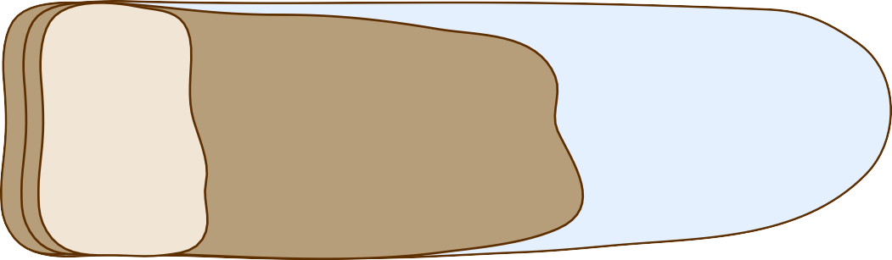
Amendment introduction via injection wells
Amendment Injection Wells
Extent of Dissolved Contaminant Plume
Ground Surface
GROUNDWATER LEVEL
Groundwater Flow Direction
Injected Amendment
AQUITARD
Organic Amendment Zone
Reactive Zone: Area of Enhanced Contaminant Degradation
DNAPL

