Slide 1
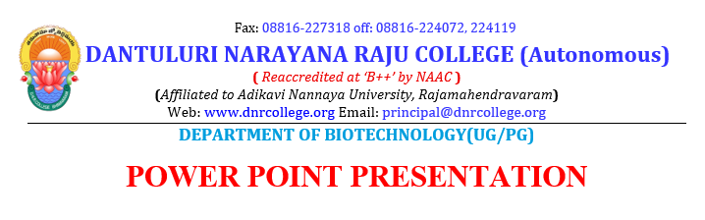
Presented By:
P D R SATISH
ASSISTANT PROFESSOR

Slide 2
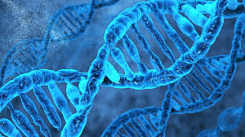
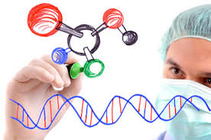
RECOMBINANT DNA

Slide 3

Introduction
Definition
Steps
Applications

Slide 4
INTRODUCTION
Recombinant DNA (rDNA): DNA molecules formed by laboratory methods of genetic recombination (such as molecular cloning) to bring together genetic material from multiple sources, creating sequences that would not otherwise be found in the genome.
rDNA is possible because DNA molecules from all organisms share the same chemical structure. They differ only in the nucleotide sequence within that identical overall structure.

Slide 5
rDNA is the general name for a piece of DNA that has been created by the combination of at least two strands. rDNA molecules are sometimes called chimeric DNA, because they can be made of material from two different species, like the mythical chimera. R-DNA technology uses palindromic sequences and leads to the production of sticky and blunt ends.

Slide 6
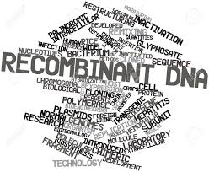
What is Recombinant DNA
This is DNA that has been formed artificially by combining constituents from different organisms.

Slide 7
Recombinant DNA Technology
Using Recombinant DNA technology, we can isolate and clone single copy of a gene or a DNA segment into an indefinite number of copies, all identical. These new combinations of genetic material or Recombinant DNA (rDNA) molecules are introduced into the host cells, where they propagate and multiply. The technique or methodology is called Recombinant DNA technology.

Slide 8
Obtaining rDNA
Step 1: The DNA fragment containing the gene sequence to be cloned (also known as insert) is isolated.
Step 2: Cutting DNA.
Step 3: Joining DNA
Step 4: Insertion of these DNA fragments into host cell using a “vector” (carries DNA molecule).

Slide 9
Conti…
Step 5: The rDNA molecules are generated when the vector self replicates in the host cell.
Step 6: Transfer of the rDNA molecules into an appropriate host cell.
Step 7: Selection of the host cells carring the rDNA molecule using a marker.
Step 8: Replication of the cells carrying rDNA molecules to get a genetically identical cells or clone.

Slide 10
Isolation
The first step in making recombinant DNA is to isolate donar and vector DNA. The procedure used for obtaining vector DNA depends on the nature of the vector. Bacterial plasmids are commonly used vectors, and these plasmids must be purified away from the bacterial genomics DNA.

Slide 11
Ultracentrifugation
A protocol for extracting plasmids DNA can be achieved by ultracentrifugation Plasmids DNA forms a distinct band after ultracentrifugation in a cesium chloride density gradient containing ethidium bromide. The plasmid band is collected by punching a hole in the plastic centrifuge tube.
https://www.youtube.com/watch?v=n-lVxNjfeio

Slide 12
Alkaline Lysis
Another protocol relies on the observation that, at a specific alkaline pH, bacterial genomic DNA denatures but plasmids do not. Subsequent neutralization precipitates the genomic DNA, but plasmids stay in solution. Phages can also be used as vectors for cloning DNA in bacterial systems. Phage DNA is isolated from a pure suspension of phages recovered from a phage lysate.

Slide 13

Cutting DNA
The restriction enzymes EcoRi cuts a circular DNA molecule bearing one target sequence, resulting in a linear molecule with single stranded sticky ends.

Slide 14
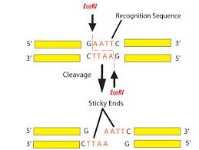

Slide 15
Insertion
Choosing a gene Cloning Vector
A vector is any DNA molecule which is capable of multiplying inside the host to which our gene of interest is integrated for cloning. In this process restriction enzyme function as scissors for cutting the DNA molecule. Ligase enzyme is the joining enzyme that join the vector DNA with the gene of interest this will produce the recombinant DNA.

Slide 16
Introducing Vector DNA into Host Cell
Plasmid Vector
The vector is added to a flask containing a culture of E.coli.
Calcium ions usually in the form of calcium chloride are added to the flask followed by a brief heat shock.
This allows holes to briefly appear in the cell surface membrane of the E.coli making it permeable to DNA and allowing the plasmids to enter.

Slide 17
Phage Vectors
Introduced by infection of bacterial lawn growing on an agar plate.
The culture or growth of viruses is made more difficult than the culture of bacteria or fungi by the fact that viruses will only grow.

Slide 18
Placing the Gene in the vector.
Plasmid DNA
DNA molecule are small and can be easily separated based on the size.
Bacterial cells are broken open and chromosomal DNA is centrifuged down.
This leaves the plasmid DNA in the liquid above the pellet.
The plasmid are purified before cutting with a restriction enzyme.

Slide 19
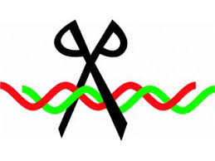
Conti…
Restriction fragments from donar DNA are mixed with plasmid DNA and joined by their sticky ends, the initial attraction is due to the hydrogen bonds, but the sugar phosphate backbone is then joined using and enzyme called DNA ligase.

Slide 20
Example of use of Recombinant DNA Technology
Insulin Production
The DNA for insulin is first isolated
A plasmid made of DNA is removed from a bacterial cell
A restriction enzyme cuts the plasmid DNA open, leaving sticky ends.
The insulin gene, with complementary sticky ends is added.

Slide 21
Examples of Use of Recombinant DNA Technology
DNA ligase enzyme splices (joins) together the plasmid DNA and the insulin DNA.
The plasmid (now genetically modified) is inserted back into the bacterium.
The bacterium host cell, divides and produces copies of the plasmid.
The Bacterium makes human insulin using the gene in the plasmid.
The insulin is extracted from the bacterial culture.

Slide 22
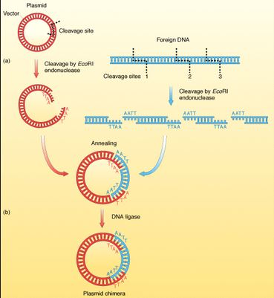
Joining DNA

Slide 23
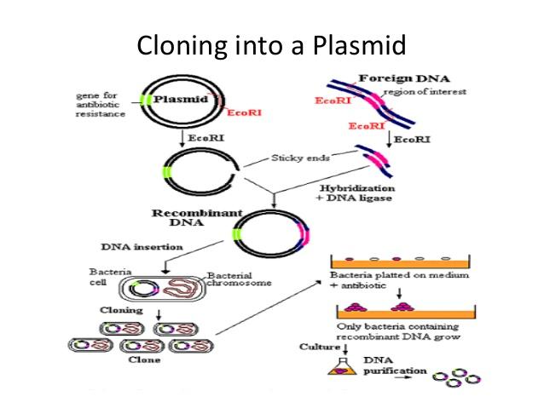

Slide 24
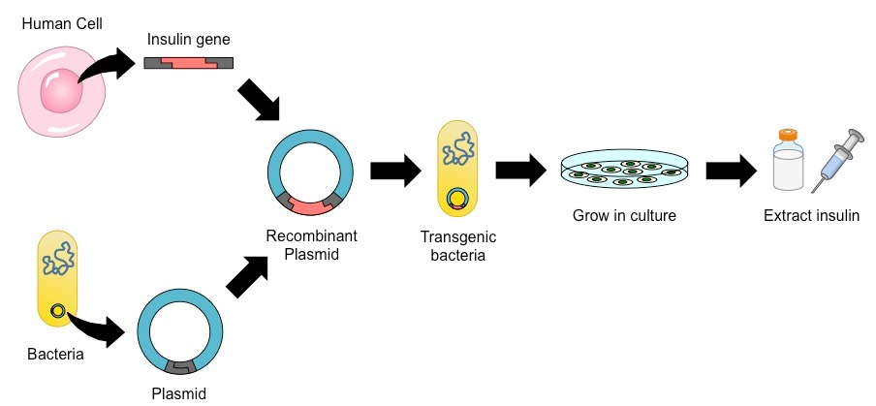
Production of an Insulin

Slide 25
Applications
Preparation of gene maps.
In revealing details of various infections, diseases such as "inborn errors of metabolism."
Finding out the complete nucleotide sequence of genome of an organism and identification of genes.
Detecting cytogenetic abnormalities e.g. Down's syndrome, multifactorial disorders, atherosclerosis, coronary artery disease etc.
Preventing various genetic disorders e.g. inherited haemoglobin disorders, phenylketonuria, retinoblastoma etc.
Understand a molecular event is biological processes like growth, differentiation, ageing etc.

Slide 26
Conti…
Replacement or correction of deleterious mutation by transfer of clone gene in a patient.
Production of genetically modified organisms (GMOs) or transgenic organisms for providing particular product and nutrient.
Gene Therapy: Removal and replacement of defective genes with normal healthy functional genes is known as gene therapy e.g. Sickle cell anaemia, Severe Combined Immuno-Deficiency (SCID). SCID is due to a defect in the gene for the enzyme adenosine deaminase (ADA) in 25 per cent of the cases.

Slide 27
It has several negative features as well: extensive erosion and genetic destruction of plant Germplasm; ecological imbalance; production of monsters; production of dangerous toxic chemicals, production of highly lethal microbes and their use in microbiological warfare to kill humans, animals and plants.

