Slide 1

Presented By:
P D R SATISH
ASSISTANT PROFESSOR

Slide 2
Blotting techniques

Slide 3
What is blotting?
Blots are techniques for transferring DNA , RNA and proteins onto a carrier so they can be separated, and often follows the use of a gel electrophoresis. The Southern blot is used for transferring DNA, the Northern blot for RNA and the western blot for PROTEIN.

Slide 4
TYPES OF BLOTTING TECHNIQUES
Blotting technique
Southern Blot
It is used to detect DNA.
Northern Blot
It is used to detect RNA.
Western blot
It is used to detect protein.

Slide 5
SOUTHERN BLOTTING
The technique was developed by E.M. Southern in 1975.
The Southern blot is used to detect the presence of a particular piece of DNA in a sample.
The DNA detected can be a single gene, or it can be part of a larger piece of DNA such as a viral genome.

Slide 6
Cont….
Southern blotting combines agarose gel electrophoresis for size separation of DNA with methods to transfer the size separated DNA to a filter membrane for probe hybridization.
The key to this method is Hybridization.
Hybridization - Process of forming a double-stranded DNA molecule between a single-stranded DNA probe and a single-stranded target patient DNA.

Slide 7

PRINCIPLE
  1. The mixture of molecules is separated.
  2. The molecules are immobilized on a matrix.
  3. The probe is added to the matrix to bind to the molecules.
  4. Any unbound probes are then removed.
  5. The place where the probe is connected corresponds to the location of the immobilized target molecule.

Slide 8
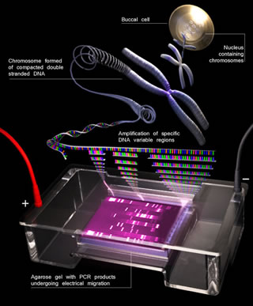
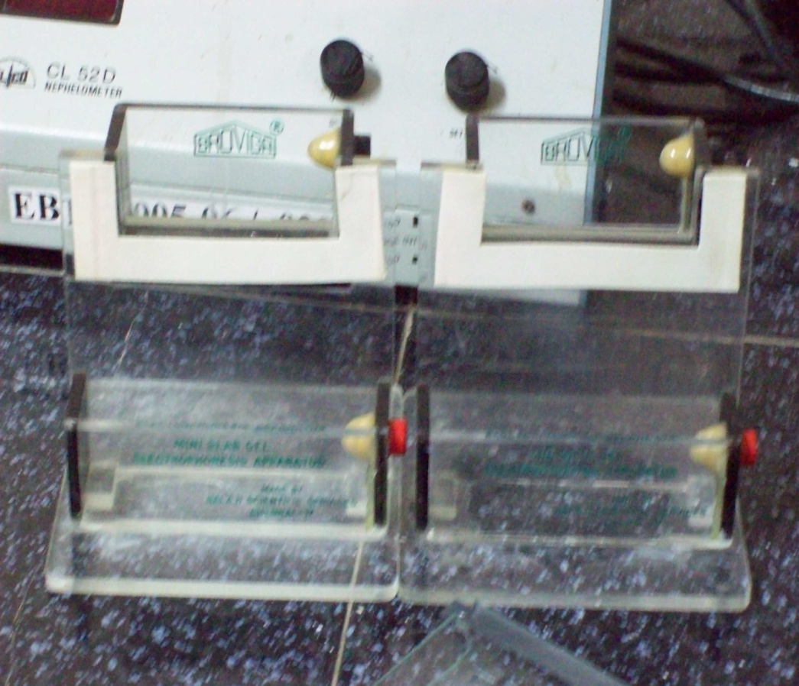
APPARATUS

Slide 9
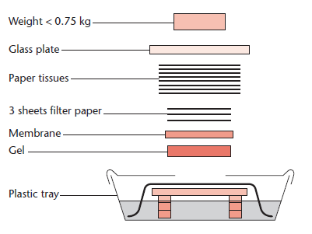
Capillary plotting apparatus

Slide 10
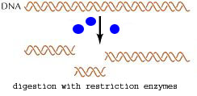
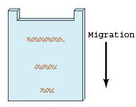
Steps in southern blotting
1. Digest the DNA with an appropriate restriction enzyme.
2.The complex mixture of fragments is subjected to gel electrophoresis to separate the fragments according to size.

Slide 11
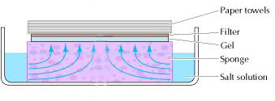
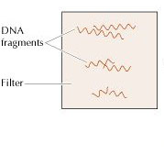
Cont….
3.The restriction fragments present in the gel are denatured with alkali and transferred onto
4. a nitrocellulose filter or nylon membrane by blotting.
This procedure preserves the distribution of the fragments in the gel, creating a replica of the gel on the filter.

Slide 12
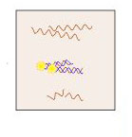
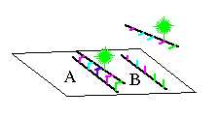
Cont….
5.The filter is incubated under hybridization conditions with a specific radiolabeled DNA probe.
The probe hybridizes to the complementary DNA restriction fragment.

Slide 13
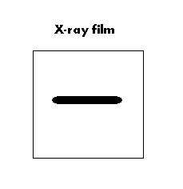
Cont….
6.Excess probe is washed away and the probe bound to the filter is detected by autoradiography, which reveals the DNA fragment to which the probe hybridized.

Slide 14
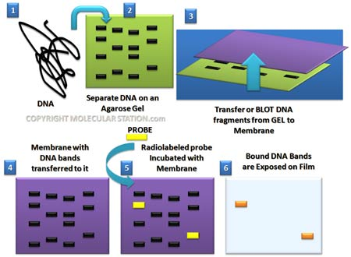

Slide 15
SUMMARY OF PROCEDURE
  1. Extract and purify DNA from cells
  2. DNA is restricted with enzymes
  3. Sort by electrophoresis
  4. Denature DNA
  5. Transfer to nitrocellulose paper
  6. Block with excess DNA
  7. Wash off unbound probe
  8. Autoradiograph

Slide 17
APPLICATIONS
Southern blots are used in gene discovery , mapping, evolution and development studies, diagnostics and forensics (It is used for DNA fingerprinting, preparation of RFLP maps)
identification of the transferred genes in transgenic individuals, etc.

Slide 18
Northern Blotting
Northern blotting is a technique for detection of specific RNA sequences. Northern blotting was developed by James Alwine and George Stark at Stanford University (1979) and was named such by analogy to Southern blotting

Slide 19
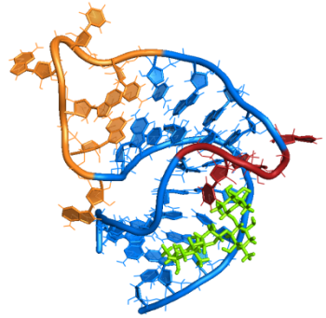
Steps involved in Northern blotting
1. RNA is isolated from several biological samples (e.g. various tissues, various developmental stages of same tissue etc.)
* RNA is more susceptible to degradation than DNA.

Slide 20
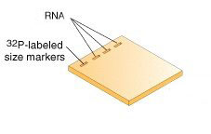
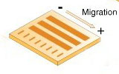
Cont……
2. Sample’s are loaded on gel and the RNA samples are separated according to their size on an agarose gel .
The resulting gel following after the electrophoresis run.

Slide 21
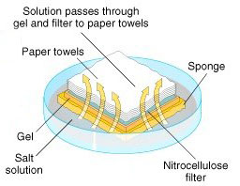
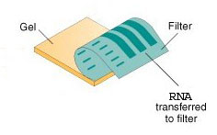
Cont……
3. The gel is then blotted on a nylon membrane or a nitrocellulose filter paper/ diazobenzyloxymethyl papers by creating the sandwich arrangement.

Slide 22
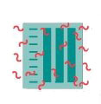
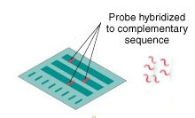
Cont……
4. The membrane is placed in a dish containing hybridization buffer with a labeled probe.
Thus, it will hybridize to the RNA on the blot that corresponds to the sequence of interest.
5. The membrane is washed to remove unbound probe.

Slide 23
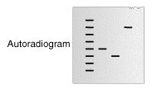
Cont……
6. The labeled probe is detected via autoradiography or via a chemiluminescence reaction (if a chemically labeled probe is used). In both cases this results in the formation of a dark band on an X-ray film.
Now the expression patterns of the sequence of interest in the different samples can be compared.

Slide 24
APPLICATIONS
A standard for the study of gene expression at the level of mRNA(messenger RNA transcripts)
Detection of mRNA transcript size
Study RNA degradation
Study RNA splicing
Study RNA half-life
Often used to confirm and check transgenic / knockout mice (animals)

Slide 25
Disadvantage of Nourthern plotting
1.The standard northern blot method is relatively less sensitive
2. Detection with multiple probes is a problem
3. If RNA samples are even slightly degraded by RNases, the quality of the data and quantitation of expression is quite negatively affected.

Slide 26
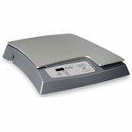

Western blotting
Western blotting (1981) is an Immunoblotting technique which rely on the specificity of binding between a protein of interest and a probe (antibody raised against that particular protein) to allow detection of the protein of interest in a mixture of many other similar molecules.
The SDS PAGE technique is a prerequisite for Western blotting .

Slide 27
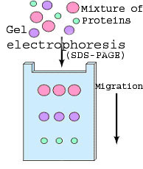
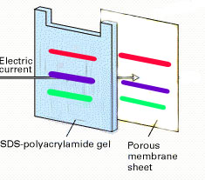
Steps in western blotting
A protein sample is subjected to electrophoresis on an SDS-polyacrylamide gel.
Electroblotting transfers the separated proteins from the gel to the surface of a nitrocellulose membrane.

Slide 28
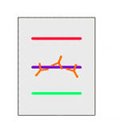
Cont…
3. The blot is incubated with a generic protein (such as milk proteins or BSA) which binds to any remaining sticky places on the nitrocellulose.
4. An antibody that is specific for the protein of interest (the primary antibody - Ab1) is added to the nitrocellulose sheet and reacts with the antigen. Only the band containing the protein of interest binds the antibody, forming a layer of antibody molecules .

Slide 29
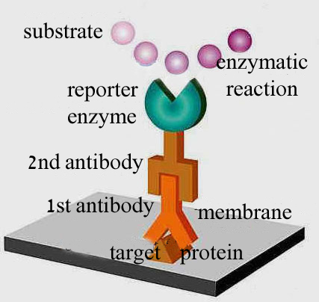
Cont…
5. After washing for removal of non-specifically bound Ab1, second antibody (Ab2)is added, which specifically recognizes the Fc domain of the primary antibody and binds it. Ab2 is radioactively labeled, or is covalently linked to a reporter enzyme, which allows to visualize the protein-Ab1-Ab2 complex.

Slide 30
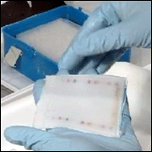
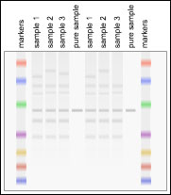
An example

Slide 31
Application
1.The confirmatory HIV test
2.Western blot is also used as the definitive test for Bovine spongiform encephalopathy (BSE(
3.Some forms of Lyme disease testing employ Western blotting.

