Slide 1
Presented By:
P D R SATISH
ASSISTANT PROFESSOR

Slide 2
What is blotting?
Blots are techniques for transferring DNA , RNA and proteins onto a carrier so they can be separated, and often follows the use of a gel electrophoresis. The Southern blot is used for transferring DNA, the Northern blot for RNA and the western blot for PROTEIN.

Slide 3
TYPES OF BLOTTING TECHNIQUES
Blotting technique
Southern Blot
It is used to detect DNA.
Northern Blot
It is used to detect RNA.
Western blot
It is used to detect protein.

Slide 4
Northern Blotting
Northern blotting is a technique for detection of specific RNA sequences. Northern blotting was developed by James Alwine and George Stark at Stanford University (1979) and was named such by analogy to Southern blotting

Slide 5
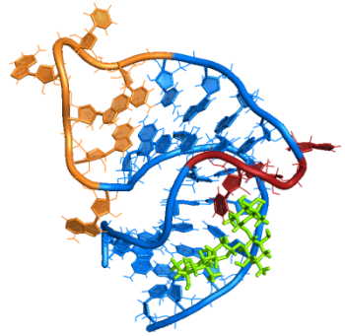
Steps involved in Northern blotting
1. RNA is isolated from several biological samples (e.g. various tissues, various developmental stages of same tissue etc.) * RNA is more susceptible to degradation than DNA.

Slide 6
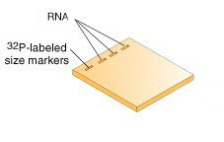
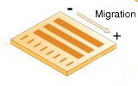
Cont……
2. Sample’s are loaded on gel and the RNA samples are separated according to their size on an agarose gel .
The resulting gel following after the electrophoresis run.

Slide 7
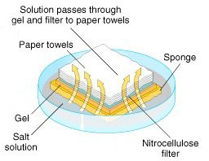
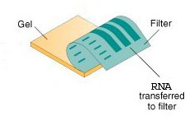
Cont……
3. The gel is then blotted on a nylon membrane or a nitrocellulose filter paper/ diazobenzyloxymethyl papers by creating the sandwich arrangement.

Slide 8
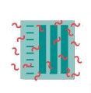
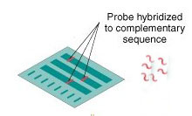
Cont……
4. The membrane is placed in a dish containing hybridization buffer with a labeled probe.
Thus, it will hybridize to the RNA on the blot that corresponds to the sequence of interest.
5. The membrane is washed to remove unbound probe.

Slide 9
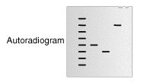
Cont……
6. The labeled probe is detected via autoradiography or via a chemiluminescence reaction (if a chemically labeled probe is used). In both cases this results in the formation of a dark band on an X-ray film.
Now the expression patterns of the sequence of interest in the different samples can be compared.

Slide 10
APPLICATIONS
A standard for the study of gene expression at the level of mRNA(messenger RNA transcripts)
Detection of mRNA transcript size
Study RNA degradation
Study RNA splicing
Study RNA half-life
Often used to confirm and check transgenic / knockout mice (animals)

Slide 11
Disadvantage of Nourthern plotting
1.The standard northern blot method is relatively less sensitive
2. Detection with multiple probes is a problem
3. If RNA samples are even slightly degraded by RNases, the quality of the data and quantitation of expression is quite negatively affected.

Slide 12
Western blotting
Western blotting (1981) is an Immunoblotting technique which rely on the specificity of binding between a protein of interest and a probe (antibody raised against that particular protein) to allow detection of the protein of interest in a mixture of many other similar molecules.
The SDS PAGE technique is a prerequisite for Western blotting .

Slide 13
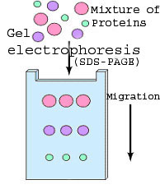
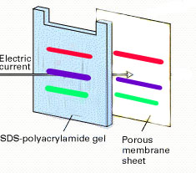
Steps in western blotting
A protein sample is subjected to electrophoresis on an SDS-polyacrylamide gel.
Electroblotting transfers the separated proteins from the gel to the surface of a nitrocellulose membrane.

Slide 14
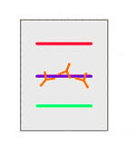
Cont…
3. The blot is incubated with a generic protein (such as milk proteins or BSA) which binds to any remaining sticky places on the nitrocellulose.
4. An antibody that is specific for the protein of interest (the primary antibody - Ab1) is added to the nitrocellulose sheet and reacts with the antigen. Only the band containing the protein of interest binds the antibody, forming a layer of antibody molecules .

Slide 15
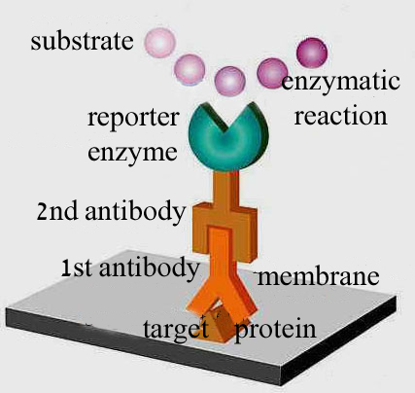
Cont…
5. After washing for removal of non-specifically bound Ab1, second antibody (Ab2)is added, which specifically recognizes the Fc domain of the primary antibody and binds it. Ab2 is radioactively labeled, or is covalently linked to a reporter enzyme, which allows to visualize the protein-Ab1-Ab2 complex.

Slide 16
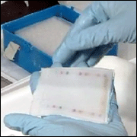
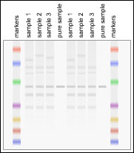
An example

Slide 17
Application
1.The confirmatory HIV test
2.Western blot is also used as the definitive test for Bovine spongiform encephalopathy (BSE(
3.Some forms of Lyme disease testing employ Western blotting.

