Slide 1

Presented By:
P D R SATISH
ASSISTANT PROFESSOR

Slide 2
Blotting techniques

Slide 3
What is blotting?
Blots are techniques for transferring DNA , RNA and proteins onto a carrier so they can be separated, and often follows the use of a gel electrophoresis. The Southern blot is used for transferring DNA, the Northern blot for RNA and the western blot for PROTEIN.

Slide 4
TYPES OF BLOTTING TECHNIQUES
Blotting technique
Southern Blot
It is used to detect DNA.
Northern Blot
It is used to detect RNA.
Western blot
It is used to detect protein.

Slide 5
SOUTHERN BLOTTING
The technique was developed by E.M. Southern in 1975.
The Southern blot is used to detect the presence of a particular piece of DNA in a sample.
The DNA detected can be a single gene, or it can be part of a larger piece of DNA such as a viral genome.

Slide 6
Cont….
Southern blotting combines agarose gel electrophoresis for size separation of DNA with methods to transfer the size separated DNA to a filter membrane for probe hybridization.
The key to this method is Hybridization.
Hybridization - Process of forming a double-stranded DNA molecule between a single-stranded DNA probe and a single-stranded target patient DNA.

Slide 7

PRINCIPLE
  1. The mixture of molecules is separated.
  2. The molecules are immobilized on a matrix.
  3. The probe is added to the matrix to bind to the molecules.
  4. Any unbound probes are then removed.
  5. The place where the probe is connected corresponds to the location of the immobilized target molecule.

Slide 8
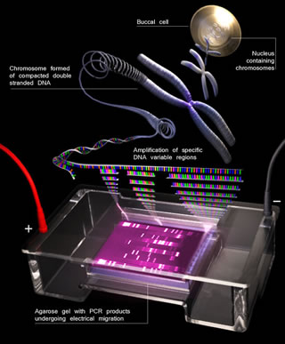
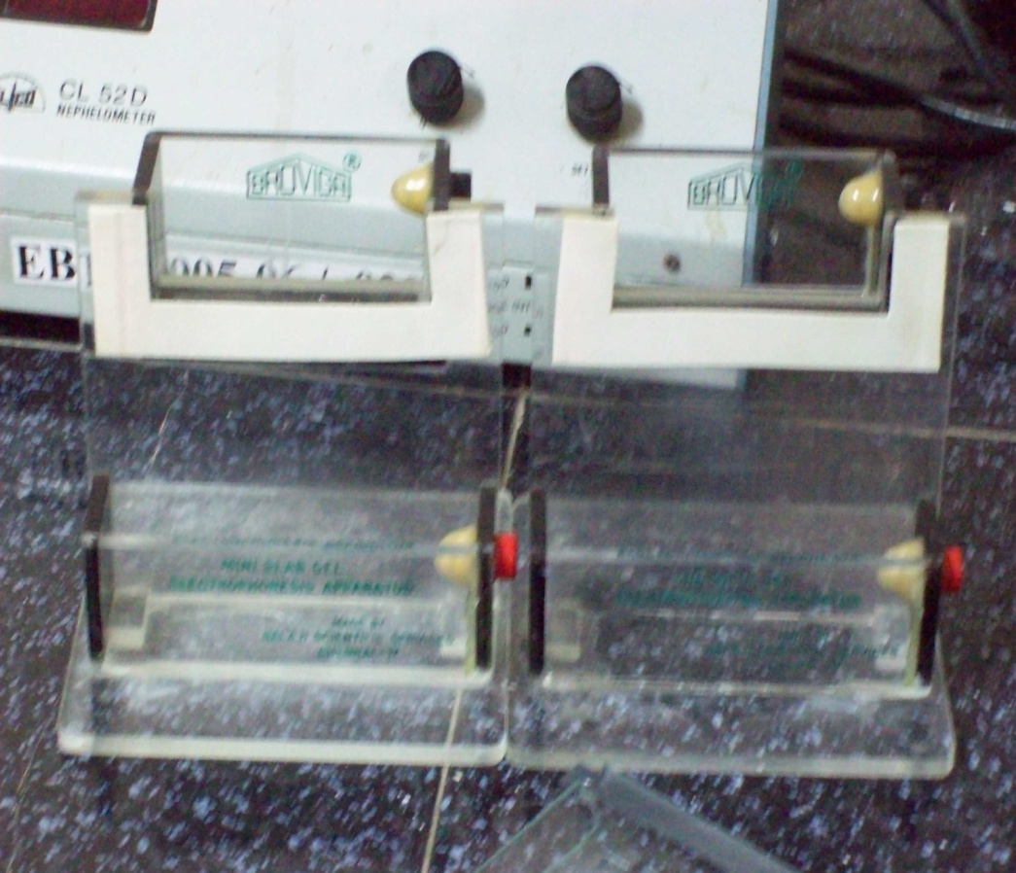
APPARATUS

Slide 9
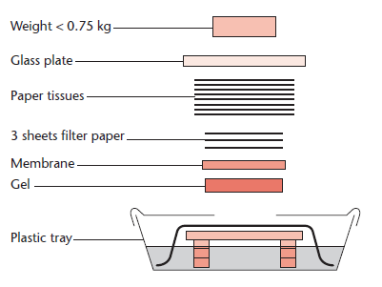
Capillary plotting apparatus

Slide 10
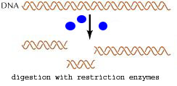
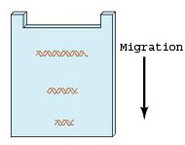
Steps in southern blotting
1. Digest the DNA with an appropriate restriction enzyme.
2.The complex mixture of fragments is subjected to gel electrophoresis to separate the fragments according to size.

Slide 11
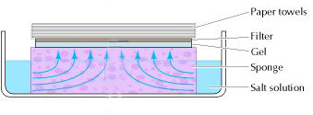
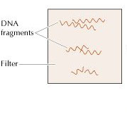
Cont….
3.The restriction fragments present in the gel are denatured with alkali and transferred onto
4. a nitrocellulose filter or nylon membrane by blotting.
This procedure preserves the distribution of the fragments in the gel, creating a replica of the gel on the filter.

Slide 12
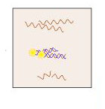
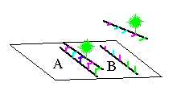
Cont….
5.The filter is incubated under hybridization conditions with a specific radiolabeled DNA probe.
The probe hybridizes to the complementary DNA restriction fragment.

Slide 13
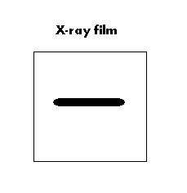
Cont….
6.Excess probe is washed away and the probe bound to the filter is detected by autoradiography, which reveals the DNA fragment to which the probe hybridized.

Slide 14
