Slide 1
METHODOLOGIES IN ASYMMETRIC SYNTHESIS
B.VN.K.SRIDEVI

Slide 2
CLASSIFICATION OF ASYMMETRIC SYNTHESIS:
The basic principle of asymmetric synthesis is by using chiral substrates,chiral auxillary,chiral reagent,chiral catalyst we can produce unequal ratio of stereo isomers.
Asymmetric synthesis can create a new chiral centre,based on the nature of the compounds,the asymmetric synthesis is divided into 4 types.
chiral substrates controlled asymmetric synthesis.
chiral auxillary controlled asymmetric synthesis.
chiral reagent controlled asymmetric synthesis.
chiral catalyst controlled asymmetric synthesis.

Slide 3
Chiral reagent controlled asymmetric synthesis:
Chiral reagents can form energetically different TS’s when approaching prochiral faces or groups on a molecule,and thus perform enantioselective reqctions directly on an achiral starting material.

Slide 4
Example:
Asymmetric reductions using BINAL-H (Alpine Borane) are a powerful method for achieving high enantioselectivity in the reduction of prochiral ketones and other carbonyl compounds. BINAL-H stands for B-isopinocampheyl-9-borabicyclo[3.3.1]nonane, and it exists in two enantiomeric forms, (R)- and (S)-BINAL-H, which can be used to induce chirality in the product.
Mechanism of Asymmetric Reduction with BINAL-H
Formation of the BINAL-H Complex: BINAL-H, a chiral borane reagent, forms a complex with the carbonyl compound. This complexation is crucial for the transfer of chirality.
Stereoselective Hydride Transfer: The hydride transfer occurs from the boron-hydrogen bond to the carbonyl carbon. The chirality of the boron complex dictates the approach of the hydride, leading to a preferential formation of one enantiomer over the other.
Release of the Alcohol Product: The product, a secondary alcohol, is released from the borane complex, and the borane is typically recycled or used in subsequent reactions.

Slide 5
Example: Reduction of Acetophenone
Let's consider the asymmetric reduction of acetophenone using (R)-BINAL-H​
Initial Complex Formation: Acetophenone forms a complex with (R)-BINAL-H.
Hydride Transfer: The hydride is transferred from the borane to the carbonyl carbon. The (R)-BINAL-H directs the hydride to one face of the planar carbonyl group, preferentially forming one enantiomer over the other.
Product Release: The product, (R)-1-phenylethanol, is released with high enantioselectivity.

Slide 6
Mechanism
To visualize the mechanism, consider the following simplified steps:
Complex Formation:
PhCOCH3​+(R)-BINAL-H→[PhCOCH3​⋅(R)-BINAL-H]
Hydride Transfer:
[PhCOCH3​⋅(R)-BINAL-H]→PhCH(OH)CH3​+BINAL-H
The hydride transfer is stereoselective due to the chiral environment provided by BINAL-H, leading to the preferential formation of one enantiomer.

Slide 7
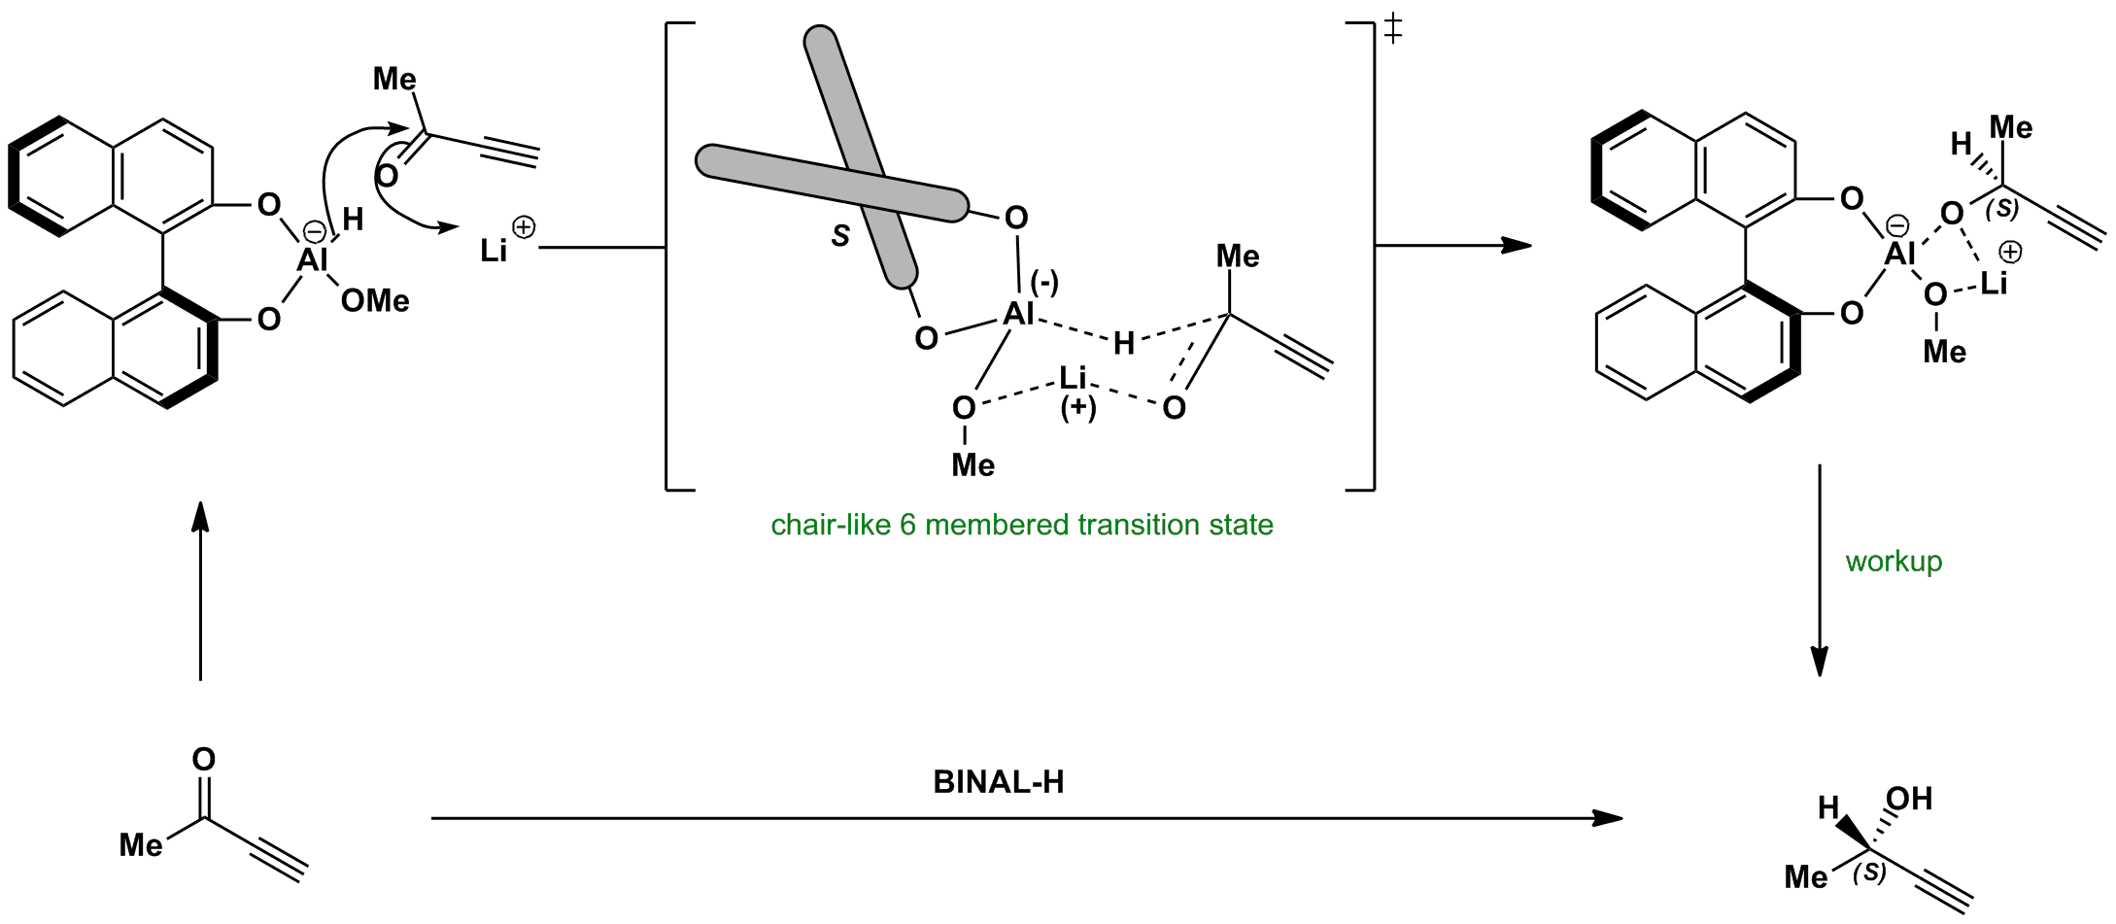

Slide 8
2.Asymmetric hydroboration using diisopinocampheylborane (Ipc₂BH) is a method for converting alkenes into chiral alcohols with high enantioselectivity. Ipc₂BH is a chiral borane reagent derived from the naturally occurring compound pinene, and it is available in both (R)- and (S)-enantiomeric forms.
Example: Hydroboration of Styrene
Let's consider the asymmetric hydroboration of styrene using (S)-Ipc₂BH:
​ PhCH=CH2​+(S)-Ipc2​BH→PhCH(BH2​)CH3​→PhCH(OH)CH3
Formation of the Borane-Alkene Complex: Styrene forms a complex with (S)-Ipc₂BH, aligning such that the steric bulk of the isopinocampheyl groups dictates the approach of the alkene.
Syn Addition: The boron atom and a hydrogen atom add to the same face of the double bond in styrene, forming a chiral organoborane intermediate.
Oxidative Workup: The intermediate is oxidized using H₂O₂ and NaOH, resulting in (S)-1-phenylethanol with high enantioselectivity.
​Complex Formation: PhCH=CH2​+(S)-Ipc2​BH→PhCH(BH2​)CH3​

Slide 9
THANK YOU

