Slide 1
BASIC QUANTUM CHEMISTRY-I
B.V.N.K.SRIDEVI

Slide 2
The Schrödinger equation is a fundamental equation in quantum mechanics that describes how the quantum state of a physical system changes over time. When applied to the hydrogen atom, the Schrödinger equation provides solutions that describe the allowed energy levels and corresponding wavefunctions of the electron.
For the hydrogen atom, which consists of a single proton and a single electron, we solve the time-independent Schrödinger equation in spherical coordinates because of the spherical symmetry of the problem. The time-independent Schrödinger equation is given by:
H^ψ=Eψ
where H^ is the Hamiltonian operator, E is the energy of the system, and ψ is the wavefunction of the electron.
The Hamiltonian for the Hydrogen Atom

Slide 3
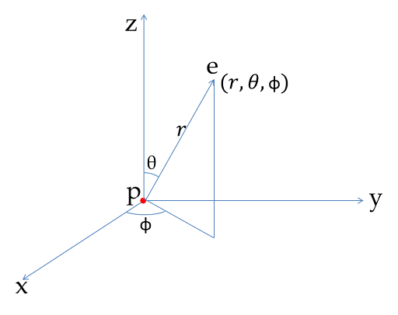

Slide 4
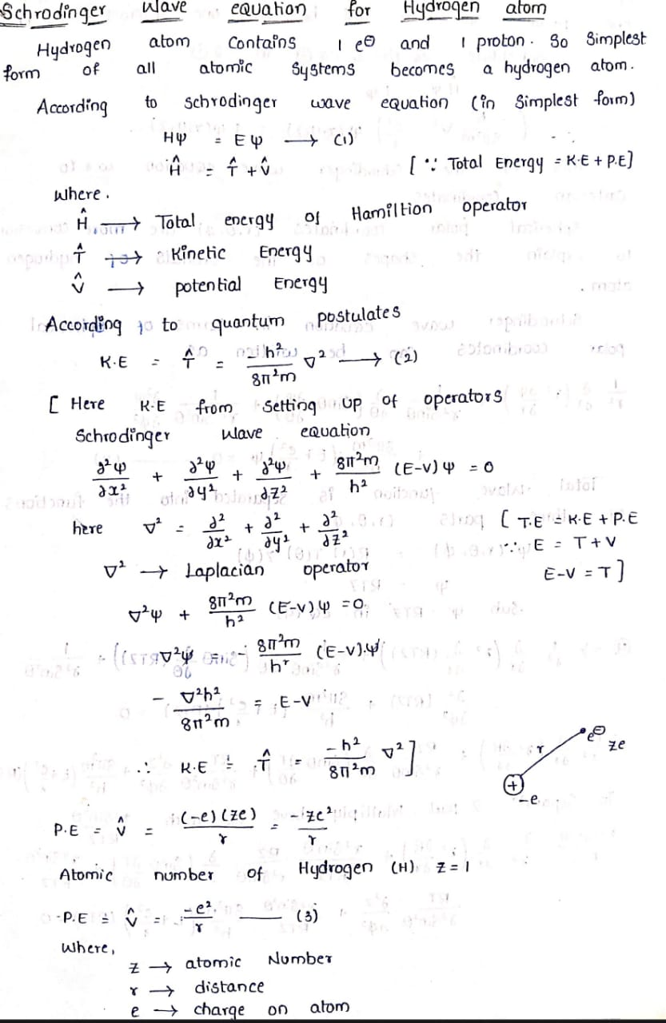

Slide 5
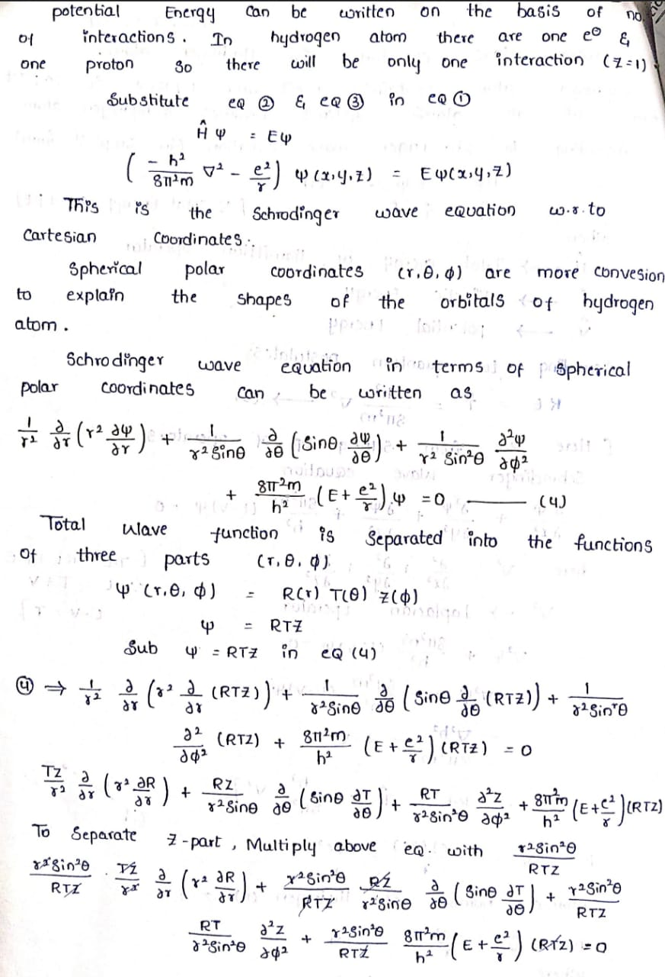

Slide 6
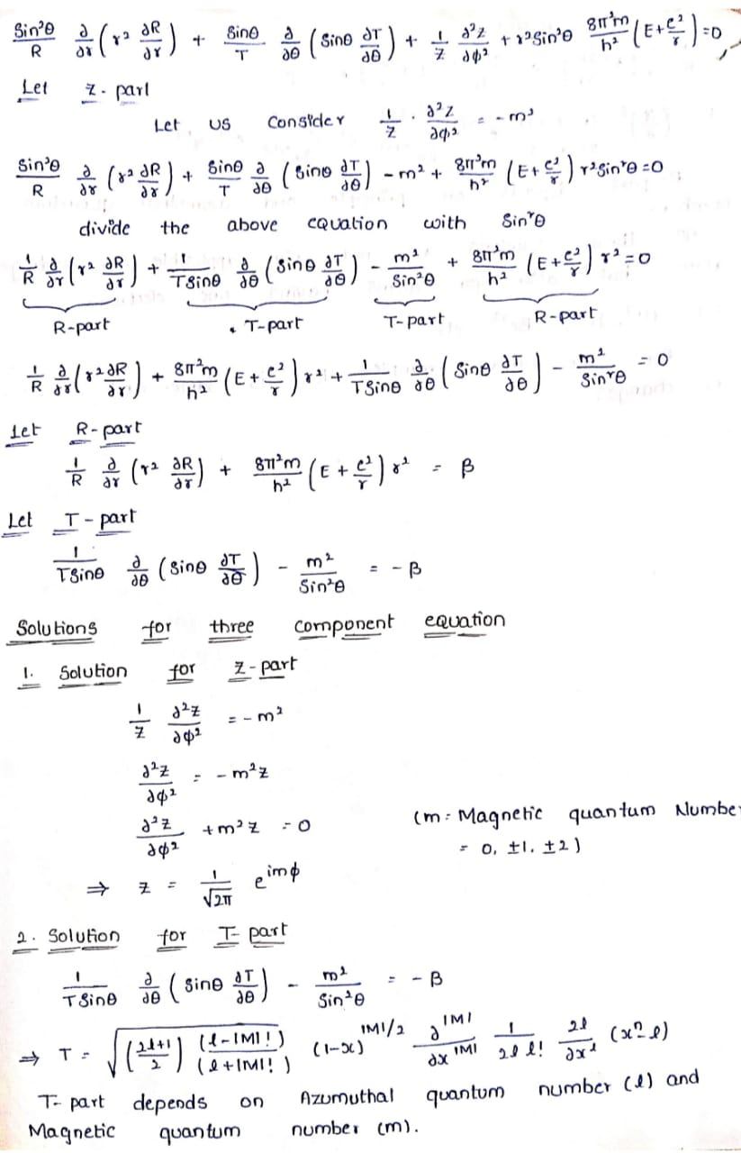

Slide 8
THANK YOU

