Slide 1
INORGANIC CHEMISTRY IN BORANES
N.SANTHI
DEPT of P.G CHEMISTRY

Slide 2
Boran hydrides are called boranes they are electron deficient compounds
Boran is a non metallic refractory element with a mp at2300
It is second only to carbon catenation
First boron hydride is prepared in 1909 by ALFRED STOCK
He synthesized and characterized six boranes they are
B2H6,B4H10 ,B5H9,B5H11,B6H10,B10H14
In 1958 W.V KOTLENSKY and R.SCHABBER synthesized nano borane n-B9H15

Slide 3
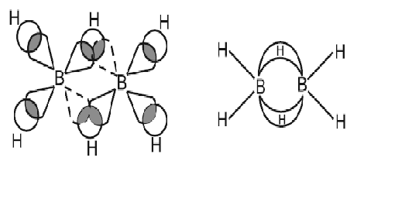
Boranes were believed to the most powerful Rocket Fuels
STRUCTURE:
In Diborane each boran atom is sp3 hybridised and is surrounded by a tetrahedron of hydrogen atoms

Slide 4
Out of four SP3 hybrid orbitals of boranes three orbitals has electrons &The remaining one is vacant orbital.
Diborane has six orbitals with electrons and two vacant orbitals boran forms four B-H bonds with hydrogen atoms.
The remaining orbital for Each Boran Has One Vacant Orbitals And One Orbital With Electron
Now one vacant orbital of boran and 1S orbital of hydrogen.
One orbital with electron of another boran atom involve in formation of 2B_H_B bonds b/w two boran atoms.
These bonds have three centers but there are only two electrons.

Slide 5
The B-H-B bonded hydrogen atoms are perpendicular to the plane of boran atoms and remaining hydrogens are in the same plane.
B-H-B bonds are called 3C-2e bonds (or) Banana bonds (or) Bridged bonds.

Slide 6
PREPARATIONS:
Diborane can be prepared by reaction of metal hydrides with boran trifluoride a convenient method being to drop BF3 etherate in a solution of sodium borohydride in ethylene glycol dimethyl ether
3NaBH4+4BF3→3NaBF4+2B2H6
B2H6 can be prepared by the reaction of BX3 using a reducing agent like NaH(or)LiAlH4
6NaH+8BF3 → 6NaBF4+4B2H6

Slide 7
3LiAlH4+4BCl3 →3Alcl3+3Licl+2B2H6
Action of H2SO4 on sodium borohydride also produce Diborane
2NaBH4+H2SO4 →Na2SO4+B2H6+2H2
At high temperature B2O3 reacts with H2 in the presence of Al+AlCl3 as catalyst to produce diborane
B2O3+6H2 →B2H6+3H2O
CHEMICAL PROPERTIES:
Hydrolysis:
Diborane on hydrolysis gives orthoboric acid along hydrogen gas.This method is good source for liberation of H2
B2H6+6H2O→2H3BO3+6H2

Slide 8
Reducing agent:
Diborane is powerful reducing agent for organic functional groups.Aldehydes and Cyanides are reduced to Alcohols and Amines respectively
R-CHO+B2H6 →R-CH2OH+B2O3
R-CN+B2H6 →R-CH2NH2
Pyrolysis:
Most of higher boranes are prepared from diboranes pyrolysis of diborane at 100̥°C gives tetraboranes
2B2H6 →B4H10+H2

Slide 9
Reacton with Ammonia:
Diborane reacts with ammonia to give borazole
3B2H6+6NH3 →2B3N3H6+H2

Slide 10
Thank you

