Slide 1
INORGANIC CHEMISTRY IN CRYSTAL FIELD THEORY
N. Santhi
Dept of PG Chemistry

Slide 2
CFT was first developed and used by H.Bethe &Vanvleck in 1930 to explain the colours and magnetic properties of crystalline solids.
It is asumes that the attraction b/w the central metal and ligands in a complex is purely electrostatic.
The ligands are considered as the point charges
The theory mainly concerns with the metal orbitals and their electrons that means the properties of metal complexes depend on the distribution of metal electronsin its orbitals as influenced by the surrounded ligands there is no interaction b/w metal and ligand.

Slide 3
The interaction b/w the metal and ligand is purely reverse.
The d orbitals in a free metal have the same energy(degenerate) in the presence of ligands these degenerate d orbitals undergo splitting this is called crystal field splitting.
This is the most important aspect of crystal fiewld theory
On the basis of orientation and lobes of d orbitals have been divided into two groups
i)The orbitals which lie on their lobes along the co-ordinate axis namely dx2-y2,dz2 are called as axial orbitals and it is representedas eg orbitals

Slide 4
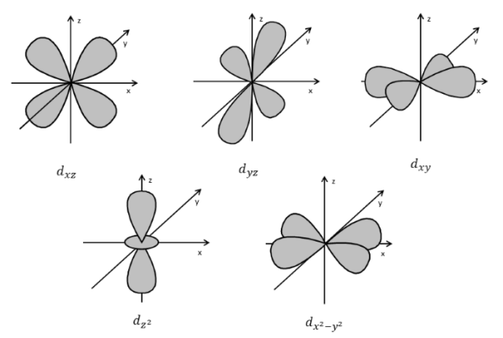
ii)The orbitals which lie with maximum probability in the lobes b/w the axis namely dxy,dyz,dzx are called non axial orbitals and it is represented as t2g orbitals.

Slide 5
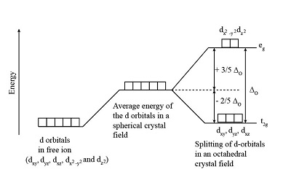
Crystal field splitting in octahedral field:
In octahedral complex the metal at the centre of the octahedron and the ligands are at the six corners
The directions x,yand z point to three adjacent corners of the octahedron as shown in figure

Slide 6
The ligands along x,y,z directions will increase the energy of the dx2-y2,dz2 orbitals much more than the energy of dxy,dyz and dzx orbitals
Thus under the influence of an octahedral ligand field the d orbitals split into two groups of different energies.
The algebraic sum of these energy of orbitals is taken as zero.
The difference energy between the two d levels is given either of the symbol 10dq.
It follows that the eg orbitals +6dq & 2t2g orbitals -4dq below the energy level

Slide 7
Crystal field splitting in tetrahedral complexes:
We can understand the splitting of d orbitals in a tetrahedral complex that the t2g orbitals which are present in between the axises are nearer to the ligands than the eg orbitals.
The t2g orbitals will under go some what greater repulsive interaction with the ligands than the eg orbitals.
Since the tetrahedral field has no center of the symmetry.

Slide 9
Thank you

