Slide 1
INORGANIC CHEMISTRY In [JOHN TELLER EFFECT]
n.Santhi
Dept .of pg chemistry

Slide 2
In 1937 john &teller proposed a theorem which explains why certain 6-coordinated complexes under go distortion to form distorted structures.
Any non linear molecular system in a degenerate electronic state will be unstable & will under go distortion to lowers the symmetry, removes the degeneracy & lower the energy.
The shapes of transition metal complexes are affected by whether the d- orbital's are symmetrically (or) asymmetrically filled.
If the d electrons are symmetrically arranged thus the structure will be completely regular octahedral.
If the d electrons are asymmetrically arranged thus the structure will be distorted.
If d electrons are unsymmetrical arrangement in t2g orbital's will produce small distortion & If d electrons are unsymmetrical arrangement in eg orbital's will produce large distortion.
And example of d9 octahedral system such as {Cu(H2O)6}+2 in this complex has the configuration t2g6 eg3 which may have two possibilities .
i)t2g6 dx2-y22dz21 ii) t2g6dz22 dx2-y21.

Slide 3
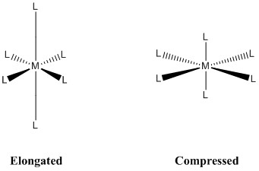
Both configurations the t2g orbital's are completed filled & so distortion arises only due to incompletely filled eg orbital's.
Z-in/compression :-
If we considered the first possible configuration t2g6 dx2-y22 dz21.
The dx2-y2 orbital is completed filled were a the dz21 orbital is half filled.
So that the ligands along z-axis less repelled by the d-electrons as a result the distance b/w the four ligands along x-y-axis and metal ion is constant and is greater than that along z-axis.
So the order distance of ligands is inthe following way.
ML6=ML5<ML1=ML2=ML3=ML4

Slide 4
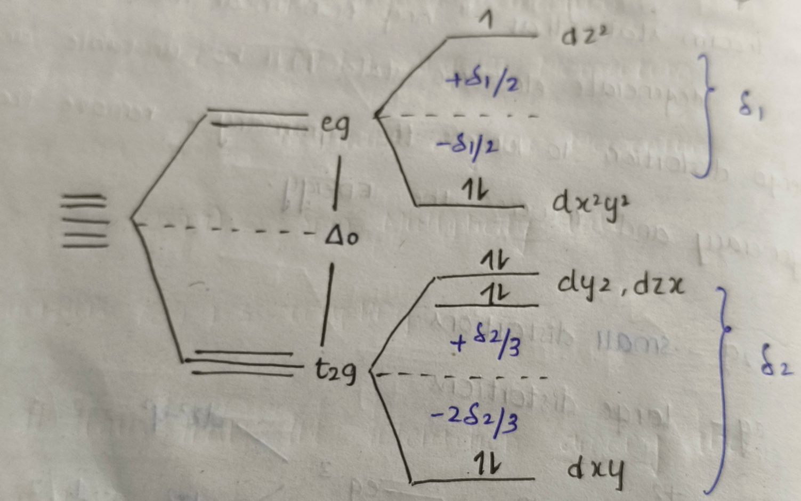
In this case 2 short bonds and 4 long bonds are formed
So ligands approach along z axis experience a large effective nuclear charge will split up higher energy this is called Z-in case, the resulting structure is called compressed octahedron.

Slide 5
Net splitting energy for t2g is
2[-2δ2/3]+4[δ2/3]=0
Net splitting energy for eg is
2[-δ1/2]+[δ1/2]=-δ1/2
Z-out/Elongation
If we consider the second configuration t2g6dz22dx2-y21.
The dz2 is completely filled
So it repuls the ligands strongly along z-axis.

Slide 6
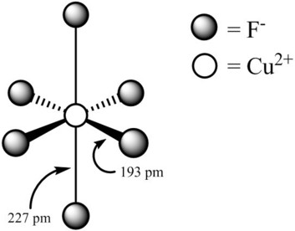
Hence the distance b/w the ligands and central metal along the z-axis is slightly greater than that along x, y axis.
The order of metal ligand is as follows
ML1=ML2=ML3=ML4<ML5=ML6

Slide 7
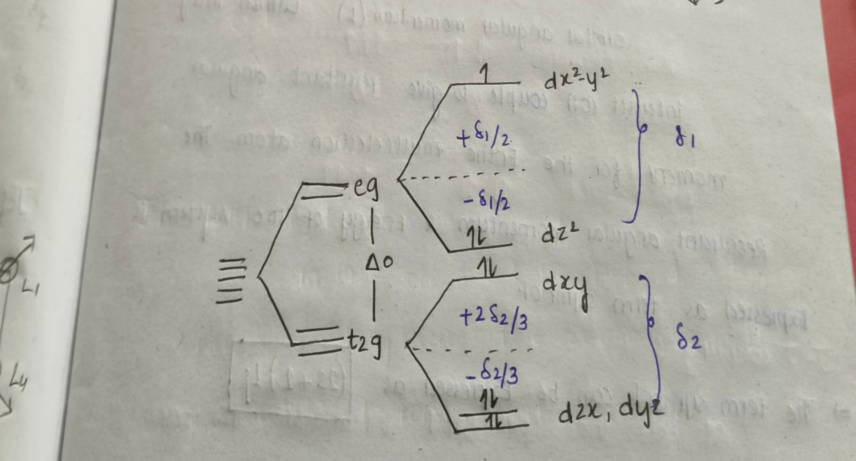
Thus the ligands on the z-axis experience a lower effective nuclear charge &along the x,y axis experience large effective nuclear charge
So which are split up into higher energy this is called Z-out case, thus the structure is called elongated octahedron.

Slide 8
Net splitting energy for t2g
4[-δ2/3]+2[2δ2/3]=0
Net splitting energy for eg is
2[-δ1/2]+1[δ1/2]=-δ1/2

Slide 9
Thank you

