Slide 1
INORGANIC CHEMISTRY IN BINUCLEAR CLUSTERS
N. Santhi
Dept of PG Chemistry

Slide 2
Binuclear clusters are those which contains two metal centers in a molecule
Both metal atoms lie on a same plane
Ex: Re2Cl8,Mn2(CO)10
Re2Cl8(octa chloro dirhenate ion)
Preparation:
It can be prepared by the reduction of perrhenate with HCl in presence of strong reducing agent(H3PO2).
2ReO4+2H3PO2+8HCl→Re2Cl8+2H3PO4+4H2O

Slide 3
Structure & Bonding:
The Structure of Re2Cl8 has two interesting structural features. They are
i)The bond length between Re-Re is 2.24A°(extremely short)
ii)It has eclipsed configuration rather than the more stable staggard geometry
Re-Re bond is extremely short compared with an average Re-Re distance of 2.75A° in Rhenium metal and 2.48A° in Re3Cl9

Slide 4
Let two ReCl4 units are situated in xy plane which are parallel to each other
Re atom is in dsp2 hybridization on each metal utilizing the dx2-y2 orbitals
Re atom forms four sigma bonds with 4 chlorine atoms
The pz and dz2 orbitals of the metal lie along the bond axis and may be hybridized to form one orbital directed towards other Re atom and a second Re atom to form a sigma bond while the second hybrid orbital form an approximately non bonding orbital

Slide 5
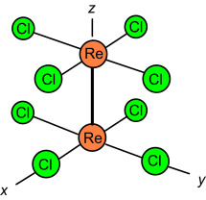
The dyz,dzx orbitals of each Re atom are towards their counterparts on the other Re and can overlap to form 2π bonds
The dxy orbitals can not form π bonds
Since 4 chlorine atoms are in xy plane there is no overlapping b/w them,

Slide 6
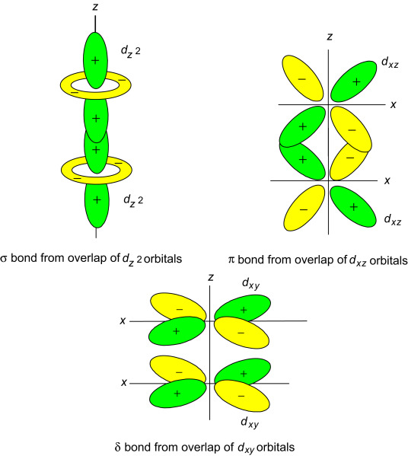
The fourth bond can now formed by sidewise overlap of the remaining two dxy orbitals on each Re resulting in the formation of a δ bond

Slide 7
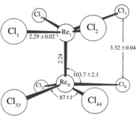
STRUCTURE:
Thus four bonds formed b/w two Re atoms. They are
1. one sigma bond is due to overlapping of dz2& pz orbitals
2.two π bonds due to overlapping of dyz,dzx orbitals
3. oneδ bond due to overlapping of dxy orbitals

Slide 8
All the orbitals filled with electrons. Hence it is diamagnetic
GEOMETRY:
It has octahedral structure
The δ component restricts rotation in just such a way as to favor the eclipsed configuration.
The overlap is maximum for this configuration & goes to zero for the staggard configuration.
Overlap of the dxy orbitals can occur only if the Cl atoms are in eclipsed geometry.
If they have staggered geometry the overlap of 2dxy orbitals can’t occur.
Hence the molecule assusmes eclipsed configuration also in eclipsed configuration,the bond energy dominates sterichindrense.
So Re2Cl8 prefers eclipsed configuration.

Slide 9
Thank You

